Slide 1
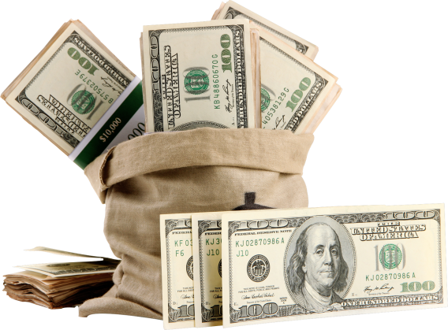
What’s Needed to get a SBA Loan, and the Steps to Getting One

Slide 2
What Does the SBA do?
The Small Business Administration does not actually loan money
Instead, they set loan guidelines
Because the SBA guarantees these loans …
… the rates are more favorable; terms are more flexible
But the SBA says real estate investing, for example, is too high risk for them

Slide 3
The Small Business Administration
Not every company can qualify for an SBA loan
But for those that are able to …
… the SBA can come to the rescue and get you funding
But be aware – there’s a lot of paperwork

Slide 4
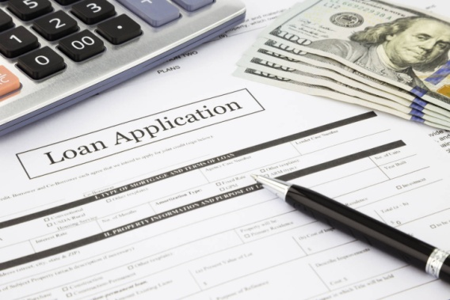
The Small Business Administration
They have various CAPLines loan programs and SBA Express
The SBA’s lending partners actually make the loans
The SBA also offers research grants …
… if your company engages in scientific research and development

Slide 5
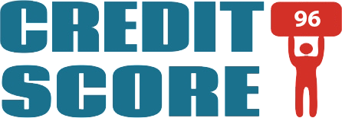
Scores the SBA Wants Your Company to Have
The SBA uses the FICO SBSS (Small Business Scoring Service)
Scores reflect likelihood of an applicant paying their bills timely
Scores range from 0 to 300
Higher scores mean lower risk
The higher score you have, the better
Personal and business credit history plus financial data go into the total score calculation

Slide 6
FICO SBSS Scoring Range
For SBA loans, you will not be approved with a score under 140
However, they typically set a cutoff as high as 160
Below that, you will probably be denied because of being too high a risk
Chances are good an SBA lender won’t even submit your application to SBA if your score doesn’t meet the threshold

Slide 7
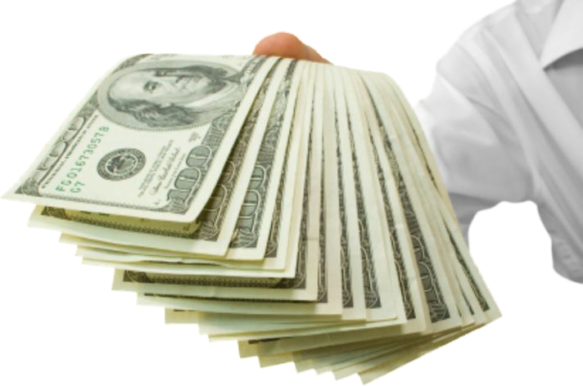
SBA Loans
You usually need to show some time in business
The most popular SBA loan for working capital is the 7(a)
Approvals for up to $750,000
Rates are usually 2-4% above prime rate
All owners with more than 20% ownership must provide a personal guarantee
Good consumer credit is required

Slide 8
7(a) Loans
You must demonstrate a need for funds …
… and have a sound business purpose in mind
Your business must meet SBA’s size standards …
…and be considered small within your particular industry
You have to operate for profit and must have reasonable equity to invest

Slide 9
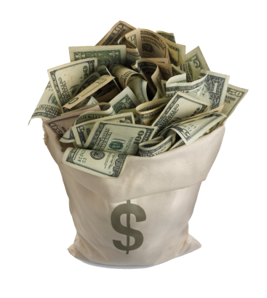
7(a) Loans
A company must do, or propose to do business ...
... in the United States or its possessions
Plus the company must have tried to use other financial resources
These include personal assets (AKA bootstrapping), before applying

Slide 10
Using 7(a) Funds
The 7(a) Program allows for loan amounts …
… of up to $5 million to:
fund startup costs
buy equipment, etc.

Slide 11
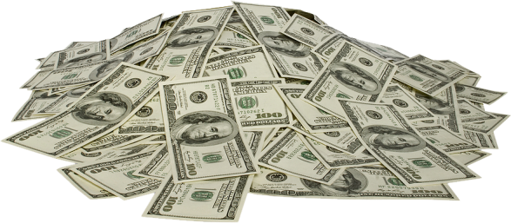
Using 7(a) Funds
A company can also:
Buy new land (this includes construction costs)
Repair existing capital
Buy or expand an existing business
Refinance existing debt
Buy machinery, fixtures, furniture, supplies or materials

Slide 12
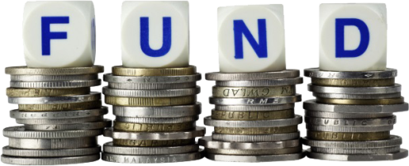
7(a) Fund Benefits
Flexibility, longer terms and potentially lower down payments versus other financing options
Plus there are specialized programs for entrepreneurs:
interested in exporting
located in underserved communities
who are members of the military community, and
those looking to meet short-term and cyclical working capital needs

Slide 13
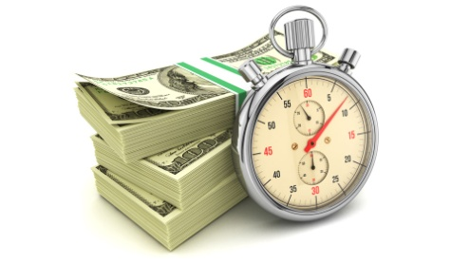
7(a) Repayment Terms
Most such loans are repaid with monthly payments of principal and interest
For fixed-rate loans, the payments stay the same ...
... since the interest rate is constant
For variable-rate loans, a lender can require a different-sized payment amount when the interest rate changes

Slide 14
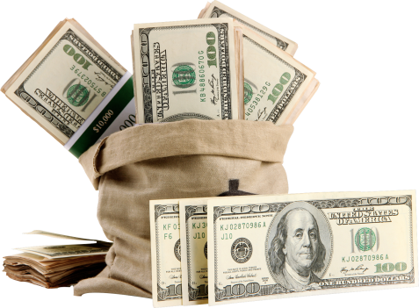
SBA CapLines
According to the SBA… “CAPLines is the umbrella program under which SBA helps business owners meet short-term and cyclical working capital needs”
Loan amounts go up to $5 million
Loan qualification requirements are same as with other SBA programs
Loan or revolving are available

Slide 15
SBA CapLines
Seasonal Line – Advances against anticipated inventory and accounts receivables, meant to help seasonal businesses
Contract Line – Finances direct labor and material cost associated with performing assignable contracts
Builders Line – Meant for general contractors or builders constructing or renovating commercial or residential buildings. Finance direct labor-and material costs, where the building project serves as the collateral
Standard Asset-Based Line – For businesses unable to meet credit standards associated with long-term credit. Financing for cyclical growth, recurring and/or short-term needs. Repayment is from converting short-term assets into cash
Small Asset-Based Line – Asset-based revolving line of credit up to $200,000. Operates like standard asset-based line except some of the stricter servicing requirements are waived if the business can consistently show repayment ability from cash flow for the full amount

Slide 16
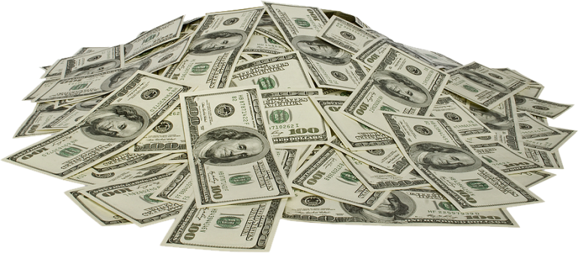
SBA Loans
SBA Express is a faster means of securing a SBA loan
Loans go up to $250,000
Rates usually range from 2 – 4% above prime rate
Also available is Community Express for low and moderate income entrepreneurs

Slide 17
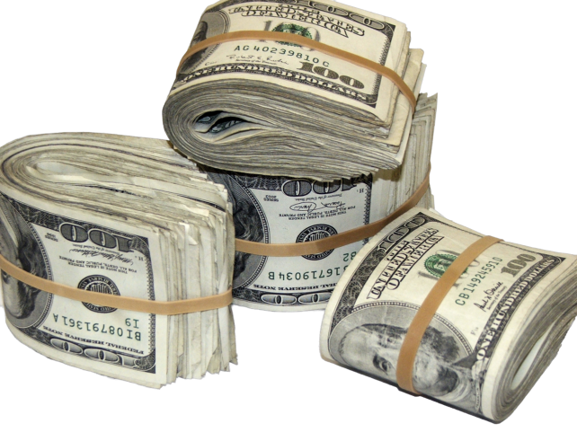
SBA Express
SBA Express offers access to a credit line for well-qualified borrowers
Approvals go up to $350,000
Interest rates vary; SBA lets banks charge as much as 6.5% over their base rate
Loans over $25,000 require collateral
For approval you need:
Balance sheet & income statement
Account receivables
Collateral
Articles of incorporation
Business licenses
Contracts with 3rd parties
Lease

Slide 18
SBA Loans
SBA 504 is the SBA’s second-most popular loan type
Often used to buy land, equipment, or real estate
The bank funds the loan; SBA generally guarantees up to 40%
You can usually get a loan up to $1 million
Typically, you contribute 10% of the equity

Slide 19
SBA 504 Requirements
You must operate your business for profit …
… with a feasible business plan and relevant management expertise
A company must do business in the United States or its territories
The company must have tried to use other financing
This includes personal assets (AKA bootstrapping), before applying for a loan

Slide 20
SBA 504 Requirements and Terms
Your business must have a tangible net worth of under $15 million
Your business must have an average net income of less than $5 million after taxes for the last 2 years
A business must be able to repay the loan on time from its projected operating cash flow
Maximum loan amounts are determined by usage
For land and buildings, the loan term is 20 years; it’s a 10-year term for machinery and equipment

Slide 21
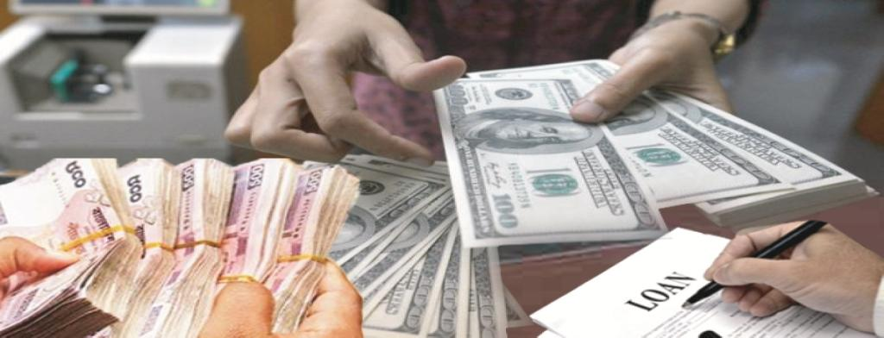
SBA Loans
7(m) is their Microloan program
Loans up to $35,000 for working capital and growth
Average loan amounts of about $10,000
Funds come straight from the SBA
This is unlike the 7(a), where funds come from a bank

Slide 22
SBA 7(m) Microloans
SBA’s Microloan Program provides short-term loans up to $50,000 to help small businesses startup and expand
The average microloan is about $13,000
SBA makes funds available through specially designated intermediary lenders
These are nonprofit community-based organizations with experience in lending, management, and technical assistance
These intermediaries make loans to eligible borrowers

Slide 23
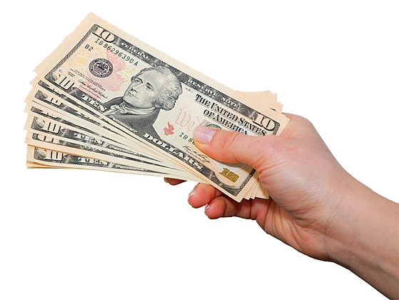
SBA 7(m) Microloans
Microloans have to be repaid in six years and can be used for:
Working capital
Buying inventory or supplies
Purchasing furniture or fixtures
Buying machinery or equipment

