Slide 1
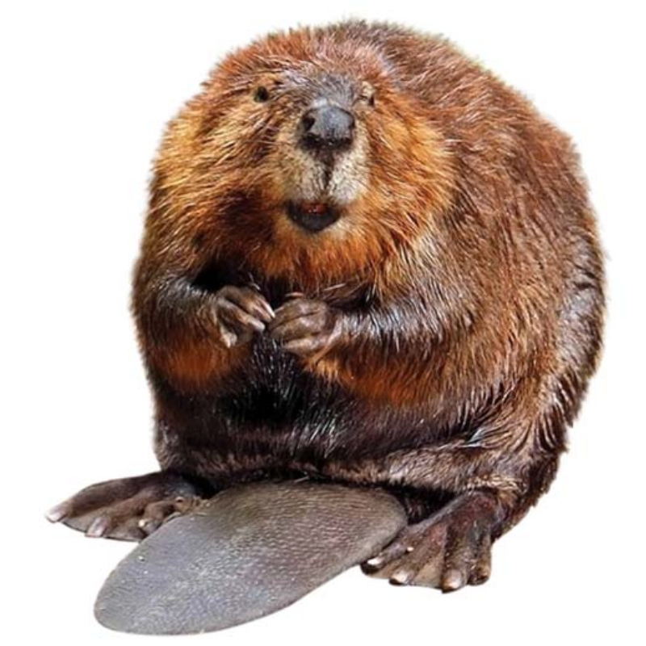
Beavers

Slide 2
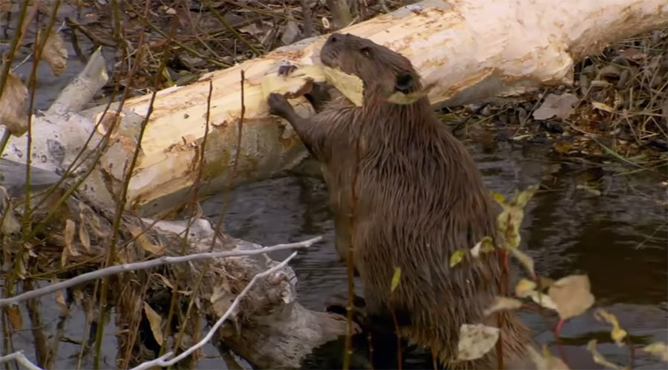
Beaver is called an animal engineer.

Slide 3
An engineer builds many things.

Slide 4
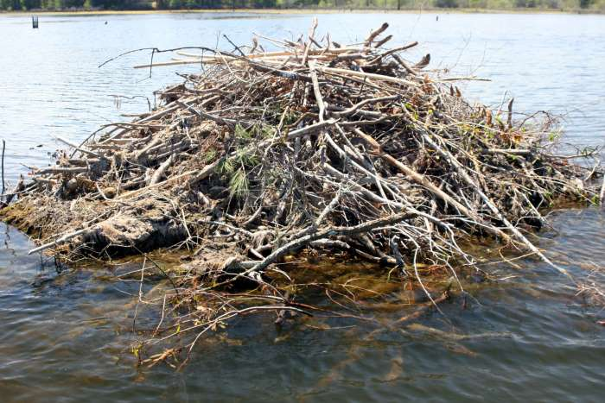
Beavers build their homes in the middle of pond.

Slide 5
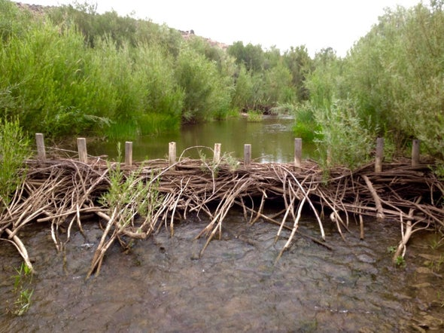
If they cannot find a pond in which to make a home, they will build a dam across a stream to make a pond.

Slide 6
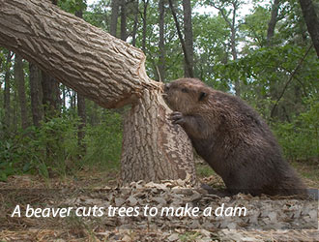

Slide 8
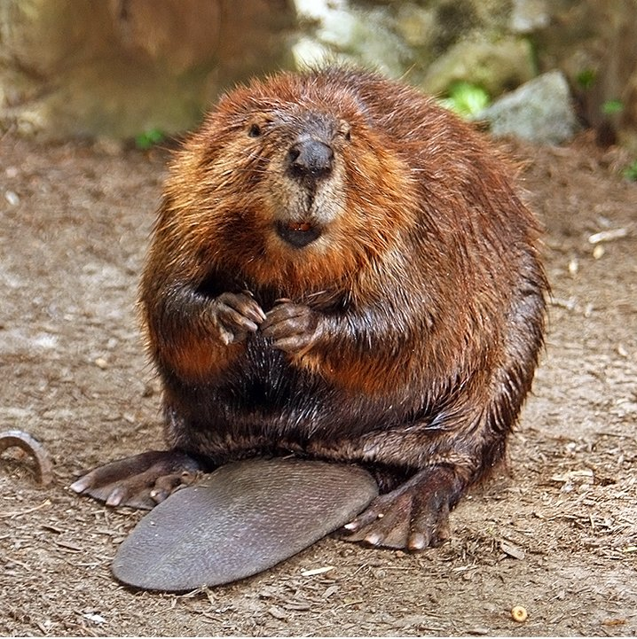
God made the beaver to be a builder of ponds, That’s why he gave the beaver’s body a special design.

Slide 9
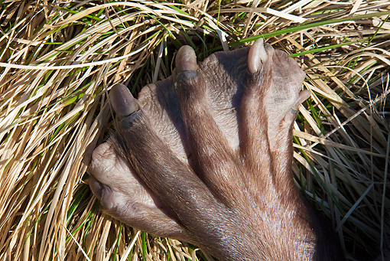
Webbed back feet of beaver

Slide 10
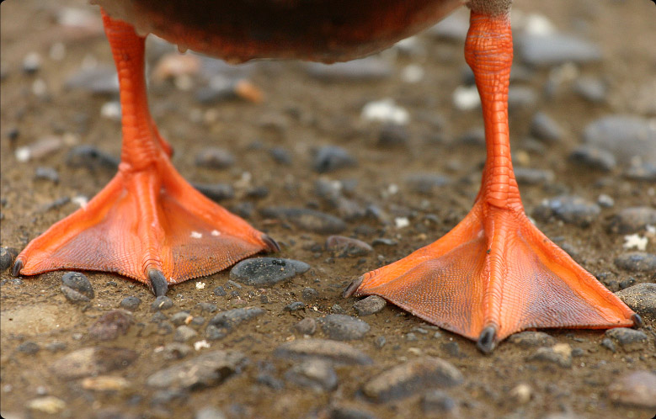
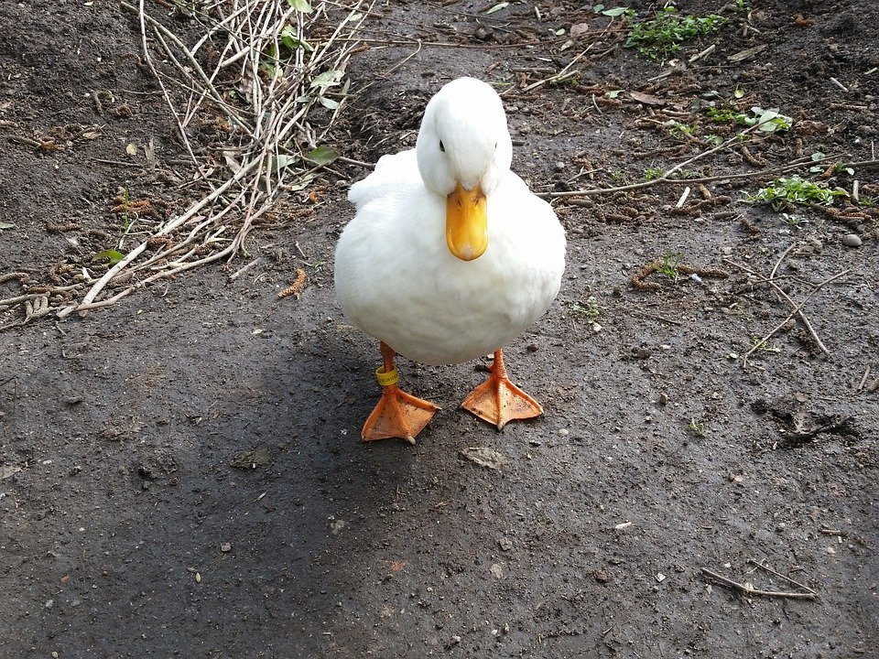

Slide 11
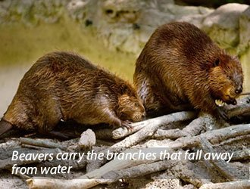
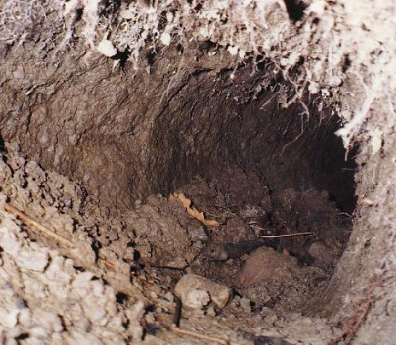
The front feet of beaver s are paws that have a sharp claws. These are used for digging mud and dragging tree branches.

Slide 12
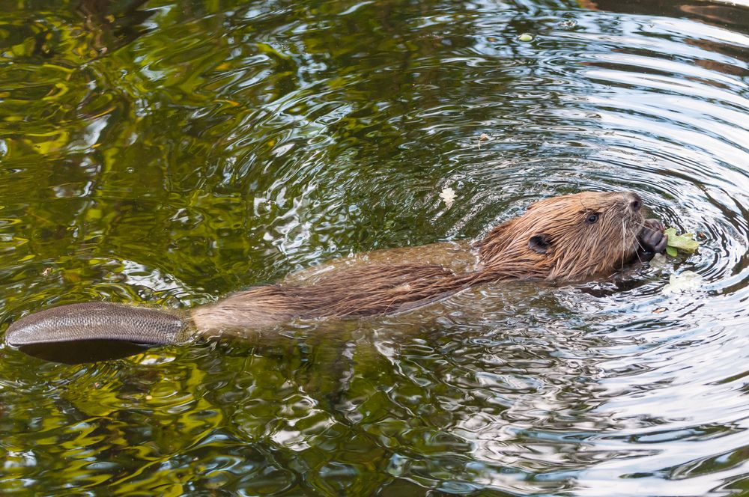
Beaver is a good swimmer.

Slide 13
How can the beaver cut down so many trees?

Slide 14
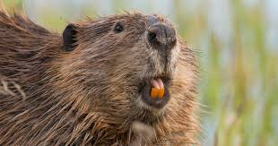
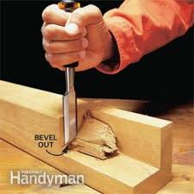
His teeth are sharp like a chisels.

Slide 15
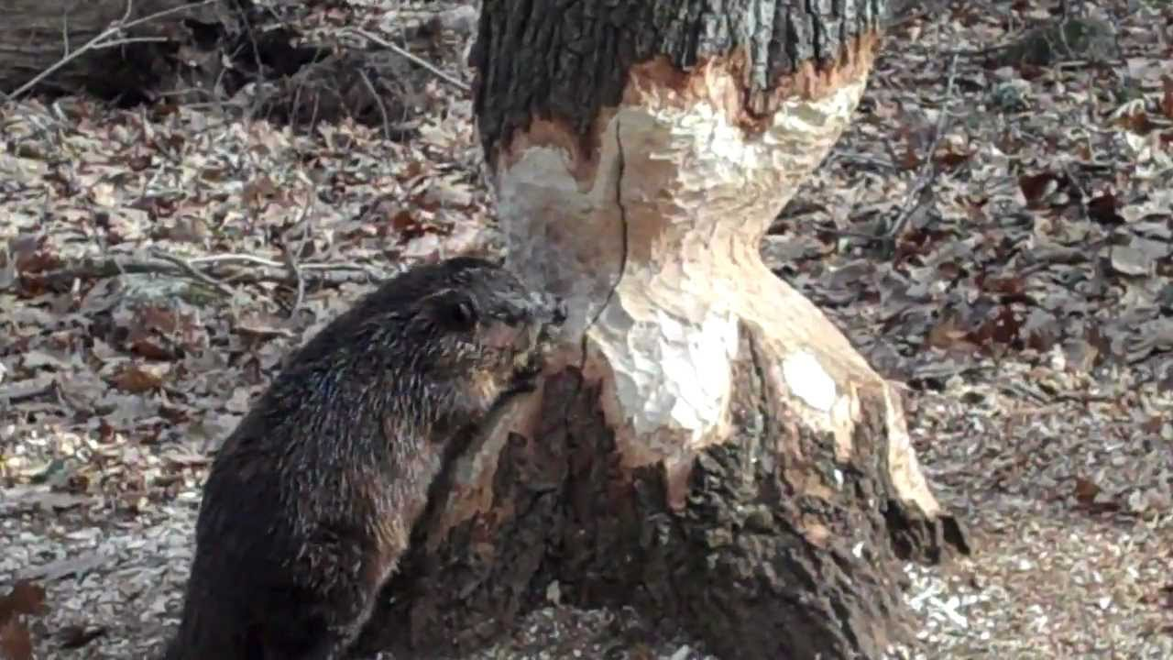

Slide 16
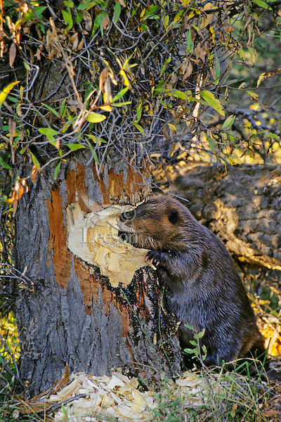
What does a beaver eat?
Beaver’s favorite food is the tree barks.

Slide 17
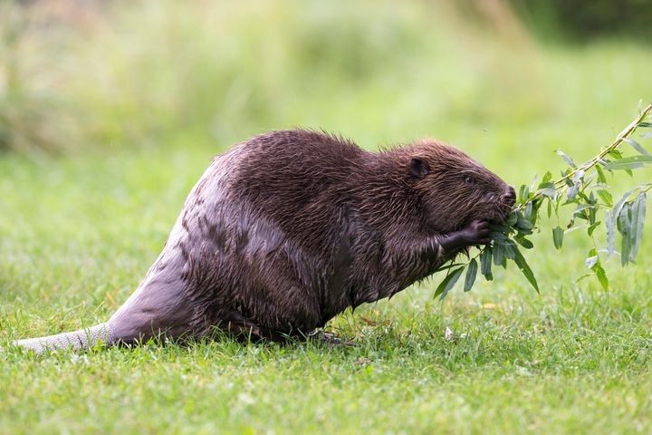
Beavers also eats berries, grass and plants.

Slide 18
Let’s Review!

Slide 19
The beaver is called
An animal destroyer
An animal explorer
An animal engineer

Slide 20
The beaver is called
An animal destroyer
An animal explorer
An animal engineer

Slide 21
Where do beavers build their homes?
Lake
Ponds or streams
sea

Slide 22
Where do beavers build their homes?
Lake
Ponds or streams
sea

Slide 23
Why God made a beaver?
To keep his creation
To be a builder of ponds
To be a helper to people

Slide 24
Why God made a beaver?
To keep his creation
To be a builder of ponds
To be a helper to people

Slide 25
What does a beaver use to cut down the trees?
his feet
his tail
his teeth

Slide 26
What does a beaver use to cut down the trees?
his feet
his tail
his teeth

Slide 27
What is a beaver’s favorite food?
fruits
tree bark
grass

Slide 28
What is a beaver’s favorite food?
fruits
tree bark
grass

Slide 29
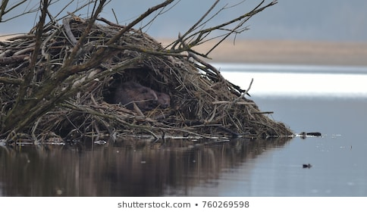
Beaver’s home is called lodge.

Slide 30
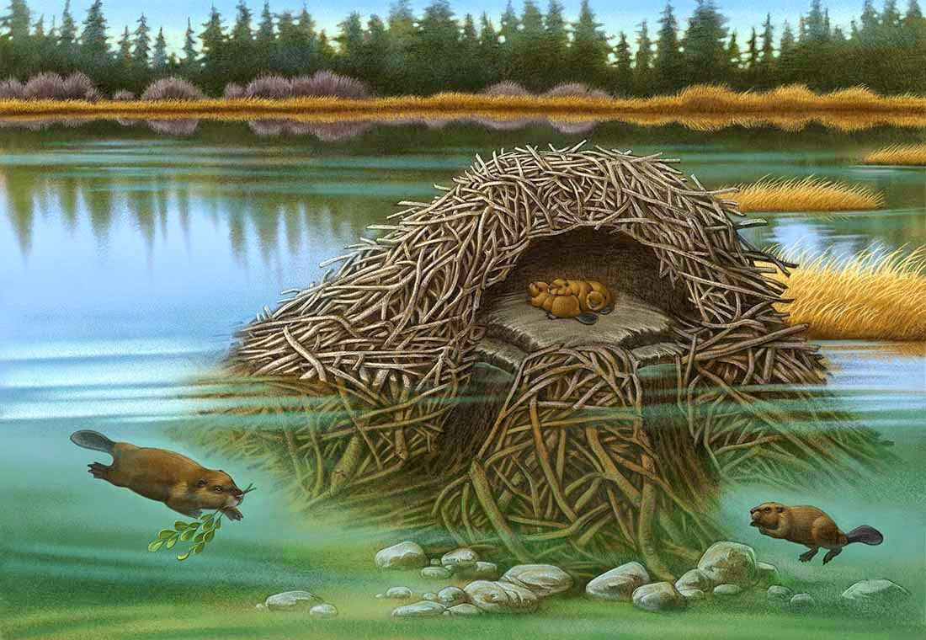

Slide 31
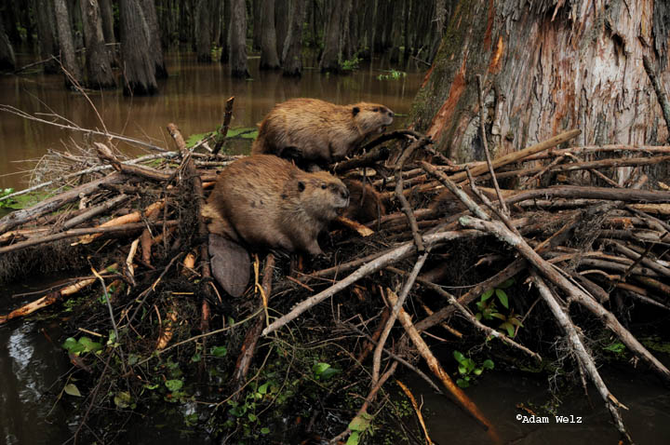
To build the lodge, the beaver cuts down hundreds of trees and branches to build a dam across a stream.

Slide 32
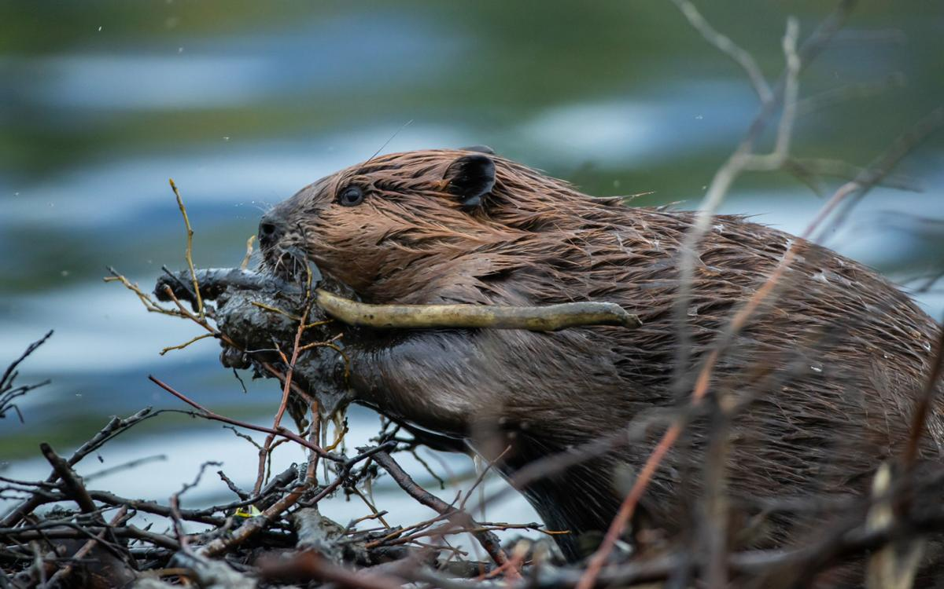
Beavers build their lodge out of mud and branches.

Slide 33
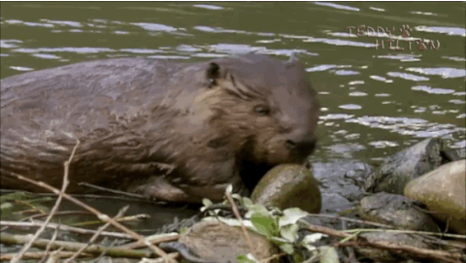

Slide 34
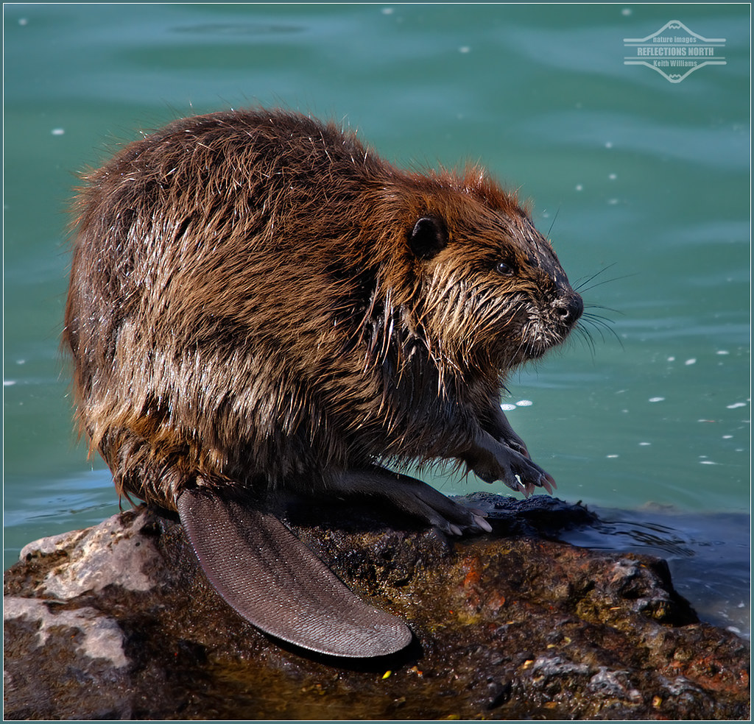
Why is his tail flat?
The beaver has a wide, flat tail that helps him stand when he is gnawing the tree.

Slide 35
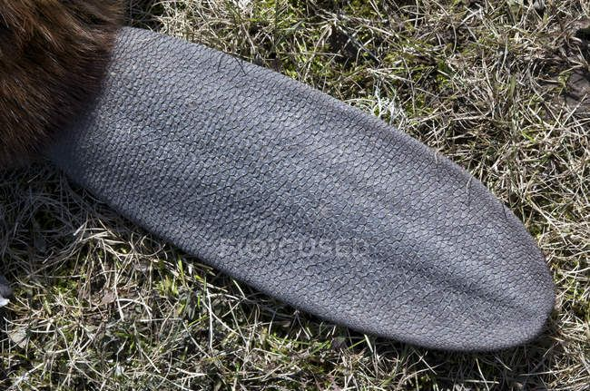

Slide 36
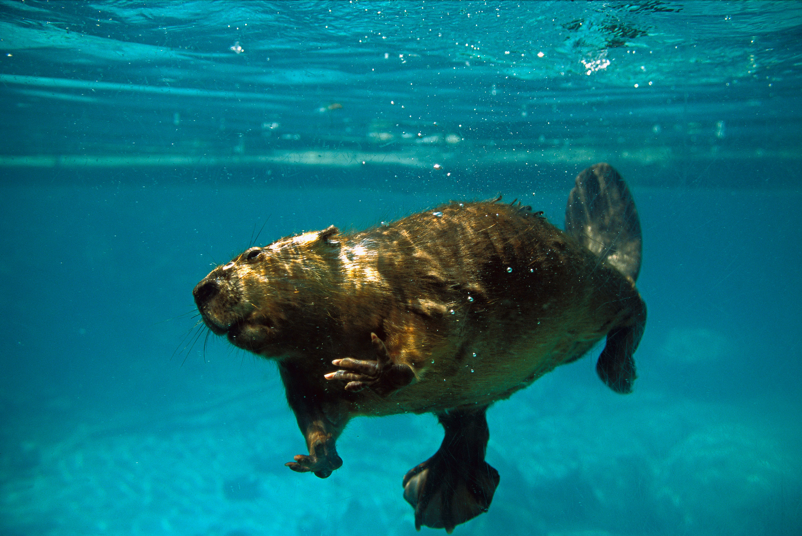
Why do beavers build their lodges in the middle of ponds?
Beavers are fast swimmers, but very slow runners. If they lived on land, many animals would be able to catch them and eat them.

Slide 37
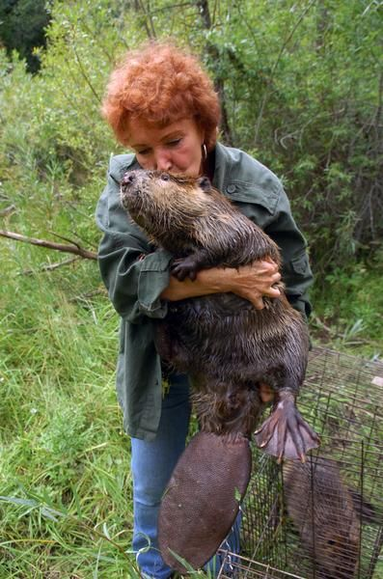
Is the beaver your friend?
Beaver is a very good friend of man. Beavers knows how to take good care of land and water.

Slide 38
Wherever beavers builds dams, the grass will become thick and green.
The soil around them is better for growing plants.

Slide 39
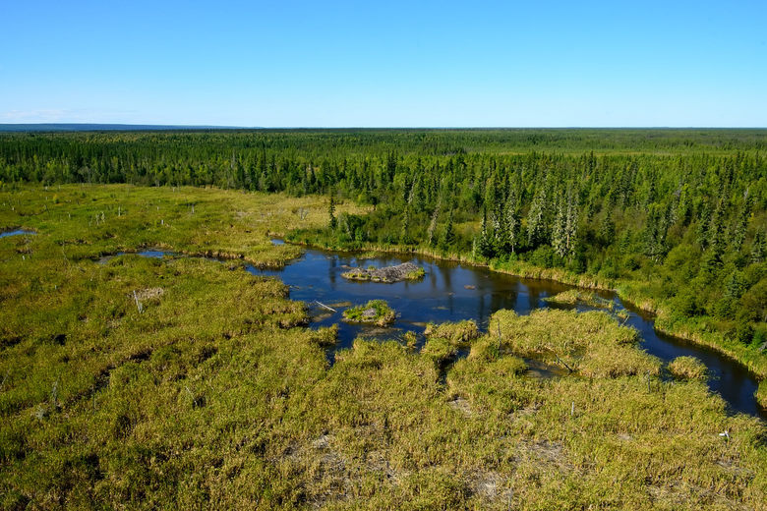
World’s Largest Beaver Dam

Slide 40
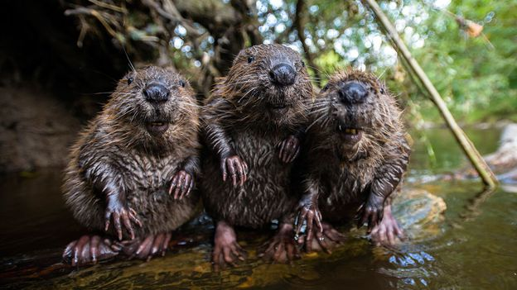
How does the beaver get so much done?
The members of the beaver family work together to build their home. They help each other.

Slide 41
If there is a danger, one beaver will warn the others by slapping his tail on the water.

Slide 42
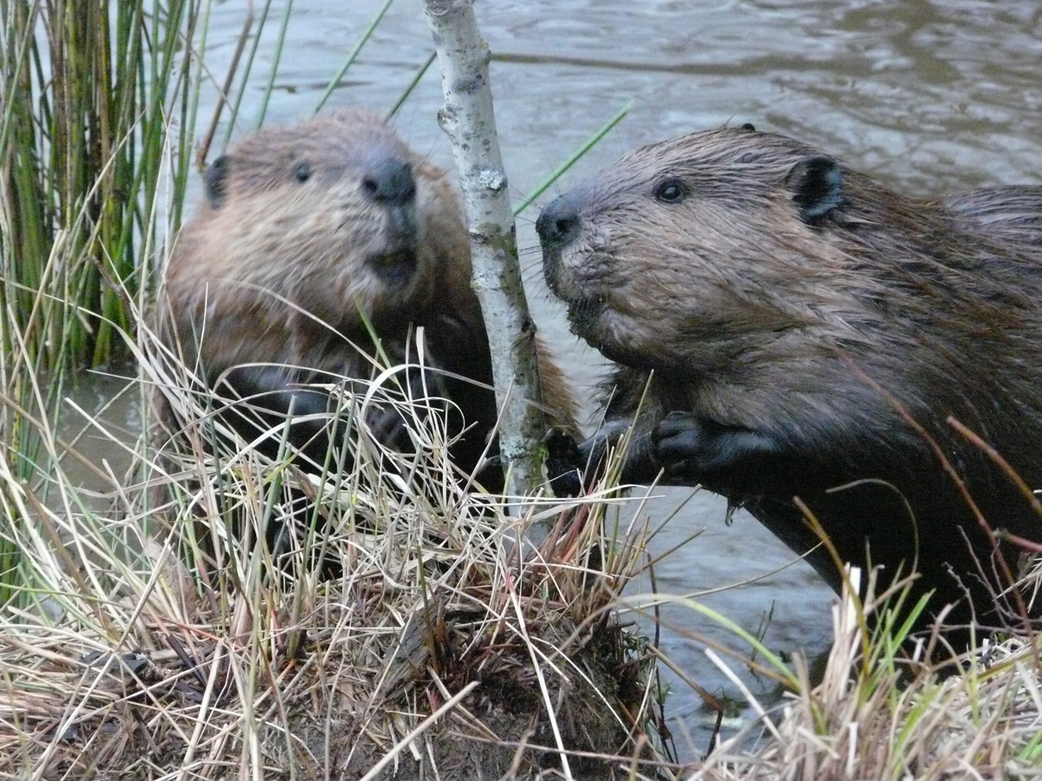
If a beaver is in trouble, other beavers will come to help him even if the other beaver is stranger.

Slide 43
Think About It

Slide 44
What lessons do you think God wants us to learn?

Slide 45
What do you called the beaver’s home?
burrow
lodge
nest

Slide 46
What do you called the beaver’s home?
burrow
lodge
nest

Slide 47
How does a beaver warn others of danger?
He kick it using his feet.
He throw the woods and rocks on the water.
He slaps his tail on the water.

Slide 48
How does a beaver warn others of danger?
He kick it using his feet.
He throw the woods and rocks on the water.
He slaps his tail on the water.

