Slide 1
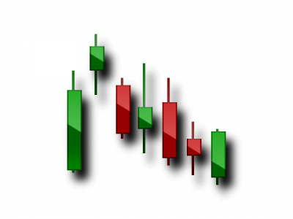
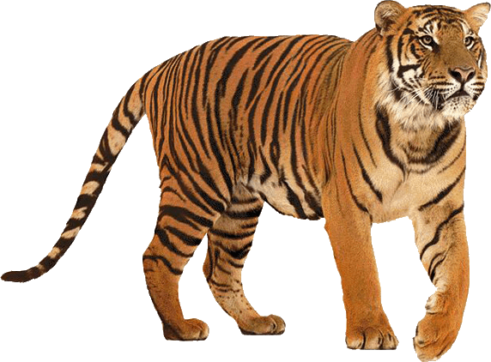
TIGER IYE
EDUCATION PART 1
INSTRUCTOR
QUENN V. GARRIS JR.

Slide 2
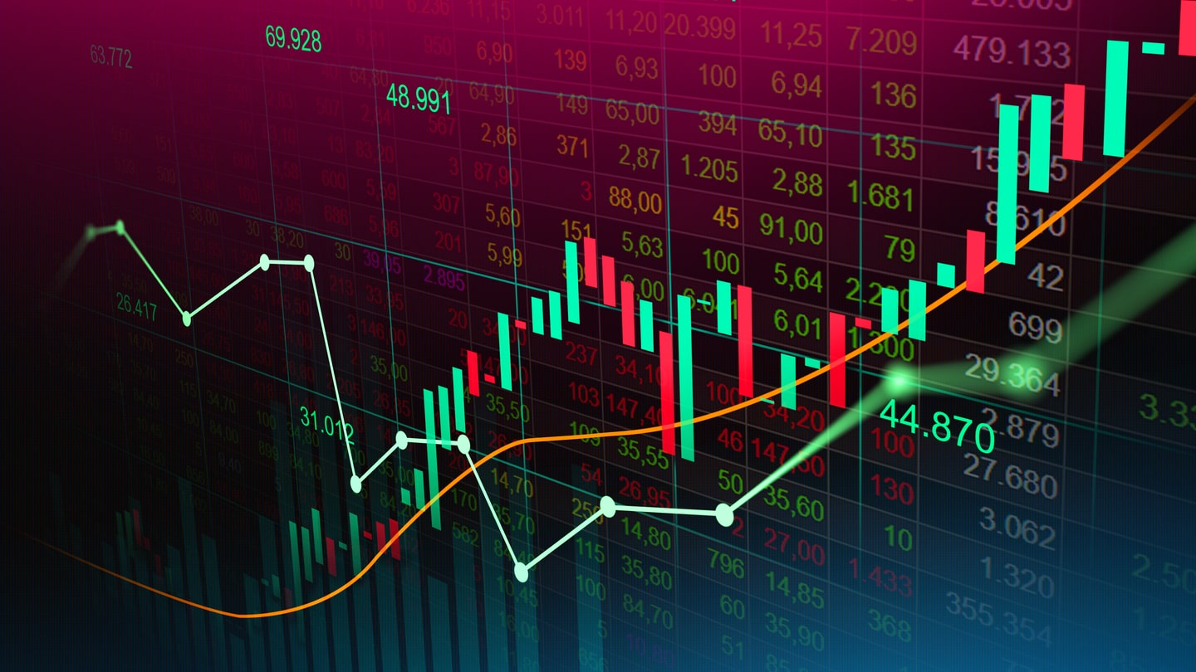
WHAT IS FOREX?
OVER THE COUNTER MARKET FOR TRADING CURRENCIES
2 DIFFERENT COUNTRIES HAVE A CURRENCY VALUE THAT MERGE INTO ONE CREATING, A SINGLE VALUE CALLED “PAIR”
ANY CURRENCY PAIR THAT INCLUDES USD (XXXUSD,USDXXX) IS CONSIDERED MAJOR
ALL OTHER CURRENCIES FOR COUNTRIES ARE CONSIDERED REGULAR
THIS ALL APPLIES FOR METALS, EXOTICS, CRYPTO, & INDICES

Slide 3
SO WHERE DO YOU EVEN START??

Slide 4
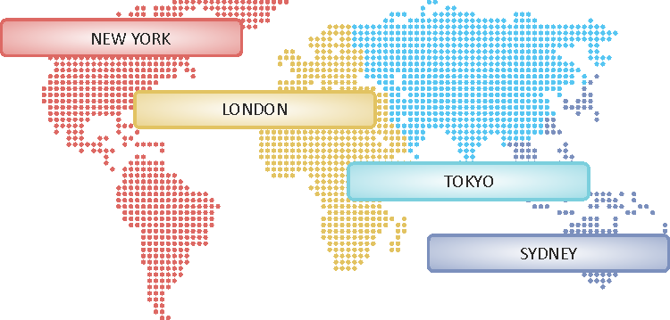
HERE’S A GOOD BEGINNING...
A “PIP” IS THE UNIT OF MEASUREMENT USED TO READ THE CHANGE IN VALUE Ex. (1.2345 ~> 1.2349 = 4 pip change)
OPEN TRADING SESSIONS UTC (Universal Time)
NY = (1pm - 10pm) - USD, CAD, US30
Tokyo = (12am - 9am) - JPY
Sydney = (10pm - 7am) - AUD
London = (8am - 5pm) - EUR & GBP
TRY TO MATCH CURRENCY PAIR WITH OPEN SESSIONS WHEN PLACING TRADES!!!

Slide 5
LOT SIZES
LOTS ARE DIFFERENT TRADING UNITS USED TO EXCHANGE YOUR CURRENCIES IN QUANTITIES OR MULTIPLES
DEPENDING ON WHICH BROKER AND LEVERAGE YOUR ACCOUNT IS SET UP WILL DETERMINE THESE FOLLOWING NUMBERS (BUT THESE ARE UNIVERSAL STANDARD)
Standard - 1.0 = $10 / pip
Mini - 0.1 = $1 / pip
Micro - 0.01 = $0.1 /pip
THE SPREAD IS THE PRICE DIFFERENCE BETWEEN THE BID & ASK (WHERE YOUR BROKER PLACES YOU IN THE TRADE

Slide 6
RECOMMENDED BROKERS
RECOMMENDED MENTORS
KOT4X
MINIMUM DEPOSIT = $10
https://kot4x.com/
ICMARKETS
MINIMUM DEPOSIT = $200
https://www.icmarkets.com/global/en/
TIGER IYE
FOREX, CRYPTO, STOCKS, & OPTIONS
https://tiger-iye.teachable.com/
TIMOTHY SYKES
STOCKS, OPTIONS, PENNY STOCKS
TIMOTHYSYKES.COM

Slide 7
THANK YOU FOR CHOOSING TIGER IYE
HERE’S THE LINK FOR FULL ACCESS
CHECK OUT THE FOLLOWING PARTS!!!
https://tiger-iye.teachable.com/p/tiger-iye-boot-camp

