Slide 1
Management Of Tone Abnormalities in Cerebral Palsy
Paeds Rehab Series
NIPMR
Sept 26, 2020
Dr. Sindhu Vijayakumar
MD, DNB
Physiatrist, NIPMR

Slide 2
Disclaimer
This is a general overview of the topic being discussed and is not intended as a consultation
All the points may not be applicable to all persons with cerebral palsy
Many practical points from the presenter’s experience is mentioned which may differ from individual practitioner’s opinion
Those who would like to consult for individual problems may please contact NIPMR – for a consult or tele-consult
Site: www.nipmr.org.in
Email: info@nipmr.org.in
Phone: 0480-288-1959, +91 7510870111
National Institute of Physical Medicine and Rehabilitation(NIPMR), Kallettumkara P.O, Thrissur – 680683.

Slide 3
ലക്ഷ്യങ്ങൾ (Objectives)
Understand types of tone abnormalities in Cerebral Palsy [സെറിബ്രൽ പാൽസി ബാധിതരുടെ മാംസപേശികളിൽ ഉണ്ടാകാവുന്ന അസ്വാഭാവിക "ടോൺ" (ഇറുക്കം / അയവ്)]
Know at least 5
methods of management [ചികിത്സ/ നിയന്ത്രിക്കുന്ന രീതികൾ]
complications of that can develop due to abnormal tone [സങ്കീർണ്ണതകൾ]
Transition to adulthood – anticipated issues (due to abnormal tone) [പ്രായപൂർത്തിയാകുമ്പോൾ ഉണ്ടായേക്കാവുന്ന അവസ്ഥകൾ]

Slide 4
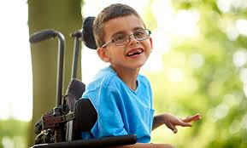
Physical Medicine and Rehabilitation (PM&R)
PMR also known as Physiatry
A branch of medicine that aims to enhance and restore functional ability and quality of life to those with physical impairments or disabilities
പുനരധിവാസം
ഫിസയാട്രി

Slide 5
What is Muscle Tone? മസിൽ ടോൺ എന്താണ്?
Resistance offered by a muscle to passive stretch
വിശ്രമാവസ്ഥയിൽ - പരിശോധിക്കുന്നയാൾ മാംസപേശിയെ (കുട്ടിയുടെ യാതൊരു ശ്രമവും കൂടാതെ) ചലിപ്പിക്കുമ്പോൾ അനുഭവപ്പെടുന്ന പ്രതിരോധം
കൂടുതൽ - ഇറുക്കം - Increased Tone / Hypertonicity (Spasticity സ്പാസ്റ്റിസിറ്റി )
കുറവ് – അയവ് - Decreased Tone / Hypotonia (Flaccid ഫ്ലാസിഡ്)
സ്വാഭാവികം/സാധാരണം - Normal Tone

Slide 6
Tone Abnormalities
Muscle tone abnormalities occur in many disease conditions
പേശികളുടെ അവസ്ഥയിൽ കാണപ്പെടുന്ന വ്യതിയാനങ്ങൾ സാധാരണയായി ഇങ്ങനെ തരം തിരിക്കാം
Generally,
Increased muscle tone (ഇറുക്കം/സ്പാസ്റ്റിസിറ്റി) in upper motor neuron (UMN) lesions– brain and spinal cord (നട്ടെല്ല്, തലച്ചോറ് എന്നിവയുടെ ക്ഷതങ്ങളിൽ).
Decreased muscle tone (അയവ്/ ഫ്ലാസിഡിറ്റി) in lower motor neuron (LMN) lesions – peripheral nerves, muscles, etc (നാഡികൾ, പേശികൾ എന്നിവയുടെ ക്ഷതങ്ങളിൽ).

Slide 7
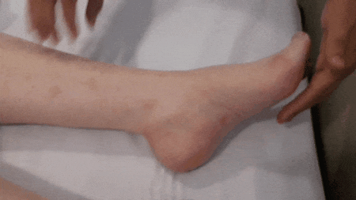
Spasticity സ്പാസ്റ്റിസിറ്റി
Velocity dependent increase in tone
വേഗതയെ ആശ്രയിച്ചുള്ള ടോണിലെ വർദ്ധനവ്
It masks the true strength of the muscle - പേശിയുടെ യഥാർത്ഥ ശക്തി മറയ്ക്കുന്നു
Picture depicts sustained clonus ക്ലോണസ്

Slide 8
Cerebral Palsy (CP) സെറിബ്രൽ പാൽസി
A group of permanent disorders of the development of movement and posture, causing activity limitation, that are attributed to non-progressive disturbances that occurred in the developing fetal or infant brain
വളർന്നു വരുന്ന മസ്തിഷ്കത്തിന് സംഭവിക്കുന്ന ഹാനി മൂലം ഉണ്ടാകുന്ന
പുരോഗമിക്കാത്ത അവസ്ഥ
ചലനത്തിന്റെയും പോസ്ചർ ന്റെയും തകരാറ്
Most common motor disability of childhood കുട്ടിക്കാലത്തെ ഏറ്റവും സാധാരണമായ മോട്ടോർ/ ചലനസംബദ്ധമായ പ്രത്യേകത

Slide 9
Associated Conditions അനുബന്ധ അവസ്ഥകൾ
Intellectual disability (ബുദ്ധിപരമായ പ്രശ്നങ്ങൾ) – 30%
Seizures (അപസ്മാരം) – 17 – 28%
Problems with vision, hearing, or speech (കാഴ്ച [CVI – Cortical vision impairment], കേൾവി, സംസാരം എന്നിവയിലെ പ്രശ്നങ്ങൾ)
Feeding difficulties/dysphagia (ഭക്ഷണം നൽകുന്നതിനുള്ള ബുദ്ധിമുട്ടുകൾ / ഡിസ്‌ഫേജിയ)

Slide 10
Early Identification and Intervention നേരത്തെയുള്ള തിരിച്ചറിയൽ, ഇടപെടൽ
CP Diagnosis, Causes, Mimics, etc. of CP is beyond the scope of this session
Preventable complications
ഇന്ന് ഒരു പ്രത്യേക പ്രശ്നത്തെപ്പറ്റി മാത്രമാണ് ചർച്ച കാരണം, അത് പ്രത്യക്ഷമാണ്, നിയന്ത്രിക്കുവാൻ പല മാർഗ്ഗങ്ങളുണ്ട്, എന്നതിലുപരി, ഇത് മൂലമുണ്ടാകുന്ന സങ്കീർണ്ണതകൾ ഒരു പരിധി വരെ തടയുവാൻ സാധിക്കുന്നവയാണ്

Slide 11
Types of CP തരങ്ങൾ
Spastic (സ്പാസ്റ്റിക് )
Dyskinetic (ഡിസ്‌കൈനെറ്റിക് )
Ataxic (അറ്റാക്സിക് )
Worster-Drought Syndrome (വോർസ്റ്റർ-ഡ്രോട് സിൻഡ്രോം)
Other specified CP(മറ്റ് സ്പെസി ഫൈഡ്)
CP, Unspecified (അൺസ്പെസിഫൈഡ്‌)
ICD 11 classification
Based on tone abnormalities

Slide 12
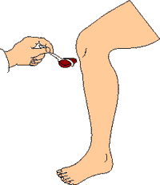
Spastic CP സ്പാസ്റ്റിക്
Spastic cerebral palsy is characterised by increased muscle tone associated with hyperactive muscle stretch reflexes (deep tendon reflexes) and an increase in resistance to rapid muscle stretch. Extensor plantar responses are commonly present.
പേശികളിൽ കൂടുതൽ ടോൺ / ഇറുക്കം; ഹൈപ്പർ ആക്ടീവ് മസിൽ സ്ട്രെച്ച് റിഫ്ലെക്സുകൾ; ദ്രുതഗതിയിൽ പേശി നീട്ടുമ്പോൾ വർദ്ധിച്ച പ്രതിരോധം

Slide 13
Dyskinetic CP ഡിസ്‌കൈനെറ്റിക്
Dyskinetic CP is characterised by impairment of voluntary movement because of the presence of interfering involuntary movements (സ്വമേധയാ അല്ലാത്ത ചലനങ്ങൾ), and inappropriate co-contraction of agonist and antagonist muscles (dystonia).
Choreoathetotic: large amplitude, involuntary movements of mainly distal limbs(athetosis - അതെട്ടോസിസ്) with or without small amplitude, fleeting, asymmetric contractions of individual muscle groups (chorea - കൊറിയ).
Dystonic (ഡിസ്റ്റോണിയ): predominantly affects proximal trunk and limb muscles, which may show slow, persistent movements, leading to the adoption of unusual postures, such as torticollis.

Slide 14
Ataxic CP അറ്റാക്സിക്
CP is dominated by signs of cerebellar dysfunction, including hypotonia, ataxia, dysdiadochokinesis, dysmetria, dysarthria and nystagmus.
Reflexes may be pendular, Ataxic although there are often also signs of spasticity.
Ataxia (അറ്റാക്സിയ) is the inability to make smooth, accurate and coordinatetd movements - സുഗമവും കൃത്യവും പല പേശികളെ ഏകോപിപ്പിച്ചുമുള്ള ചലനങ്ങൾ നടത്താൻ കഴിയാത്ത അവസ്ഥ
ബാലൻസ് കുറഞ്ഞ പോലെ

Slide 15
Worster-Drought syndrome (WDS) വോർസ്റ്റർ-ഡ്രോട് സിൻഡ്രോം
Worster-Drought syndrome (WDS) is a form of cerebral palsy characterised by congenital pseudobulbar (suprabulbar) paresis manifesting as selective weakness of the lips, tongue and soft palate, dysphagia, dysphonia, drooling and jaw jerking.
ചുണ്ടുകൾ, നാവ്, മൃദുവായ അണ്ണാക്ക്, എന്നിവയുടെ ബലഹീനത മൂലം വിഴുങ്ങുവാനുള്ള ബുദ്ധിമുട്ട് (ഡിസ്ഫാജിയ), ശബ്ദ വ്യതിയാനങ്ങൾ (ഡിസ്ഫോണിയ), ഡ്‌റൂളിംഗ് , മുതലായവ

Slide 16
Types of CP തരങ്ങൾ
Topographical (ടോപ്പോഗ്രാഫിക്കൽ) classification describes body parts affected
Monoplegia/monoparesis : only one limb
Diplegia/diparesis : legs than the arms
Hemiplegia/hemiparesis: arm and leg on one side
Paraplegia/paraparesis: lower half of the body, including both legs
Triplegia/triparesis: three limbs
Double hemiplegia/double hemiparesis: all four limbs are involved, but one side of the body is more affected than the other.
Tetraplegia/tetraparesis: all four limbs

Slide 17
Types of CP തരങ്ങൾ
Mild – Mild Cerebral Palsy means a child can move without assistance; his or her daily activities are not limited.
Moderate – Moderate Cerebral Palsy means a child will need braces, medications, and adaptive technology to accomplish daily activities.
Severe – Severe Cerebral Palsy means a child will require a wheelchair and will have significant challenges in accomplishing daily activities.

Slide 18
Classifications Based on Function
Classification | Function Assessed | Levels
GMFCS (Gross Motor Function Classification System) | Self-initiated gross motor movements in their typical environments | I – V I: Independent V: Totally dependent for all functional mobility
MACS (Manual Ability Classification System) | Ability to handle objects in everyday activities like self-care skills and play | I – V I: Easy manipulation of objects V: Limited ability to perform simple actions
CFCS (Communication Function Classification System) | Everyday communication performance | I – V I: most effective level of communication V: most ineffective

Slide 19
Management of CP
Inter-disciplinary Team Approach
All aspects of development to be considered
Regular Follow up
Progress in therapy and function
Give utmost importance to performance of function as close to neurotypical as possible
DO NOT WAIT FOR THE CHILD TO WALK!!!!!
TO INITIATE OTHER THERAPIES AND/OR SCHOOLING

Slide 20
Representation of the ICF

Slide 21
Summary
Ongoing growth, development, family considerations and the interplay of the child’s condition with the educational setting create a unique milieu in which interventions can be offered.
Using a team approach will ensure that the different stakeholders in the child’s care have an understanding of the goals and effects of these interventions, so that care can be optimized throughout childhood.

Slide 22
NICE Guideline algorithm

Slide 23
Tone Abnormalities in CP
Hypotonia
Hypertonia
Rare
Very important to rule out other causes
Referral to a geneticist
Most common is spasticity
Spasticity, rigidity and posturing

Slide 24
Movement Disorders
Dystonia ഡിസ്റ്റോണിയ
Choreoathetosis കൊറിയോഅതെട്ടോസിസ്
Ataxia (rare) അറ്റാക്സിയ

Slide 25
Consequences of Abnormal Tone
Weakness of muscles
Muscle imbalance
Abnormal positioning, inability to maintain posture
Difficulty to perform function or tasks
Abnormal gait patterns
Pain
Increased energy expenditure
Muscle tightness → muscle Contracture → Joint Deformity
Callus formation, skin ulceration, etc.
Subluxation or dislocation of joints

Slide 26
Consequences that develop depends on the functional level of the child/person
If confined to bed, tightness causes difficulties with care, perineal hygeine, feeding, etc.
If ambulatory/functional, abnormal forces on joints, pain, increased energy expnediture, faulty gait patterns
പരിണതഫലങ്ങൾകുട്ടിയുടെ പ്രവർത്തനശേഷിയെ ആശ്രയിച്ചിരിക്കുന്നു.
ബലക്ഷയം, മസിൽ ഇമ്പാലൻസ്, കൺട്രാക്ച്ചർ (ചുരുക്കം), ഡിഫോർമിറ്റി , അസാധാരണ നടത്ത ശൈലി

Slide 27
Clarification
Even though, we call abnormal or faulty patterns of movement, we must understand that the person is actually doing a function in a way that he/she can do best in the setting of spasticity, muscle imbalance and poor coordination; that pattern may be most efficient/energy conserving for the person
The tightness may actually be helping the particular movement and the muscle may be much weaker if there were no spasticity

Slide 28
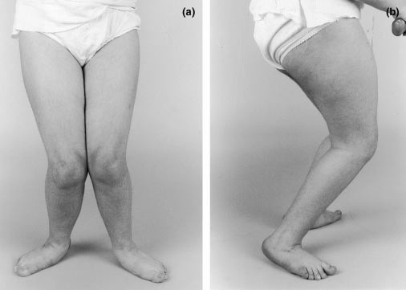
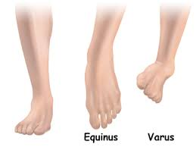
Common Musculoskeletal Abnormalities
Foot – equinus, planovalgus, and equinovarus’
Contractures can occur in any joint but most commonly in muscles that cross two joints – gastrocnemius, medial hamstrings and hip adductors
Typical pattern – hip adduction, hip flexion, knee flexion and ankle plantar flexion
Patella alta – rectus femoris spasticity

Slide 29
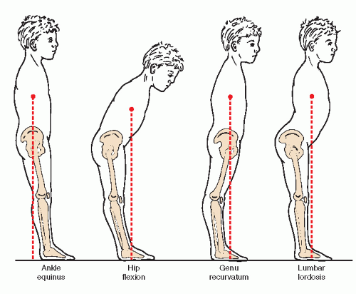
Common Musculoskeletal Abnormalities
Rotational deformities of femur and tibia
Femoral anteversion
History of W-sitting
High risk of hip subluxation or dislocation – Hip Surveillance Protocol

Slide 30
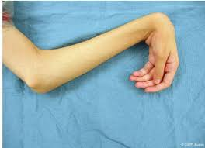
Upper limb
Shoulder adduction and internal rotation
Elbow flexion
Forearm pronation
Wrist flexion, finger flexion, and thumb in palm

Slide 31
Spine
Scoliosis – sideways curve of spine
Exaggerated lumbar lordosis- dynamic deformities

Slide 32
Hypertonicity and Movement Disorders
Affect function – ability to ambulate, manipulate objects, care for themselves, and communicate
Gait is affected by hypertonicity, movement disorders as well as weakness and impaired motor control.
Not all requires treatment – some children use hypertonicity functionally for standing, transfers and even ambulation

Slide 33
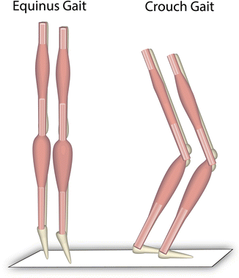
Gait patterns in spastic diplegia
True equinus
Genu recurvatum
Jump knee pattern
Stiff knee pattern
Apparent equinus
Crouch gait

Slide 34
Gait patterns in spastic hemiplegia
Type 1 – Compensatory steppage pattern
Type 2A - True equinus
Type 2B – includes genu recurvatum
Type 3 - Jump knee pattern
Type 4 – equinus at foot/ankle with a Jump knee and pelvic rotation, hip flexion, adduction and internal rotation

Slide 35
Management of Hypertonicity and Movement Disorders
Depends on the impairments, activity limitations and participation restrictions
Reduction of noxious stimuli
Positioning (carrying, bed, chair)/Orthoses
Therapy – stretching, casting, physical modalities, electrical stimulation (TENS)
Assistive Devices
Medications
Chemoneurolysis
Surgery

Slide 36
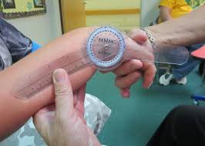
Examination
Thorough history and physical examination
Joint range of motion (ROM), Spasticity scales (Modified Ashworth Scale, Tardieu scale)
Functional Assessment and Classification
Instrumented gait and motion analysis gives more information
Video recording of activity by parents may be extremely useful in the present clinical scenario
The activity may be recorded with the same reference points at different times

Slide 37
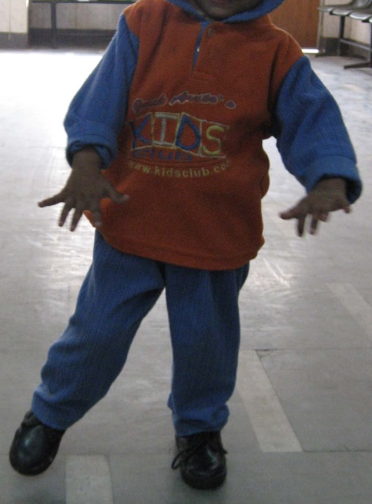
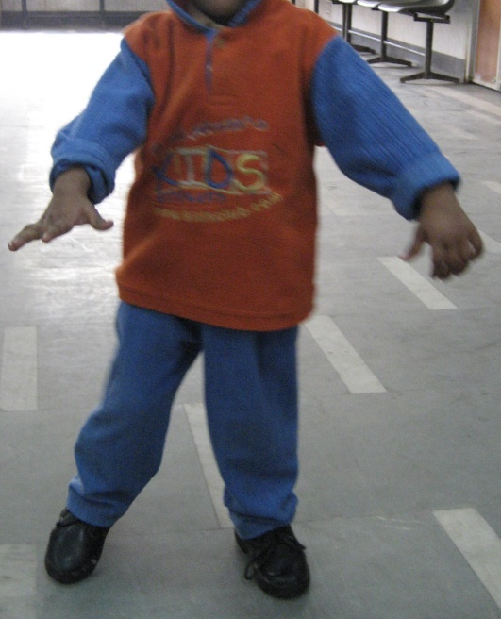
Gait Analysis

Slide 38
Positioning
പൊസിഷനിംഗ് - കുട്ടികളെ എടുക്കുന്ന / കിടത്തുന്ന / ഇരുത്തുന്ന രീതികൾ
Carrying/handling
Bed
Chair
Standing and walking
Orthoses (ബാഹ്യ ഉപകരണങ്ങൾ /ഓർത്തോസെസ്)

Slide 39
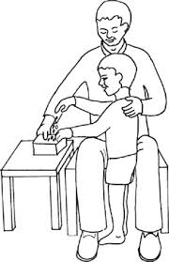
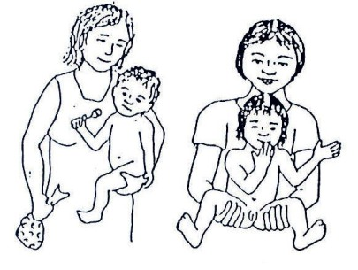
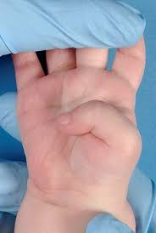
ലളിതമായ രീതികൾ

Slide 40
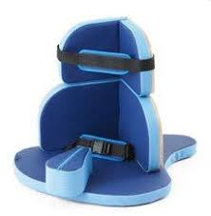
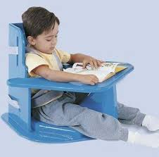
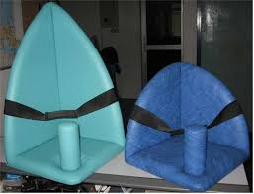
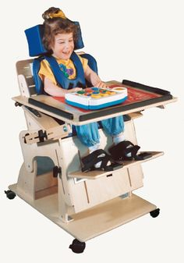
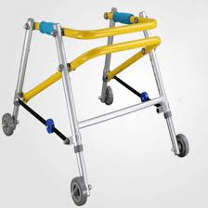
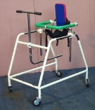
AT for Locomotor Impairments
Appropriate Device can reduce tone abnormalities and dynamic deformities

Slide 41
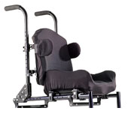
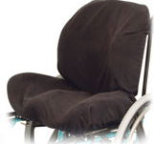
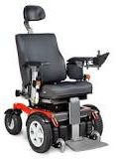
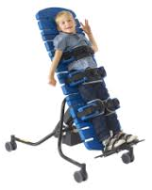
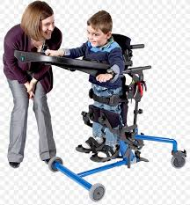
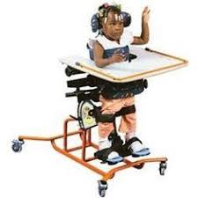
Wheelchair, Standing Frame other seating and transport systems

Slide 42
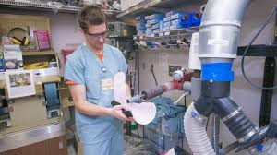
Orthotics
Branch of allied health specialty that focuses on the design and application of orthoses (single: orthosis)
Orthotics combines knowledge of anatomy and physiology, pathophysiology, biomechanics and engineering.
Although practiced together, Prosthetics is the branch that deals with artificial limbs

Slide 43
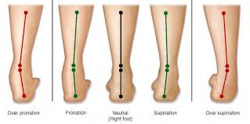
Orthosis
Control biomechanical alignment
Correct or accommodate deformity - correct the shape and/or function of the body
Protect and support an injury.
Restrict movement in a given direction
Assist movement
Reduce weight bearing forces for a particular purpose
Night splinting
Tone reduction

Slide 44
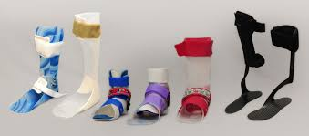
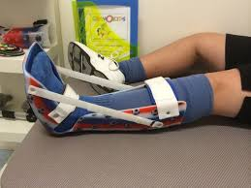
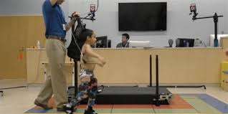
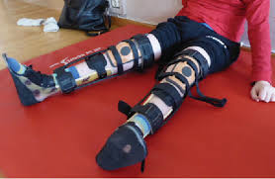
Lower Extremity Orthoses
Shoes and Foot Orthoses (FO)
SMO (supramalleolar orthosis)
AFO
KAFO
KO
HKAFO
RGO, Parapodium

Slide 45
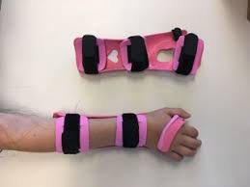
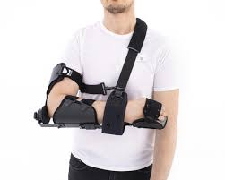
Upper Extremity Orthoses
HO / Finger orthoses
WHO
EWHO
EO – Gaiters for elbow
SEWHO – aeroplane splint
Functional vs Nonfunctional

Slide 46
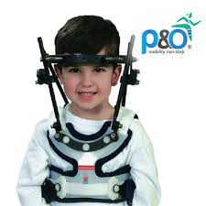
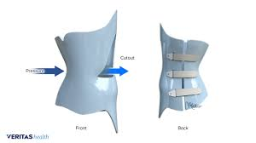
Spinal Orthoses
TLSO – thoracolumbosacral orthosis – spinal brace for scoliosis
CTO
CTLSO

Slide 47
Therapy തെറാപ്പി
Sensory stimulation
Exercises – passive → active assisted → active
Stretching the tight muscles
Strengthening the antagonists/opposite muscles
Facilitating cocontractions
Breaking up the activities to smaller steps – repetitions
Encourage active movements and participation
Constant reminders/verbal cues

Slide 48
Specific Therapy Techniques
Serial casting
Physical modalities –cooling/cryotherapy; heat
Electrical stimulation (TENS)
Vibration, Hippotherapy
CIMT
NDT – PNF, Bobath, Rood
PT, OT, Hydrotherapy, Recreation, Sports
Dance, Martial arts

Slide 49
Progress Therapy
Set goals → progress as child achieves each goal
Eg: - if the child attains sitting balance, improve the sitting and trunk balance by higher level balance activities in sitting position itself, while also progressing to standing balance training.
Sits with support → sits without support → lifts up one arm in unsupported sitting → lifts up both arms in unsupported sitting position → throws ball in unsupported sitting position → catches ball from left and back side in unsupported sitting position

Slide 50
Fine tune the activity, increase the level of complication
Every task or goal may be performed in a basic manner and may add higher level balance, coordination and complication levels to the same task and goal
Also, proceed to the next activity/goal
So, as the child attains standing balance, ideally, the child would have excellent sitting balance – however, this is often not stressed in clinical practice

Slide 51
Fine tune the activity, increase the level of complication
Example: Child is walking independently – but has tendency to fall
Standing with feet together, standing on one leg, standing with eyes closed, standing on one leg with eyes closed, standing on one leg with arms raised, standing on one leg and lifting up only hip and keeping back (breaking up the walking activity), simulated slow motion walking, walking in a straight line, walking backwards, walking on a beam, specific strengthening exercises for specific muscles, walking training in water, virtual reality games, etc

Slide 52
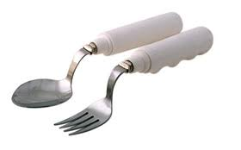
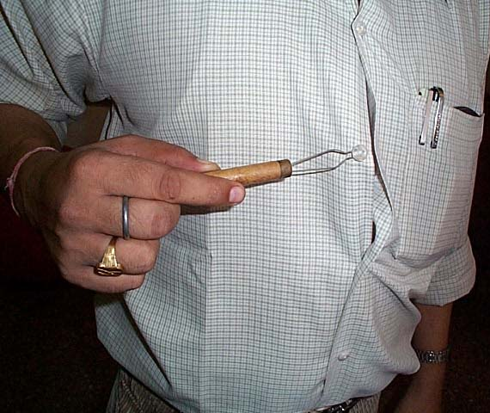
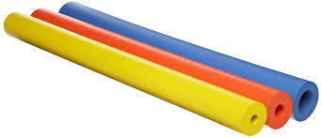
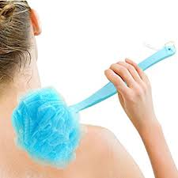
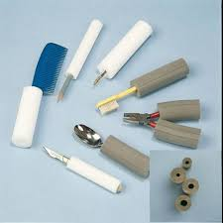
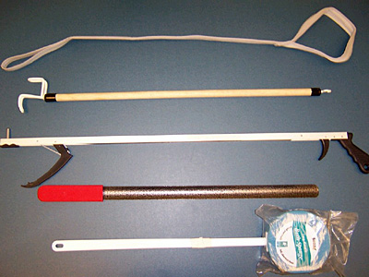
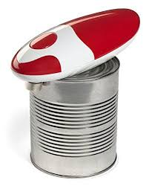
Self help devices

Slide 53
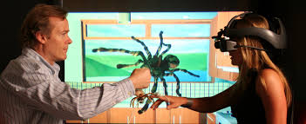
Virtual Reality
Robotic Therapy

Slide 54
Enteral Medications മരുന്നുകൾ
Enteral medications - systemic effects
Reasons:
For generalised hypertonicity and movement disorder
Impairment of function, pain, or difficulty with care
Carefully chosen by Physician –
Baclofen, Diazepam for spasticity. Less commonly, dantrolene, clonidine and tizanidine
Trihexyphenidyl, carbidopa/levodopa for dystonia

Slide 55
Chemodenervation
Focal areas treated
Chemodenervation – botulinum toxin denervates the muscle into which it is injected
ബോട്ടുലിനം ടോക്സിൻ ഇഞ്ചക്ഷൻ
Onset of action in about 3 days, peak effect in 3 weeks and lasts 3 months – 6 months

Slide 56
Chemoneurolysis
Chemoneurolysis – phenol or alcohol injected into a purely motor peripheral nerve
ഫിനോൾ / ആൽക്കഹോൾ ഇഞ്ചക്ഷൻ
Immediate effect, lasts 6 months
Side effects/complications: Potential side effect of painful dysesthesias if sensory nerve involved

Slide 57
Specific Surgeries ശസ്ത്രക്രിയകൾ
Tendon release/lengthening/Tenotomies
Neurotomies
Tendon transfers
Deformity corrections/osteotomies
Arthrodesis/joint fusion

Slide 58
Intrathecal Baclofen Pump ഇൻട്രാതീകൽ ബാക്ലോഫെൻ പമ്പ്
ITB pump delivers baclofen directly into the intrathecal space/CSF
Programmable pump implanted subfascially into the abdomen and connected to a catheter
Simple continuous dosing or bolus dosing
Requires lesser doses of baclofen than the enteral route
Side effects/complications

Slide 59
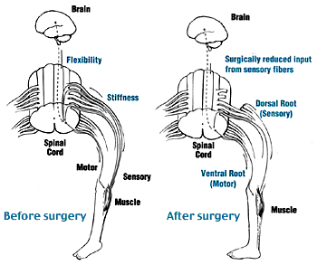
Selective Dorsal Rhizotomy സെലെക്ടിവ് ഡോർസൽ റൈസോടമി
Goals of surgery: better gait and leg function
Surgical procedure performed on the lower spinal cord - nerves are separated then identified via an electrical stimulation; certain sensory nerve fibers are cut that lead to too much muscle tone

Slide 60
Alternative Medicine
I do not have expertise to comment on other systems of medicine
However, understanding the physiology of dysfunction is mandatory
Passive measures like massage, cold, heat, etc. do have specific effects

Slide 61
What to expect in Adulthood
There is no condition known as late-onset CP. You can’t develop this condition as an adult.
CP is non-progressive. That means it doesn’t worsen over a person’s lifetime.
However, as a person living with CP ages, the condition can cause new challenges and issues.

Slide 62
Higher incidence of
High blood pressure (Hypertension)
Joint pain / Arthritis
Speech problems
Swallowing difficulty
Diabetes
Heart conditions
Stroke
Seizures
changes in the spine (such as scoliosis); or joint problems (such as contractures)

Slide 63
Earlier onset of age-related changes
Premature aging or earlier onset of age-related changes
People with CP use 3-5 times the energy of people without the disorder to complete everyday tasks.
Over time, that strain and demand on muscles and bones can begin to wear down the body. Eventually, the overuse of joints like those in the knees, ankles, hips, and arms can lead to osteoarthritis, also called degenerative arthritis.
For some individuals, premature aging may require the use of mobility aids, such as wheelchairs or crutches. For others, the ability to walk may be lost entirely.
Other signs of premature aging include increased pain, stiff muscles, and problems with the heart or lungs.

Slide 64
Challenges related to pain
Abnormalities with muscles, joints, and bones can produce discomfort during childhood, but as a person with CP ages, this discomfort can turn into pain.
This pain is most common in the body’s major joints, including the hips, knees, ankles, and upper and lower back.
Managed with preventative measures – Medication, physical and occupational therapy, injections, surgery.

Slide 65
Key Points പ്രധാന കാര്യങ്ങൾ
Many ways to manage tone abnormalities – a combination of techniques and modalities can be used
ഒന്നിലധികം രീതികളിലൂടെ ടോൺ നിയന്ത്രിക്കാവുന്നതാണ്
Regular follow up is necessary - റെഗുലർ ഫോളോ അപ്പ്

Slide 66
Hip Surveillance
“The process of monitoring and identifying the critical early indicators of hip displacement.”
Surveillance consists of two components: a clinical examination and a radiographic examination
Surveillance intervals vary according to risk.
Clinical examination: determining/re-confirming, age, Gross Motor Function Classification System (GMFCS) level and gait type at each surveillance interval, history of pain; Hip abduction passive range of motion (PROM)
Radiographic examination: measurement of migration percentage (MP) from a supine AP pelvis radiograph with standardized positioning.

Slide 67
Focal
Generalised
Therapy
Cold application or cryotherapy
Orthosis
Function training
Chemoneurolysis
Surgery
Regular follow up
Compensatory strategies
Therapy
Positioning
Function training
Enteral medications
ITB Pump
Selective Dorsal Rhizotomy
Regular follow up
Deep brain stimulation (DBS) for dystonia – more research needed

Slide 68
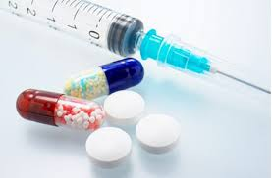
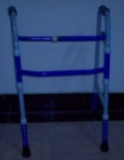
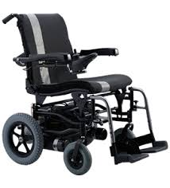
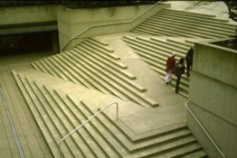
Rehab Interventions- പുനരധിവാസ രീതികൾ
മരുന്നുകൾ Medications | വ്യായാമം Exercises, Therapy
പ്രവൃത്തി/ദിനചര്യകളിൽ പരിശീലനം – Functional Assessment and Training | ശസ്ത്രക്രിയ/മറ്റു ഉപാധികൾ Surgical/other interventions
ബാഹ്യ ഉപകരണങ്ങൾ (Orthosis) | സഹായ ഉപകരണങ്ങൾ Assistive devices
ബോധവൽക്കരണം Education | തടസ്സങ്ങൾ ഇല്ലാത്ത ചുറ്റുപാട് Barrier-free environment
Psychosocial and vocational counseling and interventions (മാനസിക- സാമൂഹിക-തൊഴിൽ സംബന്ധിച്ച ഉപദേശങ്ങൾ/ഇടപെടലുകൾ)

