Slide 1
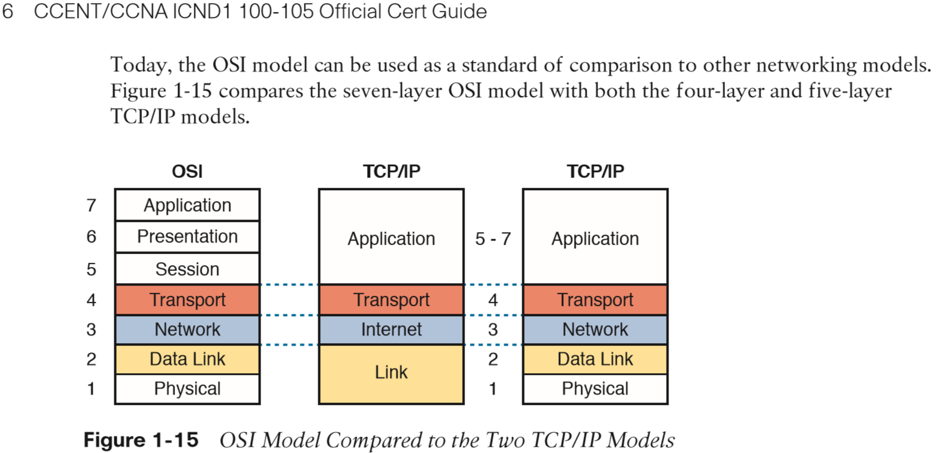
Overview of the TCP/IP Model
TCP/IP Networking Model
  Overview of the TCP/IP networking model

Slide 2
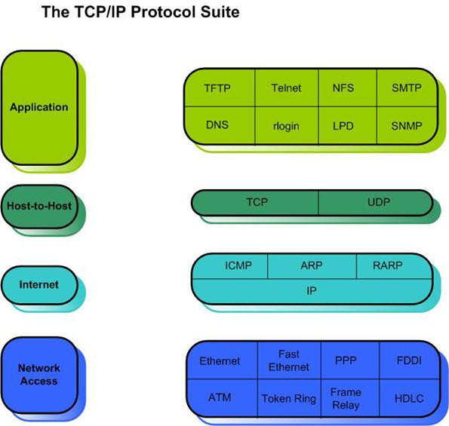
Brief History of TCP/IP
History leading to TCP/IP
  internet timeline

