Slide 1
DBH VIRTUAL PROVIDER TRAINING​
Emergency Management Protocol
Presenter: Andrea Piazza, Director of Virtual Programming​

Slide 2
Content Synopsis
OVERVIEW OF KEY IDEAS
DBH Resources
Emergency Screenings
Safety Planning in Virtual
Lessons from a crisis Line
Alerting the Team
Local Emergencies
Documenting Emergencies
Emergency After Care for Teams
Covid Related Team Support

Slide 3
Overview
OVERVIEW OF KEY IDEAS
Welcome to Discovery Behavioral Health’s training on Emergency Management Protocol. This hour will be a comprehensive overview of DBH emergency management protocols and the strategies recommended by leading telehealth education organizations. We will review screening, management, documentation and after care. Resources will also be provided for additional information on emergency management.

Slide 4
Learning Objectives
DISCOVERY BEHAVIORAL HEALTH RESOURCES
EMERGENCY SCREENING IN VIRTUAL
SAFETY PLANNING IN VIRTUAL
TEAM COMMUNICATION DURING AN EMERGENCY
DOCUMENTATION OF AN EMERGENCY
EMERGENCY AFTER CARE FOR TEAMS
COVID RELATED TEAM SUPPORT

Slide 5
What are the emergency management protocols & resources for DBH?
5 Questions You Will be Able to Answer
How do I effectively screen for emergencies in virtual?
What are important considerations for safety planning while virtual?
How do I document emergencies?
How do I care for myself and my team when emergencies happen?

Slide 6
DBH Resources
DBH Joint Commission Resource Manual 2020, Page 27
Zavanta Emergency Management Plan Policy
Zavanta Medical Emergency Policy
Zavanta Action Plan for Psychiatric Emergency
Others

Slide 7
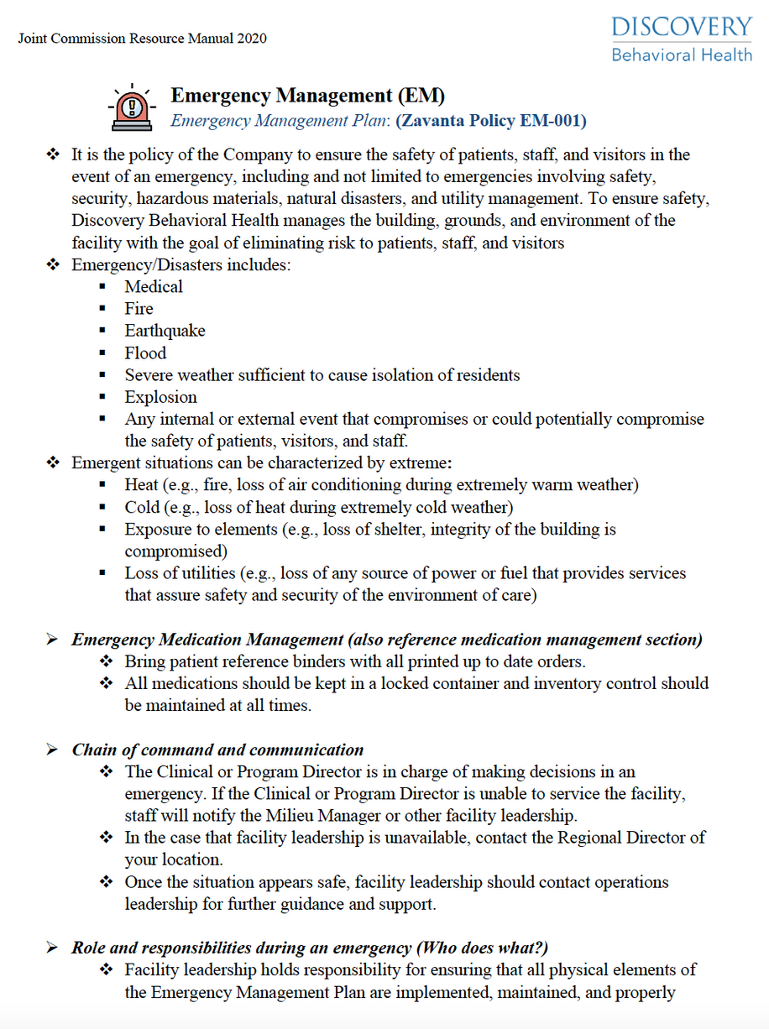
JOINT COMMISSION
RESOURCE MANUAL
Highlights
Emergency/Disaster
Emergent Situations Characterized by the Extreme
Emergency Medication Management
Chain of Command Communication
Roles and Responsibilities
Evacuation

Slide 8
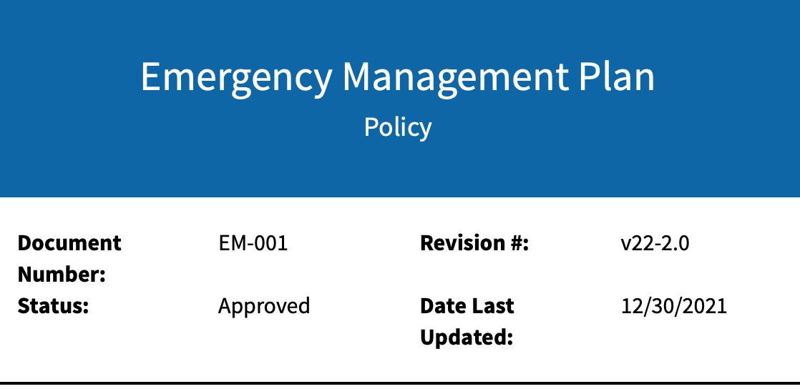
DBH Medical Emergency Management
The company focuses on 6 critical areas - communication, patient and clinical and support activities, resources and assets, safety and security, utilities management, and staff responsibilities
Emergency/Disaster -medical, fire, earthquake, flood, severe weather sufficient to cause isolation of residents, explosion, any internal or external event that compromises or could potentially compromise the safety of patients, visitors, and staff
Emergent situations characterized by extreme - heat, cold, exposure to elements, loss of utilities
Notes:
https://discoverybehavioralhealth.sharepoint.com/teams/CSQMTeam/Shared%20Documents/Forms/AllItems.aspx?id=%2Fteams%2FCSQMTeam%2FShared%20Documents%2F5%2E%20Clinical%20Quality%20%28%26%20Documentation%29%2F5%2E%20Clinical%20Supervision%2F1%2E%20Clinicians%20Desk%20Reference%202021%2Epdf&parent=%2Fteams%2FCSQMTeam%2FShared%20Documents%2F5%2E%20Clinical%20Quality%20%28%26%20Documentation%29%2F5%2E%20Clinical%20Supervision&p=trueps%3A%2F%2Fdiscoverybehavioralhealth.sharepoint.com%2Fteams%2FCSQMTeam%2FShared%2520Documents%2FForms%2FAllItems.aspx%3Fid%3D%252Fteams%252FCSQMTeam%252FShared%2520Documents%252F5%252E%2520Clinical%2520Quality%2520%2528%2526%2520Documentation%2529%252F5%252E%2520Clinical%2520Supervision%252F1%252E%2520Clinicians%2520Desk%2520Reference%25202021%252Epdf%26parent%3D%252Fteams%252FCSQMTeam%252FShared%2520Documents%252F5%252E%2520Clinical%2520Quality%2520%2528%2526%2520Documentation%2529%252F5%252E%2520Clinical%2520Supervision%26p%3Dtrue&client=safari&rls=en&sxsrf=APq-WBuEkL-BLoHkUa5kTubFt96LOluLDA%3A1645483081310&ei=SRQUYsDIEpPNkPIP__uL8AQ&ved=0ahUKEwiAka6U7pH2AhWTJkQIHf_9Ak4Q4dUDCA0&uact=5&oq=https%3A%2F%2Fdiscoverybehavioralhealth.sharepoint.com%2Fteams%2FCSQMTeam%2FShared%2520Documents%2FForms%2FAllItems.aspx%3Fid%3D%252Fteams%252FCSQMTeam%252FShared%2520Documents%252F5%252E%2520Clinical%2520Quality%2520%2528%2526%2520Documentation%2529%252F5%252E%2520Clinical%2520Supervision%252F1%252E%2520Clinicians%2520Desk%2520Reference%25202021%252Epdf%26parent%3D%252Fteams%252FCSQMTeam%252FShared%2520Documents%252F5%252E%2520Clinical%2520Quality%2520%2528%2526%2520Documentation%2529%252F5%252E%2520Clinical%2520Supervision%26p%3Dtrue&gs_lcp=Cgdnd3Mtd2l6EAMyBwgAEEcQsAMyBwgAEEcQsAMyBwgAEEcQsAMyBwgAEEcQsAMyBwgAEEcQsAMyBwgAEEcQsAMyBwgAEEcQsAMyBwgAEEcQsANKBAhBGABKBAhGGABQsgdY5gxghBFoAXABeACAAQCIAQCSAQCYAQCgAQHIAQjAAQE&sclient=gws-wiz

Slide 9
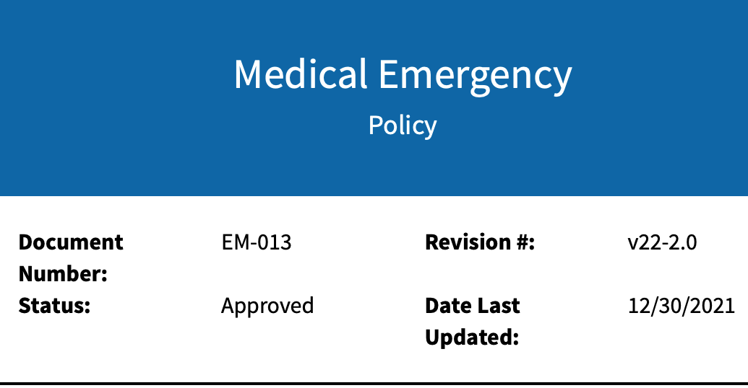
DBH Medical Emergency Management
In the event of a medical emergency (an injury or illness that is acute and poses an immediate risk to a person’s life or long-term health), staff shall:
Call 911 and stay with the injured person until emergency services arrive.
Find out where the injured person will be transported (hospital or acute care center). When possible, obtain a signed Release of Information from the patient for the hospital to which they are being transported.
Notify program/operations leadership.
Notify emergency contact.
Complete an incident report.
Notes:
https://discoverybehavioralhealth.sharepoint.com/teams/CSQMTeam/Shared%20Documents/Forms/AllItems.aspx?id=%2Fteams%2FCSQMTeam%2FShared%20Documents%2F5%2E%20Clinical%20Quality%20%28%26%20Documentation%29%2F5%2E%20Clinical%20Supervision%2F1%2E%20Clinicians%20Desk%20Reference%202021%2Epdf&parent=%2Fteams%2FCSQMTeam%2FShared%20Documents%2F5%2E%20Clinical%20Quality%20%28%26%20Documentation%29%2F5%2E%20Clinical%20Supervision&p=trueps%3A%2F%2Fdiscoverybehavioralhealth.sharepoint.com%2Fteams%2FCSQMTeam%2FShared%2520Documents%2FForms%2FAllItems.aspx%3Fid%3D%252Fteams%252FCSQMTeam%252FShared%2520Documents%252F5%252E%2520Clinical%2520Quality%2520%2528%2526%2520Documentation%2529%252F5%252E%2520Clinical%2520Supervision%252F1%252E%2520Clinicians%2520Desk%2520Reference%25202021%252Epdf%26parent%3D%252Fteams%252FCSQMTeam%252FShared%2520Documents%252F5%252E%2520Clinical%2520Quality%2520%2528%2526%2520Documentation%2529%252F5%252E%2520Clinical%2520Supervision%26p%3Dtrue&client=safari&rls=en&sxsrf=APq-WBuEkL-BLoHkUa5kTubFt96LOluLDA%3A1645483081310&ei=SRQUYsDIEpPNkPIP__uL8AQ&ved=0ahUKEwiAka6U7pH2AhWTJkQIHf_9Ak4Q4dUDCA0&uact=5&oq=https%3A%2F%2Fdiscoverybehavioralhealth.sharepoint.com%2Fteams%2FCSQMTeam%2FShared%2520Documents%2FForms%2FAllItems.aspx%3Fid%3D%252Fteams%252FCSQMTeam%252FShared%2520Documents%252F5%252E%2520Clinical%2520Quality%2520%2528%2526%2520Documentation%2529%252F5%252E%2520Clinical%2520Supervision%252F1%252E%2520Clinicians%2520Desk%2520Reference%25202021%252Epdf%26parent%3D%252Fteams%252FCSQMTeam%252FShared%2520Documents%252F5%252E%2520Clinical%2520Quality%2520%2528%2526%2520Documentation%2529%252F5%252E%2520Clinical%2520Supervision%26p%3Dtrue&gs_lcp=Cgdnd3Mtd2l6EAMyBwgAEEcQsAMyBwgAEEcQsAMyBwgAEEcQsAMyBwgAEEcQsAMyBwgAEEcQsAMyBwgAEEcQsAMyBwgAEEcQsAMyBwgAEEcQsANKBAhBGABKBAhGGABQsgdY5gxghBFoAXABeACAAQCIAQCSAQCYAQCgAQHIAQjAAQE&sclient=gws-wiz

Slide 10
Action Plan for Psychiatric Emergency
Contact the Psychiatrist or On Call Therapist
Contact Psychiatric Emergency Response Team or 911
The Psychiatric Emergency Response Team should be given copies of insurance cars, emergency contact information, medication records, and diagnosis
Support the patient is putting together a bag with clean clothes and hygiene products
Provide a copy of the patient's emergency information
If directed by the program director, notify the patient's family and if possible obtain and oral release to communicate with the hospital
Complete an incident report
Seek support for yourself
Notes:
https://discoverybehavioralhealth.sharepoint.com/teams/CSQMTeam/Shared%20Documents/Forms/AllItems.aspx?id=%2Fteams%2FCSQMTeam%2FShared%20Documents%2F5%2E%20Clinical%20Quality%20%28%26%20Documentation%29%2F5%2E%20Clinical%20Supervision%2F1%2E%20Clinicians%20Desk%20Reference%202021%2Epdf&parent=%2Fteams%2FCSQMTeam%2FShared%20Documents%2F5%2E%20Clinical%20Quality%20%28%26%20Documentation%29%2F5%2E%20Clinical%20Supervision&p=trueps%3A%2F%2Fdiscoverybehavioralhealth.sharepoint.com%2Fteams%2FCSQMTeam%2FShared%2520Documents%2FForms%2FAllItems.aspx%3Fid%3D%252Fteams%252FCSQMTeam%252FShared%2520Documents%252F5%252E%2520Clinical%2520Quality%2520%2528%2526%2520Documentation%2529%252F5%252E%2520Clinical%2520Supervision%252F1%252E%2520Clinicians%2520Desk%2520Reference%25202021%252Epdf%26parent%3D%252Fteams%252FCSQMTeam%252FShared%2520Documents%252F5%252E%2520Clinical%2520Quality%2520%2528%2526%2520Documentation%2529%252F5%252E%2520Clinical%2520Supervision%26p%3Dtrue&client=safari&rls=en&sxsrf=APq-WBuEkL-BLoHkUa5kTubFt96LOluLDA%3A1645483081310&ei=SRQUYsDIEpPNkPIP__uL8AQ&ved=0ahUKEwiAka6U7pH2AhWTJkQIHf_9Ak4Q4dUDCA0&uact=5&oq=https%3A%2F%2Fdiscoverybehavioralhealth.sharepoint.com%2Fteams%2FCSQMTeam%2FShared%2520Documents%2FForms%2FAllItems.aspx%3Fid%3D%252Fteams%252FCSQMTeam%252FShared%2520Documents%252F5%252E%2520Clinical%2520Quality%2520%2528%2526%2520Documentation%2529%252F5%252E%2520Clinical%2520Supervision%252F1%252E%2520Clinicians%2520Desk%2520Reference%25202021%252Epdf%26parent%3D%252Fteams%252FCSQMTeam%252FShared%2520Documents%252F5%252E%2520Clinical%2520Quality%2520%2528%2526%2520Documentation%2529%252F5%252E%2520Clinical%2520Supervision%26p%3Dtrue&gs_lcp=Cgdnd3Mtd2l6EAMyBwgAEEcQsAMyBwgAEEcQsAMyBwgAEEcQsAMyBwgAEEcQsAMyBwgAEEcQsAMyBwgAEEcQsAMyBwgAEEcQsAMyBwgAEEcQsANKBAhBGABKBAhGGABQsgdY5gxghBFoAXABeACAAQCIAQCSAQCYAQCgAQHIAQjAAQE&sclient=gws-wiz

Slide 11
Others
Intranet and Zavanta Review
Notes:
https://discoverybehavioralhealth.sharepoint.com/teams/CSQMTeam/Shared%20Documents/Forms/AllItems.aspx?id=%2Fteams%2FCSQMTeam%2FShared%20Documents%2F5%2E%20Clinical%20Quality%20%28%26%20Documentation%29%2F5%2E%20Clinical%20Supervision%2F1%2E%20Clinicians%20Desk%20Reference%202021%2Epdf&parent=%2Fteams%2FCSQMTeam%2FShared%20Documents%2F5%2E%20Clinical%20Quality%20%28%26%20Documentation%29%2F5%2E%20Clinical%20Supervision&p=trueps%3A%2F%2Fdiscoverybehavioralhealth.sharepoint.com%2Fteams%2FCSQMTeam%2FShared%2520Documents%2FForms%2FAllItems.aspx%3Fid%3D%252Fteams%252FCSQMTeam%252FShared%2520Documents%252F5%252E%2520Clinical%2520Quality%2520%2528%2526%2520Documentation%2529%252F5%252E%2520Clinical%2520Supervision%252F1%252E%2520Clinicians%2520Desk%2520Reference%25202021%252Epdf%26parent%3D%252Fteams%252FCSQMTeam%252FShared%2520Documents%252F5%252E%2520Clinical%2520Quality%2520%2528%2526%2520Documentation%2529%252F5%252E%2520Clinical%2520Supervision%26p%3Dtrue&client=safari&rls=en&sxsrf=APq-WBuEkL-BLoHkUa5kTubFt96LOluLDA%3A1645483081310&ei=SRQUYsDIEpPNkPIP__uL8AQ&ved=0ahUKEwiAka6U7pH2AhWTJkQIHf_9Ak4Q4dUDCA0&uact=5&oq=https%3A%2F%2Fdiscoverybehavioralhealth.sharepoint.com%2Fteams%2FCSQMTeam%2FShared%2520Documents%2FForms%2FAllItems.aspx%3Fid%3D%252Fteams%252FCSQMTeam%252FShared%2520Documents%252F5%252E%2520Clinical%2520Quality%2520%2528%2526%2520Documentation%2529%252F5%252E%2520Clinical%2520Supervision%252F1%252E%2520Clinicians%2520Desk%2520Reference%25202021%252Epdf%26parent%3D%252Fteams%252FCSQMTeam%252FShared%2520Documents%252F5%252E%2520Clinical%2520Quality%2520%2528%2526%2520Documentation%2529%252F5%252E%2520Clinical%2520Supervision%26p%3Dtrue&gs_lcp=Cgdnd3Mtd2l6EAMyBwgAEEcQsAMyBwgAEEcQsAMyBwgAEEcQsAMyBwgAEEcQsAMyBwgAEEcQsAMyBwgAEEcQsAMyBwgAEEcQsAMyBwgAEEcQsANKBAhBGABKBAhGGABQsgdY5gxghBFoAXABeACAAQCIAQCSAQCYAQCgAQHIAQjAAQE&sclient=gws-wiz

Slide 12
SUICIDE SCREENING AND VIRTUAL CONSIDERATIONS
Screening for fit prior to program
Verify location before every session
Even when we work with patients in-person, we are not with them 24 hours so its important we are always competent in emergency screening
Follow suicide screen protocols
Collaborate with the patients support system
Ensure local emergency services are included in the safety plan
Verify the involuntary commitment laws in the state and check whether a telehealth clinican can initiate a hold
If not, identify a local clinician who can and is willing to support the patient
Refer to the appropriate level of care if the suicidality is severe as this could be a potential contraindication for telehealth

Slide 13
SELF-HARM AND VIRTUAL CONSIDERATIONS
Screening for fit prior to program
It can be difficult to assess the severity of certain self-harm wounds like cutting over webcam
If appropriate, have a support person assess the wounds and always recommend medical evaluation if necessary
Assess self-harm via the company protocols to check for frequency, severity, potential for harm, intention, ability to manage self -harm, etc.
efer to the appropriate level of care if the self-harm is severe as this could be a potential contraindication for telehealth

Slide 14
OTHER EMERGENCY SCREENING
Hunger Strike
Delusions
Hallucinations
Substance Use/Intoxication
Homicidal Ideation
Domestic Violence/Intimate Partner Violence
Abuse

Slide 15
Lessons from Crisis Lines
If appropriate or necessary, the telehealth provider can direct the client to call a crisis line while supporting the patient via video or phone and the crisis line can initiate an emergency response
Verbal De-escalation
https://suicidepreventionlifeline.org/wp-content/uploads/2016/08/Suicide-Risk-Assessment-Standards-1.pdf

Slide 16
Unique Virtual Safety Planning Reminders
Screen for fit
Document location every session
Verify emergency contact numbers work and update regularly
Document local resources and any specialized resources
Review boundaries and plans for in between sessions consistently
Highlight protective factors regularly

Slide 17
National Resources
Crisis and Suicide Helplines
National Suicide Prevention Lifeline
Call: 1-800-273-8255
Veterans Crisis Line
Call: 1-800-273-8255 (and press 1)
Deaf or hard of hearing: 1-800-799-4889
Text: 838255
Samaritans (24/7 Crisis Services)
Helpline: Call or Text (877) 870-4673
Trevor Project (LGBTQ crisis line)
Call: 1-866-488-7386
Text: Text START to 678678
The Trans Lifeline
Call (USA): 877-565-8860 / (Canada): 877-339-6366
National Safe Place Text Safe
Text: Text the word “safe” and your current location (address, city, state) to 4HELP (44357)
Domestic Violence and Assault Hotlines
National Domestic Violence Hotline
Call: 1−800−799−7233
TTY: 1−800−787−3224
RAINN (National Sexual Assault Hotline)
Call: 800-656-4673
National Safe Place Text Safe
Text: Text the word “safe” and your current location (address, city, state) to 4HELP (44357)
Boys Town National Hotline
Call: 800-448-3000
TDD Line: 1-800-448-1833
National Runaway Safeline
Call: 1-800-786-2929
Text: 66008
Teen Help
The Safe School Hotline
Anonymously report to your school situations that can be threatening, dangerous, or harmful to students.
Sexual Health
National STD and AIDS Hotline (American Sexual Health Association)
Call: (800) 232-4636
LGBTQ+ Hotlines
Trevor Project (LGBTQ crisis line)
Call: 1-866-488-7386
Text: Text START to 678678
The Trans Lifeline
Call (USA): 877-565-8860 / (Canada): 877-339-6366
Substance Abuse Awareness and Hotlines
Substance Abuse and Mental Health Services Administration (SAMHSA) National Hotline
Call: 1-800-662-HELP (4357)
National Drug Helpline
Call: 1-844-289-0879
Teen Domestic Violence
Call: 1-866-331-9474
Text: Text LOVEIS TO 22522
Youth (and Parent) Resources
Childhelp National Child Abuse Hotline
Call or Text: 1-800-422-4453
Teen Domestic Violence
Call: 1-866-331-9474
Text: Text LOVEIS TO 22522
National Council on Alcoholism and Drug Dependence, Inc. (NCADD)
Call: 1-800-NCA-CALL (622-2255)
National Institute on Drug Abuse (NIDA)
Call: 1-301-443-1124
The Partnership at Drugfree.org
Call: 1-855-DRUG-FREE (378-4373)
Eating Disorders Awareness and Prevention
The National Eating Disorders Association (NEDA)
Helpline: (800) 931-2237
The Eating Disorder Foundation
The Alliance for Eating Disorders Awareness

Slide 18
Alerting Teams to Emergencies
Chain of Command
Emergency Phone Tree
Teams

Slide 19
Emergency Contact List
I recommend completing similar plans for each patient, especially if they're in regions you're not as familiar with

Slide 20
Regional Disasters of Emergencies
Follow the chain of command and collaborate with regional directors and operations leaders on strategies to keep your teams safe and support your patients

Slide 21
Documenting the Emergency
Follow suicide assessment and documentation procedures as specified in Zavanta
Update suicidality, homicidality, and self-harm screening and ideation in each session note as appropriate by documentation standards

Slide 22
Self-Care After and Emergency
Follow your personal self-care plan
Ensure you're getting every type of rest
Complete the stress cycle

Slide 23
Supporting the Team After an Emergency
Its important after an emergency to feel connected and supported by one's team
Plan for how your team will connect after emergencies to create space for healing and support
Seek support from regional, operations and virtual program teams
Ideas: 20 minutes of gratitude at the beginning of treatment team, coffee chats on Frriday

Slide 24
INCIDENT REPORTING THROUGH ORIGAMI
Demonstration
origamihelp@discoverybh.com

Slide 25
Reporting Abuse
You are not an investigator and it is not your job to confirm suspicions or identify all the information before calling
Each state has a hotline and potentially an online reporting system
There are different requirements per state
Be sure to document the ID number of the employee who receives the report and the contact information of the investigator if one is signed
Document each encounter with the abuse center as is appropriate per your division standards
Follow all abuse trainings provided

Slide 26
COVID Related Emergencies
CDC Guidlines and WHO
Up to date DBH Policies
Understanding the long term effects of COVID
COVID support groups

Slide 27
COVID FATIGUE
Check In With Yourself: On a scale of 1-10 where 10 is the worst, how bad is my pandemic anxiety right now? If you're struggling specifically with blue-screen or zoom burnout, take the following assessment and think of ways to set limits around screen time: Zoom Exhaustion & Fatigue Scale
Write It Out: Journal and put your worries onto a piece of paper. Next, use a highlighter to mark the thoughts that are not realistic, such as "I will just have to wait to start living my life until the pandemic is over." Although the feelings behind this thought are valid, it's not fair or healthy to continually push back the start date of your life.
Make A Plan: What are three small things you can start doing to feel like you again? Plan for when and how to do them in a way that is not emotionally exhausting and preferable simple. For example, you love trying new food but you're still not comfortable sitting in restaurants because the consistently shifting CDC guidelines and mask mandates make
COVID Fatigue Webinar

Slide 28
SUMMARY
Handling emergencies in telehealth can feel daunting because we may feel like we have less direct access to our patients. However, it's the same skill set we would use for patients between sessions. There are some additional considerations its important build into emergency management plans. Its critical to be aware of the national resources and company policies. Overall, there are several strategies that can be put into place to manage emergencies, prevent further emergencies, document, and support one another available.

Slide 29
Thank You!
For Questions:
Apiazza@discoverybh.com

Slide 30
Resources
“Key Substance Use and Mental Health Indicators in the ...” The National Survey on Drug Use and Health, Substance Abuse and Mental Health Services Administration, Oct. 2021, https://www.samhsa.gov/data/sites/default/files/reports/rpt35319/2020NSDUHFFR1PDFW102121.pdf.
HPSA and MUA/P: HPSA scoring criteria: Guidance portal. HPSA and MUA/P: HPSA Scoring Criteria | Guidance Portal. (n.d.). Retrieved January 28, 2022, from https://www.hhs.gov/guidance/document/hpsa-and-muap-hpsa-scoring-criteria
Two-thirds of primary care physicians can't get mental health services for patients. Commonwealth Fund. (2009, April 14). Retrieved January 28, 2022, from https://www.commonwealthfund.org/press-release/2009/two-thirds-primary-care-physicians-cant-get-mental-health-services-patients?redirect_source=%2Fpublications%2Fpress-releases%2F2009%2Fapr%2Ftwo-thirds-of-primary-care-physicians-cant-get-mental-health-services-for-patients
Behavioral Health Workforce Projections. (2020, December). Retrieved from Health Resources & Services Administration (HRSA).
Hilty DM, Yellowlees PM, Parish MB, et al. Telepsychiatry: Effective, evidence-based and at a tipping point in healthcare delivery. Psych Clin N Amer 2015;38(3):559-592.
Shore, J. H., & Yellowlees, P. (2018). Telepsychiatry and Health Technologies: A Guide for Mental Health Professionals. Arlington, VA: American Psychiatric Association Publishing.
https://www.healthdata.org/infographic/covid-19-pandemic-has-had-large-and-uneven-impact-global-mental-health
Ostrowski, J., & Collins, T.P. (2016). A Comparison of Telemental Health Terminology Used across Mental Health State Licensure Boards).
National Consortium of Telehealth Resource Centers. How patients can engage in telehealth. https://www.telehealthresourcecenter.org/wp-content/uploads/2020/03/How-Patients-Can-EngageTelehealth-FINAL.pdf
Hilty, D. M., Gentry, M. T., McKean, A. J., Cowan, K. E., Lim, R. F., & Lu, F. G. (2020). Telehealth for rural diverse populations: telebehavioral and cultural competencies, clinical outcomes and administrative approaches. mHealth, 6, 20. https://doi.org/10.21037/mhealth.2019.10.04
https://www.amazon.com/Burnout-Secret-Unlocking-Stress-Cycle/dp/198481706X

