Slide 1
Remove Background: Practice File
©Presentation-Process.com
All rights reserved. Not for distribution.

Slide 2
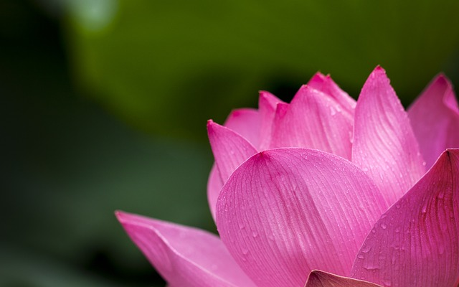
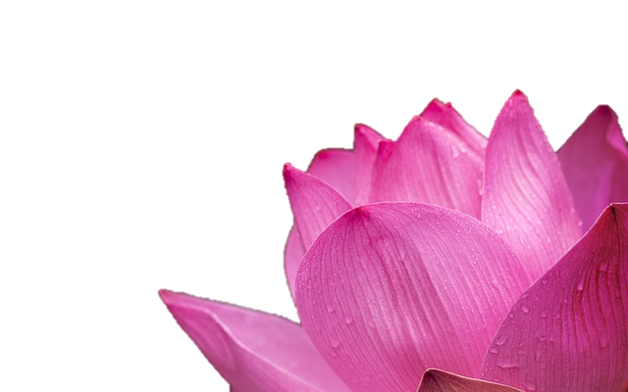
Photo for practice

