Slide 1
Investing After the Pandemic
Make Long Term Decisions in 2023
That Will Get You to Financial Independence Years Sooner

Slide 2
Investing After the Pandemic in 2023
Investing Opportunities After the Pandemic
You have a multi decade horizon,
and stock market volatility helps grow wealth faster
If stocks fall, you can save money on taxes for years. If they rise, you make money.
Older workers retiring will make room others willing to take career risks

Slide 3
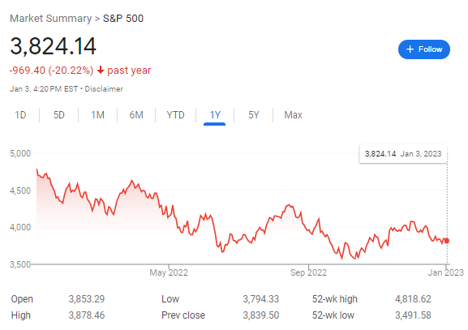
Investing After the Pandemic in 2023
S&P 500 Index
PAST 1 YEAR
Source: Google.com

Slide 4
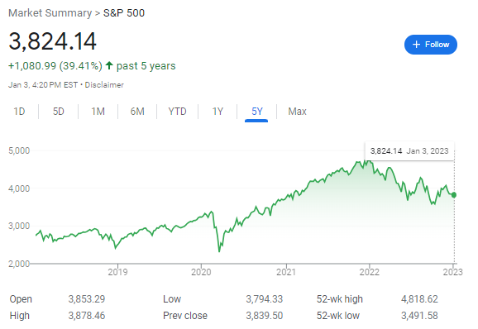
Investing After the Pandemic in 2023
S&P 500 Index
PAST 5 Years
Source: Google.com

Slide 5
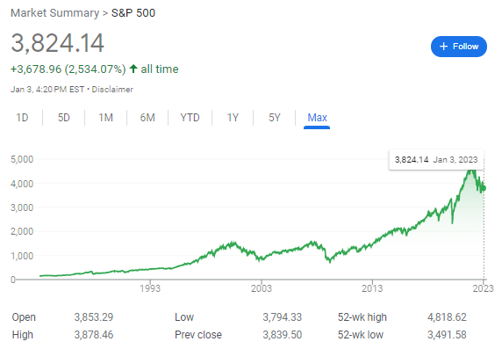
Investing After the Pandemic in 2023
S&P 500 Index
PAST 40 Years
25x price returns
Source: Google.com

Slide 6
Investing After the Pandemic in 2023
S&P 500 Index
PAST 40 Years
25x price returns
64x total returns
including
dividends
Source: Google.com

Slide 7
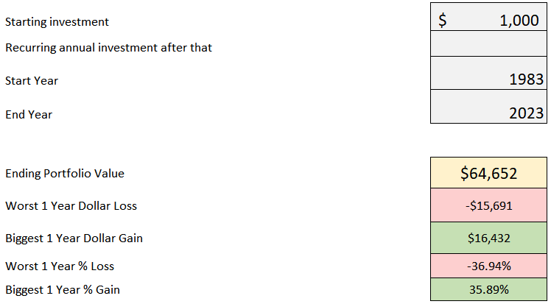
Investing After the Pandemic in 2023
S&P 500 Index PAST 40 Years WITH DIVIDENDS
64x returns !!!
Source: Studentloanplanner.com calculations

Slide 8
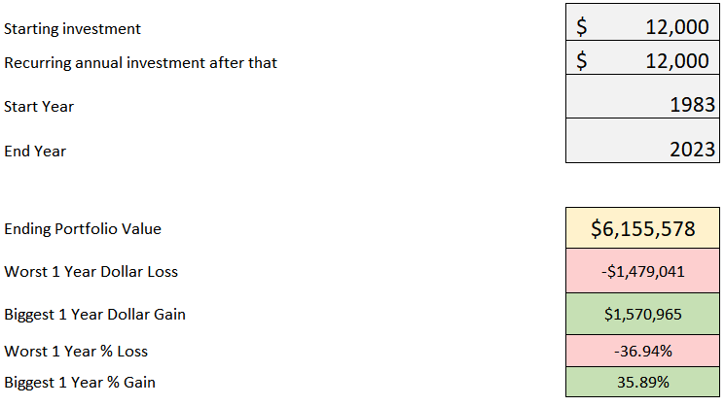
Investing After the Pandemic in 2023
If you had invested $1,000 a month in the S&P 500 over the past 40 years, today it would be worth
over $6.1 million dollars
Source: Studentloanplanner.com calculations

Slide 9
Investing After the Pandemic in 2023
What is a Harmonic Mean?
Q: If you buy $20 of gas at $1 a gallon, and $20 of gas at $2 a gallon,
what’s the average price per gallon?
A: $1.33 (not $1.50)
$20/$1 = 20 gallons
$20/$2 = 10 gallons
$40/30 gallons = $1.33

Slide 10
Investing After the Pandemic in 2023
How Regular Investing Helps You Win
Q: If you buy $1,000 of stock at $50 and $1,000 of stock at $40,
what’s the average price per share?
A: $44.44 (not $45)
$1,000/$50 per share = 20 shares
$1,000/$40 per share = 25 shares
$2,000/45 shares = $44.44, not $45

Slide 11
Investing After the Pandemic in 2023
How Regular Investing Helps You Win
Q: If you buy $1,000 of stock at $80 and $1,000 of stock at $10,
what’s the average price per share?
A: $17.78 (not $45)
$1,000/$80 per share = 12.5 shares
$1,000/$10 per share = 100 shares
$2,000/112.5 shares = $17.78, not $45

Slide 12
Investing After the Pandemic in 2023
How Regular Investing Helps You Win
$865 a paycheck maxes a 401k (which has a cap)
Then put as much as you can into a
Non-retirement account (that has no cap)
If stocks go down, save money on taxes through tax loss harvesting
If stocks go up, you make money (long term they almost surely will)
IT’S A WIN-WIN. The only way you LOSE is by NOT INVESTING

Slide 13
Investing After the Pandemic in 2023
Where to invest?
You like learning and want to manage it: Vanguard, Schwab, Fidelity
- Vanguard has a digital advisor that’ll do it for you
You want a cheap price for someone to do it for you: Betterment.com
You want high service and a human: Fiduciary CFP® planner

Slide 14
Investing After the Pandemic in 2023
What’s the yearly cost?
Do it yourself (Vanguard.com) = $0.70 (70 cents) per $1,000 of what you have invested
Cheaply have someone do it (Betterment.com) = $3 per $1,000 of what you have invested
High service human (Fiduciary CFP® planner) = $10 per $1,000 of what you have invested,
or $200 to $1,000 per month
All these options are dirt cheap compared to not investing!

Slide 15
Investing After the Pandemic in 2023
Investing Opportunities After the Pandemic Recession
You have a multi decade horizon, and stock market volatility helps grow wealth faster
If stocks fall, you can save money on taxes for years.
If they rise, you make money.
3. Older workers retiring will make room others willing to take career risks

Slide 16
Investing After the Pandemic in 2023
Tax Loss Harvesting Example at Vanguard.com
Value Before Crash
Value After Crash
Exchanged into this fund after market crash
Why do this? You got a $6,000 Loss to use
against your taxes.

Slide 17
Investing After the Pandemic in 2023
Wait 30 DAYS!!! Pretend Stocks Went Up A Bit. Now Switch Back
Value 30 Days After the Market Crash
Exchanged 30 Days After the Crash
You moved back into original investments, $2,000 gain is offset by $6,000 loss,
for net loss of $4,000

Slide 18
Investing After the Pandemic in 2023
You Get to Write Off $3,000 Against Your Active Income Each Year
This Example: $3,000 * 40% tax rate = $1,200 in tax savings compared to doing nothing
Other $1,000 in Losses You Can Carry Forward to Future Years
BUT… YOU DIDN’T LOSE ANY MONEY!!!
LOSSES WERE ONLY ON PAPER, AND YOU’RE INVESTING LONG-TERM

Slide 19
Investing After the Pandemic in 2023
Investing Opportunities After the Pandemic Recession
You have a multi decade horizon, and stock market volatility helps grow wealth faster
If stocks fall, you can save money on taxes for years.
If they rise, you make money.
3. Older workers retiring will make room others willing to take career risks

Slide 20
Investing After the Pandemic in 2023

Slide 21
Investing After the Pandemic in 2023

Slide 22
Investing After the Pandemic in 2023
PRICE INCREASES
QUANTITY DECREASES

Slide 23
Investing After the Pandemic in 2023
What it means:
You Have More Leverage
In the Labor Market
USE IT!!!

Slide 24
Investing After the Corona Recession in 2021
Investing After the Pandemic in 2023
Biggest Caution Signs for the Market in 2023 and Beyond
Stocks Shiller P/E ratio is still very high,
meaning stocks aren’t exactly cheap even after a 20% drop
Taming inflation could spark a recession
Home prices could fall significantly

Slide 25
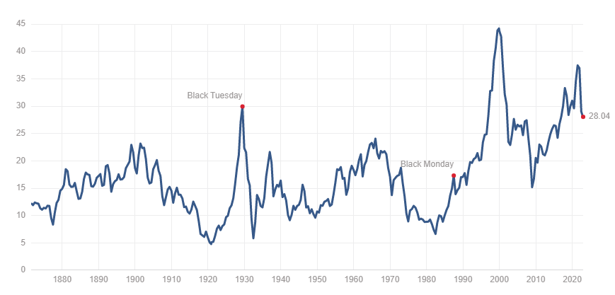
Investing After the Pandemic in 2023
Shiller P/E Ratio: 28.04 at the beginning of 2023
Source: multpl.com

Slide 26
Investing After the Pandemic in 2023
US Stocks Dropped 90% from 1929 to 1932
Japanese Stocks Dropped 80% from 1989 to 2009
This is why
diversification matters!!!

Slide 27
Investing After the Pandemic in 2023
Put 5% to retirement and $100 a month outside retirement no matter what
Then once you have no “bad debt”, a 6-month emergency fund,
and all short-term goals saved for,
then invest A LOT more on per month
automatically

Slide 28
Investing After the Corona Recession in 2021
Investing After the Pandemic in 2023
Biggest Caution Signs for the Market in 2023 and Beyond
Stocks Shiller P/E ratio is still very high,
meaning stocks aren’t exactly cheap even after a 20% drop
Taming inflation could spark a recession
Home prices could fall significantly

Slide 29
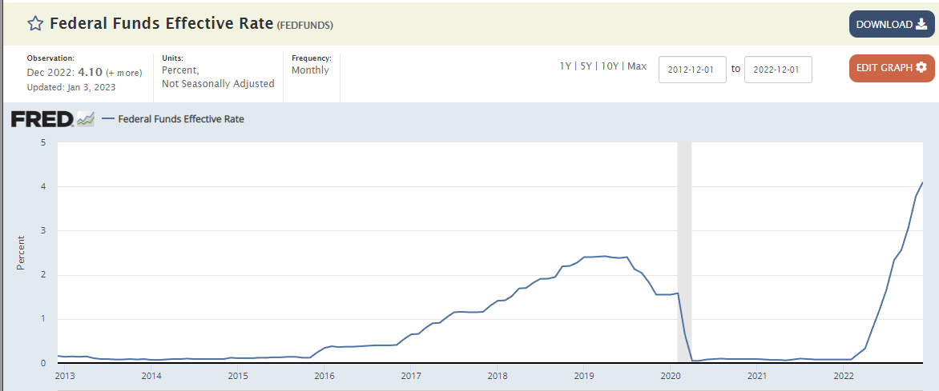
Investing After the Corona Recession in 2021
Investing After the Pandemic in 2023
Federal Reserve is trying to end inflation, but by tightening monetary policy, they could spark a recession, and possibly a serious one

Slide 30
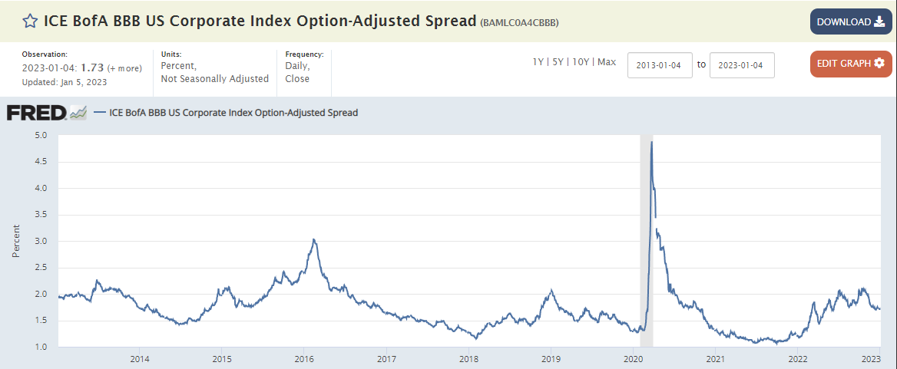
Investing After the Corona Recession in 2021
Investing After the Pandemic in 2023
This shows how much extra yield corporations with BBB credit rating must pay to borrow. It shows that credit risk fears are still modest. But that could change

Slide 31
Investing After the Corona Recession in 2021
Investing After the Pandemic in 2023
Biggest Caution Signs for the Market in 2023 and Beyond
Stocks Shiller P/E ratio is still very high,
meaning stocks aren’t exactly cheap even after a 20% drop
Taming inflation could spark a recession
Home prices could fall significantly

Slide 32
Investing After the Pandemic in 2023
The Bearish Case for Housing Prices
Mortgage rates are causing payments to become unaffordable
We’ve experienced a huge run up in prices during the pandemic
The Fed is trying to kill off inflation by throwing ice water on housing prices
A boom in new construction during the pandemic could force builders to move inventory at cheaper prices
Expiring pandemic era relief programs could cause consumers to fall behind on payments

Slide 33
Investing After the Pandemic in 2023
Why hasn’t housing fallen more?
We still have a very strong job market
Home builders didn’t go as crazy as they did in the 2000s
Most homeowners have a mortgage rate below 4% and won’t / can’t move, limiting supply
Recency bias leads many potential homeowners to still believe homeownership is a wise investment

Slide 34
Investing After the Pandemic in 2023
Why would a fall in housing prices affect stocks?
Homeowners tap their home equity for a huge percent of spending
If credit conditions tighten and home prices decline, banks won’t give home equity loans
Consumer spending could fall because of the wealth effect
Psychology: when homeowners become nervous about the value of their homes, it can lead to momentum for a recession

Slide 35
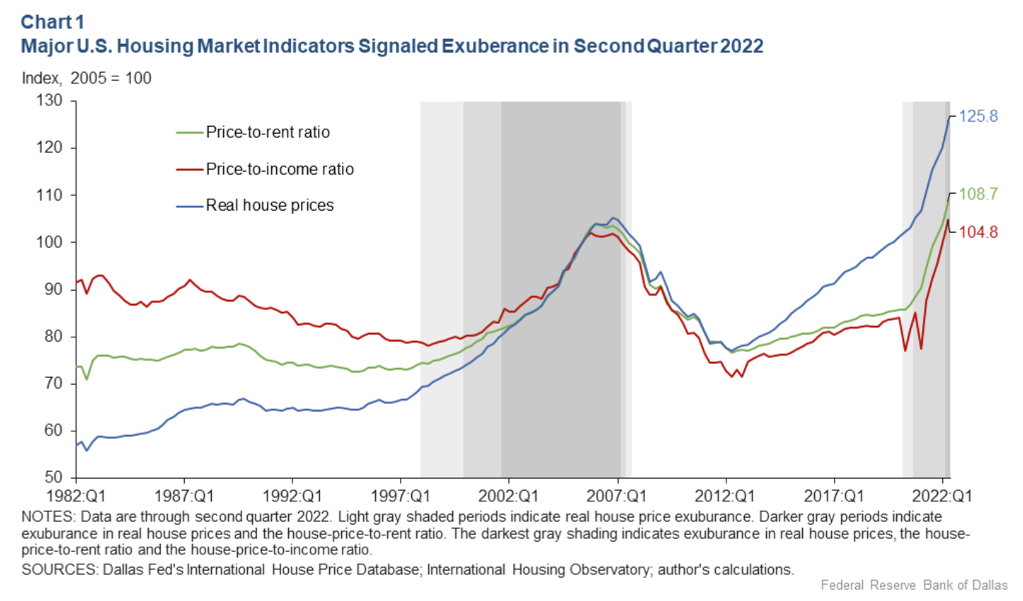
Investing After the Pandemic in 2023
The Bearish Case for Housing Prices

Slide 36
Investing After the Pandemic in 2023
But Remember!!
S&P 500 Index
PAST 40 Years
25x price returns,
64x total returns
including
dividends
Source: Google.com

Slide 37
Investing After the Pandemic in 2023
5 Action Steps to Take Now
1. Start with 5% into employer retirement plan and $100 a mo into taxable account
Then get 6 months of cash expenses + save for short term goals (also no credit card debt)
Then max out retirement account. Typically go with default investment option (target date fund)
Then increase taxable account contributions OR start paying
down loans that need to get paid off. Either one is ok.
Then try to increase income and invest more to reach financial freedom sooner
or optimize your lifestyle now

Slide 38
Investing After the Pandemic in 2023
Tips for Getting the Most Out of the Course
ASK QUESTIONS in each comment section
Join live webinars when we offer them, and listen to old ones when we post them
Actually take the time to watch the course videos
THANKS!

