Slide 1
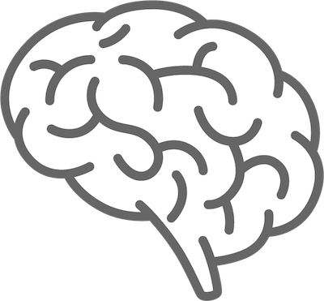
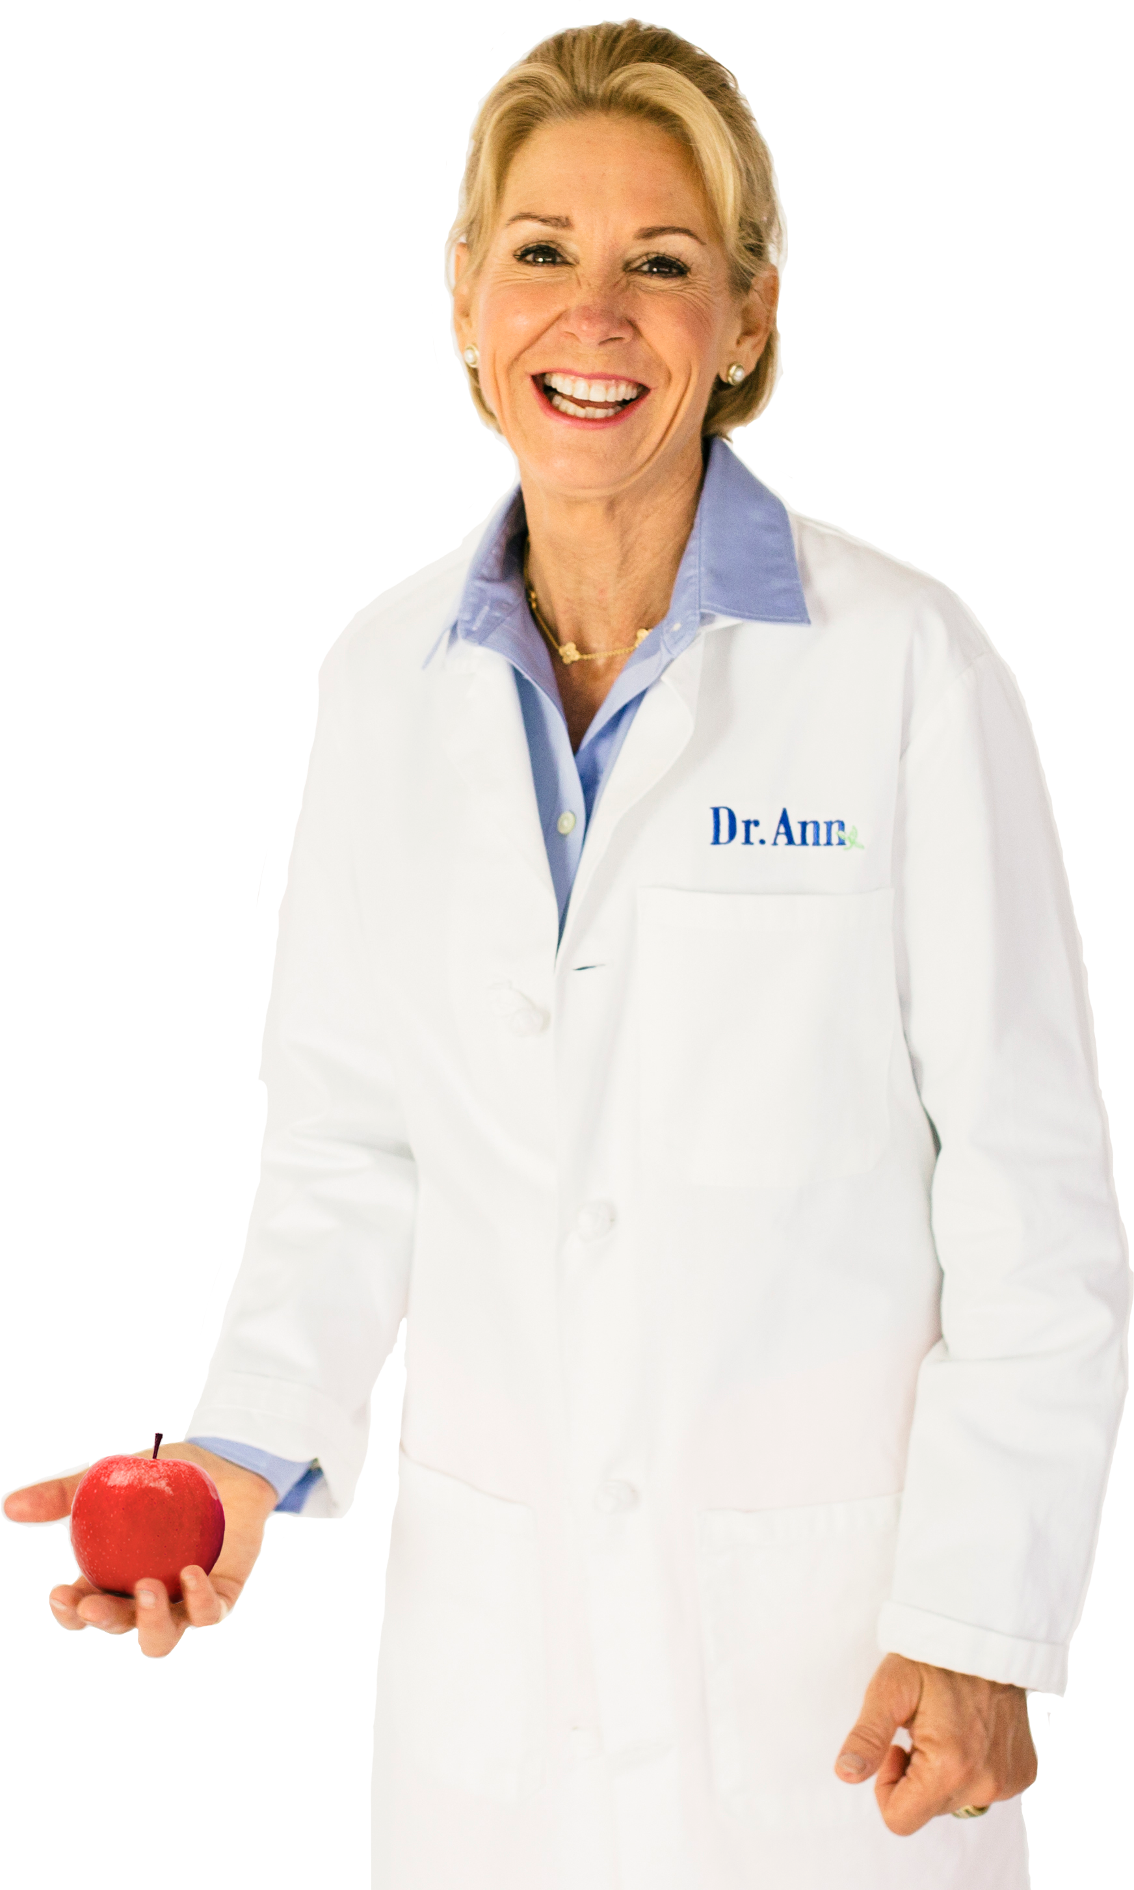
Could adding certain foods to your diet improve your memory?
Foods like Salmon rich in omega-3 fats called DHA can improve brain power.
Visit {INSERT LOCATION NAME} to learn more
from Dr. Ann with Eat Right for Life.
Dr. Ann

Slide 2

Plant-based foods are loaded with disease-fighting agents called phytochemicals that can turn bad
genes off and
good genes on.
Dr. Ann
WELLNESS

Slide 3
Learn what foods offer the most of these life-saving compounds by visiting {INSERT LOCATION NAME} to learn more from Dr. Ann with
Eat Right for Life.
Dr. Ann
WELLNESS

Slide 4
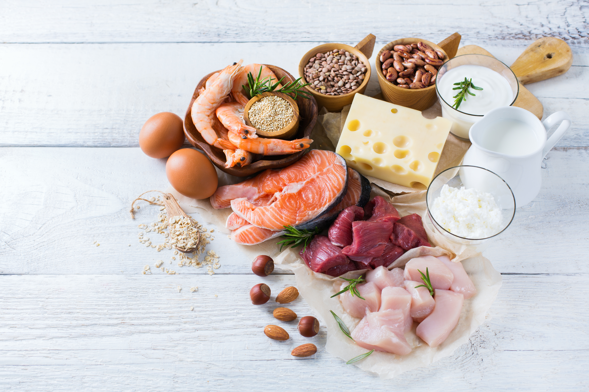
Did you know that protein is Mother Nature’s “Diet Pill”?
Visit {INSERT LOCATION NAME} to learn more from Dr. Ann with Eat Right for Life.
Dr. Ann
WELLNESS

Slide 5
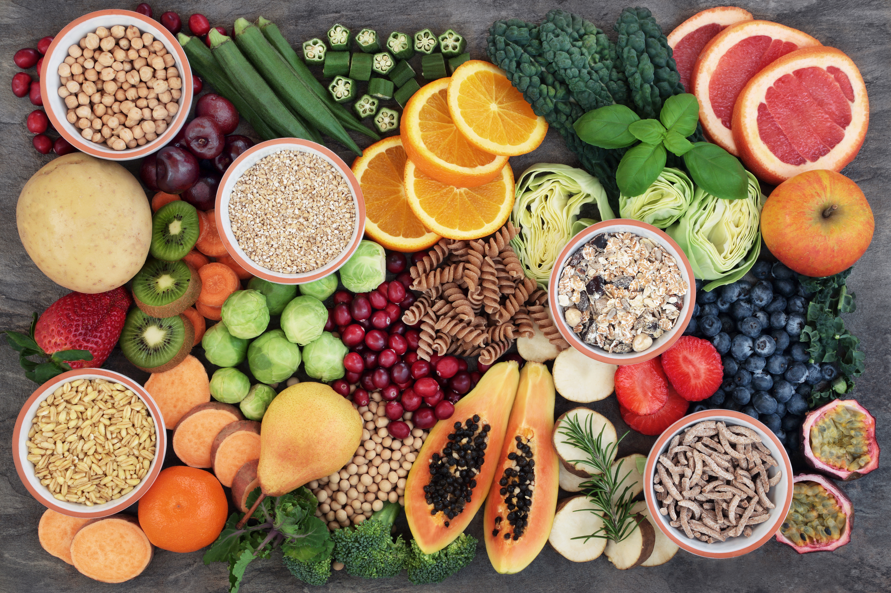

FIBER IS THE ROCK STAR OF ALL NUTRIENTS.
It can protect you from heart disease, diabetes, cancer, and dramatically
improve your weight control.

Slide 6
Learn how to BE SURE you are getting enough of this life-giving agent by visiting {INSERT LOCATION NAME} program, Eat Right for Life, by Dr. Ann.

Slide 7
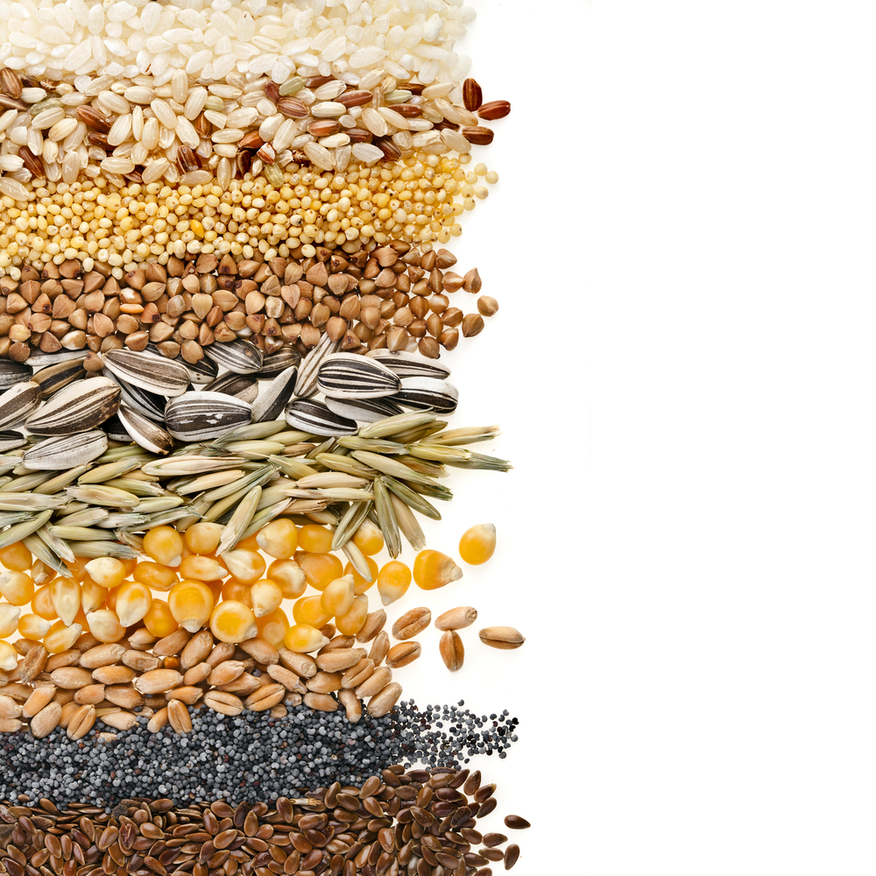

WHOLE GRAINS are
one of the very BEST
FOODS for preventing
and fighting DIABETES.
Learn how delicious and easy it is to eat more whole grains by visiting {INSERT LOCATION NAME} to learn more from Dr. Ann with Eat Right for Life.

Slide 8
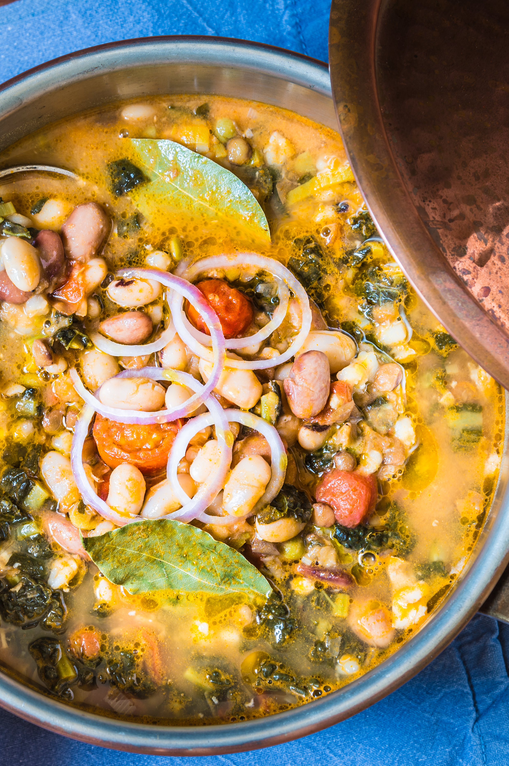
Beans are one of the top foods for brain health, heart heath, weight control and diabetes protection.
Tune into {INSERT LOCATION NAME} to learn more from Dr. Ann with
Eat Right for Life.

Slide 9
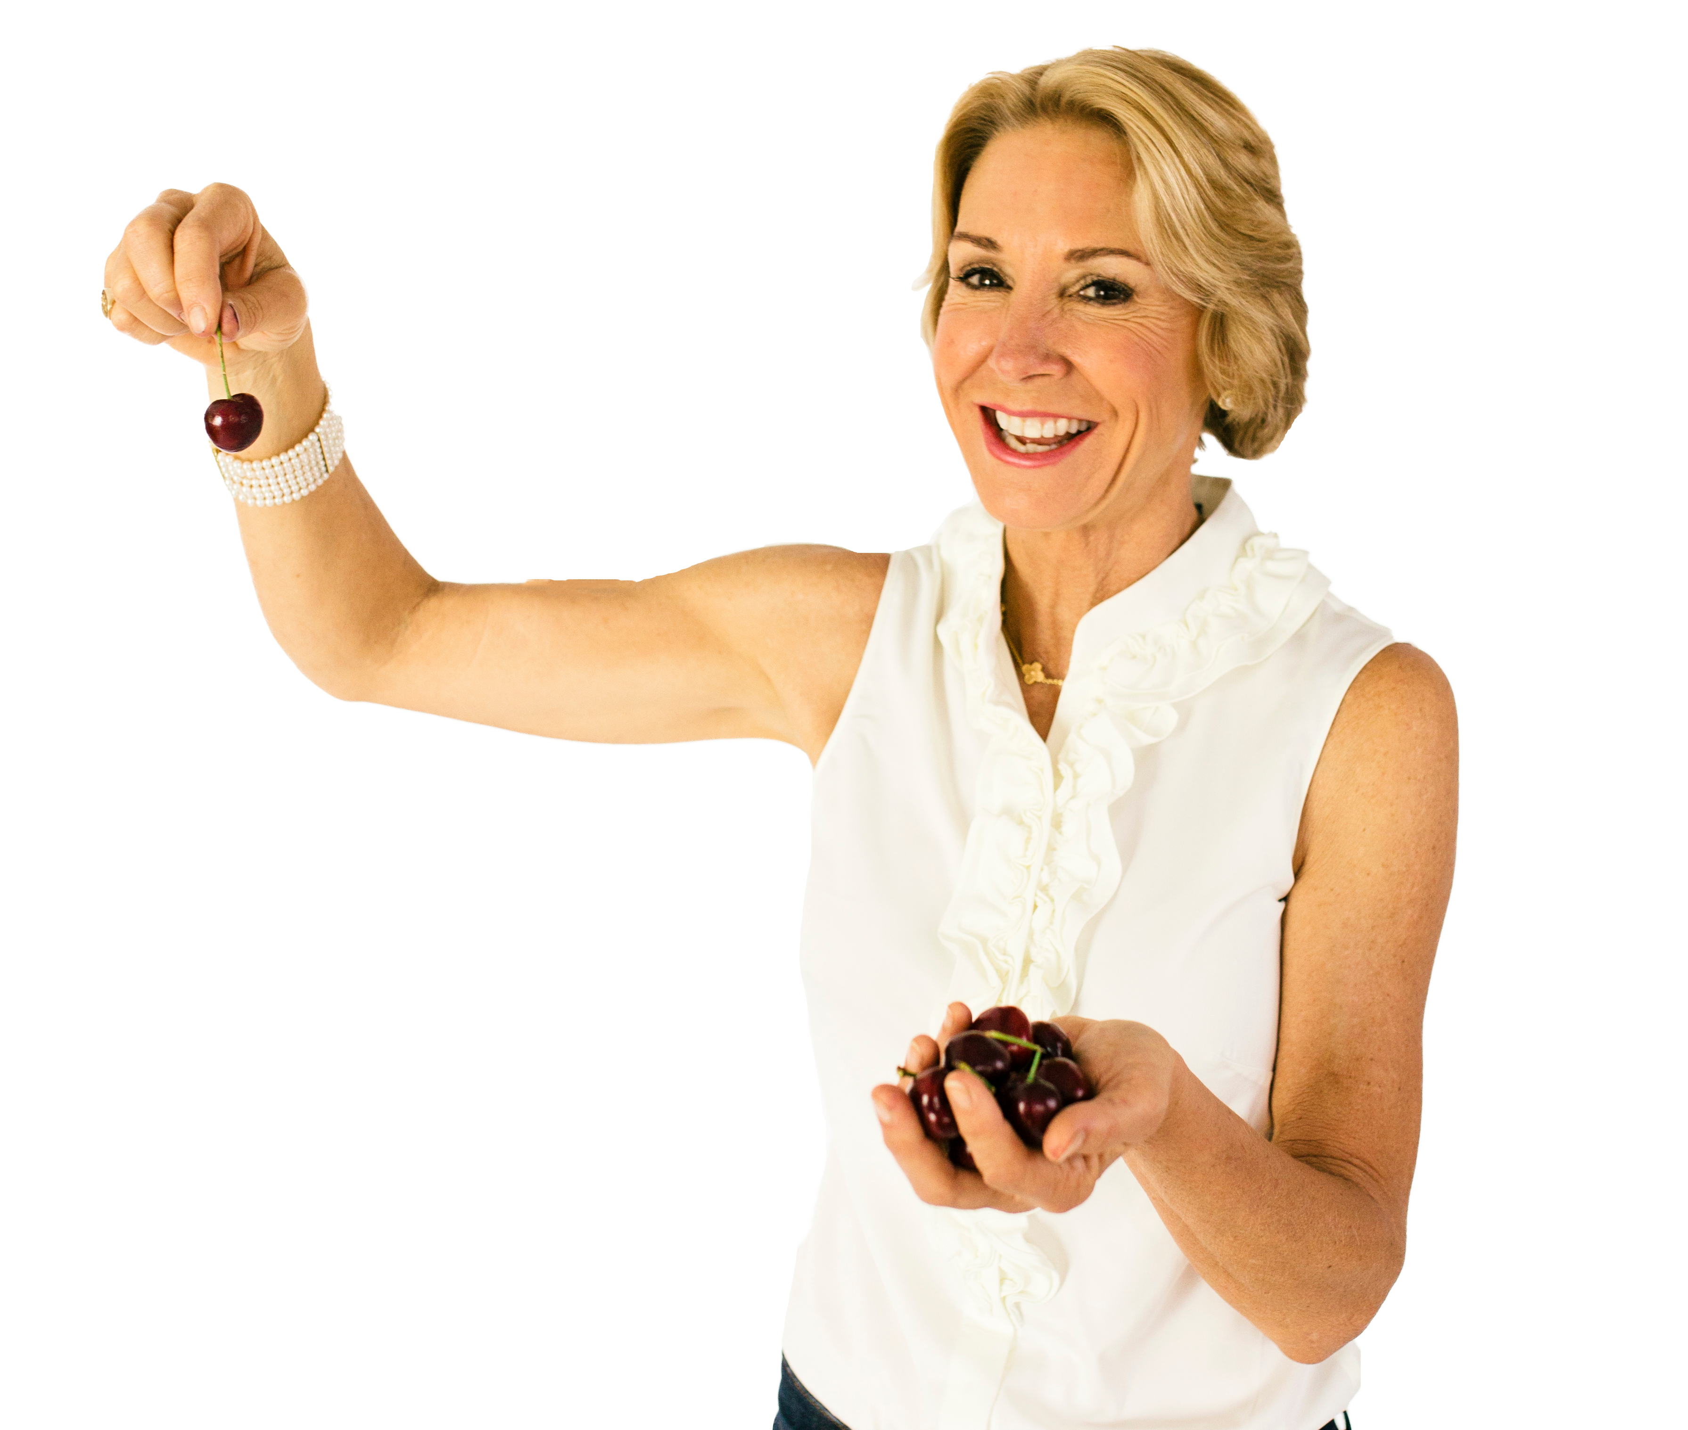
Inflammation is a key driver of our most deadly diseases.
Thankfully, there are loads of delicious foods that offer up a big dose of anti-inflammatory
P O W E R.
Visit {INSERT LOCATION NAME} to learn more from Dr. Ann with Eat Right for Life.
Dr. Ann
WELLNESS

Slide 10

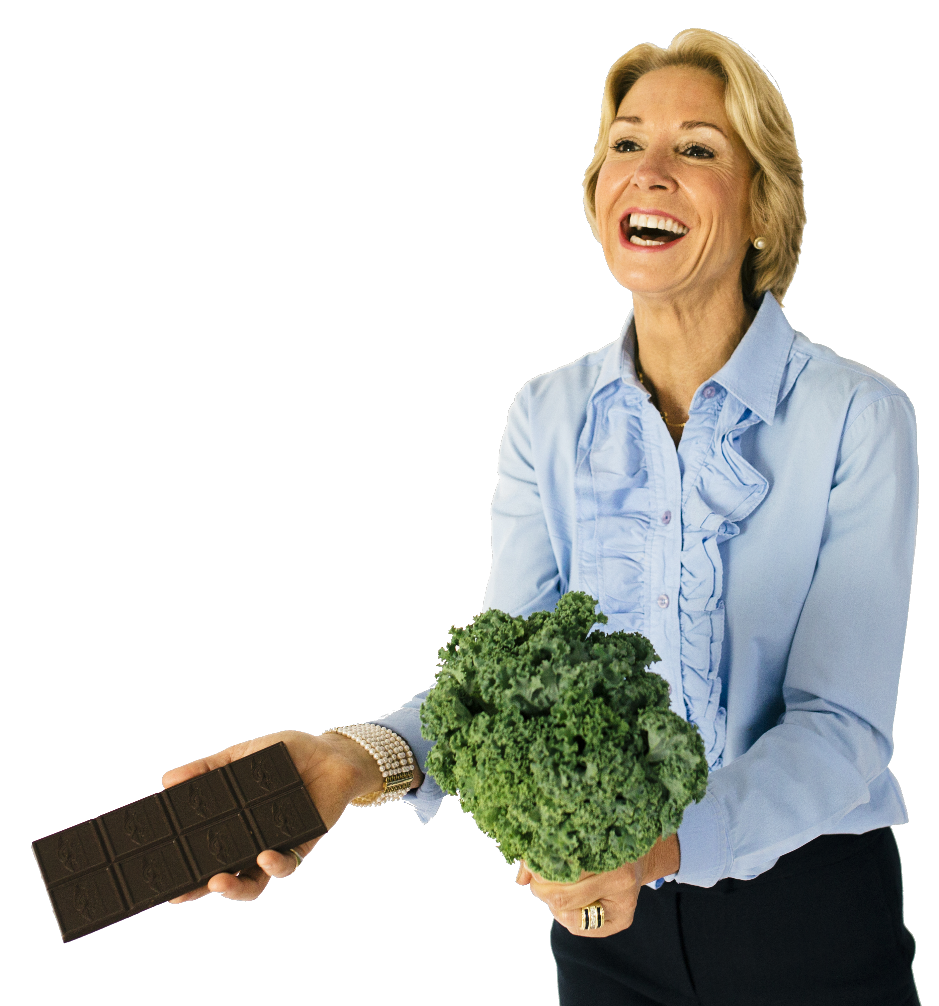
Dark chocolate is truly a healthy dessert.
It is great for your heart and your brain.
Learn more by visiting {INSERT LOCATION NAME} to learn more from Dr. Ann with Eat Right for Life.

Slide 11

Dark chocolate
is truly a
healthy
dessert.
It is great for your heart and your brain.
Learn more by visiting {INSERT LOCATION NAME} to learn more from Dr. Ann with Eat Right for Life.

Slide 12
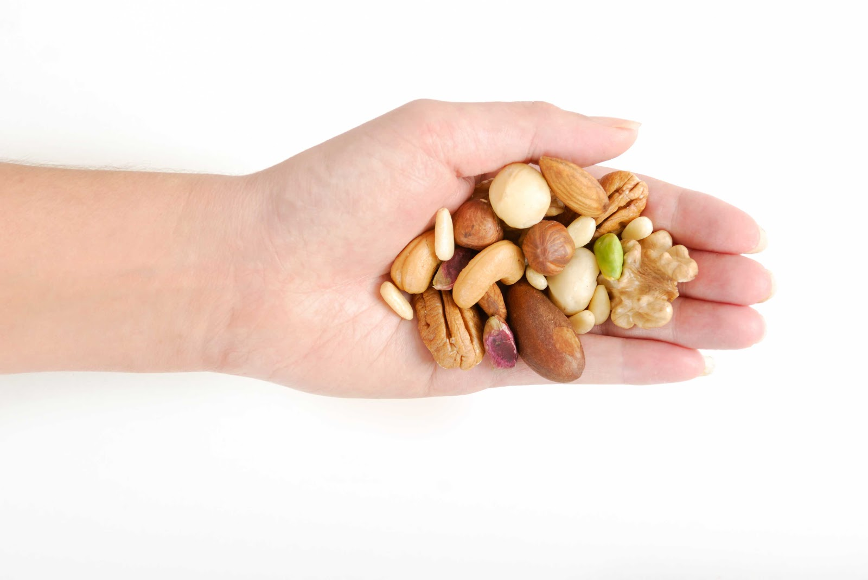
Did you know that consuming a handful of nuts daily can slash your risk of death from heart disease and improve your weight control?
Visit {INSERT LOCATION NAME} to learn more from Dr. Ann with
Eat Right for Life.
Dr. Ann
WELLNESS

Slide 13

The foods you eat have a profound impact on your happiness and mental well-being.
Learn what the very best “feel good foods” are by visiting {INSERT LOCATION NAME} to learn more from Dr. Ann with Eat Right for Life.

Slide 14
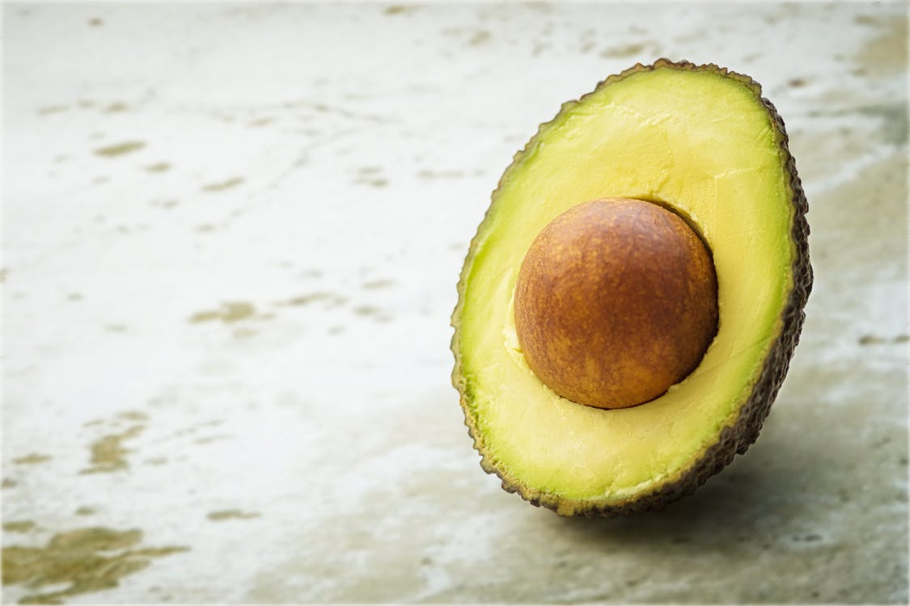
Eating the “healthy fats” is one of the most powerful steps you can take to boost your heart health, your brain health, and improve your weight control.
Learn more by visiting {INSERT LOCATION NAME} to learn more
from Dr. Ann with Eat Right for Life.

Slide 15
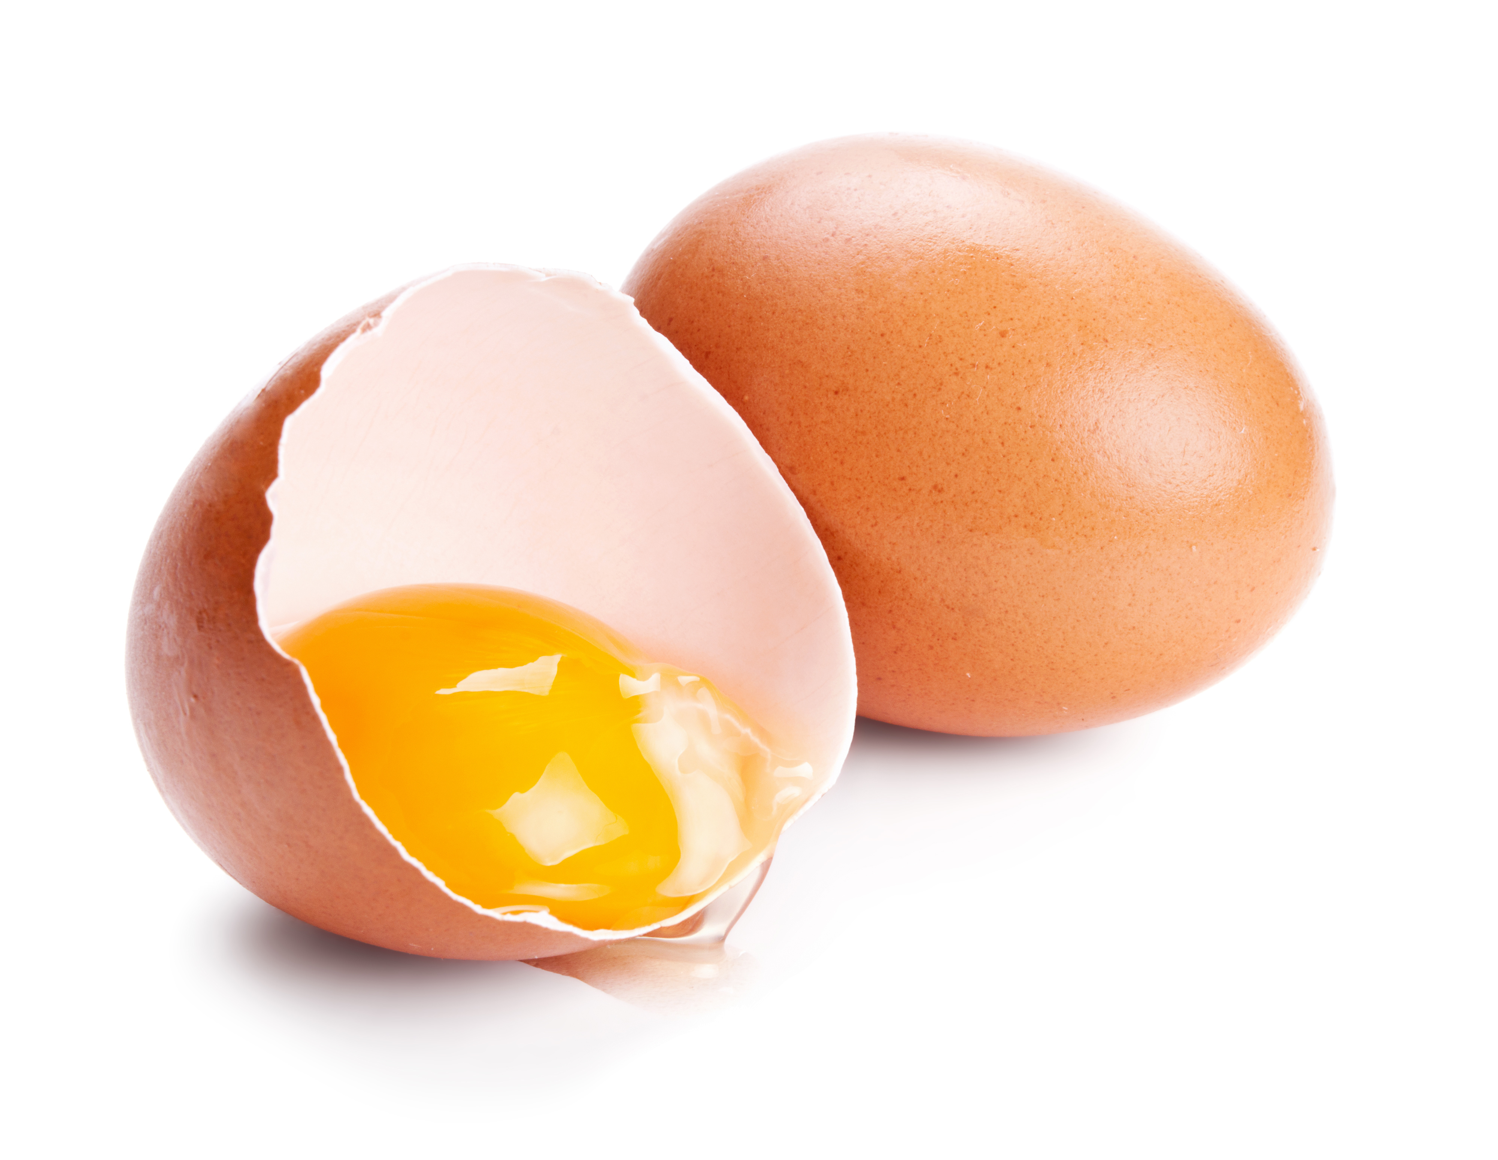
Visit {INSERT LOCATION NAME} to learn more
from Dr. Ann with
Eat Right for Life.
Learning how to “power up” with the best proteins is an indispensable strategy for boosting your energy and
your vitality.

Slide 16
Visit {INSERT LOCATION NAME} to learn more
from Dr. Ann with
Eat Right for Life.
Learning how to “power up” with the best proteins is an indispensable strategy for boosting your energy and
your vitality.
“Power Up”
with the Best Proteins
Dr. Ann
WELLNESS

Slide 17
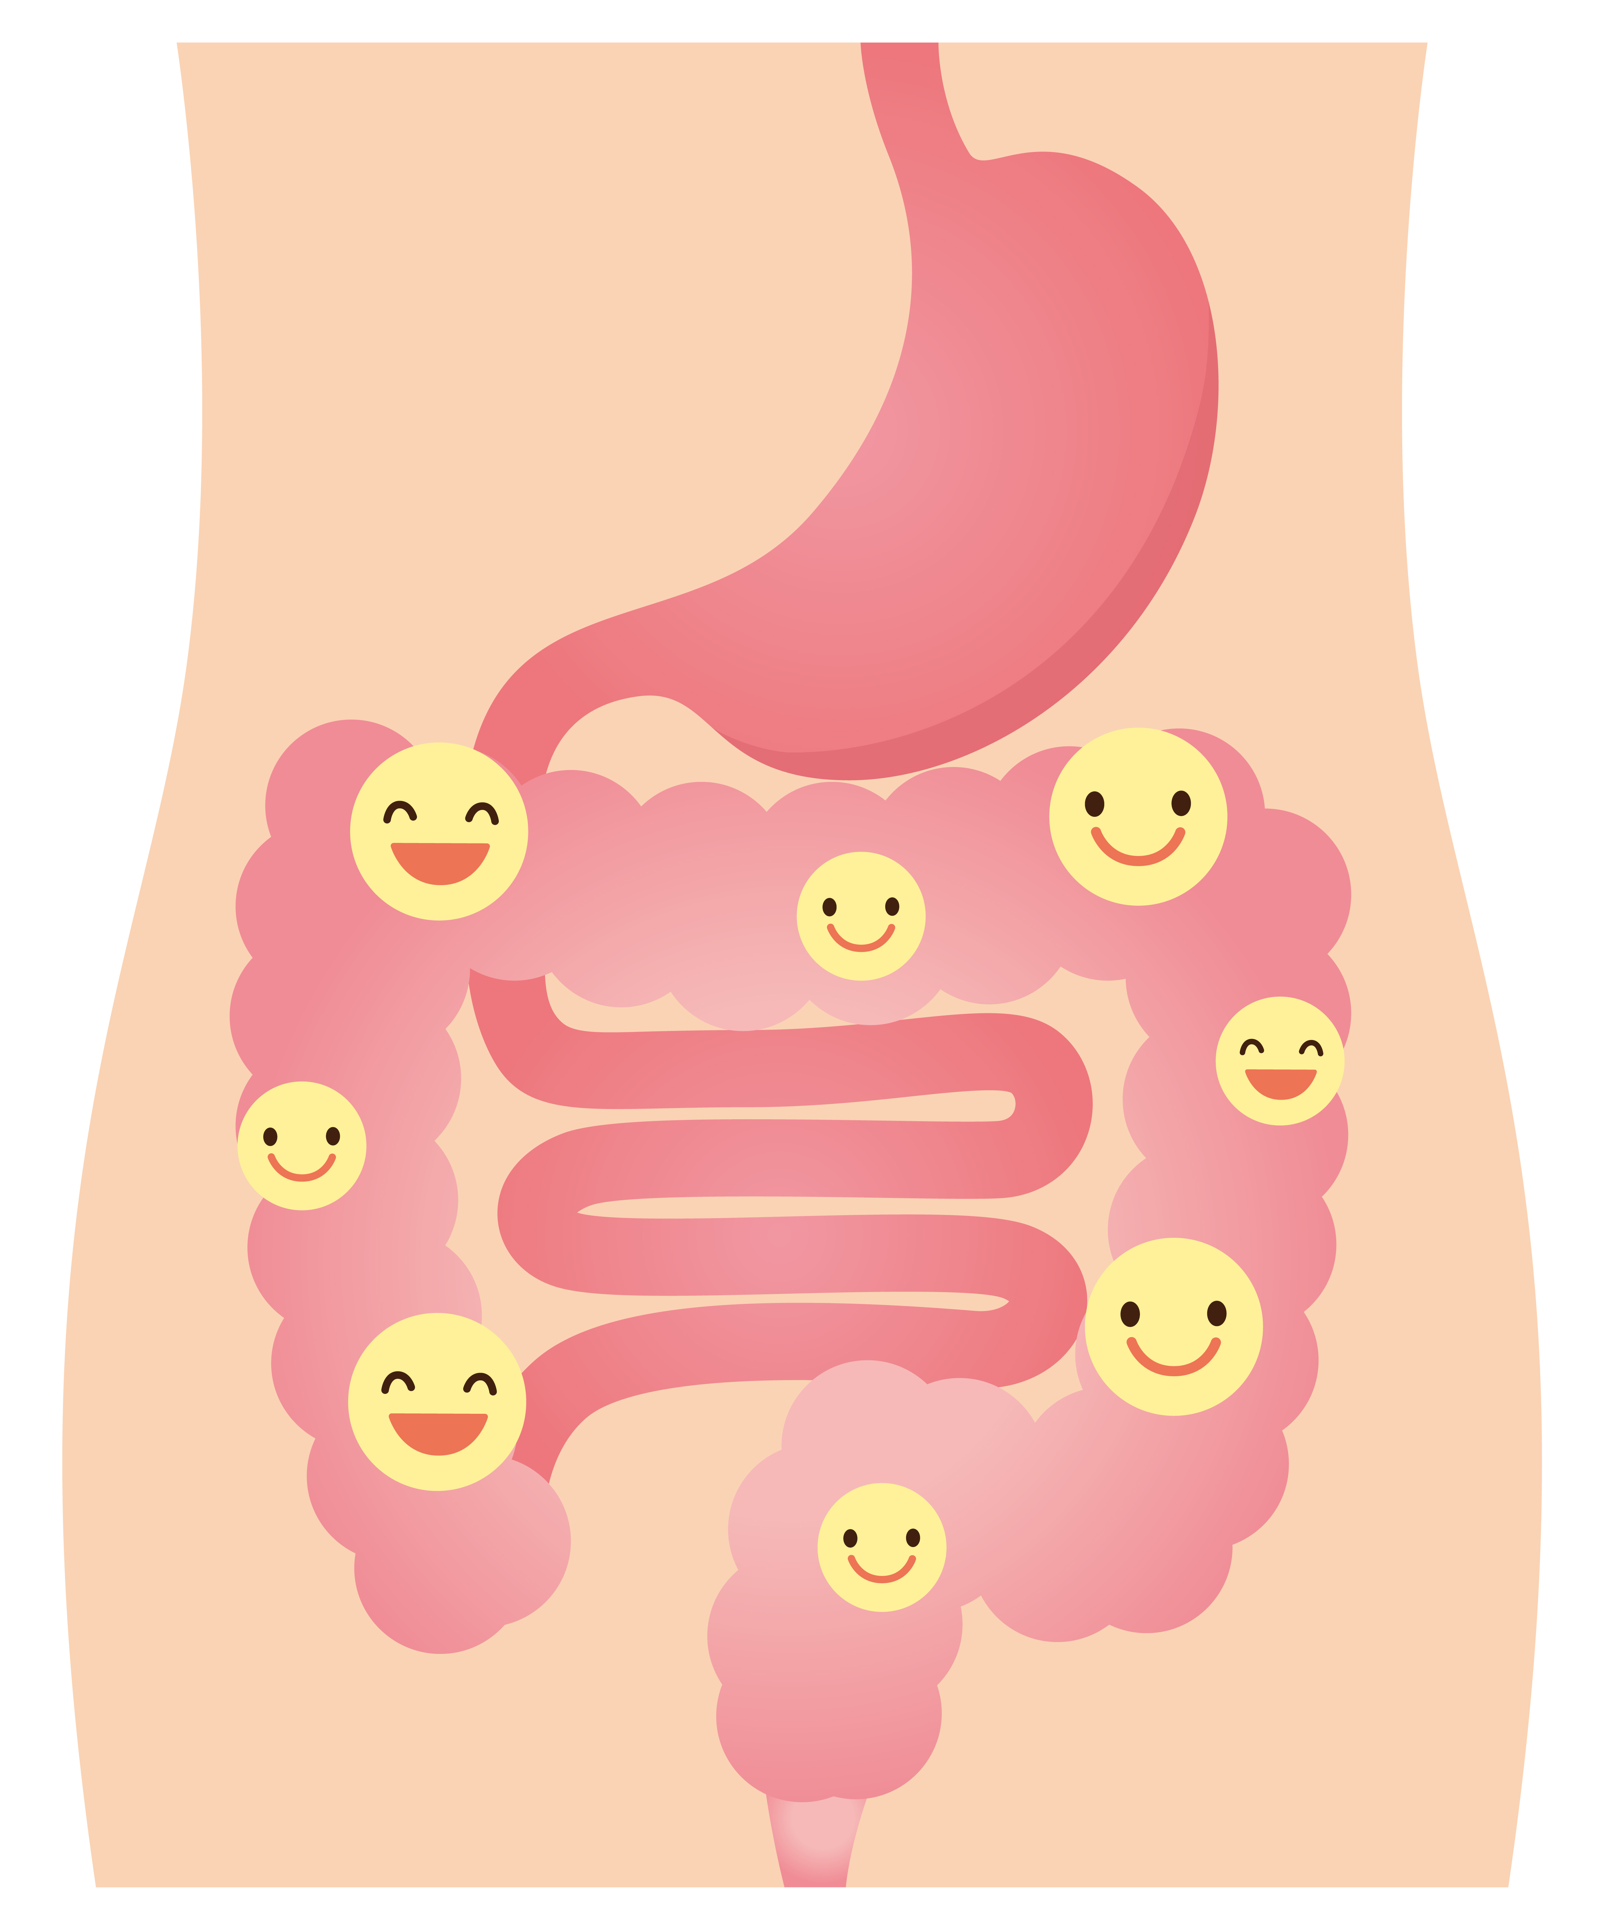
The good bacteria that reside in your gut define your health destiny.
They are your most valuable partner in health and healing!

Slide 18
Learn how to nurture and feed them properly so you can thrive!
Visit {INSERT LOCATION NAME} to learn more from Dr. Ann with Eat Right for Life.

