Slide 1
Build a business in 10 days
Day 2: Entrepreneurship
Presented to you by founders, Kayla, Keagan, & Ashley Serverius

Slide 2
Welcome Back!
Let's get started with Day 2!

Slide 3
In today's lesson,
you will be learning the definition of entrepreneurship, stats on teenpreneurs, & steps for starting a business.

Slide 4
Agenda
01
Definitions of
Entrepreneurship
02
Teenpreneur Stats
03
Business Steps
04
Homework

Slide 5
Definition of Entrepreneurship
01

Slide 6
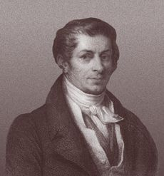
WHERE DOES THE TERM COME FROM?
The term entrepreneur is typically attributed to a well-known economist, John Baptiste Say. The French term comes from the word, entreprendre, meaning "to undertake."

Slide 7
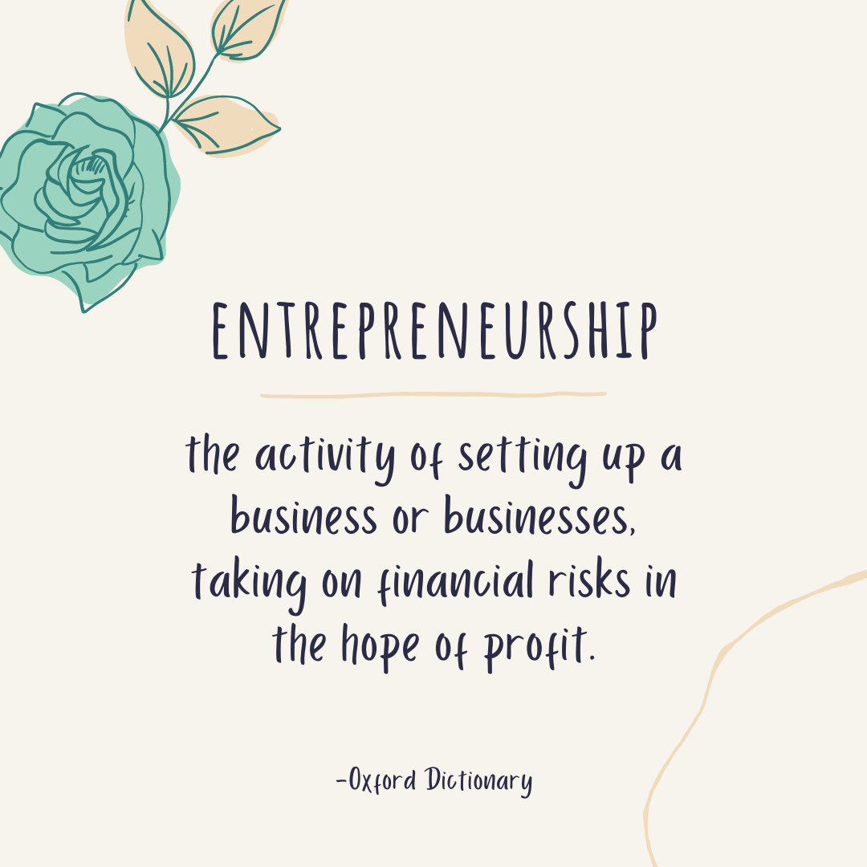
ACCORDING TO OXFORD...

Slide 8
ACCORDING TO OUR FELLOW YOUNG ENTREPRENEURS...

Slide 9
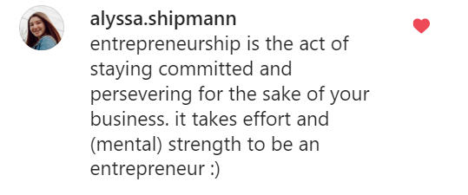

Slide 10
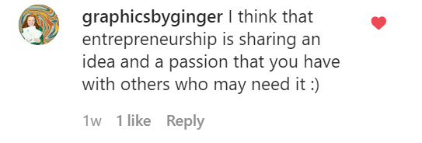

Slide 11
Teenpreneur
Stats
02

Slide 12
Did you know?
41%
57%
of kids and teens
dream of being an entrepreneur.
of those young CEOs will cite funding as their #1 struggle.

Slide 13
93% of successful entrepreneurs started as kids.
-Inc.com

Slide 14
Starting a business as a teen has so many advantages! For one, you have much more time to devote to your interest! Young entrepreneurs are also more creative, proactive, and passionate.
ADVANTAGES

Slide 15
THE GOAL OF ENTREPRENEURSHIP?
HELP PEOPLE
+
MAKE
MONEY

Slide 16
Business
Steps
03

Slide 17
BUSINESS
STEPS
Find your motivation
Ideation
Business name
Monetization
Funding
Pitch
Launch
Assessment

Slide 18
Don't worry. We are going to discuss each of these steps in detail.

Slide 19
Homework
04

Slide 20
HOMEWORK
BaB Workbook Day 2: What is your definition of an entrepreneur?

Slide 22
See you tomorrow!
hello@kideverest.com
www.kideverest.com
kid.everest

