Slide 1
Recycling & Saving our Planet

Slide 2
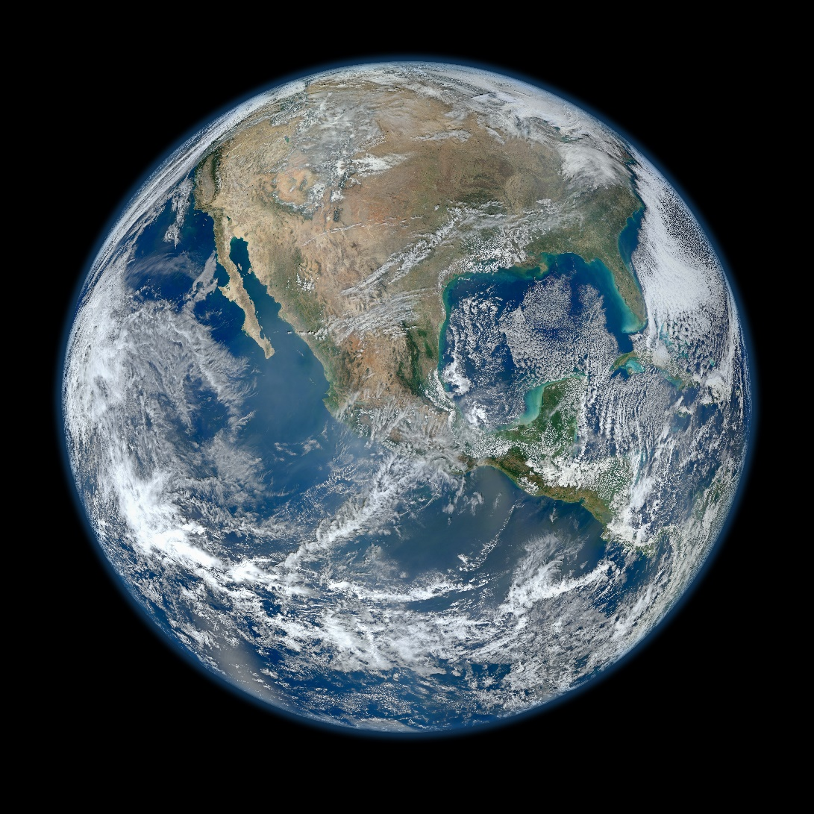
Earth is the planet we live on.

Slide 3
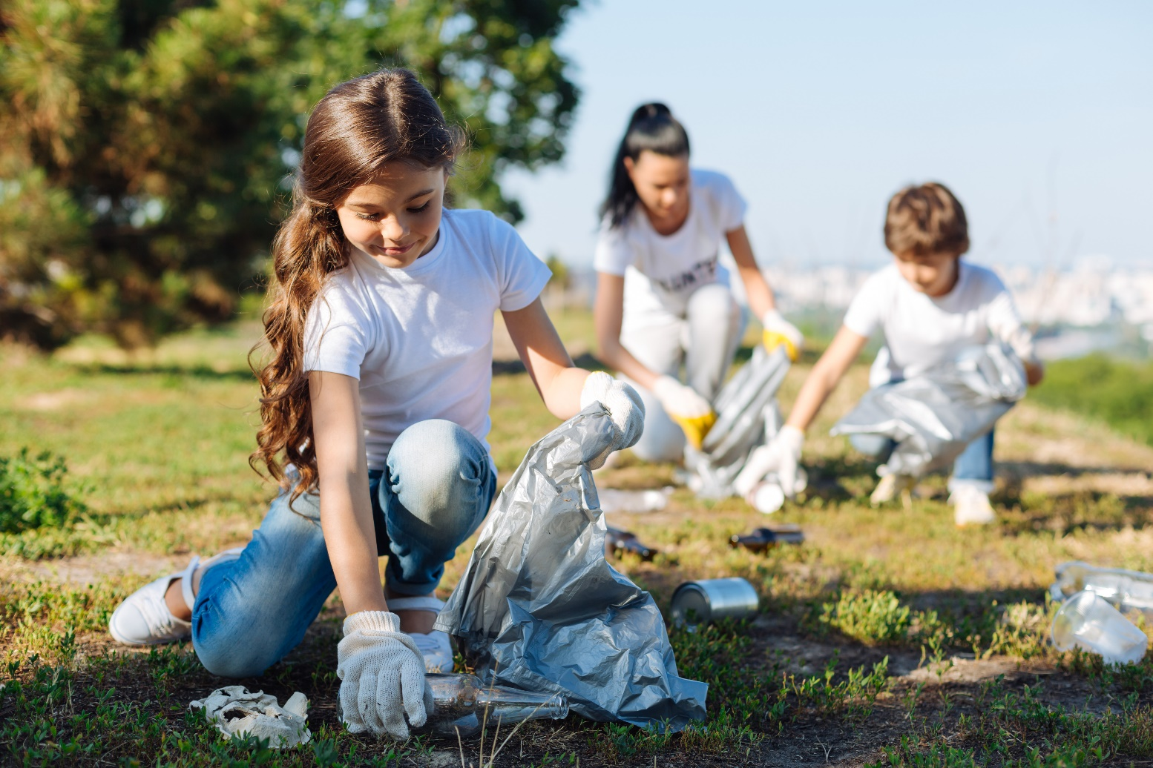
As humans, it is our job to take care of the Earth as best as we can so it can stay healthy for a long time.

Slide 4
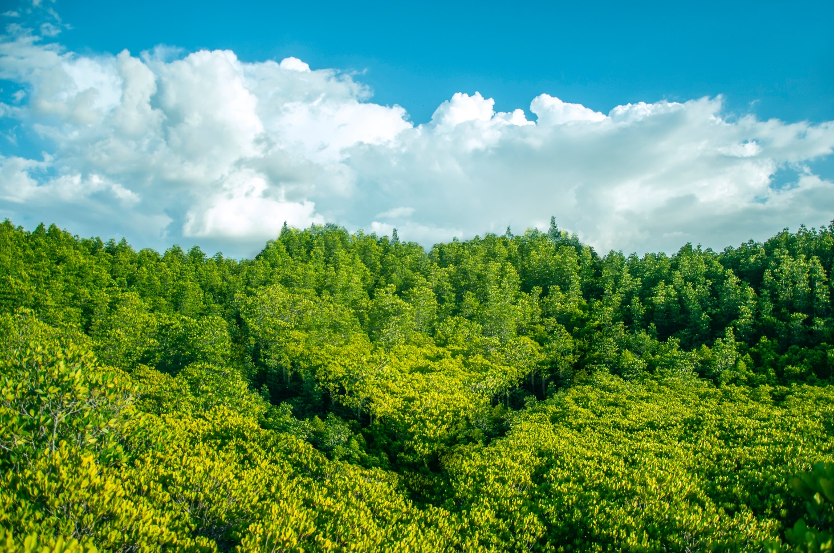
The environment is the world around us, everything we can see.

Slide 5
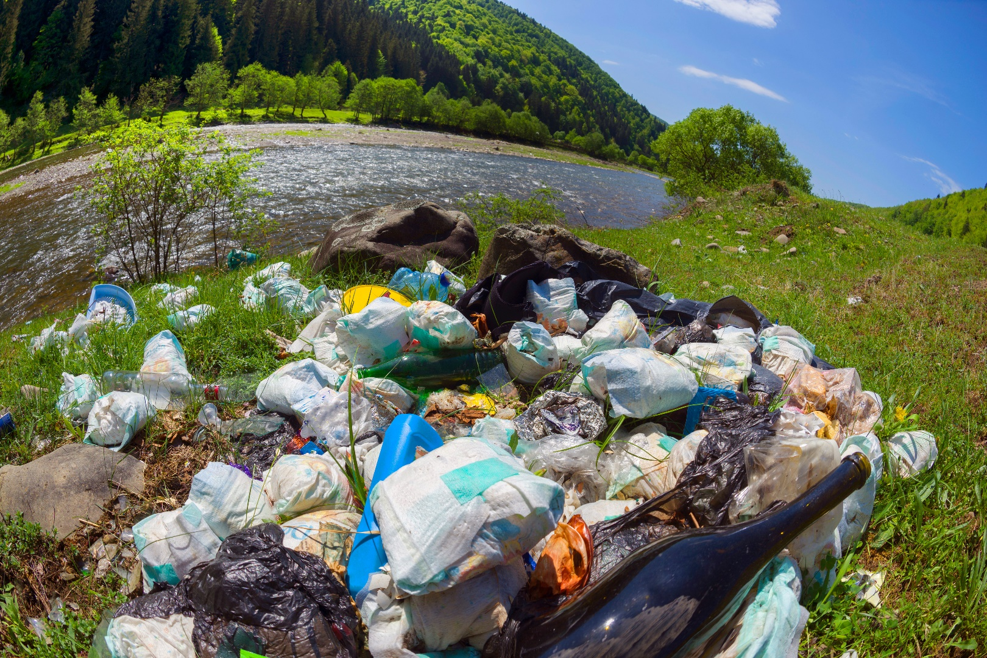
When our environment is dirtied by trash, chemicals, and waste, it is called pollution.

Slide 6
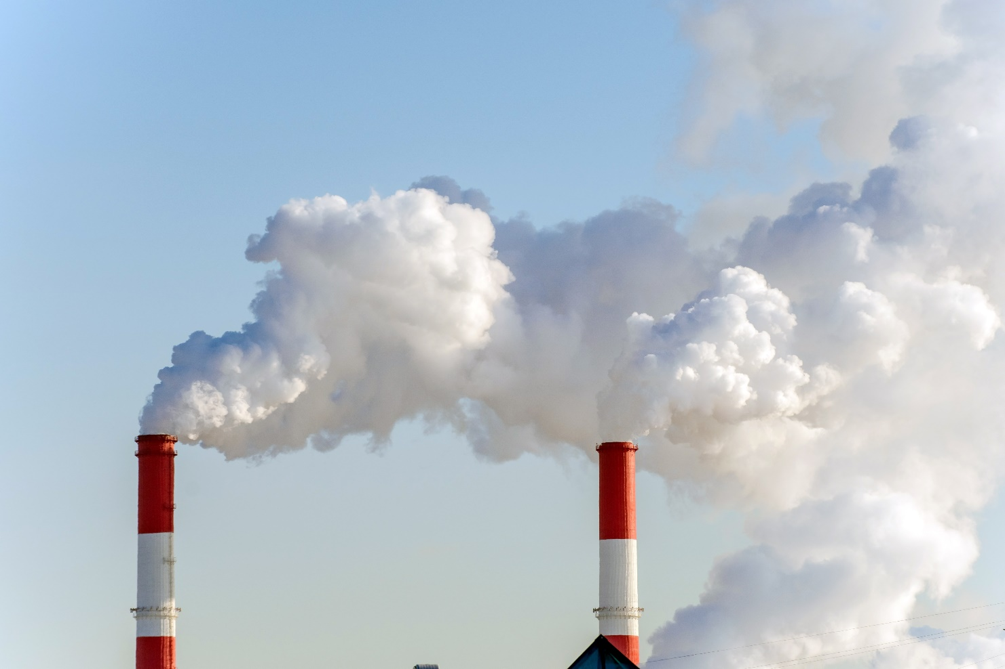
Air pollutants are causing more and more people to get sick from breathing it in.

Slide 7
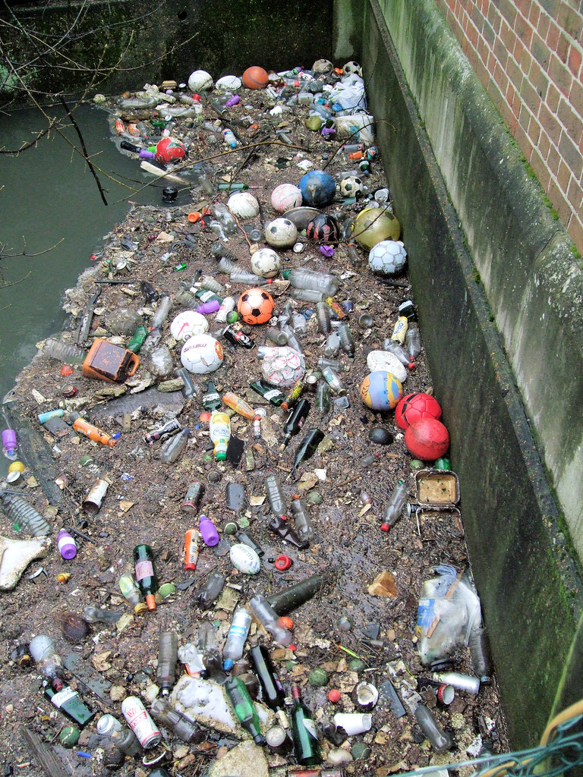
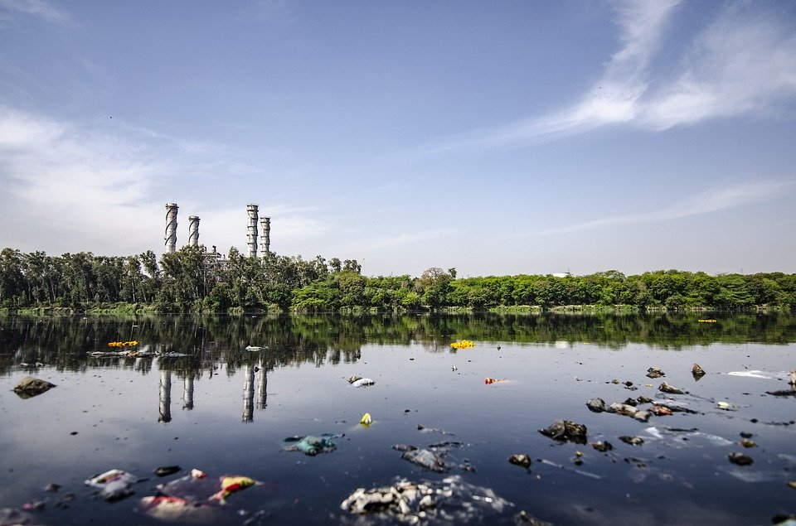
Every year millions of pounds of sewage and waste are dumped into U.S. water.

Slide 8
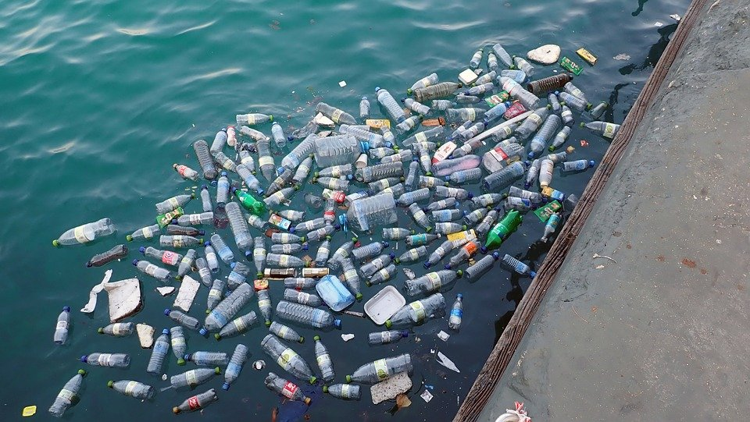
Pollution (chemical and plastic) in our oceans are causing sea animals to die or become sick or hurt by mistaking them for food.

Slide 9
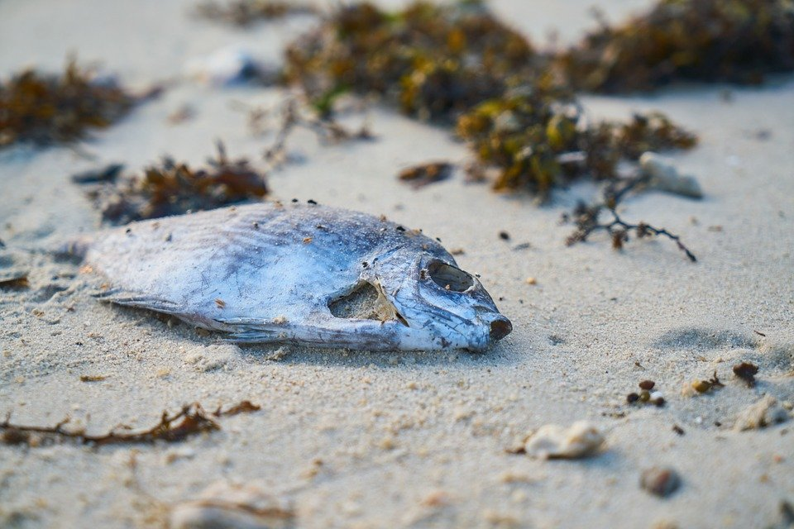
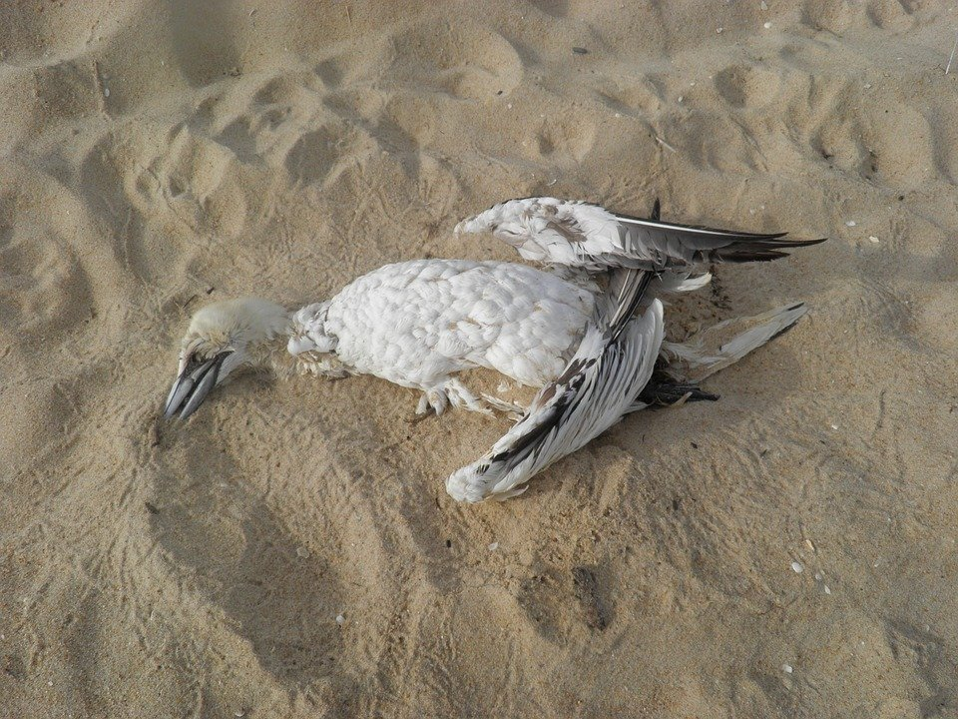
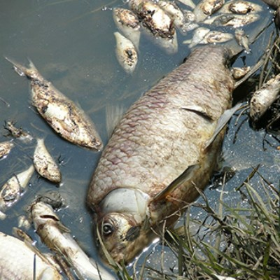
Over 1 million sea birds and sea mammals die every year because of pollution.

Slide 10
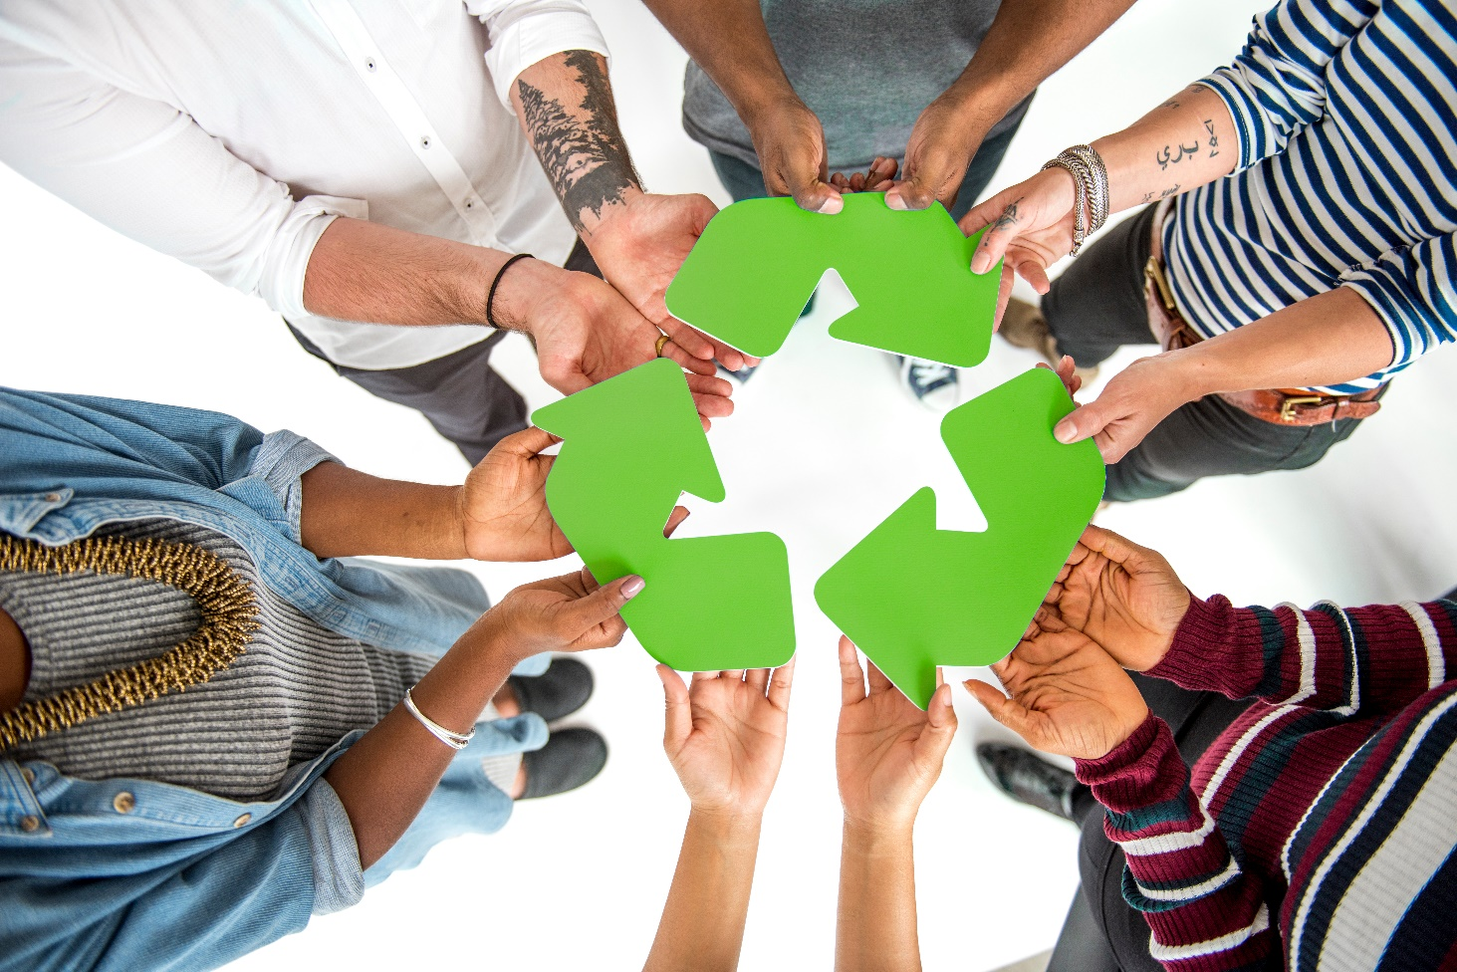
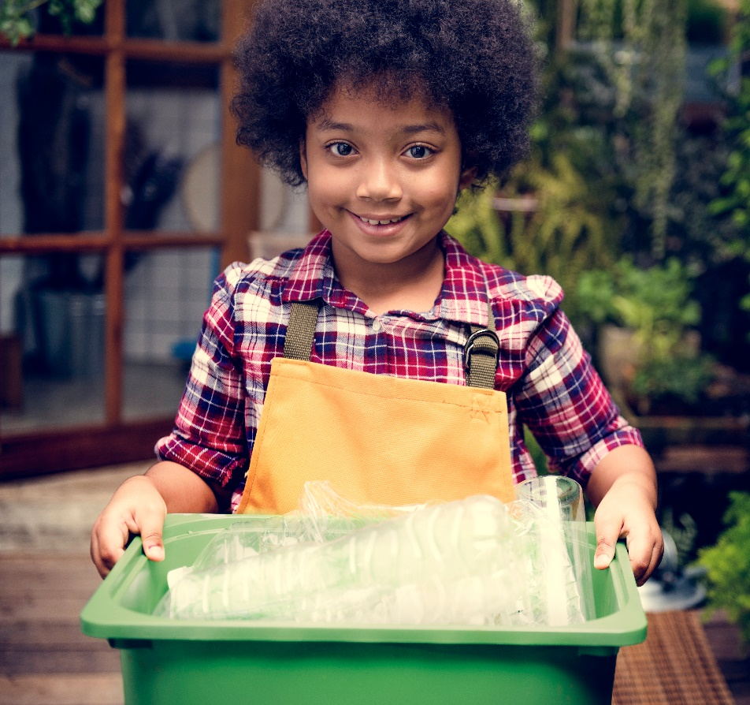
We can help keep our planet healthy by recycling.

Slide 11
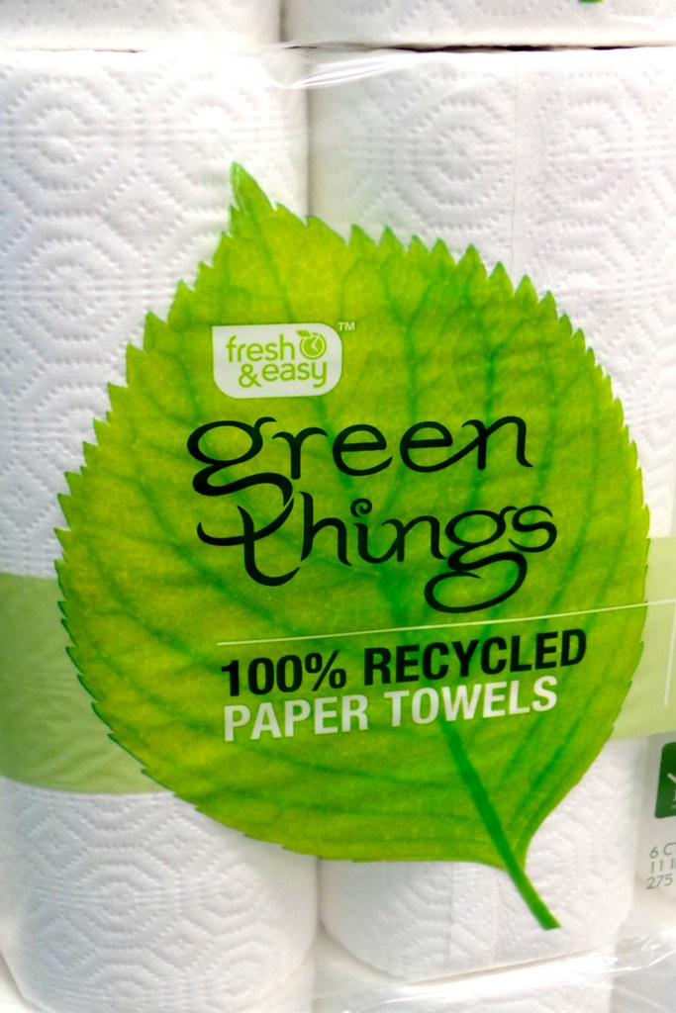
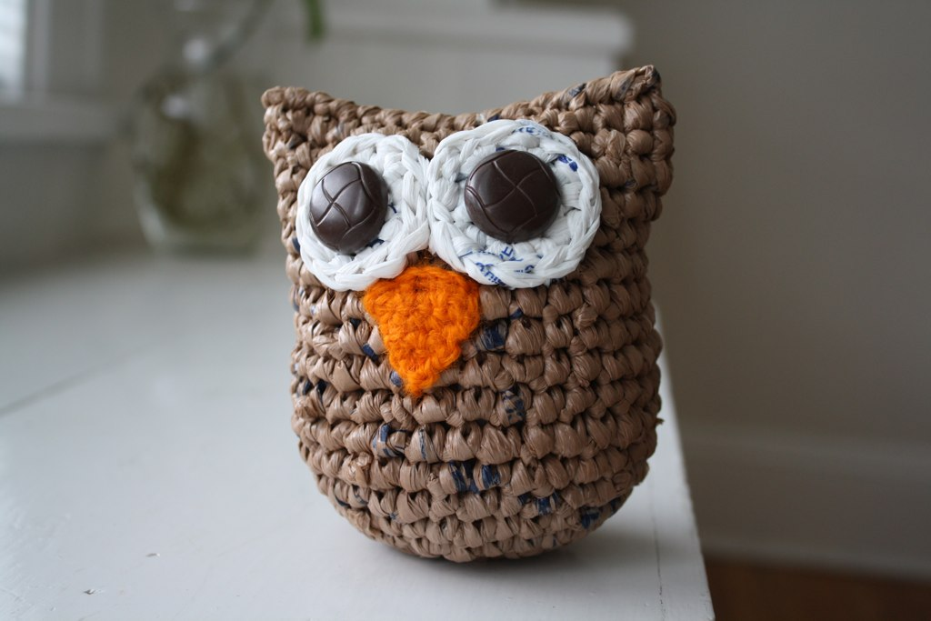
Recycling is when we can turn waste into materials that can be reused.
Made of recycled materials!

Slide 12
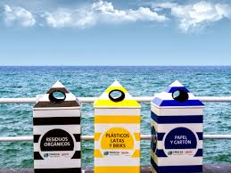
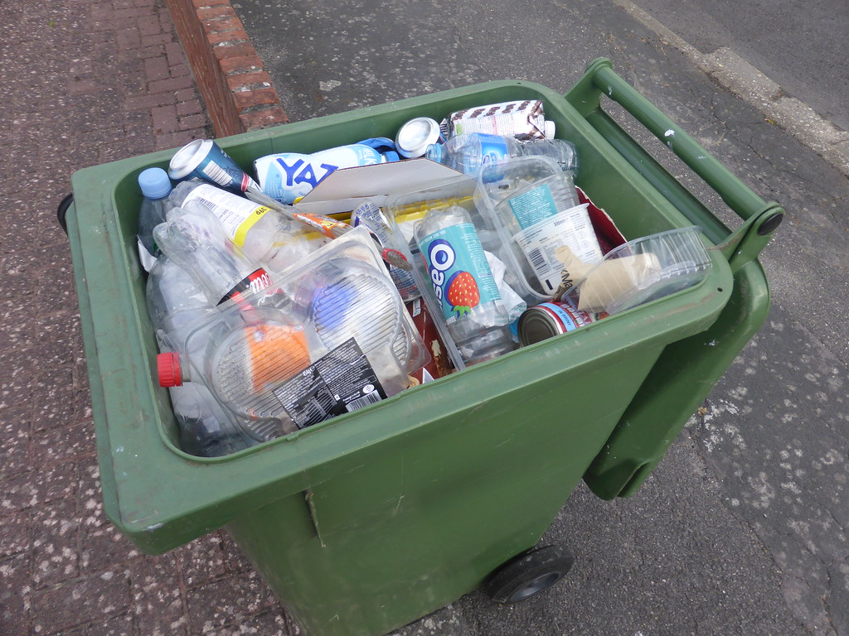
You can recycle things like plastic bottles, paper, metal containers, and glass bottles/jars.

Slide 13
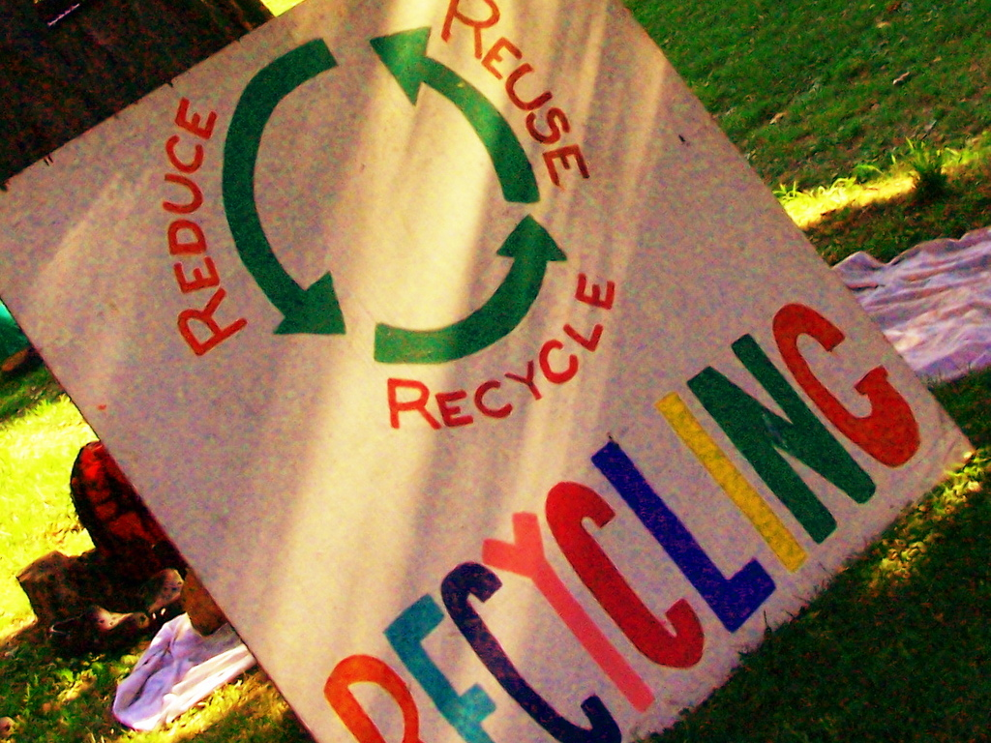
Recycling prevents millions of pounds of materials from being disposed of. We NEED to recycle to help our planet survive.

Slide 14
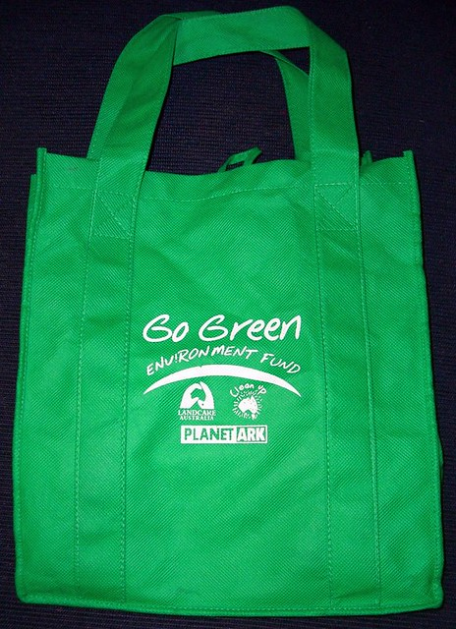
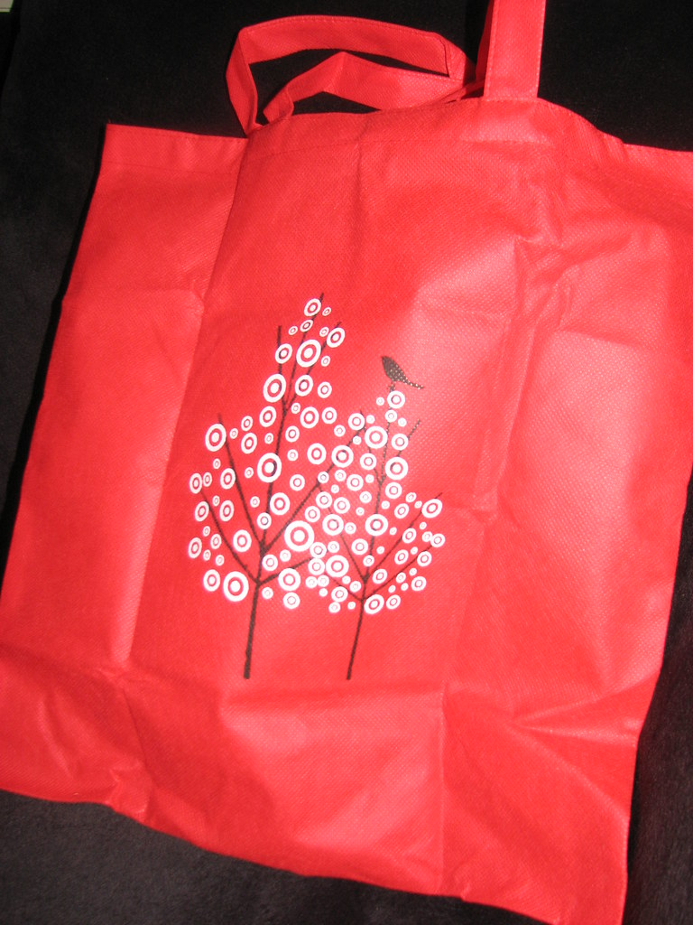
Try to use less plastic. When you go grocery shopping, use reusable bags instead of plastic shopping bags.

Slide 15
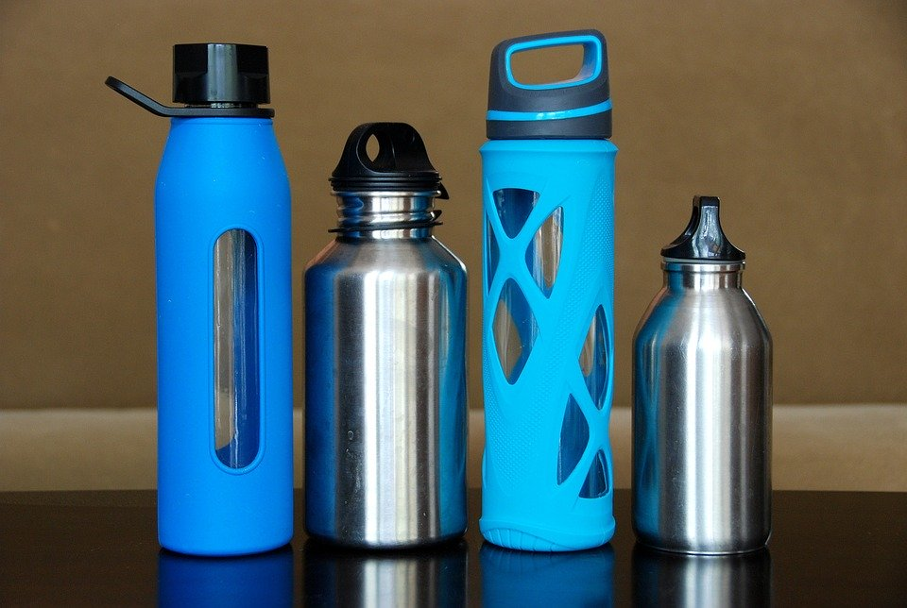
Use a reusable water bottle. If you can’t, make sure you recycle your plastic water bottle.

Slide 16
We can also try to reduce our waste. Waste is anything we throw away that does not get used.

Slide 17
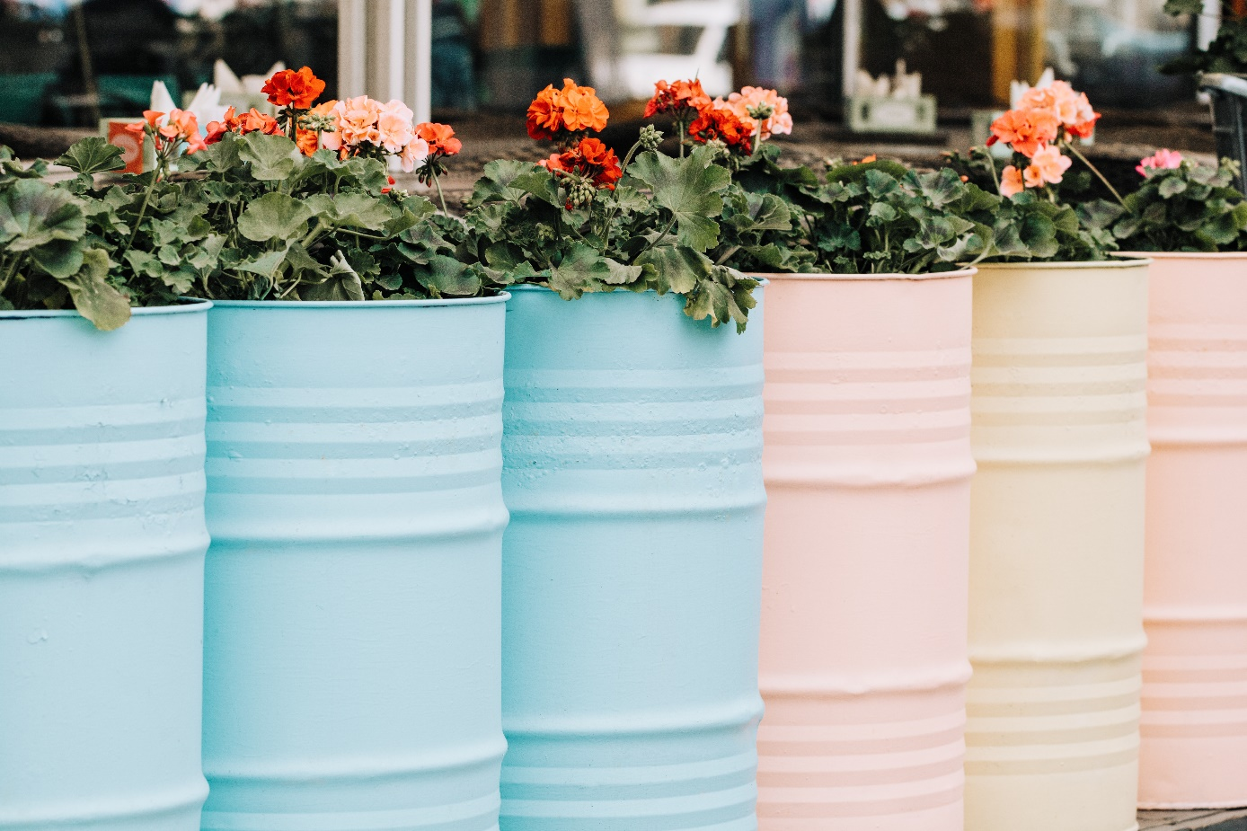
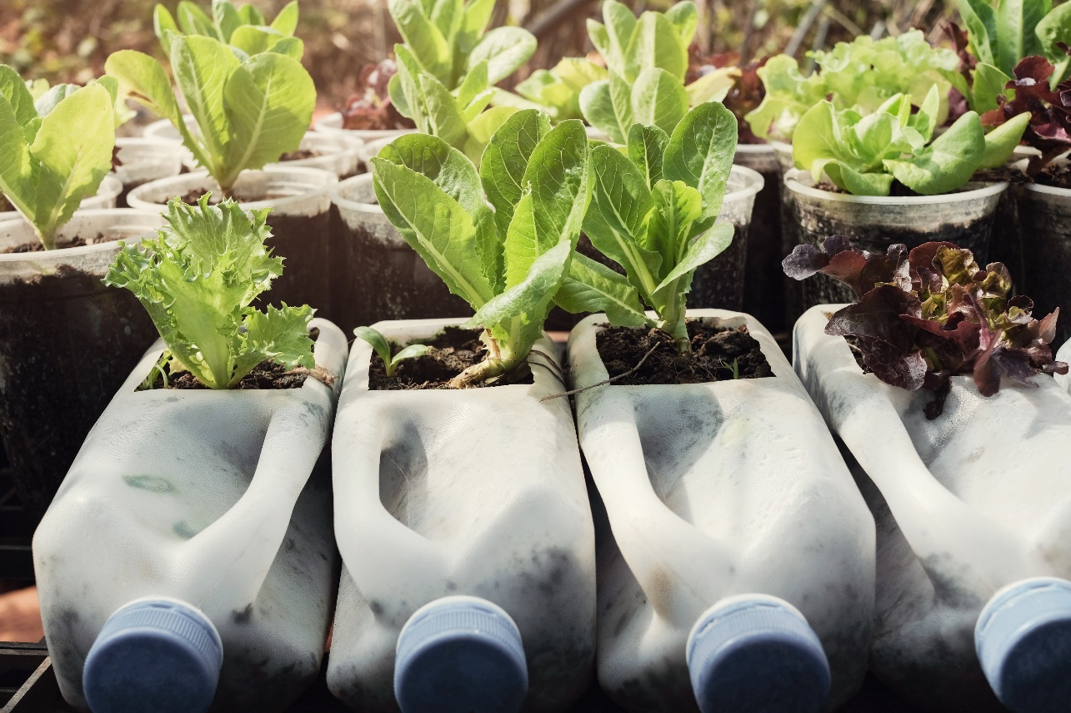
We can reuse items. If you can’t, give it to someone else who may be able to use it in another way!

Slide 18
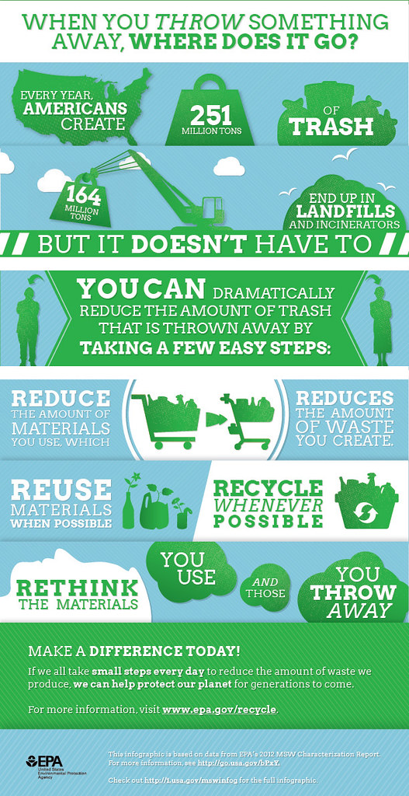
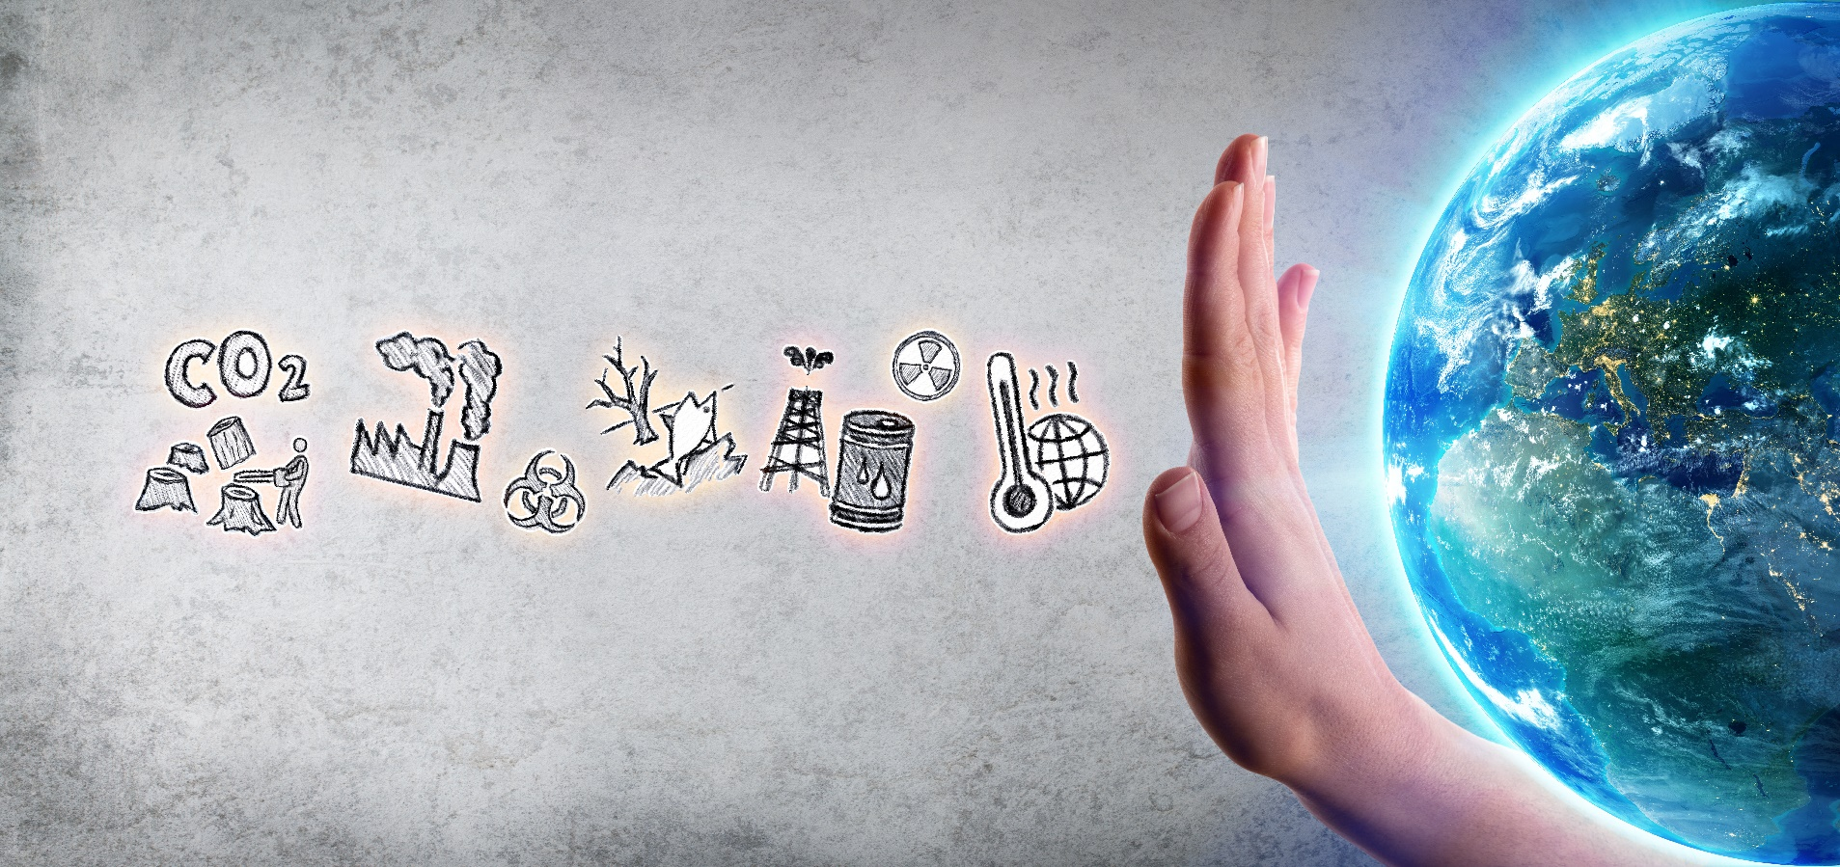
Our planet will survive and stay healthy only if we take care of it. We must all do our part. How can you start helping?

