Slide 1
Intro // Lesson 1
What You
Will Learn

Slide 2
#1 SKILL
Finding Good Real Estate Deals

Slide 3
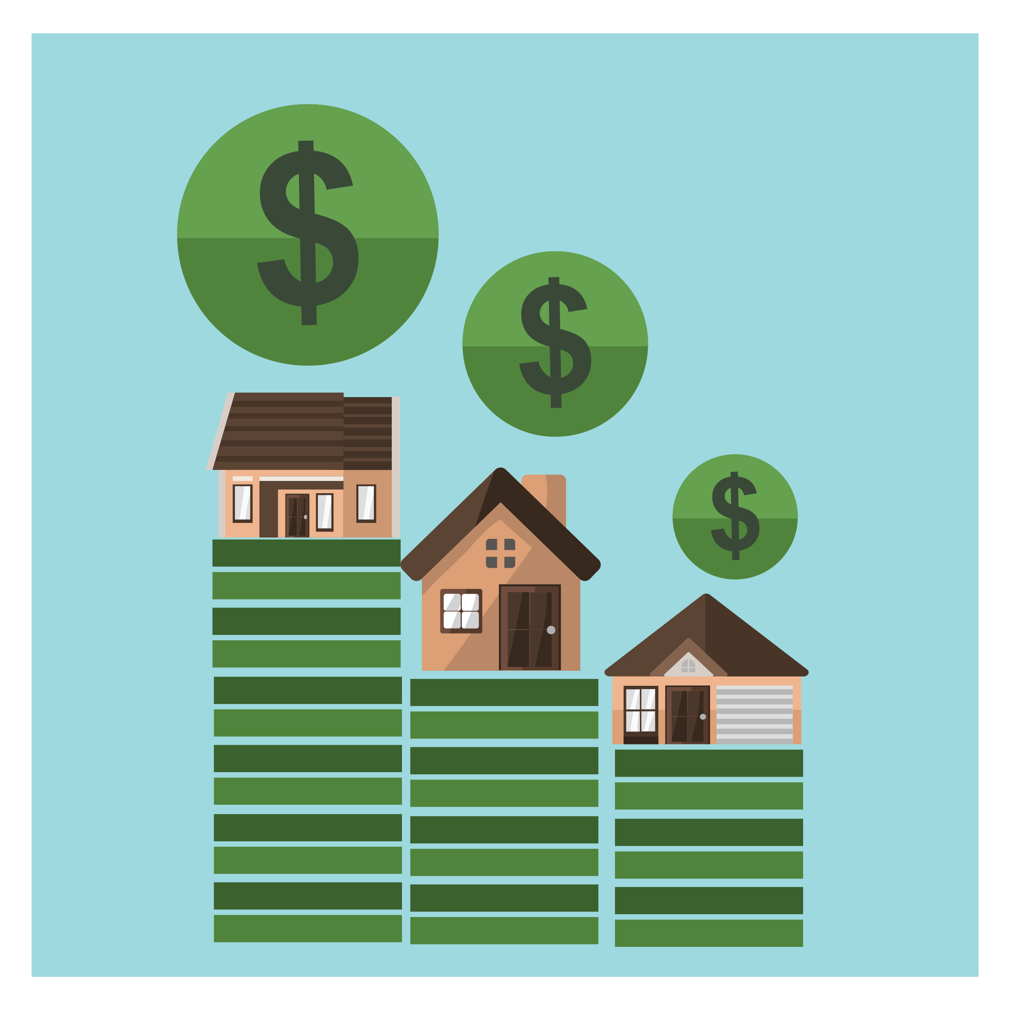
A DEAL?
A property meets your investment criteria

Slide 4
COMMIT TO THE PROCESS
Results = no direct control
Process = direct control

Slide 5
What do you hope to learn in this course?

Slide 6
NEXT:
How Deal-Finding
Really Works

