Slide 1
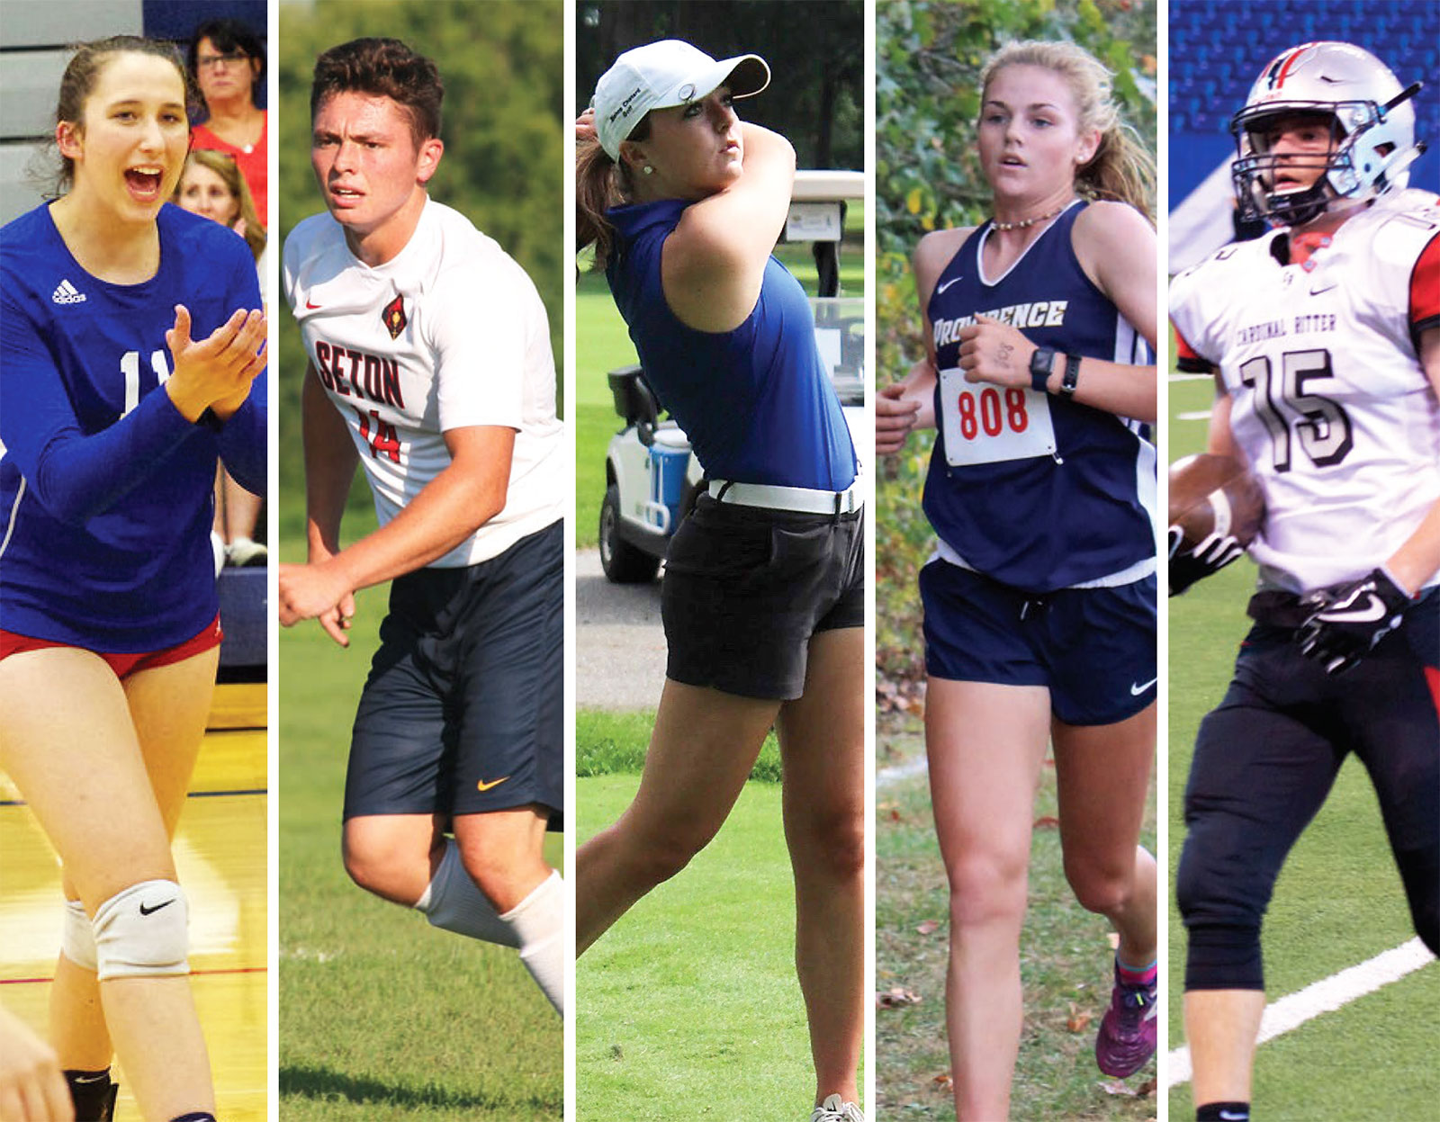
The Process of College Recruiting
(Part 3)
A Resource for Parents of College – Bound Student Athletes

Slide 2
When will a college coach be allowed to make your teen an official offer? That depends on the type of offer your teen is looking to secure. Verbal offers, non-binding, handshake agreements between a recruit and a college coach—can happen at any time and at any age level.
However, one of the biggest problems with early offers is that both the recruit and the coach can back out of them at any time. For example, if an athlete was given a verbal scholarship offer their freshman year of high school, that offer can still be rescinded the athlete’s senior year of high school. This leaves the recruit in a tough spot if they haven’t been communicating with any other schools.
Offers usually become official when the athlete signs their National Letter of Intent, which typically occurs their senior year of high school.
After all offers are made and accepted, a recruiting class can range from 2–30 athletes, depending on the sport and division level.
What this means for your teen: If your teen made it to this point of the college recruiting process, your teen need to be ready to handle some tough conversations about scholarships, offers and financial aid. Talk with your teen about narrowing down some target schools and make sure to identify the schools your teen is prepared to commit to.

Slide 3
Step 5: College coaches sign athletes and ensure academic eligibility
The last step for college coaches is ensuring that each recruit signs with their program and meets eligibility requirements.
Here’s how the committing and signing timeline works in most cases:
The student - athlete makes a verbal commitment to attend the school
The head coach extends an official offer to the student - athlete
The student - athlete signs the official offer.
Now as an official committed student – athlete your teen will need to continues to meet eligibility requirements by taking all the necessary core courses and receiving the required GPA and college admissions test scores. Your job as a parent is not over.

Slide 4
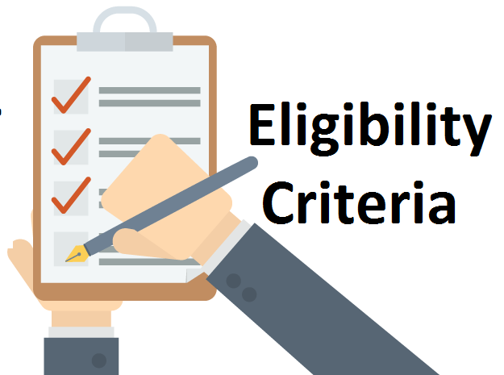
I have seen unfortunately, every year, there are athletes who have signed with a college but end their senior year ineligible to compete at the college level. This leaves both the athlete and the coach in a tough spot. The coach will need to go back to their list of top prospects and see if the athlete who ranked number two in that spot is still available, interested and academically eligible. The former recruit will likely need to compete for a year or two at a junior college to gain academic eligibility.
What this means for your teen: While it’s easy for a parents to get caught up in the rush of athletic recruiting and someday hoping their teen signs with national ranked college sports school, you still need to make sure that your teen stay academically eligible. If you’re concerned that your teen may not be able to meet the NCAA requirements, meet with your teen’s teachers and school counselor to go over what grades your teen will need to have in those required core courses and strategize a way to get there.

Slide 5
The Process of College Recruiting
(Part 3)

