Slide 1
ROMEO AND JULIET
BY
WILLIAM SHAKESPEARE
NARRATOR: BARBARA NJAU

Slide 2
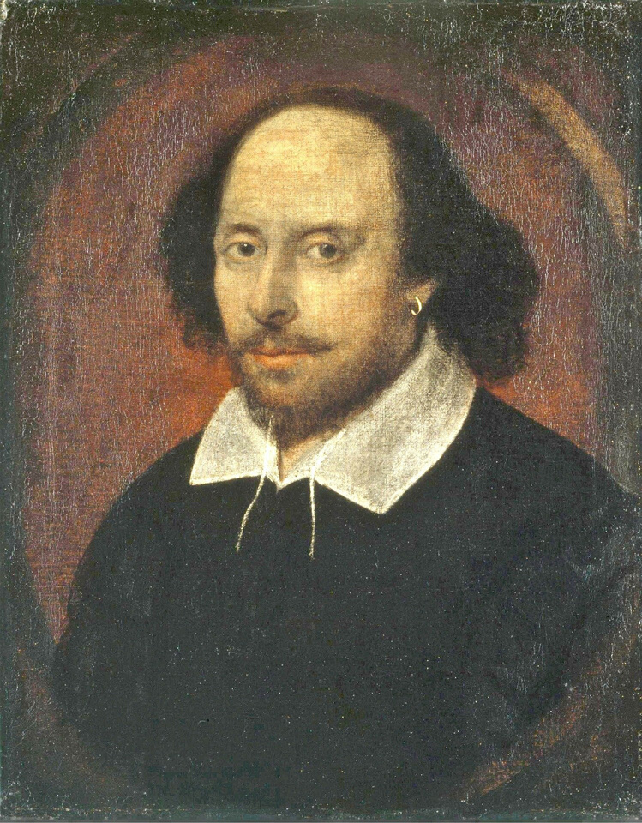
ABOUT THE PLAYWRIGHT:
•Birth: April 23, 1564 (Stratford-upon-Avon, UK)
•Death: April 23, 1616 (Stratford-upon-Avon, UK)
William was the third child of John Shakespeare, a leather merchant, and Mary Arden, a local landed heiress. William had two older sisters, Joan and Judith, and three younger brothers, Gilbert, Richard and Edmund. Before William's birth, his father became a successful merchant and held official positions as alderman and bailiff, an office resembling a mayor. However, records indicate John's fortunes declined sometime in the late 1570s.

Slide 3
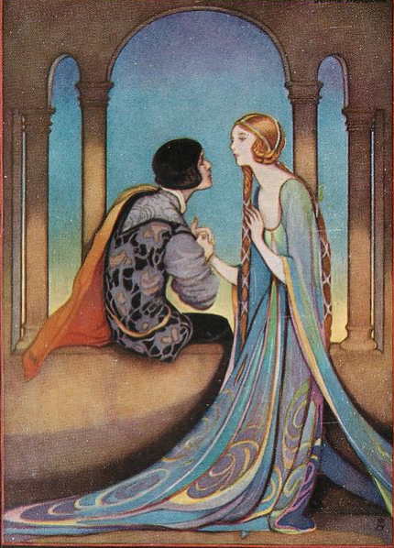
OVERVIEW:
Romeo and Juliet is a tragedy written by Shakespeare early in his career about two young star-crossed lovers whose deaths ultimately reconcile their feuding families. It was among Shakespeare's most popular plays during his lifetime and along with Hamlet, is one of the most frequently performed plays. Today, the title characters are regarded as archetypal young lovers.

Slide 4
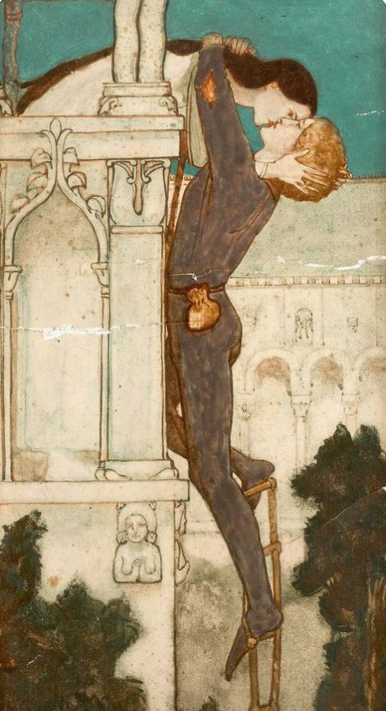
PLOT SUMMARY:
The play opens with a prologue that highlights to the audience the conflict between the two families: The Montagues and the Capulets. It is described to be an 'ancient grudge'. The families' servants have an argument, which quickly turns into something more violent and draws the families into the conflict. Romeo's cousin, Benvolio, and Juliet's cousin, the fiery Tybalt, get involved in the fray. The heads of the families, Capulet and Montague, also get involved but are quickly stopped when Prince Escalus arrives and puts a stop to the brawling. He declares that anybody fighting on the streets of Verona will be killed. He hopes to put a stop to the fighting and have peace in his city once again.

Slide 5
PLOT SUMMARY:
Mercutio, Romeo's best friend, decides it would be a good idea to gatecrash a Capulet party. Romeo, Mercutio and Benvolio (Romeo's cousin) all go and have a good time. Whilst dancing, Romeo meets Juliet and is struck by her beauty. He speaks with her and they kiss, declaring their love for one another. As he leaves, Romeo asks Juliet's nurse for Juliet's name. The nurse tells him and he is shocked to discover they are sworn enemies and that she is the daughter of Capulet. Juliet feels the same way about Romeo when she discovers his real identity. Romeo sneaks into the Capulet mansion where he meets Juliet and they decide to get married. The next day, Friar Laurence marries Romeo and Juliet in secret. He secretly hopes that it will end the conflict.

Slide 6
PLOT SUMMARY:
Romeo meets with Mercutio and Benvolio to tell them about his marriage to Juliet. However, he is soon stopped when he sees Tybalt Capulet there arguing with Mercutio. Tybalt challenges Romeo to fight, but Romeo declines, saying that he loves Tybalt like family. Tybalt is confused and angry at his response and repeats his demand. When Romeo declines again, Mercutio loses his temper and cannot believe Romeo will not fight like a man. He takes Romeo's place and Tybalt and Mercutio fight. Romeo tries to stop the fighting. Tybalt, trying to injure Romeo, accidentally stabs Mercutio. Mercutio dies a slow, painful death. He curses the Montague and Capulet houses, blaming them for his death.

Slide 7
PLOT SUMMARY:
Romeo, angered by Mercutio's death, goes searching for Tybalt. They find each other and fight. The fight ends when Romeo kills Tybalt. Realising what he has done, he flees. The Prince arrives on the scene and declares that Romeo must be banished and must leave Verona immediately. Juliet finds out the news of her cousin's death and Romeo's banishment and cannot cope with the sadness. She is heartbroken and confused.
Before Romeo leaves Verona forever, he and Juliet spend the night together and consummate their marriage. Romeo leaves in the morning and they are both heartbroken.

Slide 8
PLOT SUMMARY:
Capulet decides Juliet should marry Paris, as this will make her feel better following her cousin's death. He relays this news to his daughter and she is furious. Juliet defies her father and tells him she won't marry Paris and she will not be at the church as arranged. He is horrified with her response and tells her she must be married to Paris or else he will disown her forever. Juliet flees to Friar Laurence where she tells him this news. Friar Laurence and Juliet come up with a plan where she will fake her own death.

Slide 9
PLOT SUMMARY:
Juliet drinks a sleeping potion the night before her marriage to Paris. In the morning, she does not wake and she is pronounced dead. They take her to the Capulet tomb where she will wait for Romeo. Friar Laurence writes a letter to Romeo informing him of their plan, however, the letter doesn't get delivered to Romeo and he is told that Juliet is dead.

Slide 10
PLOT SUMMARY:
Distraught, Romeo buys some deadly poison and heads to the Capulet vault. On seeing Juliet, he drinks the poison so he can be with her in heaven. Juliet finally awakens to see Romeo there with her - however, she quickly realises he has drunk poison. She kisses his lips to try and taste the poison herself, but it doesn't work. So, instead, she kills herself with Romeo's dagger.
Realising that their two children have died because of their conflict, Capulet and Montague are mortified and declare they will honour their children's names for ever more. They vow never to argue again.

Slide 11
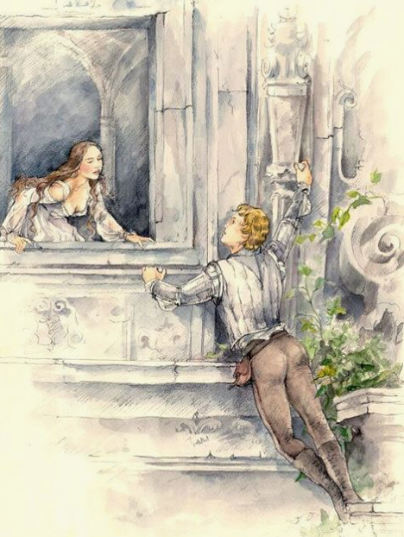
DETAILED SUMMARY:
Act I, Scene 1
Sampson and Gregory, two servants of the house of Capulet, stroll through the streets of Verona. With bawdy banter, Sampson vents his hatred of the house of Montague. The two exchange punning remarks about physically conquering Montague men and sexually conquering Montague women. Gregory sees two Montague servants approaching, and discusses with Sampson the best way to provoke them into a fight without breaking the law. Sampson bites his thumb at the Montagues—a highly insulting gesture.

Slide 12
DETAILED SUMMARY:
Act I, Scene 1
A verbal confrontation quickly escalates into a fight. Benvolio, a kinsman to Montague, enters and draws his sword in an attempt to stop the confrontation. Tybalt, a kinsman to Capulet, sees Benvolio’s drawn sword and draws his own.
Benvolio explains that he is merely trying to keep the peace, but Tybalt professes a hatred for peace as strong as his hatred for Montagues, and attacks. The brawl spreads. A group of citizens bearing clubs attempts to restore the peace by beating down the combatants. Montague and Capulet enter, and only their wives prevent them from attacking one another.

Slide 13
DETAILED SUMMARY:
Act I, Scene 1
Prince Escalus arrives and commands the fighting stop on penalty of torture. The Capulets and Montagues throw down their weapons. The Prince declares the violence between the two families has gone on for too long, and proclaims a death sentence upon anyone who disturbs the civil peace again. He says that he will speak to Capulet and Montague more directly on this matter; Capulet exits with him, the brawlers disperse, and Benvolio is left alone with his uncle and aunt, Montague and Lady Montague.

Slide 14
DETAILED SUMMARY:
Act I, Scene 1
Benvolio describes to Montague how the brawl started. Lady Montague asks whether Benvolio has seen her son, Romeo. Benvolio replies that he earlier saw Romeo pacing through a grove of sycamores outside the city; since Romeo seemed troubled, Benvolio did not speak to him. Concerned about their son, the Montagues tell Benvolio that Romeo has often been seen melancholy, walking alone among the sycamores. They add that they have tried to discover what troubles him, but have had no success. Benvolio sees Romeo approaching, and promises to find out the reason for his melancholy. The Montagues quickly depart.

Slide 15
DETAILED SUMMARY:
Act I, Scene 2
On another street of Verona, Capulet walks with Paris, a noble kinsman of the Prince. The two discuss Paris’s desire to marry Capulet’s daughter, Juliet. Capulet is overjoyed, but also states that Juliet—not yet fourteen—is too young to get married. He asks Paris to wait two years. He assures Paris that he favors him as a suitor, and invites Paris to the traditional masquerade feast he is holding that very night so that Paris might begin to woo Juliet and win her heart. Capulet dispatches a servant, Peter, to invite a list of people to the feast. As Capulet and Paris walk away, Peter laments that he cannot read and will therefore have difficulty accomplishing his task.

Slide 16
DETAILED SUMMARY:
Act I, Scene 2
Romeo and Benvolio happen by, still arguing about whether Romeo will be able to forget his love. Peter asks Romeo to read the list to him; Rosaline’s name is one of those on the list. Before departing, Peter invites Romeo and Benvolio to the party—assuming, he says, that they are not Montagues. Benvolio tells Romeo that the feast will be the perfect opportunity to compare Rosaline with the other beautiful women of Verona. Romeo agrees to go with him, but only because Rosaline herself will be there.

Slide 17
DETAILED SUMMARY:
Act I, Scene 3
In Capulet’s house, just before the feast is to begin, Lady Capulet calls to the Nurse, needing help to find her daughter. Juliet enters, and Lady Capulet dismisses the Nurse so that she might speak with her daughter alone. She immediately changes her mind, however, and asks the Nurse to remain and add her counsel. Before Lady Capulet can begin to speak, the Nurse launches into a long story about how, as a child, an uncomprehending Juliet became an innocent accomplice to a sexual joke. Lady Capulet tries unsuccessfully to stop the wildly amused Nurse. An embarrassed Juliet forcefully commands that the Nurse stop.

Slide 18
DETAILED SUMMARY:
Act I, Scene 3
Lady Capulet asks Juliet what she thinks about getting married. Juliet replies that she has not given it any thought. Lady Capulet observes that she gave birth to Juliet when she was almost Juliet’s current age. She excitedly continues that Juliet must begin to think about marriage because the “valiant Paris” has expressed an interest in her (1.3.76). Juliet dutifully replies that she will look upon Paris at the feast to see if she might love him. A serving-man enters to announce the beginning of the feast.

Slide 19
DETAILED SUMMARY:
Act I, Scene 4
•Romeo, Benvolio, and their friend Mercutio, all wearing masks, have gathered with a group of mask-wearing guests on their way to the Capulets’ feast. Still melancholy, Romeo wonders how they will get into the Capulets’ feast, since they are Montagues. When that concern is brushed aside, he states that he will not dance at the feast. Mercutio begins to gently mock Romeo, transforming all of Romeo’s statements about love into blatantly sexual metaphors. Romeo refuses to engage in this banter, explaining that in a dream he learned that going to the feast was a bad idea.

Slide 20
DETAILED SUMMARY:
Act I, Scene 4
Mercutio responds with a long speech about Queen Mab of the fairies, who visits people’s dreams. The speech begins as a flight of fancy, but Mercutio becomes almost entranced by it, and a bitter, fervent strain creeps in. Romeo steps in to stop the speech and calm Mercutio down. Mercutio admits that he has been talking of nothing, noting that dreams are but “the children of an idle brain”.

Slide 21
DETAILED SUMMARY:
Act I, Scene 4
Benvolio refocuses their attention on actually getting to the feast. Romeo voices one last concern: he has a feeling that the night’s activities will set in motion the action of fate, resulting in untimely death. But, putting himself in the hands of “he who hath the steerage of my course,” Romeo’s spirits rise, and he continues with his friends toward the feast.

Slide 22
DETAILED SUMMARY:
Act I, Scene 5
In the great hall of the Capulets, all is a-bustle. The servants work feverishly to make sure all runs smoothly, and set aside some food to make sure they have some enjoyment of the feast as well. Capulet makes his rounds through groups of guests, joking with them and encouraging all to dance.

Slide 23
DETAILED SUMMARY:
Act I, Scene 5
From across the room, Romeo sees Juliet, and asks a serving-man who she is. The serving-man does not know. Romeo is transfixed; Rosaline vanishes from his mind and he declares that he has never been in love until this moment. Moving through the crowd, Tybalt hears and recognizes Romeo’s voice. Realizing that there is a Montague present, Tybalt sends a servant to fetch his rapier. Capulet overhears Tybalt and reprimands him, telling him that Romeo is well regarded in Verona, and that he will not have the youth harmed at his feast. Tybalt protests, but Capulet scolds him until he agrees to keep the peace. As Capulet moves on, Tybalt vows that he will not let this indignity pass.

Slide 24
DETAILED SUMMARY:
Act I, Scene 5
Meanwhile, Romeo has approached Juliet and touched her hand. In a dialogue laced with religious metaphors that figure Juliet as a saint and Romeo as a pilgrim who wishes to erase his sin, he tries to convince her to kiss him, since it is only through her kiss that he might be absolved. Juliet agrees to remain still as Romeo kisses her. Thus, in the terms of their conversation, she takes his sin from him. Juliet then makes the logical leap that if she has taken Romeo’s sin from him, his sin must now reside in her lips, and so they must kiss again.

Slide 25
DETAILED SUMMARY:
Act I, Scene 5
Just as their second kiss ends, the Nurse arrives and tells Juliet that her mother wants to speak with her. Romeo asks the Nurse who Juliet’s mother is. The Nurse replies that Lady Capulet is her mother. Romeo is devastated. As the crowd begins to disperse, Benvolio shows up and leads Romeo from the feast. Juliet is just as struck with the mysterious man she has kissed as Romeo is with her. She comments to herself that if he is already married, she feels she will die. In order to find out Romeo’s identity without raising any suspicions, she asks the Nurse to identify a series of young men. The Nurse goes off and returns with the news that the man’s name is Romeo, and that he is a Montague. Overcome with anguish that she loves a Montague, Juliet follows her nurse from the hall.

Slide 26
DETAILED SUMMARY:
Act II, Scene 1
Having left the feast, Romeo decides that he cannot go home. He must instead try to find Juliet. He climbs a wall bordering the Capulet property and leaps down into the Capulet orchard. Benvolio and Mercutio enter, calling out for Romeo. They are sure he is nearby, but Romeo does not answer. Exasperated and amused, Mercutio mocks Romeo’s feelings for Rosaline in an obscene speech. Mercutio and Benvolio exit under the assumption that Romeo does not want to be found. In the orchard, Romeo hears Mercutio’s teasing. He says to himself, “He jests at scars that never felt a wound”.

Slide 27
DETAILED SUMMARY:
Act II, Scene 1
•Juliet suddenly appears at a window above the spot where Romeo is standing. Romeo compares her to the morning sun, far more beautiful than the moon it banishes. He nearly speaks to her, but thinks better of it. Juliet, musing to herself and unaware that Romeo is in her garden, asks why Romeo must be Romeo—a Montague, and therefore an enemy to her family. She says that if he would refuse his Montague name, she would give herself to him; or if he would simply swear that he loved her, she would refuse her Capulet name. Romeo responds to her plea, surprising Juliet, since she thought she was alone. She wonders how he found her and he tells her that love led him to her.

Slide 28
DETAILED SUMMARY:
Act II, Scene 1
Juliet worries that Romeo will be murdered if he is found in the garden, but Romeo refuses to budge, claiming that Juliet’s love would make him immune to his enemies. Juliet admits she feels as strongly about Romeo as he professes he loves her, but she worries that perhaps Romeo will prove inconstant or false, or will think Juliet too easily won. The Nurse calls for Juliet, and Juliet goes inside for a moment. When she reappears, she tells Romeo that she will send someone to him the next day to see if his love is honourable and if he intends to wed her.

Slide 29
DETAILED SUMMARY:
Act II, Scene 2 & 3
In the early morning, Friar Lawrence enters, holding a basket. He fills the basket with various weeds, herbs, and flowers. While musing on the beneficence of the Earth, he demonstrates a deep knowledge of the properties of the plants he collects. Romeo enters and Friar Lawrence intuits that Romeo has not slept the night before. The friar fears that Romeo may have slept in sin with Rosaline. Romeo assures him that did not happen, and describes his new love for Juliet, his intent to marry her, and his desire that the friar consent to marry them that very day.

Slide 30
DETAILED SUMMARY:
Act II, Scene 2 & 3
Friar Lawrence is shocked at this sudden shift from Rosaline to Juliet. He comments on the fickleness of young love, Romeo’s in particular. Romeo defends himself, noting that Juliet returns his love while Rosaline did not. In response, the friar comments that Rosaline could see that Romeo’s love for her “did read by rote, that could not spell.” Remaining skeptical at Romeo’s sudden change of heart, Friar Lawrence nonetheless agrees to marry the couple. He expresses the hope that the marriage of Romeo and Juliet might end the feud ravaging the Montagues and Capulets.

Slide 31
DETAILED SUMMARY:
Act II, Scene 4 & 5
In the Capulet orchard, Juliet impatiently waits for her nurse, whom she sent to meet Romeo three hours earlier. At last the Nurse returns, and Juliet anxiously presses her for news. The Nurse claims to be too tired, sore, and out of breath to tell Juliet what has happened. Juliet grows frantic, and eventually the Nurse gives in and tells her that Romeo is waiting at Friar Lawrence’s cell to marry her. The Nurse departs to wait in the ally for Romeo’s servant, who is to bring a ladder for Romeo to use to climb up to Juliet’s chamber that night to consummate their marriage.

Slide 32
DETAILED SUMMARY:
Act III, Scene 1
As they walk in the street under the boiling sun, Benvolio suggests to Mercutio that they go indoors, fearing that a brawl will be unavoidable should they encounter Capulet men. Tybalt enters with a group of cronies. He approaches Benvolio and Mercutio and asks to speak with one of them. Annoyed, Mercutio begins to taunt and provoke him. Romeo enters. Tybalt turns his attention from Mercutio to Romeo, and calls Romeo a villain. Romeo, now secretly married to Juliet and thus Tybalt’s kinsman, refuses to be angered by Tybalt’s verbal attack. Tybalt commands Romeo to draw his sword. Romeo protests that he has good reason to love Tybalt, and does not wish to fight him. He asks that until Tybalt knows the reason for this love, he put aside his sword.

Slide 33
DETAILED SUMMARY:
Act III, Scene 1
Mercutio angrily draws his sword and declares with biting wit that if Romeo will not fight Tybalt, he will. Mercutio and Tybalt begin to fight. Romeo, attempting to restore peace, throws himself between the combatants. Tybalt stabs Mercutio under Romeo’s arm, and as Mercutio falls, Tybalt and his men hurry away. Mercutio dies. Enraged, Romeo declares that his love for Juliet has made him effeminate, and that he should have fought Tybalt in Mercutio’s place. When Tybalt, still angry, storms back onto the scene, Romeo draws his sword. They fight, and Romeo kills Tybalt.

Slide 34
DETAILED SUMMARY:
Act III, Scene 2
In Capulet’s house, Juliet longs for night to fall so that Romeo will come to her “untalked of and unseen”. Suddenly the Nurse rushes in with news of the fight between Romeo and Tybalt. But the Nurse is so distraught, she stumbles over the words, making it sound as if Romeo is dead. Juliet assumes Romeo has killed himself, and she resigns to die herself. The Nurse then begins to moan about Tybalt’s death, and Juliet briefly fears that both Romeo and Tybalt are dead.

Slide 35
DETAILED SUMMARY:
Act III, Scene 3
In Friar Lawrence’s cell, Romeo is overcome with grief, and wonders what sentence the Prince has decreed. Friar Lawrence tells him he is lucky: the Prince has only banished him. Romeo claims that banishment is a penalty far worse than death, since he will have to live, but without Juliet. The friar tries to counsel Romeo but the youth is so unhappy that he will have none of it. Romeo falls to the floor. The Nurse arrives, and Romeo desperately asks her for news of Juliet. He assumes that Juliet now thinks of him as a murderer and threatens to stab himself.

Slide 36
DETAILED SUMMARY:
Act III, Scene 4
Capulet, Lady Capulet, and Paris walk together. Capulet says that because of the terrible recent events, he has had no time to ask his daughter about her feelings for Paris. Lady Capulet states that she will know her daughter’s thoughts by the morning. Paris is about to leave when Capulet calls him back and makes what he calls “a desperate tender of my child’s love”. Capulet says he thinks his daughter will listen to him, then corrects himself and states that he is sure Juliet will abide by his decision. He promises Paris that the wedding will be held on Wednesday, then stops suddenly and asks what day it is. Paris responds that it is Monday; Capulet decides that Wednesday is too soon, and that the wedding should instead be held on Thursday.

Slide 37
DETAILED SUMMARY:
Act III, Scene 5
Just before dawn, Romeo prepares to lower himself from Juliet’s window to begin his exile. Juliet tries to convince Romeo that the birdcalls they hear are from the nightingale, a night bird, rather than from the lark, a morning bird. Romeo cannot entertain her claims; he must leave before the morning comes or be put to death. Juliet declares that the light outside comes not from the sun, but from some meteor. Overcome by love, Romeo responds that he will stay with Juliet, and that he does not care whether the Prince’s men kill him.

Slide 38
DETAILED SUMMARY:
Act III, Scene 5
Faced with this turnaround, Juliet declares that the bird they heard was the lark; that it is dawn and he must flee. The Nurse enters to warn Juliet that Lady Capulet is approaching. Romeo and Juliet tearfully part. Romeo climbs out the window. Standing in the orchard below her window, Romeo promises Juliet that they will see one another again, but Juliet responds that he appears pale, as one dead in the bottom of a tomb. Romeo answers that, to him, she appears the same way, and that it is only sorrow that makes them both look pale. Romeo hurries away as Juliet pulls in the ladder and begs fate to bring him back to her quickly.

Slide 39
DETAILED SUMMARY:
Act III, Scene 5
Lady Capulet calls to her daughter. Juliet wonders why her mother would come to speak to her so early in the morning. Unaware that her daughter is married to Romeo, Lady Capulet enters the room and mistakes Juliet’s tears as continued grief for Tybalt. Lady Capulet tells Juliet of her deep desire to see “the villain Romeo” dead (3.5.80). In a complicated bit of punning every bit as impressive as the sexual punning of Mercutio and Romeo, Juliet leads her mother to believe that she also wishes Romeo’s death, when in fact she is firmly stating her love for him.

Slide 40
DETAILED SUMMARY:
Act III, Scene 5
Lady Capulet tells Juliet about Capulet’s plan for her to marry Paris on Thursday, explaining that he wishes to make her happy. Juliet is appalled. She rejects the match, saying “I will not marry yet; and when I do, I swear / It shall be Romeo—whom you know I hate— / Rather than Paris”. Capulet enters the chamber. When he learns of Juliet’s determination to defy him he becomes enraged and threatens to disown Juliet if she refuses to obey him. When Juliet entreats her mother to intercede, her mother denies her help.

Slide 41
DETAILED SUMMARY:
Act III, Scene 5
After Capulet and Lady Capulet storm away, Juliet asks her nurse how she might escape her predicament. The Nurse advises her to go through with the marriage to Paris—he is a better match, she says, and Romeo is as good as dead anyhow. Though disgusted by her nurse’s disloyalty, Juliet pretends to agree, and tells her nurse that she is going to make confession at Friar Lawrence’s. Juliet hurries to the friar, vowing that she will never again trust the Nurse’s counsel. If the friar is unable to help her, Juliet comments to herself, she still has the power to take her own life.

Slide 42
DETAILED SUMMARY:
Act IV, Scene
1
Juliet enters, and Paris speaks to her lovingly, if somewhat arrogantly. Juliet responds indifferently, showing neither affection nor dislike. She remarks that she has not married him yet. On the pretense that he must hear Juliet’s confession, Friar Lawrence ushers Paris away, though not before Paris kisses Juliet once. After Paris leaves, Juliet asks Friar Lawrence for help, brandishing a knife and saying that she will kill herself rather than marry Paris.

Slide 43
DETAILED SUMMARY:
Act IV, Scene
1
The friar proposes a plan: Juliet must consent to marry Paris; then, on the night before the wedding, she must drink a sleeping potion that will make her appear to be dead; she will be laid to rest in the Capulet tomb, and the friar will send word to Romeo in Mantua to help him retrieve her when she wakes up. She will then return to Mantua with Romeo, and be free to live with him away from their parents’ hatred. Juliet consents to the plan wholeheartedly. Friar Lawrence gives her the sleeping potion.

Slide 44
DETAILED SUMMARY:
Act IV, Scene
2
Juliet returns home, where she finds Capulet and Lady Capulet preparing for the wedding. She surprises her parents by repenting her disobedience and cheerfully agreeing to marry Paris. Capulet is so pleased that he insists on moving the marriage up a day, to Wednesday—tomorrow. Juliet heads to her chambers to, ostensibly, prepare for her wedding. Capulet heads off to tell Paris the news.

Slide 45
DETAILED SUMMARY:
Act IV, Scene
3
In her bedchamber, Juliet asks the Nurse to let her spend the night by herself, and repeats the request to Lady Capulet when she arrives. Alone, clutching the vial given to her by Friar Lawrence, she wonders what will happen when she drinks it. If the friar is untrustworthy and seeks merely to hide his role in her marriage to Romeo, she might die; or, if Romeo is late for some reason, she might awaken in the tomb and go mad with fear. She has a vision in which she sees Tybalt’s ghost searching for Romeo. She begs Tybalt’s ghost to quit its search for Romeo, and toasting to Romeo, drinks the contents of the vial.

Slide 46
DETAILED SUMMARY:
Act IV, Scenes
4 & 5
Early the next morning, the Capulet house is aflutter with preparations for the wedding. Capulet sends the Nurse to go wake Juliet. She finds Juliet dead and begins to wail, soon joined by both Lady Capulet and Capulet. Paris arrives with Friar Lawrence and a group of musicians for the wedding. When he learns what has happened, Paris joins in the lamentations. The friar reminds them all that Juliet has gone to a better place, and urges them to make ready for her funeral. Sorrowfully, they comply, and exit.

Slide 47
DETAILED SUMMARY:
Act V, Scene
1
On Wednesday morning, on a street in Mantua, a cheerful Romeo describes a wonderful dream he had the night before: Juliet found him lying dead, but she kissed him, and breathed new life into his body. Just then, Balthasar enters, and Romeo greets him happily, saying that Balthasar must have come from Verona with news of Juliet and his father. Romeo comments that nothing can be ill in the world if Juliet is well. Balthasar replies that nothing can be ill, then, for Juliet is well: she is in heaven, found dead that morning at her home. Thunderstruck, Romeo cries out “Then I defy you, stars”.

Slide 48
DETAILED SUMMARY:
Act V, Scene
1
He tells Balthasar to get him pen and paper (with which he writes a letter for Balthasar to give to Montague) and to hire horses, and says that he will return to Verona that night. Balthasar says that Romeo seems so distraught that he is afraid to leave him, but Romeo insists. Romeo suddenly stops and asks if Balthasar is carrying a letter from Friar Lawrence. Balthasar says he is not, and Romeo sends his servant on his way. Once Balthasar is gone, Romeo says that he will lie with Juliet that night. He goes to find an apothecary, a seller of drugs.

Slide 49
DETAILED SUMMARY:
Act V, Scene
1
After telling the man in the shop that he looks poor, Romeo offers to pay him well for a vial of poison. The Apothecary says that he has just such a thing, but that selling poison in Mantua carries the death sentence. Romeo replies that the Apothecary is too poor to refuse the sale. The Apothecary finally relents and sells Romeo the poison. Once alone, Romeo speaks to the vial, declaring that he will go to Juliet’s tomb and kill himself.

Slide 50
DETAILED SUMMARY:
Act V, Scene
2
At his cell, Friar Lawrence speaks with Friar John, whom he had earlier sent to Mantua with a letter for Romeo. He asks John how Romeo responded to his letter (which described the plan involving Juliet’s false death). Friar John replies that he was unable to deliver the letter because he was shut up in a quarantined house due to an outbreak of plague.

Slide 51
DETAILED SUMMARY:
Act V, Scene
2
Friar Lawrence becomes upset, realizing that if Romeo does not know about Juliet’s false death, there will be no one to retrieve her from the tomb when she awakes. (He does not know that Romeo has learned of Juliet’s death and believes it to be real.) Sending for a crowbar, Friar Lawrence declares that he will have to rescue Juliet from the tomb on his own. He sends another letter to Romeo to warn him about what has happened, and plans to keep Juliet in his cell until Romeo arrives.

Slide 52
DETAILED SUMMARY:
Act V, Scene
3
In the churchyard that night, Paris enters with a torch-bearing servant. He orders the page to withdraw, then begins scattering flowers on Juliet’s grave. He hears a whistle—the servant’s warning that someone is approaching. He withdraws into the darkness. Romeo, carrying a crowbar, enters with Balthasar. He tells Balthasar that he has come to open the Capulet tomb in order to take back a valuable ring he had given to Juliet. Then he orders Balthasar to leave, and, in the morning, to deliver to Montague the letter Romeo had given him. Balthasar withdraws, but, mistrusting his master’s intentions, lingers to watch.

Slide 53
DETAILED SUMMARY:
Act V, Scene
3
From where Paris is hiding, he recognises Romeo as the man who killed Tybalt. He is angry that Romeo has come to Juliet’s tomb as he assumes he came back to dishonor the bodies of Tybalt or Juliet. He comes out and fights with Romeo. Paris’ servant runs off to get help and in the fight, Romeo kills Paris. As he dies, Paris asks to be laid next to Juliet in the tomb and Romeo agrees.

Slide 54
DETAILED SUMMARY:
Act V, Scene
3
Romeo descends into the tomb carrying Paris’s body. He finds Juliet lying peacefully, and wonders how she can still look so beautiful—as if she were not dead at all. Romeo speaks to Juliet of his intention to spend eternity with her, describing himself as shaking “the yoke of inauspicious stars / From this world-wearied flesh”. He kisses Juliet, drinks the poison, kisses Juliet again, and dies.

Slide 55
DETAILED SUMMARY:
Act V, Scene
3
Just then, Friar Lawrence enters the churchyard. He encounters Balthasar, who tells him that Romeo is in the tomb. Balthasar says that he fell asleep and dreamed that Romeo fought with and killed someone. Troubled, the friar enters the tomb, where he finds Paris’s body and then Romeo’s. As the friar takes in the bloody scene, Juliet wakes.

Slide 56
DETAILED SUMMARY:
Act V, Scene
3
Juliet asks the friar where her husband is. Hearing a noise that he believes is the coming of the watch, the friar quickly replies that both Romeo and Paris are dead, and that she must leave with him. Juliet refuses to leave, and the friar, fearful that the watch is imminent, exits without her. Juliet sees Romeo dead beside her, and surmises from the empty vial that he has drunk poison. Hoping she might die by the same poison, Juliet kisses his lips, but to no avail. Hearing the approaching watch, Juliet unsheathes Romeo’s dagger and, saying, “O happy dagger, / This is thy sheath,” stabs herself. She dies upon Romeo’s body.

Slide 57
DETAILED SUMMARY:
Act V, Scene
3
Chaos reigns in the churchyard, where Paris’s page has brought the watch. The watchmen discover bloodstains near the tomb; they hold Balthasar and Friar Lawrence, who they discovered loitering nearby. The Prince and the Capulets enter. Romeo, Juliet, and Paris are discovered in the tomb. Montague arrives, declaring that Lady Montague has died of grief for Romeo’s exile. The Prince shows Montague his son’s body. Upon the Prince’s request, Friar Lawrence succinctly tells the story of Romeo and Juliet’s secret marriage and its consequences.

Slide 58
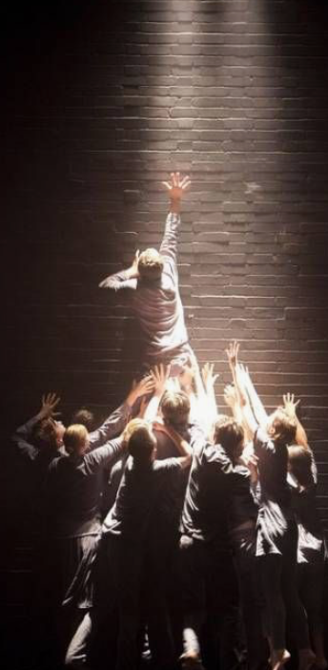
CHARACTER ANALYSIS:
Romeo
Romeo Montague is a young, passionate and headstrong teenager who thinks and acts with his emotions. When the audience first meets Romeo, he declares that he is in love with Rosaline. He states that he is heartbroken because Rosaline doesn't love him back. However, his emotions are changeable, as that very night, Romeo meets Juliet and falls in love with her instantly. He vows to marry her and they marry the next day, unbeknown to their feuding families.

Slide 59
CHARACTER ANALYSIS:
Romeo
As the play progresses, Romeo illustrates how passionate he is by avenging his best friend Mercutio's, death. He kills Juliet's cousin, Tybalt, and is forced to leave the city of Verona. Romeo thinks he cannot live without Juliet and is devastated when he hears of Juliet's 'death'. Here, he takes his own life so he can be with his one true love in heaven.

Slide 60
CHARACTER ANALYSIS:
Juliet
Juliet Capulet is a young and innocent teenage girl, but she is also decisive, passionate and headstrong. When the audience first meets Juliet, it is at her father's party. Here, she meets Romeo and flirts with him, not knowing he is a Montague. Juliet is completely smitten with Romeo and when she finds out he is a Montague, she is devastated. However, knowing her own feelings, she decides to speak to Romeo more and when he reveals his true love for her, she persuades him to promise his love and they arrange their marriage.

Slide 61
CHARACTER ANALYSIS:
Juliet
When Juliet is banished for killing her cousin Tybalt, she is devastated. She feels very confused but knowing how she feels for Romeo, she forgives him. During the mourning period for Tybalt's death and Romeo's banishment, Juliet's father tells her she is going to marry Paris. She refuses and takes drastic action to secure her relationship and future with Romeo by faking her own death. When she wakes up to find Romeo dead, she decides to take her own life so they can be together in heaven.

Slide 62
CHARACTER ANALYSIS:
Lady Capulet
Lady Capulet is Capulet's wife. Lady Capulet is quite a timid, unknowing and selfish character, as she appears to be frightened of her husband and does not love her daughter like a mother should. In the play, she forgets Juliet's age and they have a formal relationship, illustrating the distance between them both. Lady Capulet is seen as a traditional Elizabethan woman.

Slide 63
CHARACTER ANALYSIS:
Tybalt Capulet
Tybalt Capulet is Juliet's cousin. He is extremely feisty and enjoys the conflict between the Montagues and his family. He is strong-willed, argumentative, passionate and loyal. All of these characteristics are demonstrated when he finds out that Romeo has gate-crashed a Capulet party, knowing that the Montagues are not welcome. Tybalt reacts badly, almost causing a fight at the Capulet household.

Slide 64
CHARACTER ANALYSIS:
Tybalt Capulet
Lord Capulet quickly intervenes and tells Tybalt not to fight Romeo and Tybalt reluctantly obeys. Tybalt seeks his revenge by fighting with Romeo, but when Romeo refuses to fight he kills Romeo's best friend, Mercutio, instead. This causes Romeo to avenge his best friend's death.

Slide 65
CHARACTER ANALYSIS:
Friar Laurence
Friar Laurence is a priest in Verona and a confidante of Romeo, He is kind, optimistic, loving, religious and believes the best of people. Romeo sees Friar Laurence as a role model, an almost father figure. Whenever Romeo has a problem, he confides in Friar Laurence and seeks his advice. When Romeo tells Friar Laurence of his love for Juliet and his wish to marry her, the Friar hopes it will be a positive end to the Montague and Capulet conflict. Throughout the play, he is optimistic and hopes the young lovers will end the fray of their fathers. His role is very similar to that of the Nurse.

Slide 66
CHARACTER ANALYSIS:
Lord and Lady Montague
Lord and Lady Montague are Romeo's parents. They do not feature heavily in the play, however, we understand that Lord Montague initiates the conflict and fuels the arguments between the two families. They both care for their son deeply and do not want him to get banished; they try to persuade the Prince to drop the charge. At the end of the play, Lord Montague repents his sins, asks for forgiveness and vows never to argue with the Capulet family again.

Slide 67
CHARACTER ANALYSIS:
Benvolio
Benvolio is Romeo's cousin and he loves Romeo very much. When Mercutio and Tybalt are fighting, it is Benvolio who tries to stop the conflict. When Romeo decides to avenge his best friend's death, Benvolio tries to stop him but fails. When he sees that Romeo has killed Tybalt, he tells Romeo to flee. Benvolio is very loving, loyal, caring and honest.

Slide 68
CHARACTER ANALYSIS:
Paris
Paris wishes to marry Juliet and appears to like her. He persuades Lord Capulet to give his daughter's hand in marriage. At Juliet's death, Paris is mournful and fights Romeo; a man he thinks has come to upset Juliet's peace. Paris is very persuasive and honourable as a character.

Slide 69
CHARACTER ANALYSIS:
Prince Escalus
Prince Escalus is a kinsman of Mercutio and Paris. He is the seat of political power in Verona. He is angered by the feuding families but lacks the personal strength to reconcile the differences. Prince Escalus is very formal as well as pompous as a character.

Slide 70
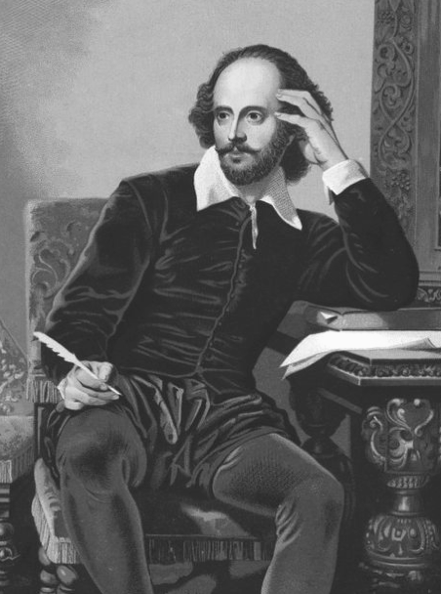
THEME ANALYSIS:
Love
Through Romeo and Juliet, Shakespeare deals with the idea of love - its meaning, its causes and its impact - both positively and negatively, and its goal. In the play, we see many different types of love and their impact on individuals, families, friendships and the wider society of Verona.

Slide 71
THEME ANALYSIS:
Love
Love between Romeo & Juliet: When Romeo and Juliet first meet, they instantly fall in love. Shakespeare presents their initial meeting as passionate, flirtatious and true.
Romeo’s friendship with Mercutio: Romeo refuses to fight Tybalt so Mercutio takes his place. When Tybalt kills Mercutio unjustly, Romeo swears to avenge his best friend's death, thus killing Tybalt.
Romeo and Juliet’s deaths: Romeo goes to find Juliet in the Capulet tomb, believing her to be dead. He takes some poison and dies. Juliet awakens, finds her love poisoned and kills herself with Romeo's dagger so they can be together in the afterlife

Slide 72
THEME ANALYSIS:
Conflict
Conflict is a central theme in Shakespeare's Romeo and Juliet. Shakespeare presents the theme of conflict through two warring families: The Montagues and the Capulets. The two families have been taught to hate each other, and this hatred impacts on the family members and the citizens of Verona. The citizens of Verona are unwillingly a part of the conflict as they witness the ongoing battles between the two families - battles which often result in death. Shakespeare also presents the themes of conflict through inner familial conflict and individual conflict. Where conflict is presented, the struggle for power and control is also apparent.

Slide 73
THEME ANALYSIS:
Conflict
Two warring families: Shakespeare opens the play with a prologue and it is here that he first depicts the conflict between the Montagues and the Capulets.
Juliet’s inner conflict: When Juliet discovers the true identity of her true love, she is shocked and cannot believe she loves someone who she is supposed to hate.
Conflict between Tybalt and Romeo: Tybalt believes Romeo to have greatly dishonoured his family when he gate-crashes the Capulet party. He decides that Romeo must pay and offers to duel with Romeo.

Slide 74
THEME ANALYSIS:
Family
In Romeo and Juliet, Shakespeare presents two families to the audience: the Montagues and the Capulets. These two families, despite their similarities, despise each other and continually battle. The conflict between the two families is almost presented to be natural until Romeo Montague and Juliet Capulet fall in love. It is here that everything changes. When Romeo and Juliet die, both families apologise for their behaviour and vow to honour each other, thus remembering their children's unjust deaths.
Within the families, there are relationships which contribute to Romeo and Juliet's tragic deaths.

Slide 75
Thank you!
www.firstratetutors.com

