Slide 1
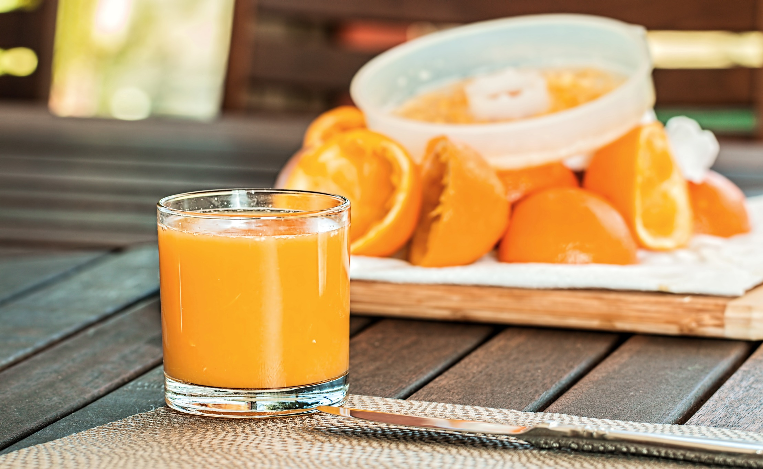
Beginner’s Guide to Juicing

Slide 2
Juicing has a lot to offer you that will benefit your health and wellbeing

Slide 3
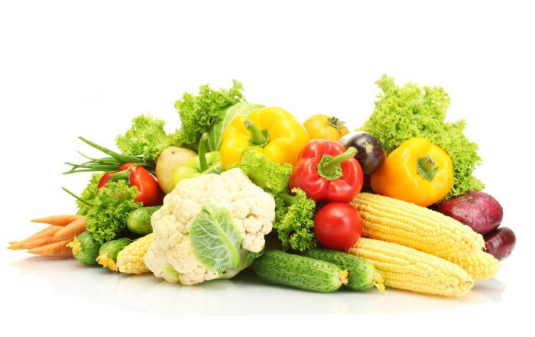
Eat your vegetables!

Slide 4
Fruits and vegetables are known to reduce the risk of certain cancers, heart disease, high cholesterol and high blood pressure
They are filled with the vitamins and minerals you need to remain healthy and full of energy
It’s a simple fact that the more fruits and vegetables you eat, the more you enjoy the benefits
You should be eating more than five servings every day

Slide 5
That sounds close to impossible, doesn’t it?

Slide 6
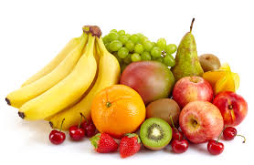
We can’t always consume all the fruits and vegetables we need
Juicing concentrates the produce so that one glass can serve as the equivalent of several pieces of fruit and vegetables
Juicing makes it easier to enjoy the benefits of fruits and vegetables

Slide 7
A juicer extracts all the liquid and discards everything else
So, what you are left with is highly concentrated fruit and vegetable juice
A blender mashes the whole fruits or vegetables, but leaves the fiber

Slide 8
Juices can serve as a vibrant meal replacement, but you need solid foods as well

Slide 9
Juicing vs. Blending
These days, people are becoming more aware of the effects that the foods they consume has on their body and entire life
Every study over the past few decades indicates that many of us are overfeed and undernourished

Slide 10
Juicing separates the juice from fiber, leaving you with a heavy concentration of plant-based nutrients
Your body gets a heavy shot of vitamins and minerals
Not surprisingly, you need a juicer to extract juice from fruits and vegetables
Blending processes the entire fruit or vegetable, simply creating a different form of the same thing

Slide 11
You blend a carrot, you get a carrot, albeit in a liquid, smoothie form
It is not concentrated, like juicing
It does, however, retain all the needed fiber that juicing removes
Juicing provides more concentrated nutrition

Slide 12
Blending gives you all the benefits of produce, along with the fiber
As a general rule of thumb, the amount of fruits and vegetables needed for one glass of juice will provide you three glasses of blended smoothies
Since blending retains fiber, which slows down the absorption of sugar into the bloodstream, blending might be an excellent option if you are watching your sugar intake

Slide 13
When you blend, you can also add different types of foods to the blender, such as yogurt or nuts
Both juicing and blending are an excellent way to consume more fruits and vegetables
If you’re feeling sneaky, it a great opportunity to get some vegetables and fruits into your finicky little eaters

Slide 14
Juicing and blending let you use up produce that is ready to wilt
For juicing fruits, try papaya, all citrus fruits, apples, pineapples, and grapes
For blending, less juicy fruits work best, such as avocados, bananas, peaches, all berries, and mangos

Slide 15
For juicing vegetables, try tomatoes, cucumber, celery, green leafy vegetables, and cabbage
Use vegetables with lots of fiber for blending, such kale, spinach and any squash
Adding some citrus fruit to your kale or spinach can remove some of the bitterness
Whenever you blend, remember to add water, coconut milk or yogurt

