Slide 1
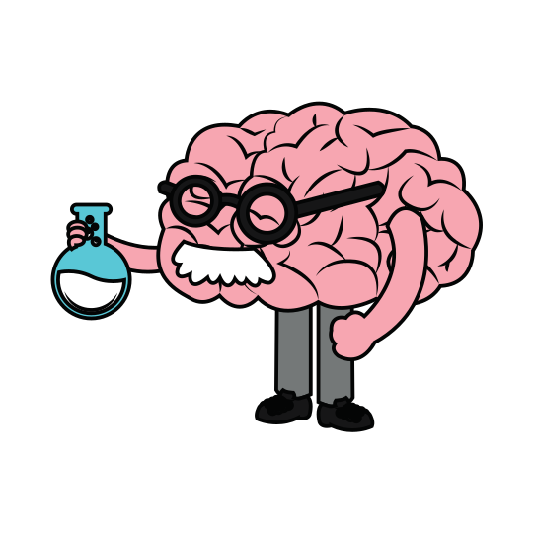
NEUROPLASTICITY
THE BRAIN IS PLASTIC
Brain basics to set the stage

Slide 2
hold up, not that kind of plastic

Slide 3
NEUROPLASTICITY - YOUR LIFE SHAPES YOUR BRAIN
IDENTITY
FOCUS
CULTURE
EXPOSURE
EXPERIENCES
FRIENDS
THOUGHTS
BEHAVIORS
FAMILY
COMMUNITY

Slide 4
EVERYONE'S EXPERIENCES ARE DIFFERENT, THEREFORE THEIR BRAINS ARE DIFFERENT

Slide 5
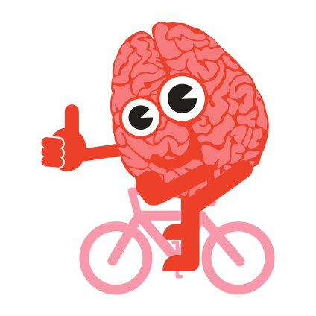
ALL MENTAL ACTIVITY IS BASED ON UNDERLYING NEURAL ACTIVITY - RICK HANSON

Slide 6
OKAY...LET'S TAKE A STEP BACK
Notes:
Photo credit:
https://medicalxpress.com/news/2018-07-neuron-axons-spindly-theyre-optimizing.html

Slide 7
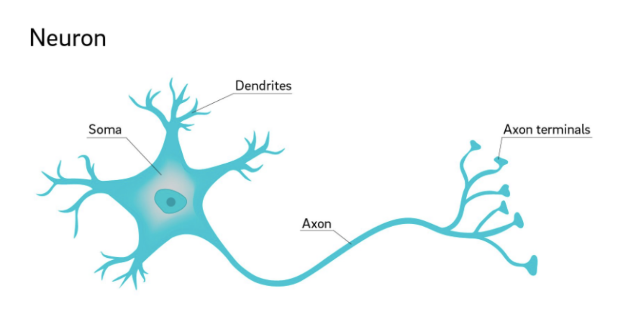
NEURONS ARE CELLS IN THE BRAIN THAT COMMUNICATE INFORMATION FROM ONE PART OF THE BRAIN TO ANOTHER
Notes:
Photo credit:
https://medicalxpress.com/news/2018-07-neuron-axons-spindly-theyre-optimizing.html

Slide 8
HOW DO NEURONS COMMUNICATE WITH EACHOTHER?
Not quite like this......but rather

Slide 9
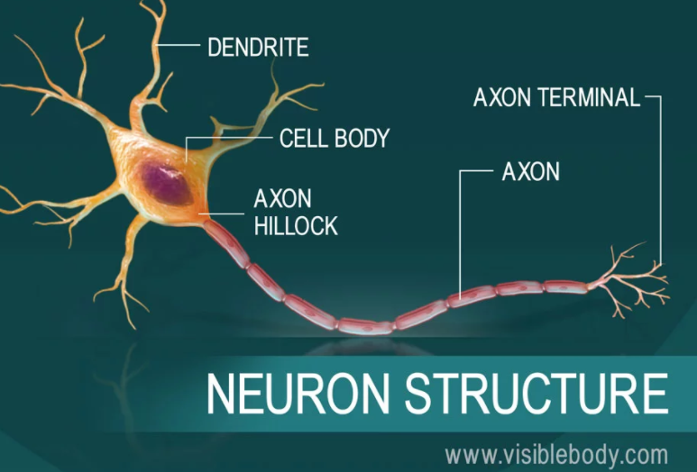
A PROCESS CALLED SYNAPTIC TRANSMISSION
Release from the axon and bind to the receptors of the receiving dendrite- kind of like Legos
Notes:
Photo credit:
https://www.visiblebody.com/learn/nervous/neurons

Slide 10
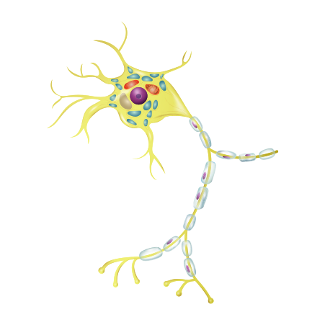
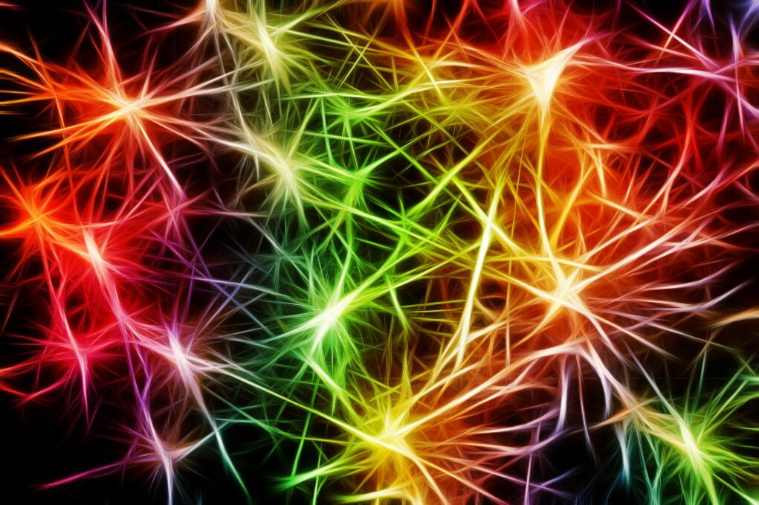
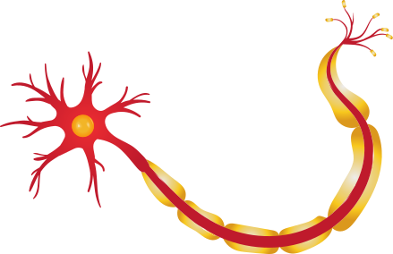
SYNAPSES
Where 2 neurons meet

Slide 11
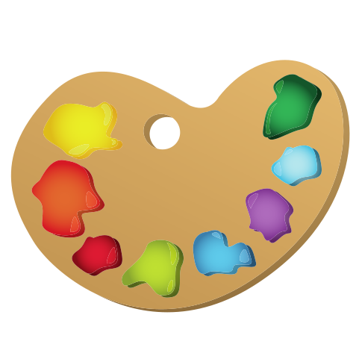
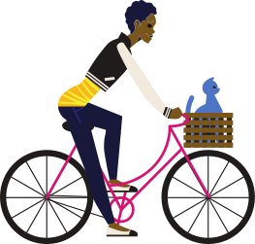
NEW NEURAL PATHWAYS ARE FORMED WHEN YOU REPEAT A BEHAVIOR - MAKING IT EASIER TO DO WITHOUT CONSCIOUS THOUGHT!

Slide 12
WHAT FIRES TOGETHER, WIRES TOGETHER
THIS CAN WORK FOR OR AGAINST US
Neurons that fire together wire together. To oversimplify: Our brain cells communicate with one another via synaptic transmission–one brain cell releases a chemical (neurotransmitter) that the next brain cell absorbs. This communication process is known as “neuronal firing.”
Notes:
Ask students examples of what we mean when we say this can work for or against us?

Slide 13
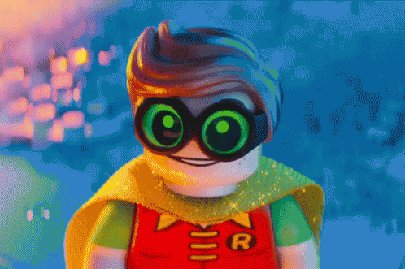
SO COOL...I THINK I'M GETTING THIS
Notes:
Ask students examples of what we mean when we say this can work for or against us?

Slide 14
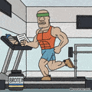
BACK TO ALL MENTAL ACTIVITY IS BASED ON UNDERLYING NEURAL ACTIVITY
The more you think something the more it fires
Every thought, action and behavior is based on neurons connecting
The more it fires, the more it wires into easily accessible pathways into the brain
Notes:
Ask students examples of what we mean when we say this can work for or against us?

Slide 15
WHY DOES THIS MATTER FOR OUR STUDENTS?
Notes:
What they say to themselves matters

Slide 16
WHY DOES THIS MATTER FOR OUR STUDENTS?

Slide 17
HABITS THEY SET UP NOW WILL CARRY WITH THEM
What are your hopes for your students in the long term?
What kind of habits do you want them to set up?
What are three key things you want them to wire in their brain from your class?
What three beliefs do you want them to have about themselves?

Slide 18
IN SUMMARY
Thoughts, behaviors and experiences shape the brain throughout our entire life
Neurons are the cell bodies of the nervous system that transmit information
Neurons communicate through synaptic transmission
Chemical messengers (neurotransmitters) release from neurons - transmission through synapses
Neurotransmitters release from the axon and bind to the receptors of the receiving dendrite
What fires together, wires together - the more you repeat a behavior the stronger the connection becomes
The brain has the capacity to create new neural connections and grow neurons in response to our thoughts and experiences
WHAT IDEAS DO YOU HAVE FOR TEACHING THIS CONTENT?

