Slide 1
Let’s Make Candy Cane Bark

Slide 2
Ingredients:
2 lbs white chocolate (that can be melted- bars, melts, chocolate chips)
12 candy canes
1 tsp of peppermint extract (if you want extra flavor)
Ziploc bags
Metal spoons or rolling pin (something to crush the candy canes)
Pan
Wax paper
Microwavable bowl
Spoon for stirring

Slide 3
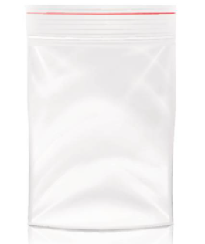
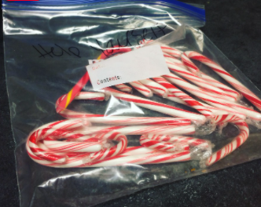
1. Put candy canes into a gallon sized Ziploc bag.
If you are doing individual bars, give each student a small Ziploc and their own candy cane.

Slide 4
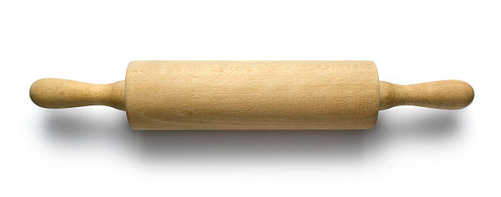
2. Using a rolling pin or other tool, crush the candy cane into small pieces.

Slide 5
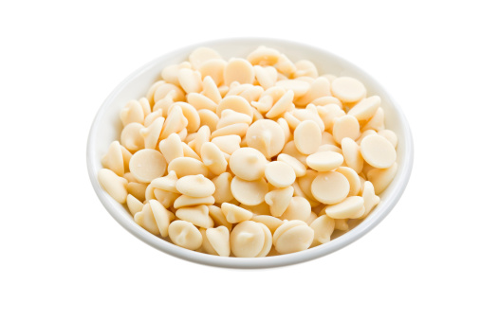
3. Pour white chocolate into a microwavable bowl.

Slide 6
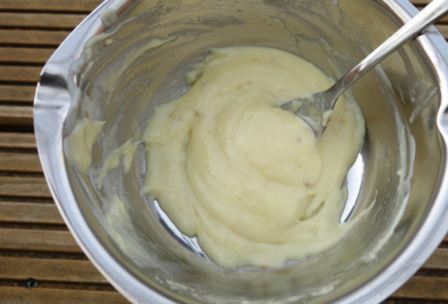
4. Put it in the microwave to melt the chocolate (follow time directions on bag).

Slide 7
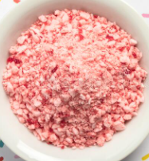
5. Pour the candy cane pieces into the melted white chocolate and stir. (Add peppermint flavor if you want)

Slide 8
6. Put the wax paper onto the pan.

Slide 9
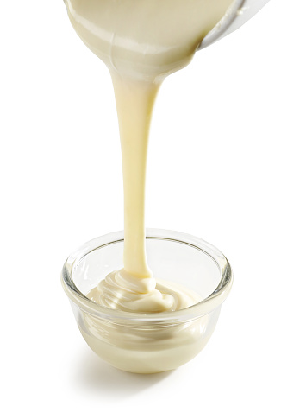
7. Pour and spread the white chocolate candy cane mixture on to the wax paper.

Slide 10
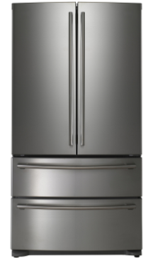
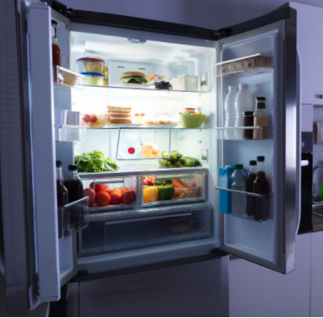
8. Put into the fridge for at least 30 minutes so it can harden (the longer the better).

Slide 11
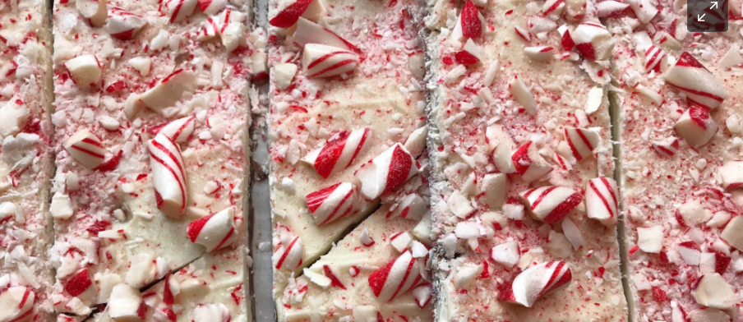
9. Break apart, eat, and enjoy!!!

Slide 12
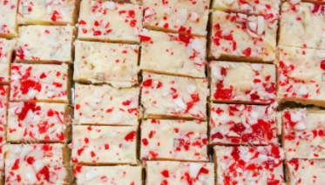
Review: Did you like the candy cane bars? How did you make it?

