Slide 1
Cyber Security Awareness
How to build an army of suspicious people
© Web Safe Staff 2023: This training is the copyright of Web Safe Staff. Requests and enquiries concerning reproduction and rights should be addressed to: michael@websafestaff.com.au
Important Disclaimer: The material in this training has been developed and drafted for information purposes only, without assumption of a duty of care by Web Safe Staff. It is not intended to be a substitute for consulting legislation directly or obtaining qualified legislative advice on any matter discussed.

Slide 2
A
B
C
wareness
ehaviour
ulture
Notes:
Get to meet people like Dave
Not much travel
Pickpocketed at Tay Tay concert in 5 minutes
Not naturally suspicious, hasn’t had to be, hasn’t been taught
Standard human: trusting, naïve, helpful, gullible
Nothing wrong with that. 20 years ago that is.
World has changed, we need to change too
Lots of Daves around
I like to have some fun with the Daves of this world
Not to annoy or be nasty, get into mind of crim
And get cool stories for social media, training

Slide 3
Human Nature
Trusting
Naive
Helpful
Gullible
Notes:
Get to meet people like Dave
Not much travel
Pickpocketed at Tay Tay concert in 5 minutes
Not naturally suspicious, hasn’t had to be, hasn’t been taught
Standard human: trusting, naïve, helpful, gullible
Nothing wrong with that. 20 years ago that is.
World has changed, we need to change too
Lots of Daves around
I like to have some fun with the Daves of this world
Not to annoy or be nasty, get into mind of crim
And get cool stories for social media, training

Slide 4
90%
Notes:
Anyone know what this number refers to?
Yes roughly number of breaches via people.
Number quoted higher and lower, but it’s high.
Ernst & Young quoted 98% a year or so ago. Then they joined the tech space. Yay for me!

Slide 5
Notes:
So we introduced Dave, now lets introduce Tech
Tech good, processes good
Relative to Dave that is

Slide 6
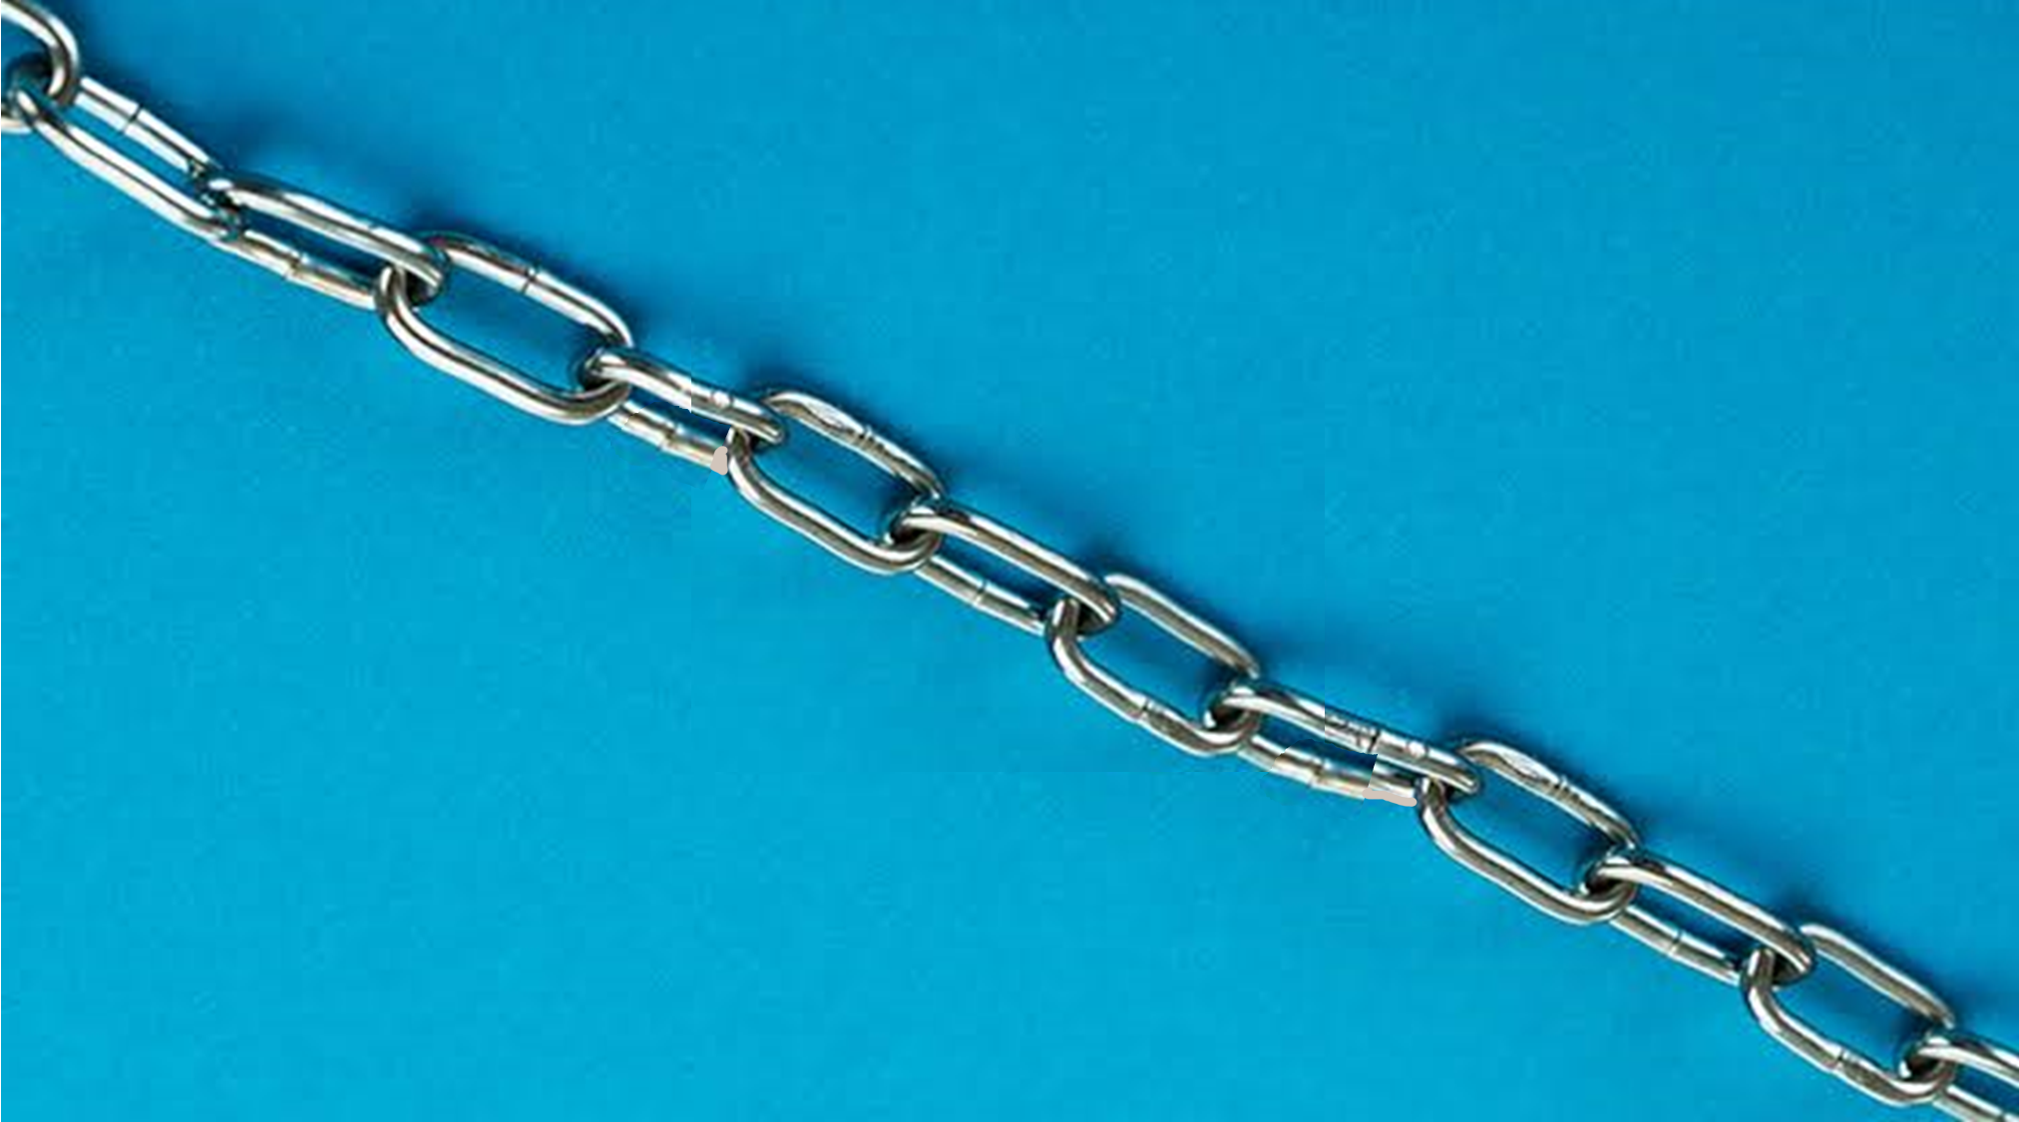
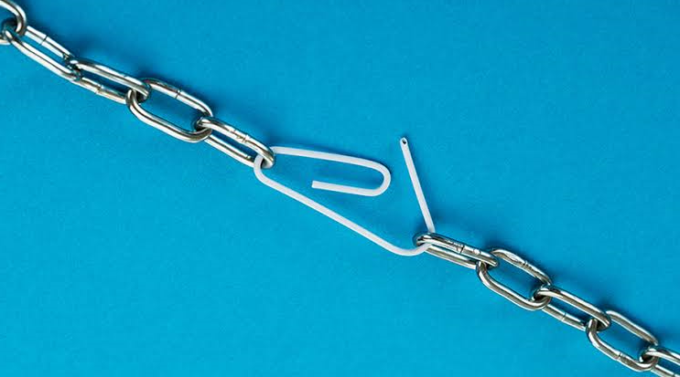
Technology
People
Processes
Dave
Notes:
Three parts to IT, and IT security. PPT
Reality is a bit different
Implies ‘weakest link’, and technically correct, though I don’t like it, will get to that.
Instead lets say that Dave is easy target
Confused because not equipped to identify and deal with threats

Slide 7
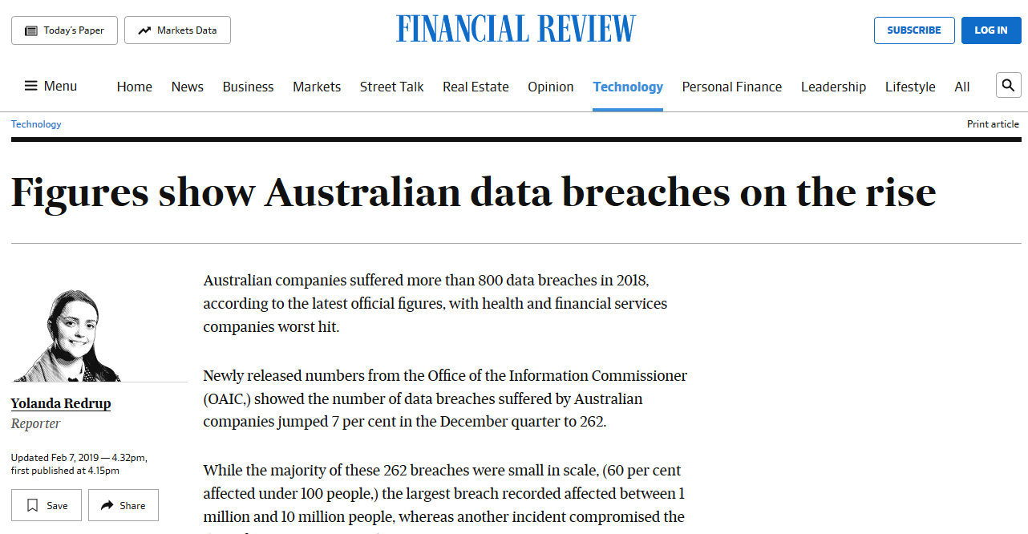
Notes:
Keeps going up.
How many of these aren’t even reported?
There’s legislation for reporting, but I know companies aren’t abiding by it.
And it’s expensive.
Anyone know average cost of a breach in Aus?
Close to $250k. Or $3m, depeding on which source you read. I think it’s closer to $250k.
Repair, downtime, reporting, reputation damage, lost customers. Adds up real fast!

Slide 8
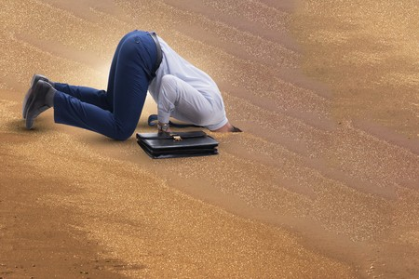
Notes:
Some companies handle risk well.
They may have to comply with standards. E.g. Finance, CPG234
Smaller comanpanies, not so much. (up to 200 staff)
Still seeing far to much of this. Ignorance.
We spent our $500, fingers crossed.

Slide 9
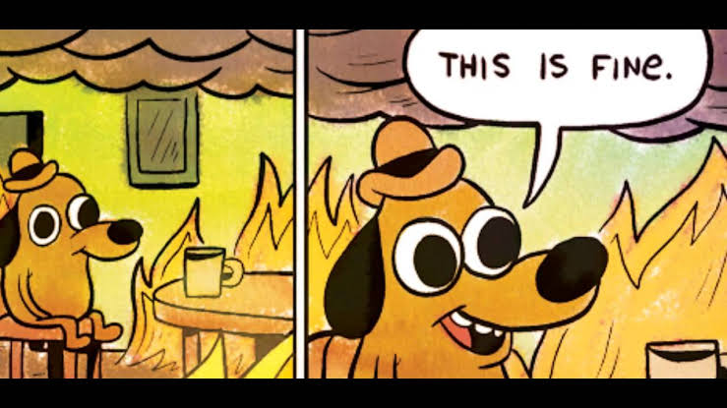
Notes:
Or Oblivious. Plenty going on in the news about breaches, but people switch off to it.
I spoke to a few of my friends recently about personal IT security. They have a firewall and antivirus. They’re all sweet! No one can touch them. A freaking firewall!
Took me about 15 minutes to rock their world a bit. Maybe it’s enough.
But people have become numb to it all.
Don’t react until they are breached, then it’s too late.

Slide 10
Recap
Notes:
Recap
People are a massive target
Most breaches are via people
So if we did want to make a big difference, what can we do?

Slide 11
Notes:
Hey guys, cyber security awareness training.
Sally responsive
For most others not
Not everyone’s cup of tea for many reasons

Slide 12
Focused on compliance
No Buy-in
People delay or don’t start
Not interactive
Boring
Distracted
Once a year
Don’t remember much
What did we actually achieve?

Slide 13
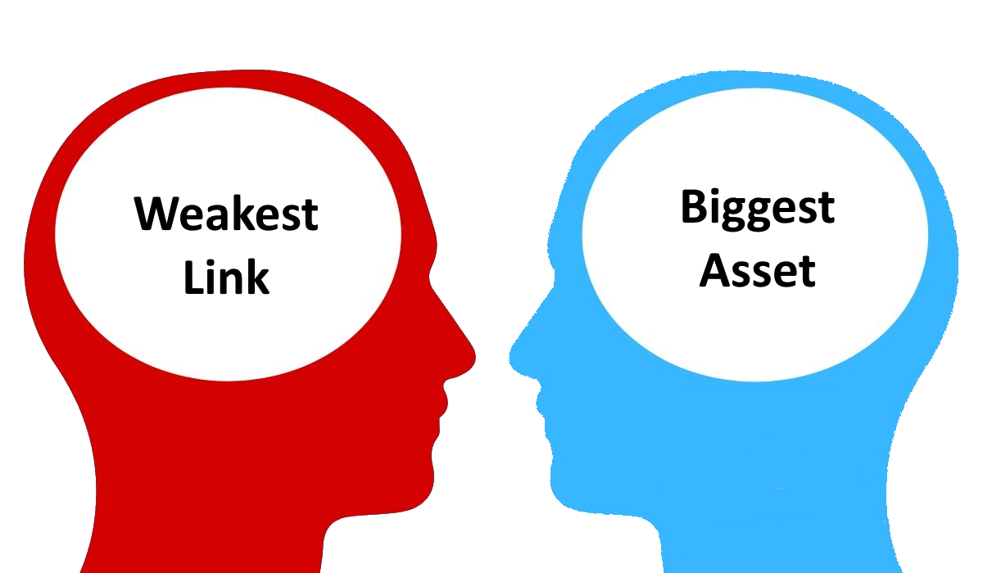
Mindset
Notes:
Weakest link, human error, stupid users etc.
Human risk. No. Risk = vulnerability + threat
The threat is the cyber criminal. People are vulnerable. Put them together, we have a risk.
You don’t blame someone who is vulnerable. You help them.
Human error: Expecting people to be at their best, without helping them to be at their best.
So we need management to reaslise people are not the problem, they are the solution, and to be encouraging and nurturing.

Slide 14
Buy-In
Notes:
People don’t like to change unless they are dissatisfied
Relate to home use – this is massive
Don’t tell people that their kids are going to be tracked down and thrown into a van. That’s probably going to mean they stay home on the porch on a rocking chair with a shotgun, so they won’t get any work done.
Instead tell them that they can better defend their information and money for the family. What they implement at home they will implement at the office.
Examples should relate largely to how it will personally impact people. Then they care, they learn, they bring the skills to work.

Slide 15
Train
Notes:
You get what you pay for.
Free? Don’t expect much
Most online training is cheap, and people will move through it and not learn
Some content is funny. You have fun, but there’s not concise messaging.
Some content is dead boring. Attention = zero.
Need to give people simple rules that deal with most scams. And this is a thing.
It’s about ROI. Do you actually want to save money, or just tick a box to say you did training?

Slide 16
So many people don’t know the basics!
Notes:
You get what you pay for.
Free? Don’t expect much
Most online training is cheap, and people will move through it and not learn
Some content is funny. You have fun, but there’s not concise messaging.
Some content is dead boring. Attention = zero.
Need to give people simple rules that deal with most scams. And this is a thing.
It’s about ROI. Do you actually want to save money, or just tick a box to say you did training?

Slide 17
https://www.mybanking.com
https://www.mybanking.com.loginnow.info CTRL+Click to follow link
Notes:
There’s so much that people don’t know!
Things like:

Slide 18
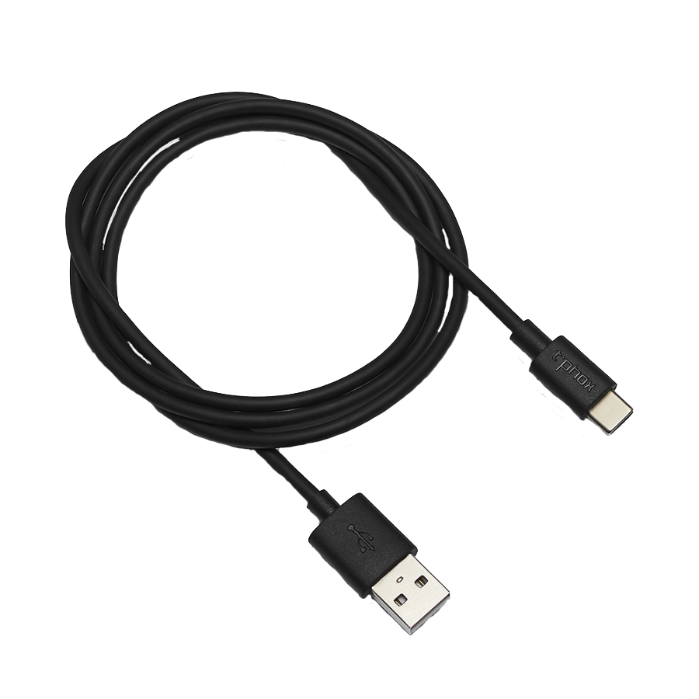
Notes:
There’s so much that people don’t know!
Things like:

Slide 19
Notes:
There’s so much that people don’t know!
Things like:

Slide 20
What damaging info can a criminal get to you?
Confirm the info is correct the first time you get it, or when it changes
Phone call (on a number you look up)
Notes:
There’s so much that people don’t know!
Things like:

Slide 21
Long
Complex
Unique
Notes:
There’s so much that people don’t know!
Things like:

Slide 22
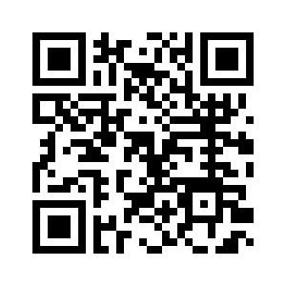
https://bit.ly/2z3hR42
Notes:
There’s so much that people don’t know!
Things like:

Slide 23
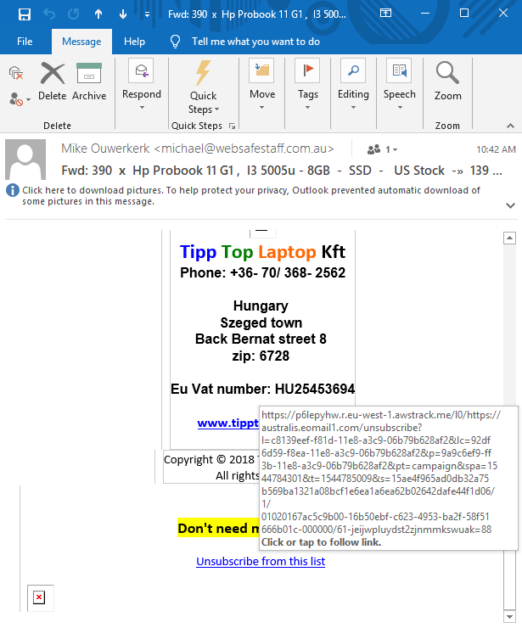
Notes:
There’s so much that people don’t know!
Things like:

Slide 24
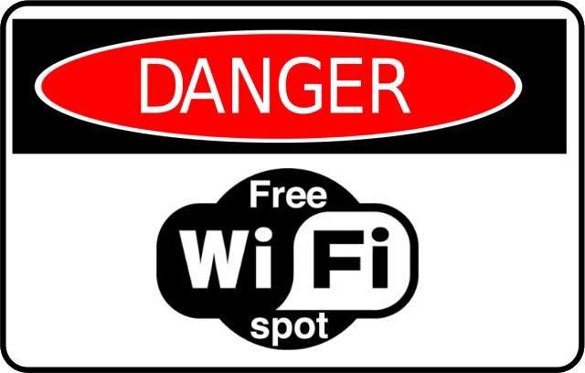
Notes:
There’s so much that people don’t know!
Things like:

Slide 25
Notes:
There’s so much that people don’t know!
Things like:

Slide 26
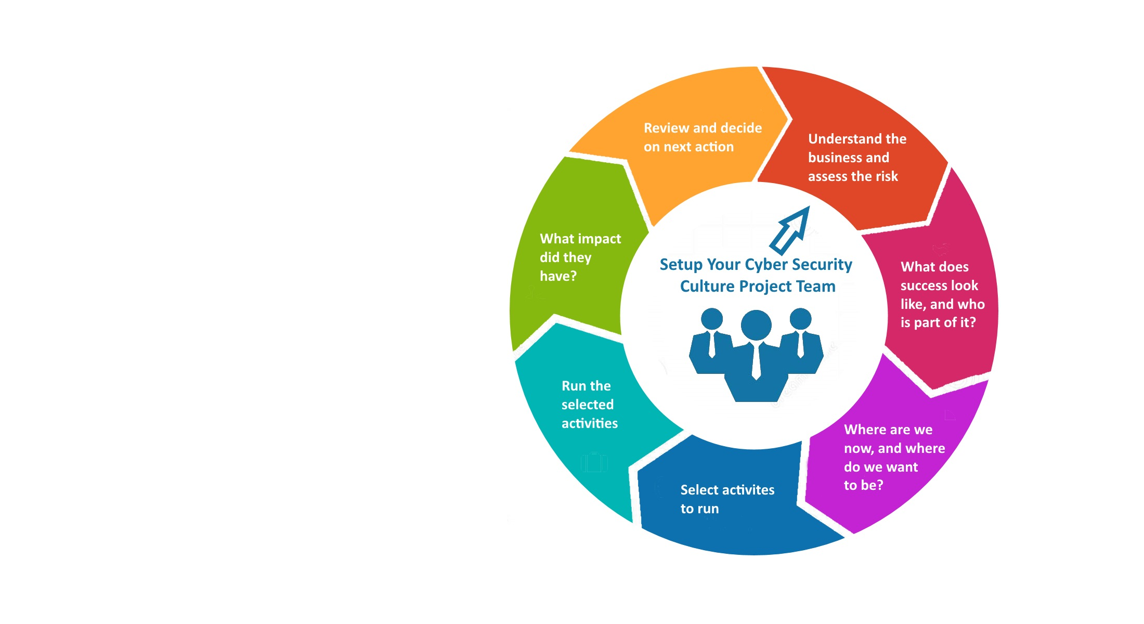
Cultural Change
Notes:
Frameworks here
We’re no longer talking about once a year training
You want to embed awareness into the beliefs, values of people and your company
Goal: constantly suspicious, regularly updated, measureable results, security first mindset
Do this with relevant, short sharp reminders, engaging.
Build internal capacity, teams, messaging, reporting, metrics.

Slide 27
Notes:
It all starts with people / companies starting to give a shit.
No, you probably do not know all the ways crims will scam you. I don’t, I am constantly learning, and I’ve been doing this for 7 years.
But wanting to stay safe is a good start, so try and get what you can out of the training, and share the knowledge.

Slide 28
Questions?
Notes:
It all starts with people / companies starting to give a shit.
No, you probably do not know all the ways crims will scam you. I don’t.
But wanting to stay safe is a good start, so try and get what you can out of the training, and share the knowledge.

