Slide 1
Resume and Interview Process

Slide 2
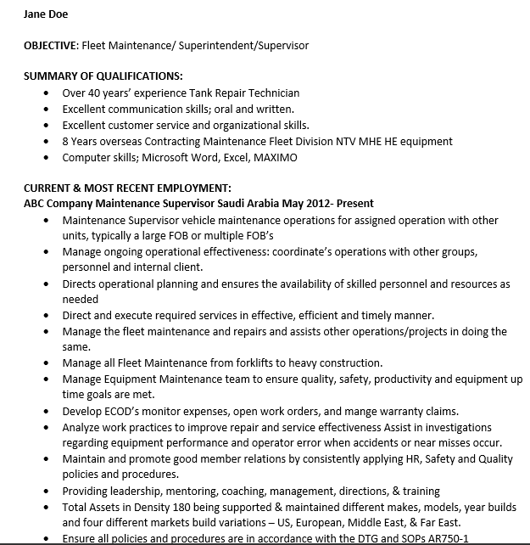
We Know the Resume is Horrible..

Slide 3
Interviewing- It’s ok to coach them through the process -TAPS hasn’t prepared the veteran candidate for your interview - No they don’t understand the STAR method - Are you really afraid of giving them an unfair advantage? What’s fairness?
-Self-Promotion is a Foreign Concept

Slide 4
Network With Vets & Active Military
Learn to Make the Link Between Job Titles:
Collateral Duty Inspector to Quality Assurance Representative Avionic Technician to Visual Dimensional Inspector
Field Logistics to Technical Program Manager
Adaptability:
Often Overlooked/ Undervalued
Hire for Fit/ Trainability Not Just Skill Set
Does Previous Skill Set = Predictable Results

Slide 5
Prior Learning Assessment (PLA)
Definition and types of PLA options
Institutional exams, standardized exams, articulated credit, ACE recommendations including military transcripts, and portfolio review
How PLA can benefit the service member and employer
The employer get assistance from NEOVETS in PLA
NEOVETS advises the college as to where the PLA credits would fit within their degree program

Slide 6
Military Transfer Assurance Guide (MTAG)
Benefits
Assure students that courses will meet the same outcomes
State-wide, faculty-led course approval process
Emphasize learning outcome based course delivery
Why do we need MTAGs?
Military courses are developed for military training not academic courses
Differences between military training and academic courses
MTAGs include course equivalencies based on military training and occupations

Slide 7
Current MTAGs
ACE ID Course | Name of the Military Training/Experience/Coursework
AR-1402-0168 | Information Technology Specialist, Version 8
AR-1402-0169 | Information Technology Specialist, Version 2
AR-1715-0928 | Signal Support Systems Specialist, Version 7
CG-1715-0169 | Information Systems Technician “A” School, Version 2
DD-1601-0036 | Geospatial Engineer, Version 3
MC-1715-0116 | Basic Electronics, Version 6
NV-1715-2089 | Information Systems Maintenance Technician, Version 3
NV-1715-2307 | Information Systems Technician Class “A”, Version 1
NV-1732-0026 | Nuclear Power School, Enlisted, Version 2
NV-1732-0026EM | Nuclear Power School, Enlisted, Version 2, Electrician Mate
NV-1732-0026ET | Nuclear Power School, Enlisted, Version 2, Electrician Technician

Slide 8
Good for quick reference
Can search based on MOS/AFSC/Rating
Can search from perspective as a veteran or an employer
Biggest national user of this platform is AT&T

