Slide 1
Moving from Stencyl 2 to Stencyl 3 & beyond
Some changes you need to be aware of

Slide 2
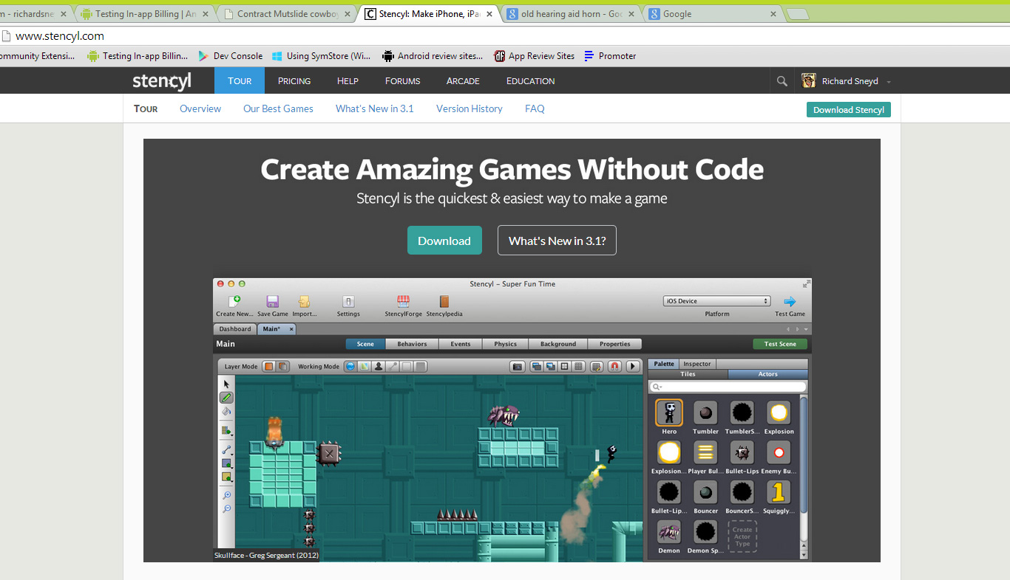
Check out: www.stencyl.com

Slide 3
At a glance
Stencyl 2
Since Stencyl 3...
Disunified engine (different base codes for flash & IOS targets)
Limited publishing options
Complex game = poor performance
No shaders
Hard to write extensions.
Glitchy MP3 based sound.
1 Unified engine! (yay!)
Native publishing for Windows, Mac, Linux, Flash, IOS & Android. Others planned.
MASSIVE performance boosts.
Full-screen shader supported for Desktop games (as of 3.2).
.OGG and MP3 support. More on this...
Image API (destructible terrains etc)

Slide 4
Unified Engine
Shared base code for all platforms
Language: Haxe
Framework: OpenFL
3rd party extensions

Slide 5
Check out: www.haxe.org

Slide 6
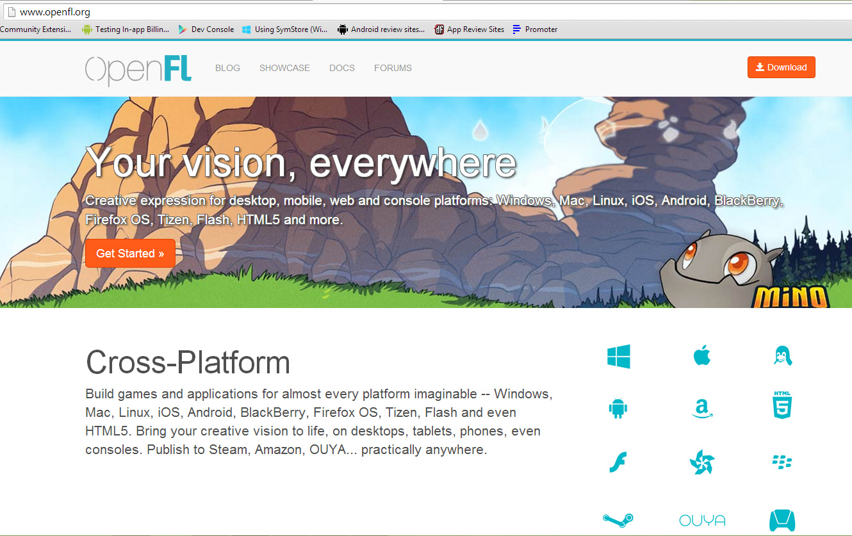
Check out: www.openfl.org

Slide 7
3rd Party Extensions!

Slide 8
Publishing Options
Publish native code to:
Windows
Mac
Linux
IOS
Android.
Flash hasn’t gone anywhere. Runs faster now, too.

Slide 9
Performance Enhancements
Frame-rates up to 4 times faster in some cases!
Optimised base classes
Memory leaks plugged

Slide 10
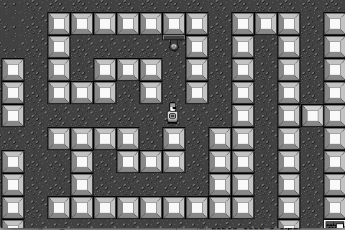
Full-screen Shader support (3.2)
Shaders alter the pixel data of your game to create interesting visual effects. Can help to add that professional touch which makes a good game great.

Slide 11
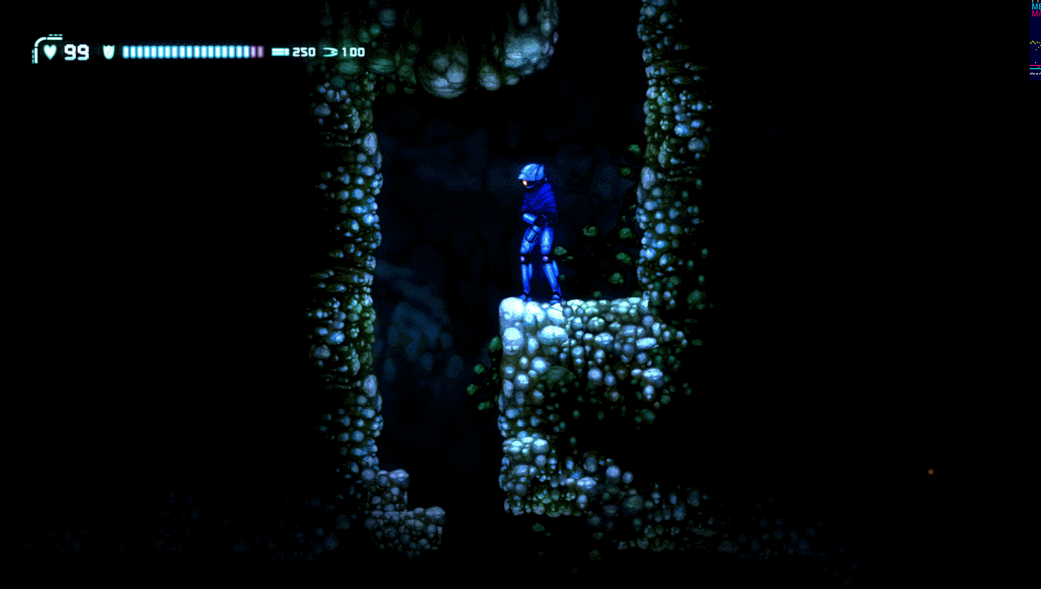
The Possibilities...

Slide 12
.OGG and .MP3
Audio is now handled differently
.MP3 files are used for flash
.OGG files are used for EVERY other platform
You must provide both a .OGG and .MP3 version of your sound files if you’re targeting flash as well as desktop and/or mobile.

Slide 13
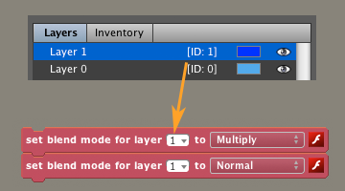
Blend Modes for Layers & Actors...
Limitations: All work on flash. Add, Multiply and Screen work on desktop and mobile. Likely to improve in near future.

Slide 14
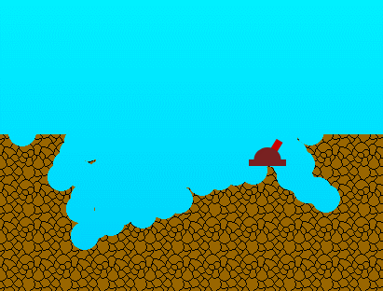
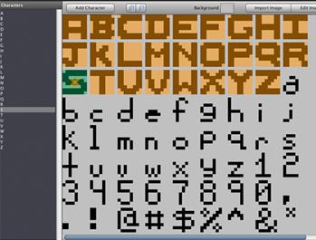
Image API Bitmap Fonts

Slide 15
Multi-resolution Support
O’ my, they’re all so different in size and resolution! If only there were a way to cater for them all simply and effectively from one game project...

Slide 16
Multi-resolution support
4X, 2X, 1.5X, 1X graphic scales
1X is base size
All others are multiples of base size, .ie:
If base size (1x) is 640 x 480, then 2X is twice that (1280 x 960), 1.5x is 1.5 times that (960 x 720), 4X is 4 times that etc...
The idea is to support all screen resolutions, from phones to tablets, to desktop PCs. Some screens (tablets for instance) show lots more Pixels Per Inch than other screens (like the standard desktop monitor).
Lesson: ALWAYS Design your graphics at 4X. Then IMPORT them at 4X. Stencyl will AUTOMATICALLY generate the lower scales from the 4X image.
This means if you decide to publish your game on a platform later on with a higher res screen, your game will not have to stretch the low res graphics. This would look blurry, messy and unprofessional.

