Slide 1
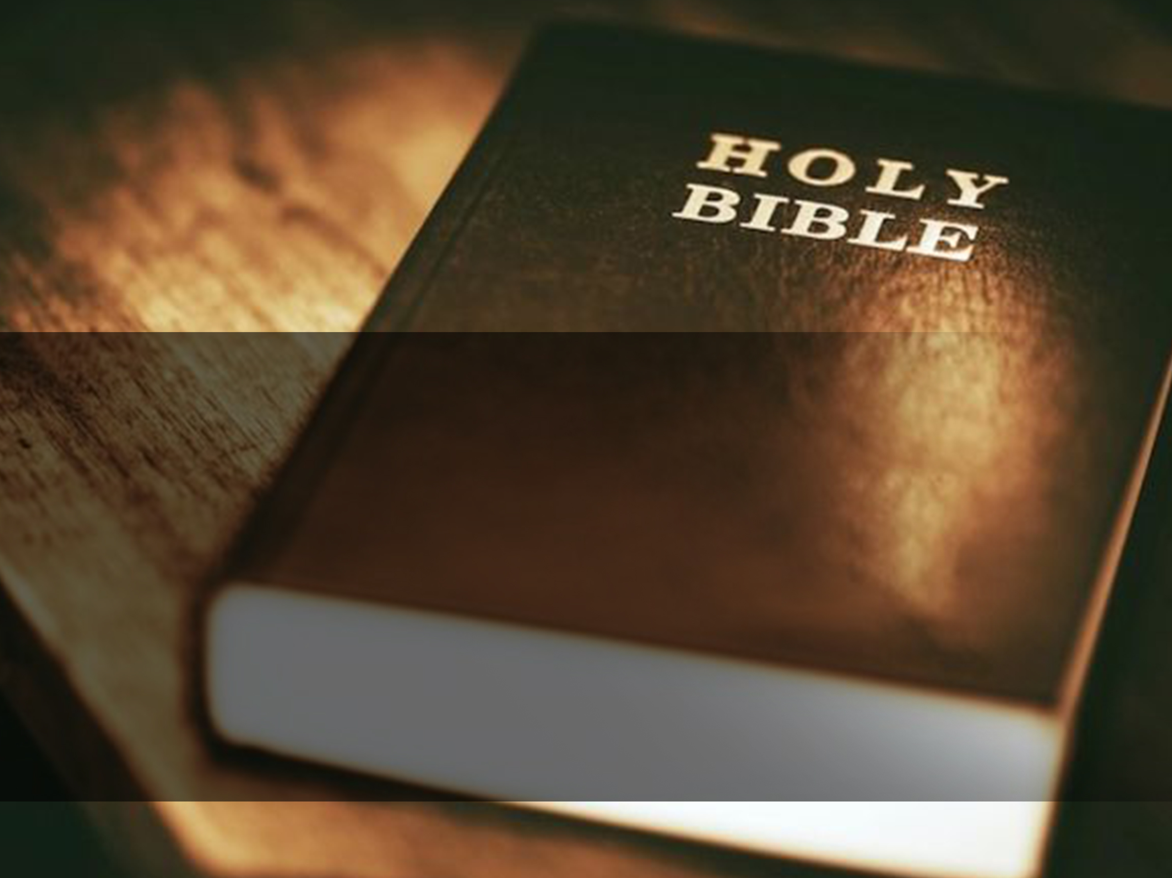
GOD’S WORD
THE CONTENTS IN THE BIBLE
Theme: Christian Living - Chapter 2
Key Verse: John 20:31
Date: 18 June 2017

Slide 2
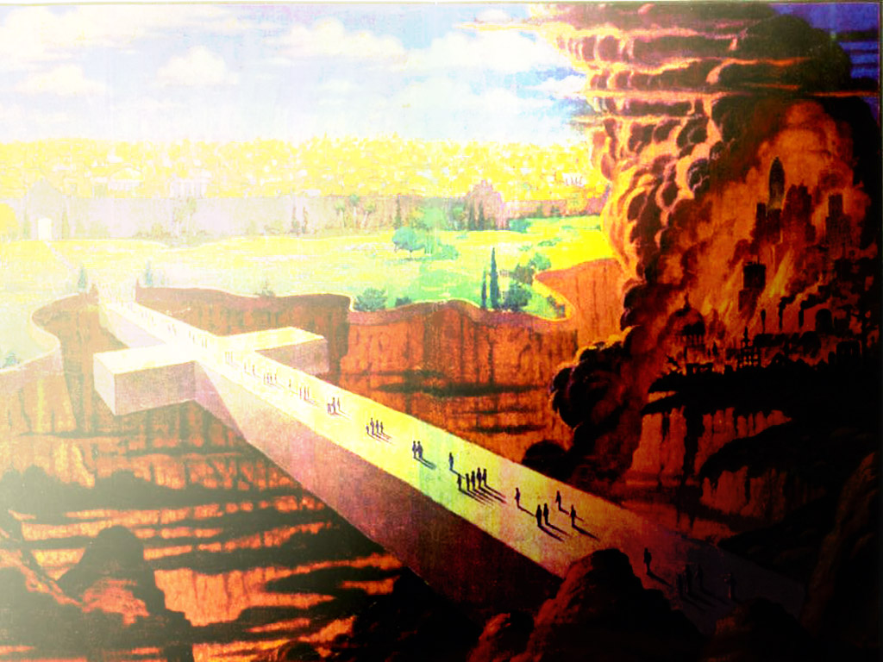
Key Verse:
But these are written that you may believe that Jesus is the Christ, the Son of God, and that believing you may have life in His name.
John 20:31

Slide 3
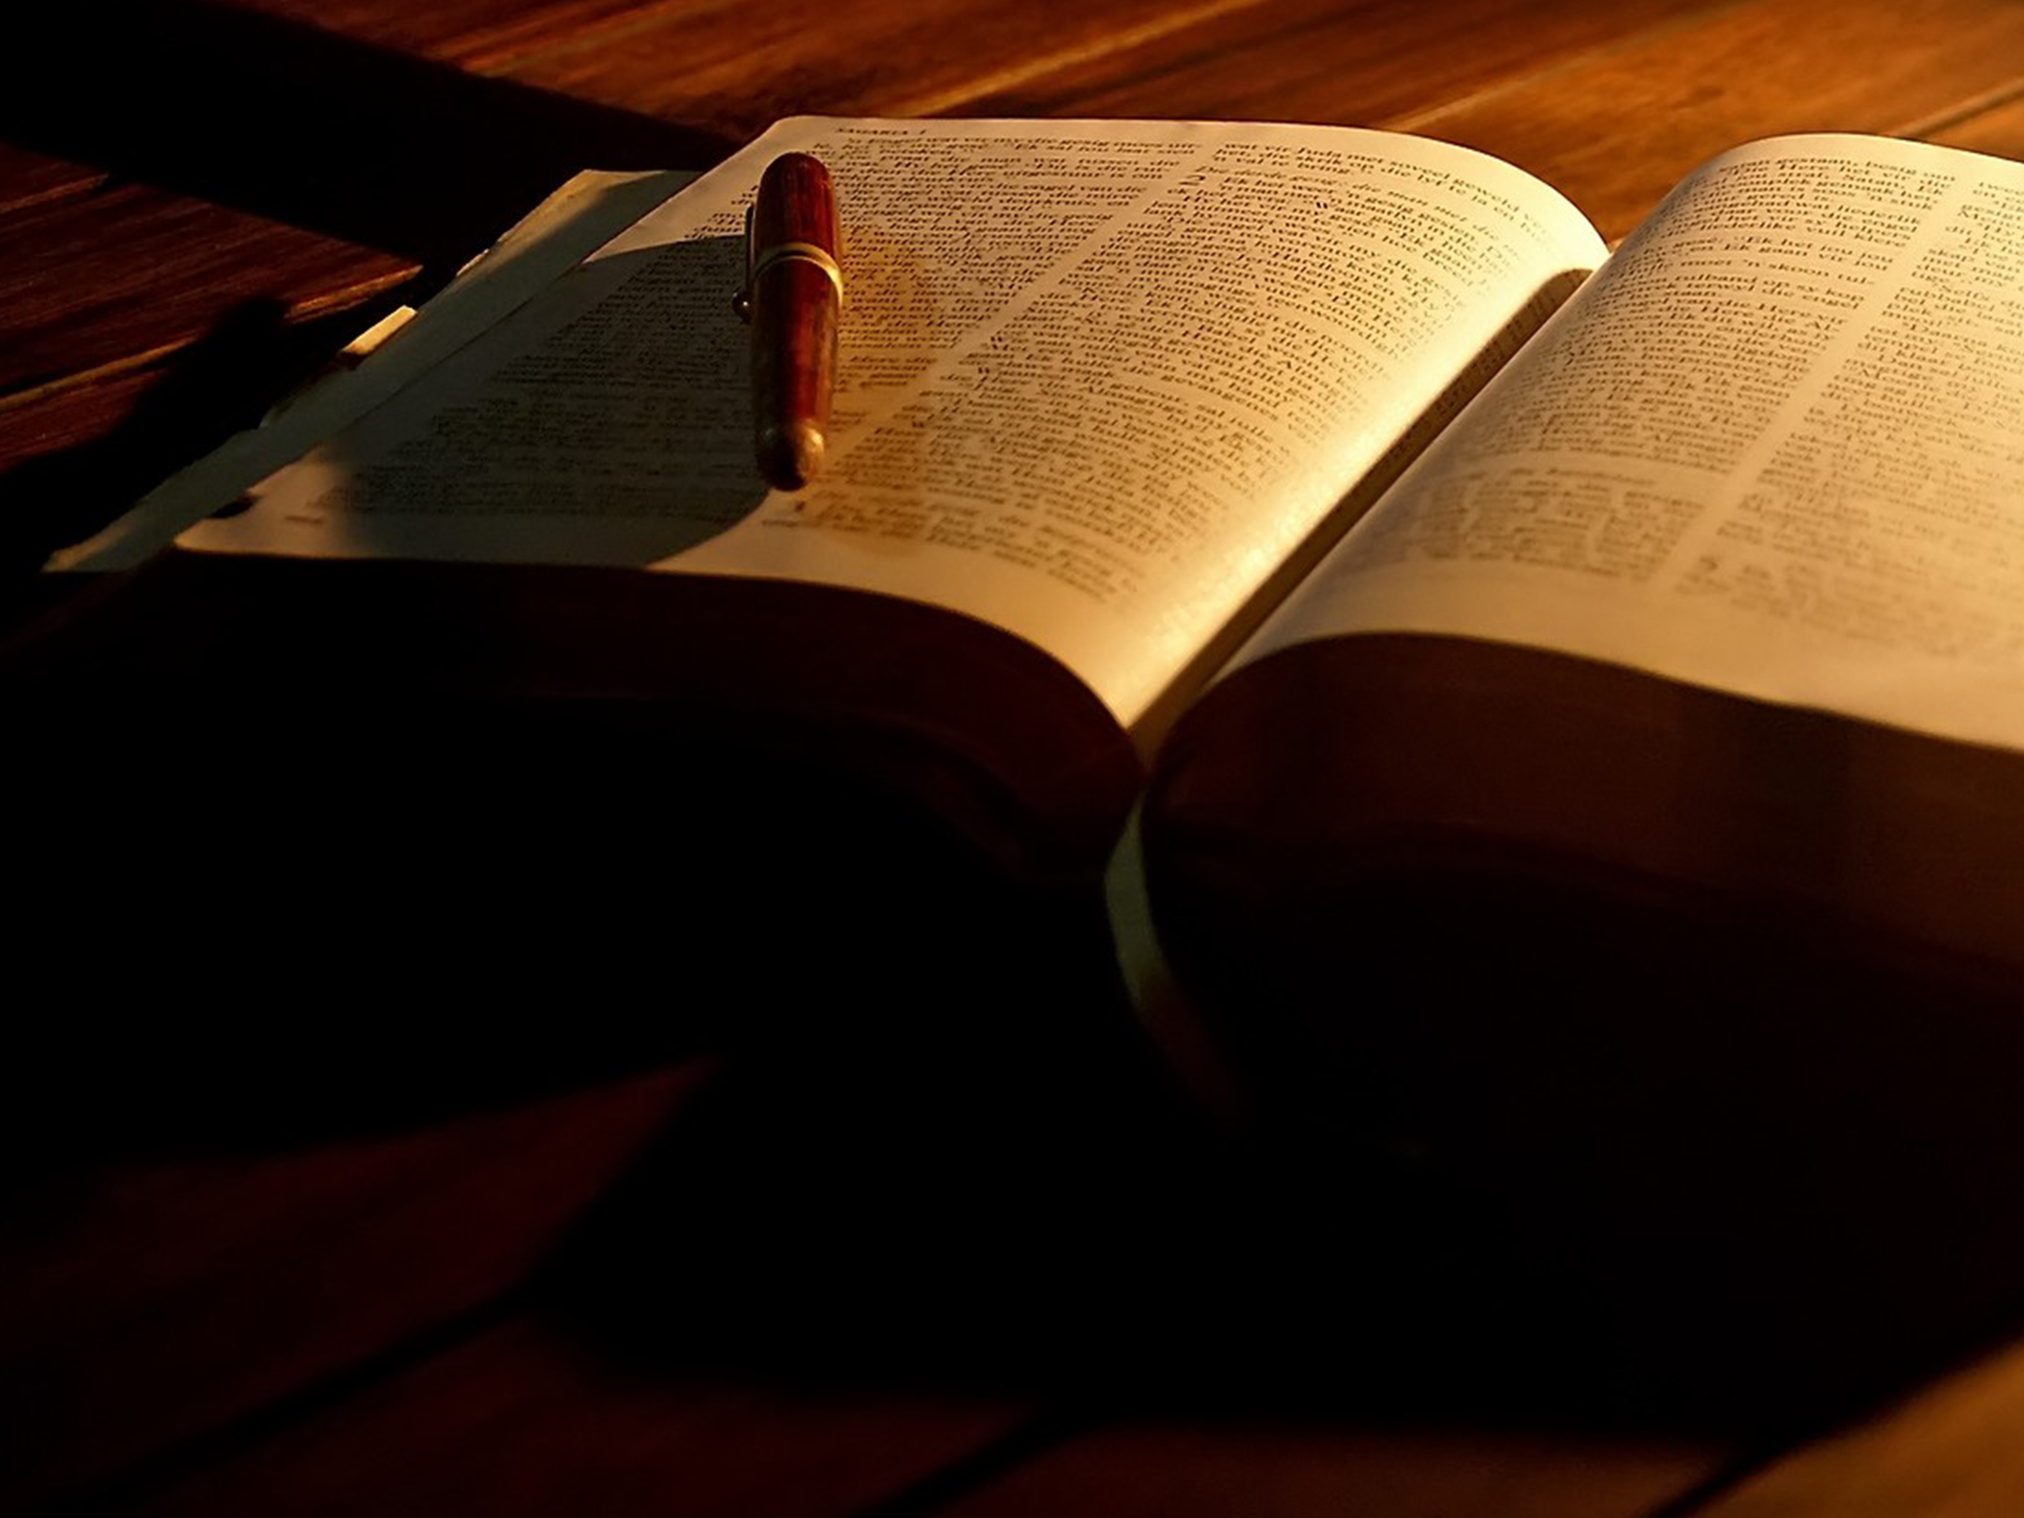
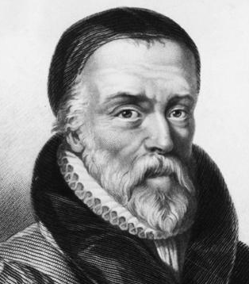
Introduction:
Why is the Bible the greatest work of literature, history and theology ever written?
Why has it been constantly the world’s best-selling non-fiction book and the most widely distributed book?
Why did Tyndale hazard his life in 1526 to translate the Bible into English and was put to death for his efforts?
In what way is the Bible different from other books?

Slide 4
GOD’S WORD - THE CONTENTS IN THE BIBLE
What is the Word of God about?
2. Purposes of the Bible
3a) Overview of the Bible
3b) Have a bird’s eye-view of the Bible

Slide 5
What is the Word of God about?
• The Author and message
- God is Author…thus saith the Lord… about 3,800 times
- it is God’s message to communicate with man
• The central theme is Jesus Christ
• The complete story of the world from beginning to end

Slide 6
What is the Word of God about?
• The structure of the Bible
- 39 Old Testament books (law 5, history 12, poetry 5, prophecy 17)
- 27 New Testament books (history 5, epistles 21, prophecy 1)

Slide 7
2. Purposes of the Bible
a) What it does
• it is powerful, exposes man’s inner hearts. Hebrews 4:12
• pure, revives man’s soul with new life. Psalm 19:7-11
• permanent, incorruptible, never to pass away. Matthew 5:18

Slide 8
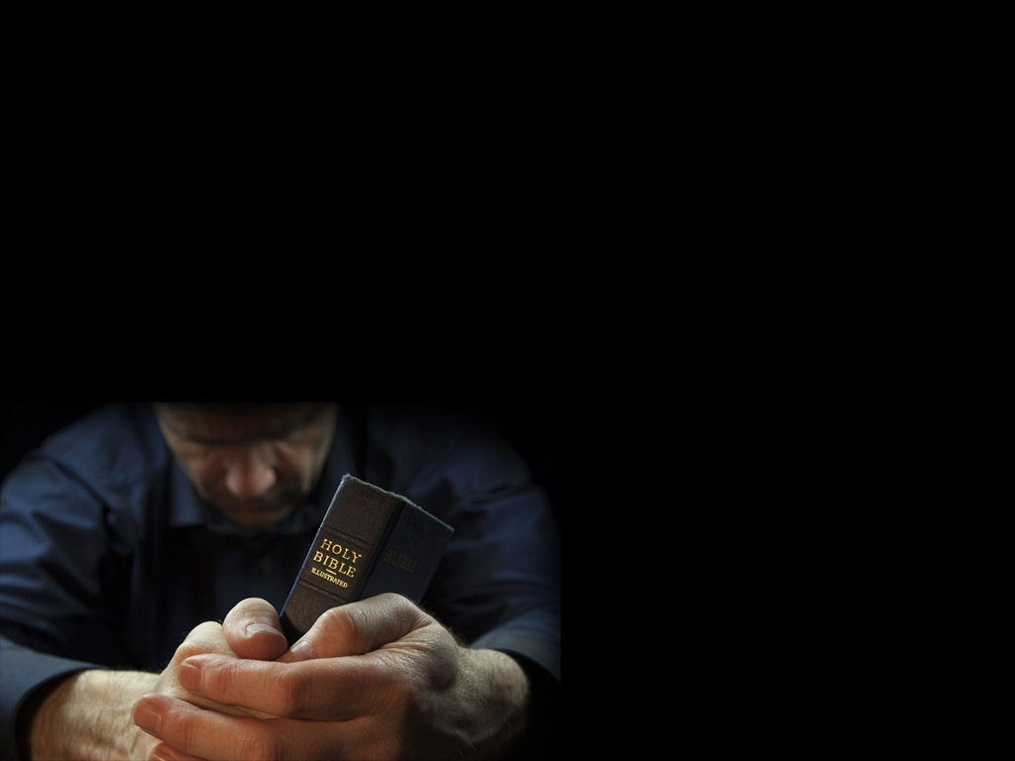
Purposes of the Bible
b) Purposes of God’s Word
to lead us to have eternal life. John 20:31
to return us to relationship with God, to know Him. John 17:8
to reveal truth in a world of fake news. Psalm 119:89

Slide 9
Purposes of the Bible
b) Purposes of God’s Word
• as lamp, gives direction, so we do not stumble. Psalm 119:105
• as mirror, exposes sin. James 1:23,24
• as food, feeds soul and spirit, unlike physical food. Matthew 4:4
• as cleanser, cleans us when we remain in Christ. John 15:3,4

Slide 10
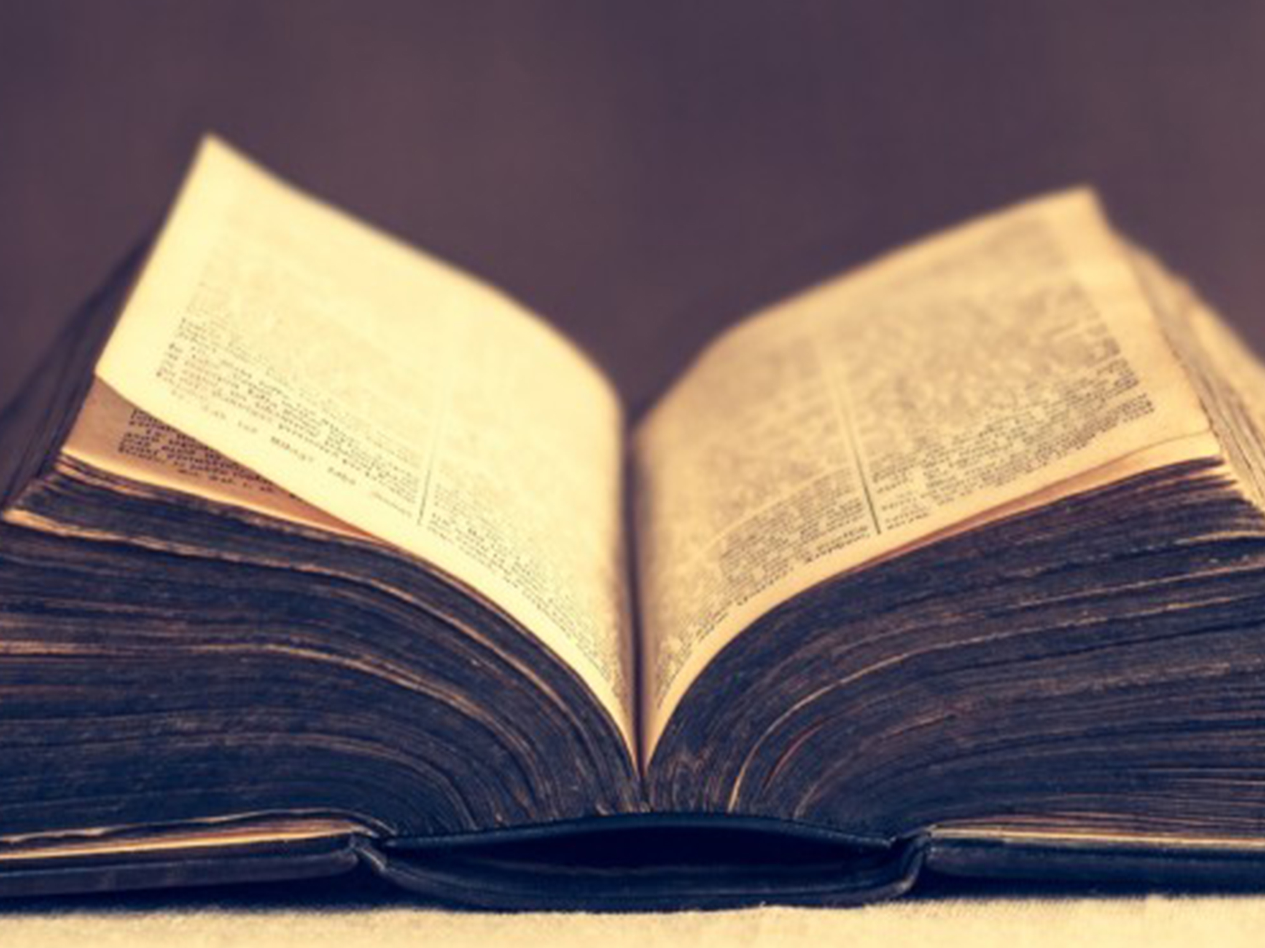
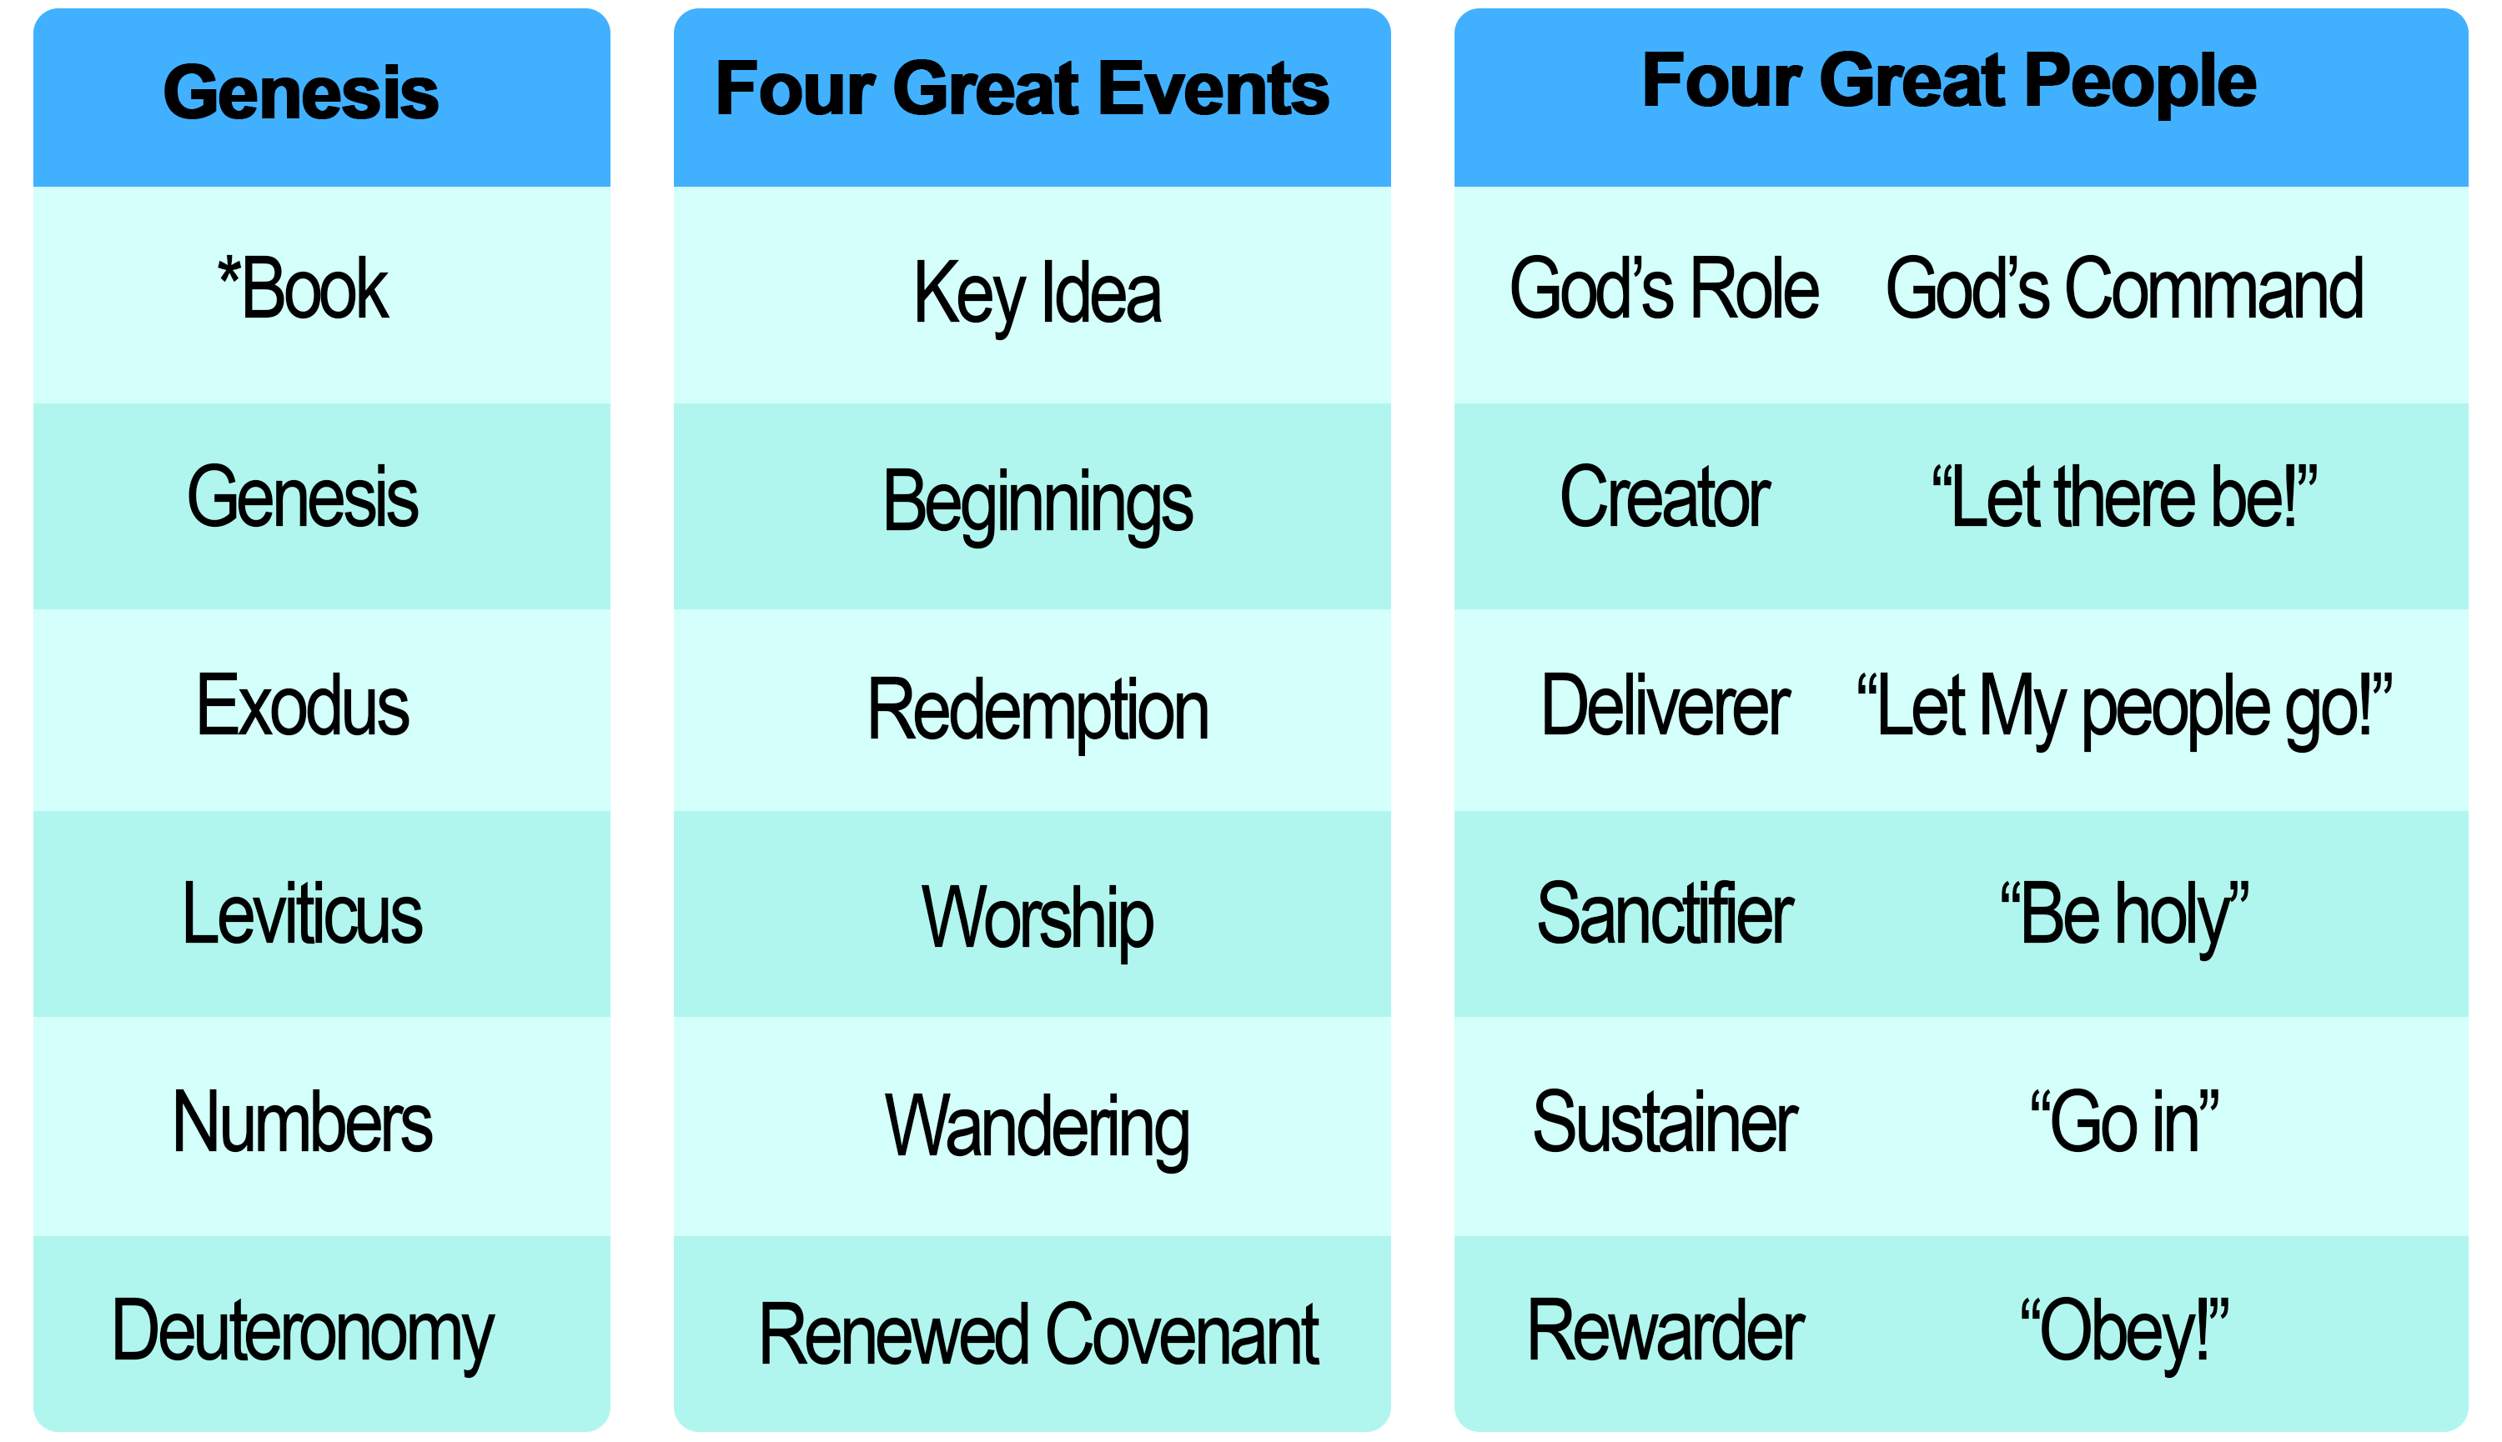
3a) Overview of the Bible:

Slide 11
3b) Have a bird’s eye-view of the Bible
1.Genesis: God the Creator launches the beginnings, elects people
2.Exodus: God redeems His people because of grace (starting out faith)
3.Leviticus: He sanctifies His people because He is holy
4.Numbers: He leads them because He is trustworthy (going on faith); portrait of Christ (bronze serpent, crucifixion Numbers 21:4-9)

Slide 12
3b) Have a bird’s eye-view of the Bible
Deuteronomy: Conditions for the blessings. “Beware lest you forget”
reminder to hear His instructions (listen 50 times)
to keep it (177 times)
to remember that it is out of love (21 times)
that He commanded
remember the past
their deliverance and judgement on their unbelief
His rule, our duties
Cursings and blessings

Slide 13
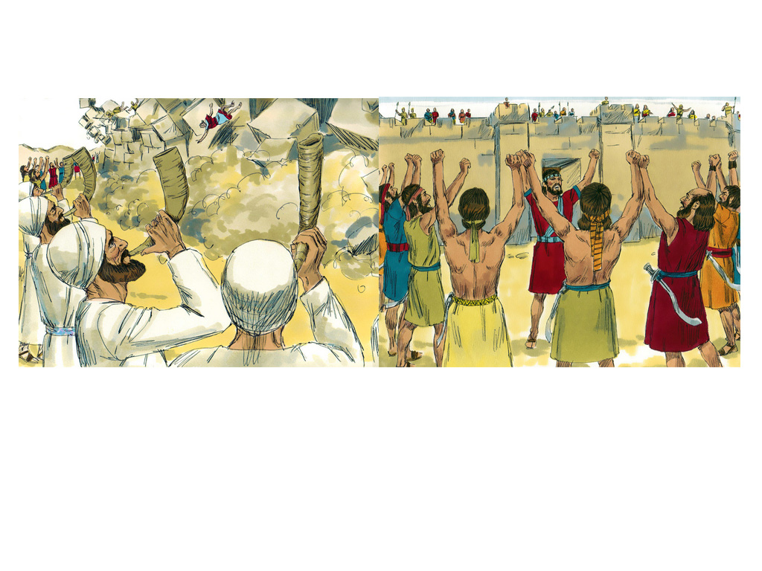
3b) Have a bird’s eye-view of the Bible
Joshua: Possessing the land, journey of faith
entering, conquering, occupying the land
Judges: Judges 2:10
7 cycles of oppression and deliverance because they were disobedient to God and compromised their faith.

Slide 14
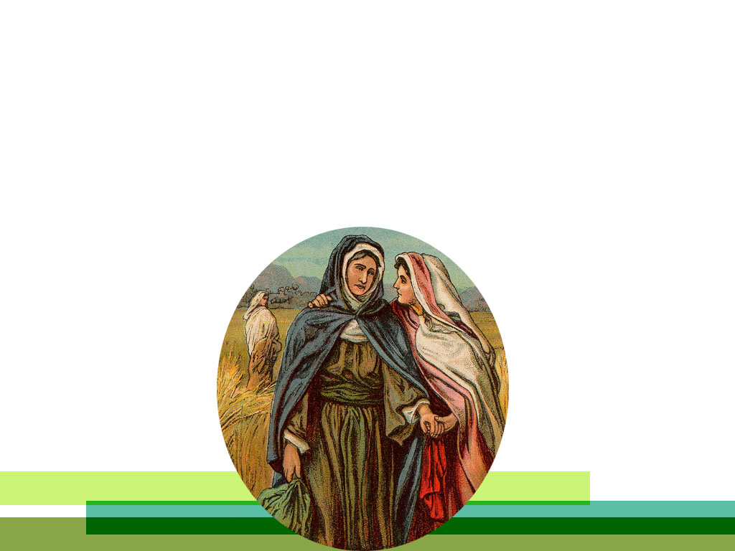
3b) Have a bird’s eye-view of the Bible
8. Ruth: Kinsmen - Redeemer
• Naomi’s bitterness turned to pleasantness
• Ruth’s loyalty… your God shall be my God …
Ruth 1:16

Slide 15
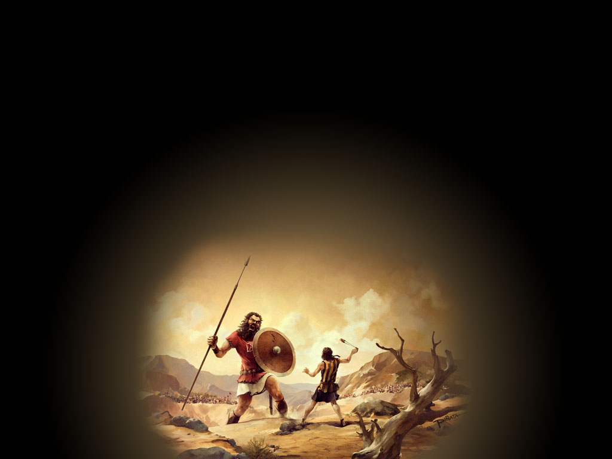
3.b) Have a bird’s eye-view of the Bible
9-14 Samuel, Kings, Chronicles (6 books) (Samuel, Saul, David)
Saul, rejected when he disobeyed God’s commands, started well, finished badly
David a man after God’s heart; accepted by God

Slide 16
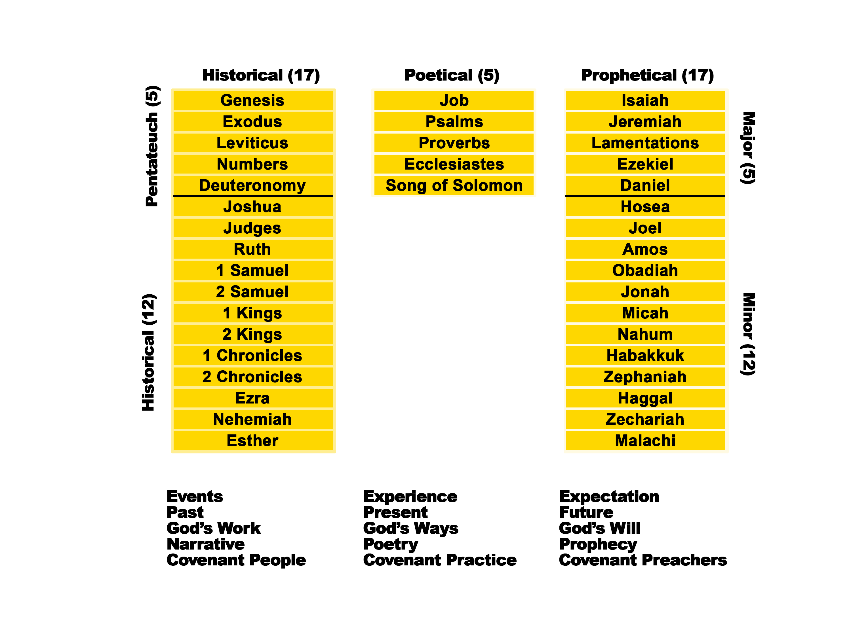
* THE OLD TESTAMENT
*Source: Talk thru the Old Testament by Kenneth Boa

