Slide 1
A Game Of Polo With
A Headless Goat
Emma Levine
Narrator: Barbara Njau

Slide 2
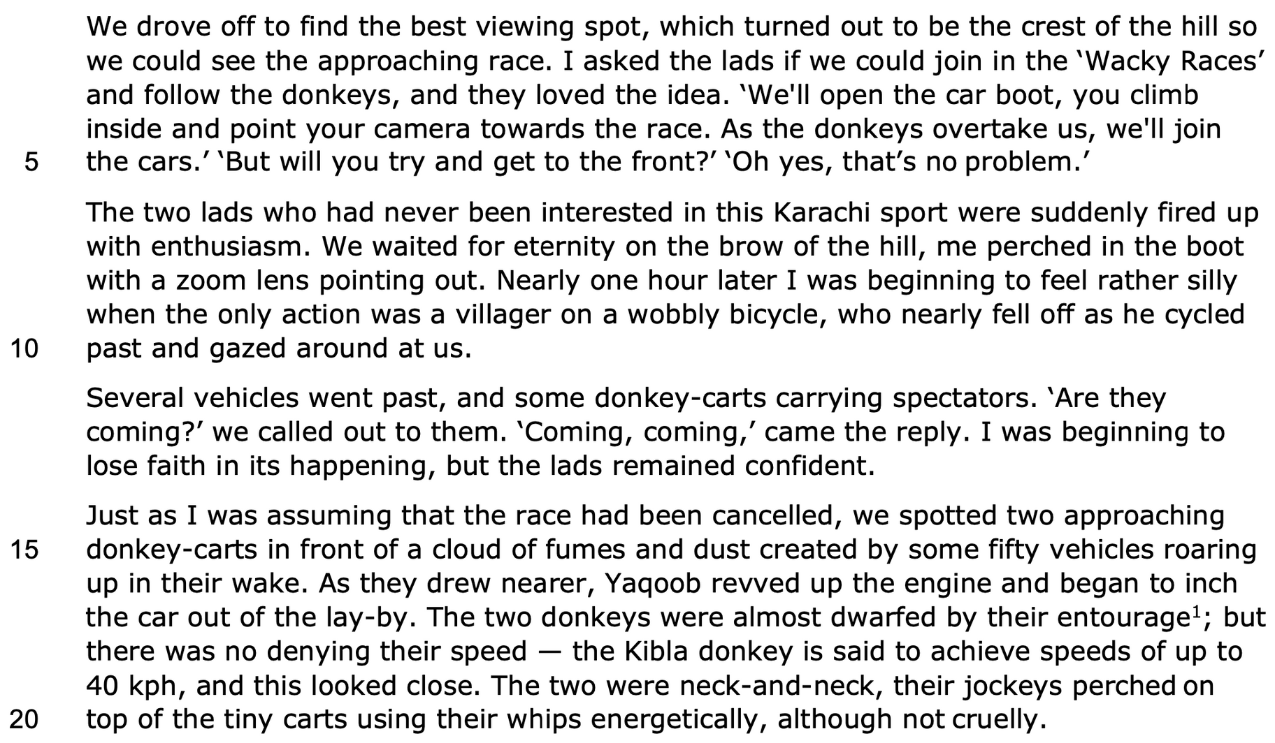
First person plural pronoun
Superlative
Conversational register - colloquial
Play on words refers to an old popular cartoon
Repetition of pronoun makes it a group adventure
Common noun
Animals - not what we expect
Imperative sentence
Colloquial language
Pre-modifier tells us the region
Complex sentence is slow - builds up our interest
Hyperbole shows impatience and excitement
Verb - humourous
Indefinite article 'a' and adjective adds humour
Contrast between her pessimism and their optimism
Repetition and clipped sentences
Animals - huge cultural gap between what we expect of a race
Vivid imagery
Onomatopoeia creates excitement
Anaphora - repetition of the donkeys
Dramatic verb
Surprising statistic
Idiom

Slide 3
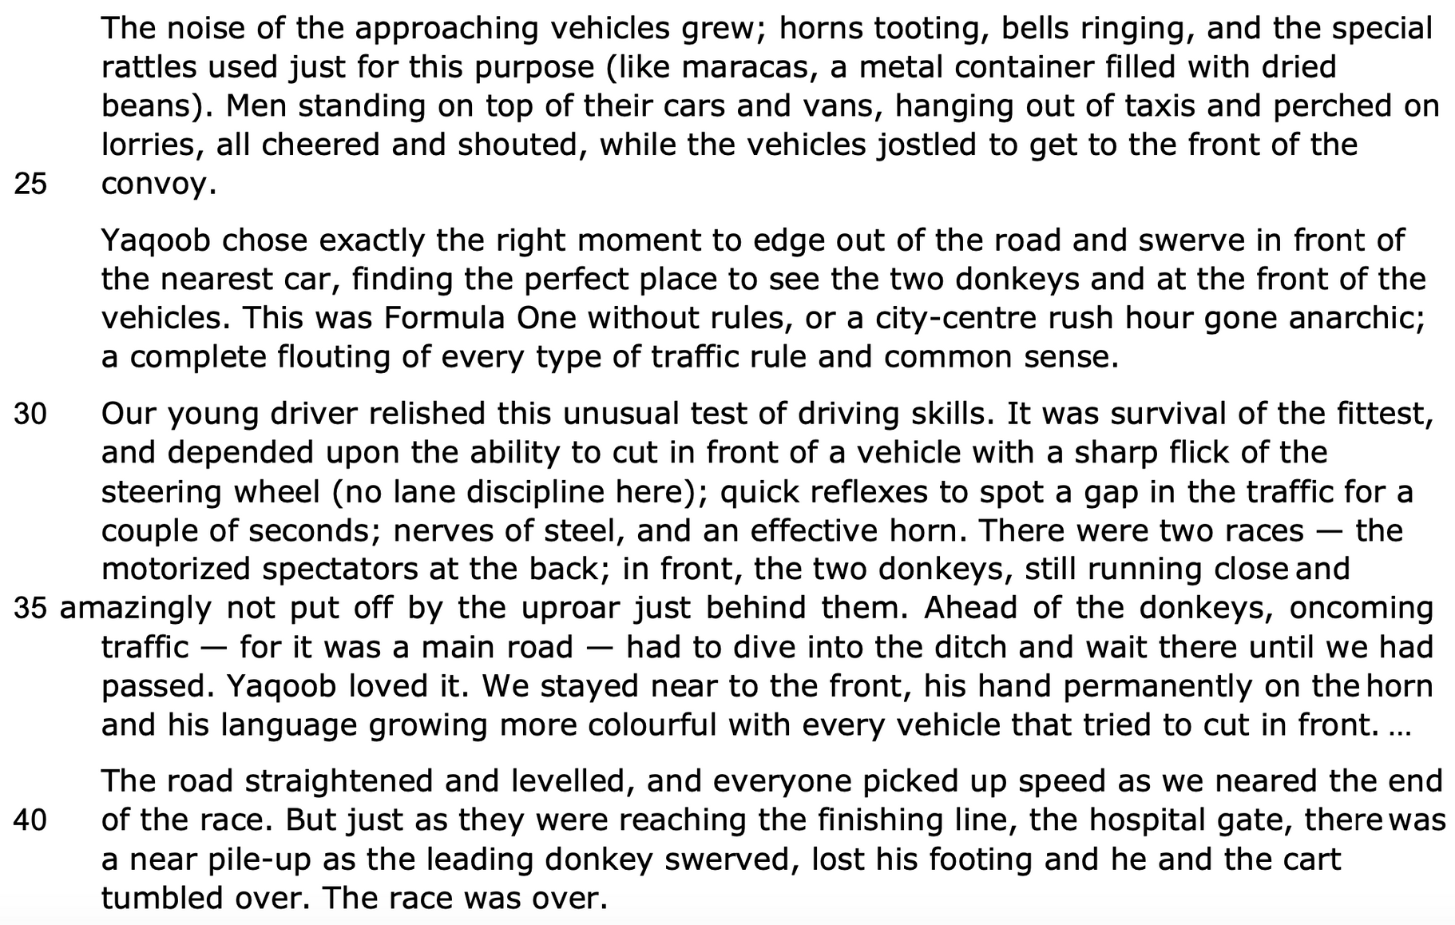
Onomatopoeia creates excitement
Simile - relatable
Semantic field
of vehicles
Personification shows it is intensely competitive
Slow verb contrasts
with rapid verb
Metaphor shows how
dangerous this race is
Alliteration and
hyperbole
Darwinian language -
adrenaline-filled
Parenthesis adds humour as it refres to UK driving rules
Dangerous driving
Cliche
Declarative sentence
Dangerous and
shocking for us
Simple sentence
Alliteration -
chaotic scene
Euphemism
Ironic -
humorous
Simple sentence emphasises suddenness

Slide 4
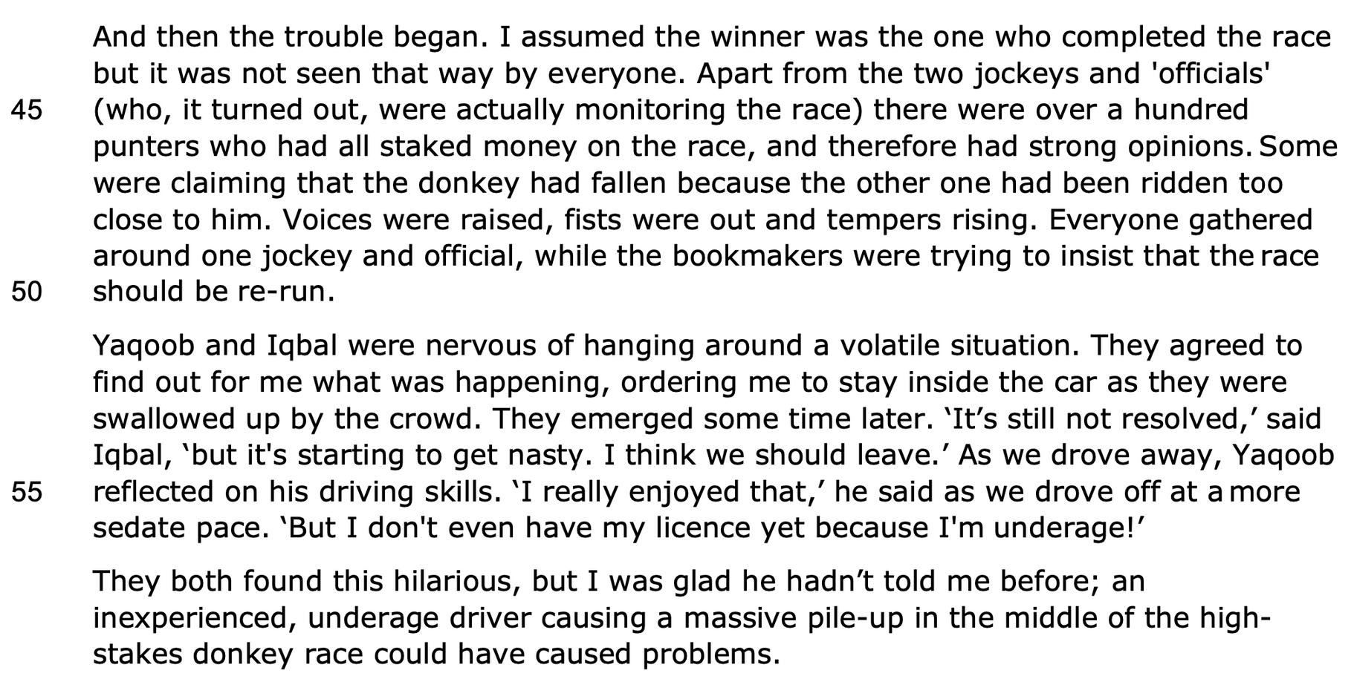
Simple sentence - change of tone and increase in tension
Inverted commas adds a mocking undertone - she discredits these people
Parenthesis shows this race was very high-stake
Gambling lexis shows many make profits on this sport
Tricolon shows emotions are running high
Adjective -
danger
We learn about
the two 'lads' -
proper nouns
Collective noun
Stative verb
Exclamatory sentence
is hilarious
Pre-modifier
emphasises how
vastly different life
in Karachi is
Euphemism

Slide 5
THANK YOU!
WWW.FIRSTRATETUTORS.COM

