Slide 1
Etiquette for Children and Youth
The Gift of Good Manners
Section 1
What Is Etiquette?

Slide 2
What Does
“Etiquette”
Mean To You?
Etiquette Today

Slide 3
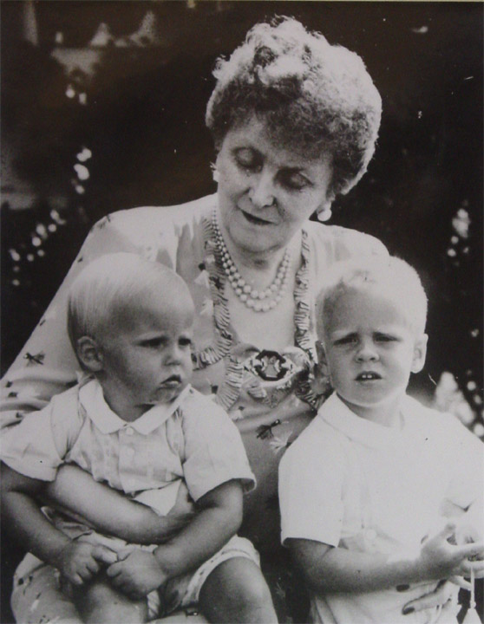
Emily Post On Etiquette
“Whenever two people come together and their behavior affects one another, you have etiquette.”
“Etiquette is not some rigid code of manners, it’s simply how persons’ lives touch one another.”

Slide 4
Etiquette Today
Etiquette is the fuel that powers all relationships.
Family
Friends
School

Slide 5

Etiquette
= Manners
+ Principles
Manners:
Smooth the way to build better relationships.
They tell us what to do and what to expect others to do.

Slide 6
Why Call Manners a Gift?
Manners are skills to be used for a lifetime.
Kids who know which manners to use in any situation will have increased self-confidence.
What better gift than social skills to navigate any relationship or social event with self-confidence?

Slide 7
Manners Are Tools
It takes 4 things to learn to use any tool:
    Basic Ability
    Good Teaching
    Practice
    Repetition

Slide 8
Etiquette
= Manners +
Principles
Manners:
  Smooth the way to build better relationships.
  They tell us what to do and what to expect others to do.
Principles:
  Serve as a foundation for all the manners.
  Help us to figure out how to interact when there is no manner.

Slide 9
Principles Of Etiquette
Consideration
Respect
Honesty

Slide 10
Consideration
Consideration simply means:
Thinking about and being aware of others who are involved.
Golden Rule.
Platinum Rule.
Notes:
Give bus example

Slide 11
Respect
Respect means caring for and accepting others just as they are.
Respect means caring for yourself.
Respect means caring for things that are important to you and others.

Slide 12
Formula for Respect
  Treat your children with respect
  Treat yourself with respect
  + Treat those around you with respect
Your children will learn to
respect themselves and others.

Slide 13
Honesty
Honesty means finding the positive
truth
Honesty means finding the positive
truth and then telling it.
Honesty means wrapping the principles and manners in sincerity.
Notes:
Honesty is
Grandmother fixes dinner and doesn’t like the spinach.

Slide 14
Manners
vs.
Principles
Manners
Time sensitive
Vary between cultures
Principles
Timeless
Cross cultural boundaries
Example: Shaking hands vs. bowing
The Manner differs culturally.
The Principle crosses cultural boundaries.

Slide 15
The Principles
Etiquette in Action
Consideration
Think Before Acting
Thinking, empathy
Respect
Make Choices
That Build Relationships
Recognize the worth and value of others by determining if your actions, appearance, and/or words grow rather than hurt the relationship
Honesty
Do It Sincerely
Acting sincerely,
being truthful

Slide 16
Five-Step Method
Step 1: Consideration
Who’s affected?
How are they affected?

Slide 17
Five-Step Method
Step 2: Solutions/Responses
Not just one.
Impulsive solution:
  Might not solve the situation.
  May hurt the relationship.

Slide 18
Five-Step Method
Step 3: Respect
Look at each solution.
How does it affect each person?

Slide 19
Five-Step Method
Step 4: Honesty
Choose the solution
that is best for everyone
and for the relationship.

Slide 20
Five-Step Method
Step 5: Refine Response
Won’t use it every time.
May improve your solution.

Slide 21
Five-Step Method
Step 1: Consideration
Step 2: Solutions/Responses
Step 3: Respect
Step 4: Honesty
Step 5: Refine Response

Slide 22
“The Sneeze”
Your and your family are going to a family friend’s wedding. Your parents have reminded you to shake hands and introduce yourself. Sure enough, you see someone sneeze into their hand. A minute later you are introduced to the person, and she extends her hand to shake hands. Mom and dad are watching.
What would you do?

Slide 23
“The Sneeze”
1. Consideration
Who is affected?
  You:
  The person:
  Your parents:
  The other family:
Notes:
Change to organization if necessary

Slide 24
“The Sneeze”
1. Consideration
Who is affected?
How are they affected?
  You:
  Unsure, nervous
  The person:
  Confused, embarrassed or
  unaware
  Your parents:
  Surprised, angry
  The other family:
  Negatively affected
Notes:
Change to organization if necessary

Slide 25
“The Sneeze”
2. Solutions
  Don’t shake hands.
  Shake hands.
  Escape
  I’m so embarrassed. I just sneezed on my hand. As soon as I get back from the restroom…”
  Please excuse me for not shaking hands. I’ve got a bad cold and don’t want to spread it.

Slide 26
“The Sneeze”
3. Respect
Don’t shake
hands.
  Ok for you: you
  temporarily avoid
  problem.
  Rude to others.
Escape.
  May work for you and
  the others immediately. Problem remains.
Shake hands.
  Hard on you.
  Works for the others.

Slide 27
“The Sneeze”
4. Honesty
Don’t shake
hands.
  Causes more trouble
  than it solves.
Escape.
  Doesn’t really resolve
  the situation.
Shake hands.
  Hard on you.
  Easy on the others.
  Ultimately, it works
  best for you.

Slide 28
“The Sneeze”
5. Refine as necessary
  You decide that after shaking hands, you will immediately excuse yourself to go to the restroom and wash your hands.

Slide 29
Manners – The Happy Gift
The American essayist Ralph Waldo Emerson once said, “Manners are the happy ways of doing things.” These “happy ways” are among the most extraordinary gifts you can give to your child. Good manners will play a considerable role in the happiness and contentment of your child and the many people he or she encounters. For eighteen years you and your child will travel a long and sometimes rocky road together. Learning and practicing good manners will often make the journey easier for you both. By the time your child is ready to tackle the world on his or her own terms, he or she will have your gift of good manners to smooth the way.

Slide 30
The Gift of Good Manners
Thank You
The Emily Post Institute, Inc.
444 South Union Street
Burlington, VT 05401

Slide 31
Misbehaving Guests
What can you do when your child’s friend who is over on a play date is misbehaving?
  Basic manners
  Plays too rough
  Uses inappropriate language

Slide 32
Greetings and Introductions
You’ve always told your child that they shouldn’t hug strangers. Great Aunt Maria will be at Thanksgiving dinner and will be seeing your child for the first time. You know she will want to hug your child. You would…
Other issues related to greetings
  Look them in the eye
  One shy child; one outgoing
  The relative who smells of cigarettes

Slide 33
Differing Standards
What do you do when your child’s friend’s family has different standards from yours?
    Day to day issues
    Safety

Slide 34
Holidays
What can you do to prepare your kids for a holiday dinner?
Table manners
Favorite foods
Children’s table

