Slide 1
WHAT TO SHARE and when

Slide 2
Types of content you can share

Slide 3
Content Buckets
Blog posts
Promotions
Free offers
Curated content
Events
Quotes

Slide 4
Blog posts
Answer questions
Interviews with customers
Roundup Posts
Helpful Tips
Videos
Tutorials

Slide 5
?
Roundup Posts

Slide 6
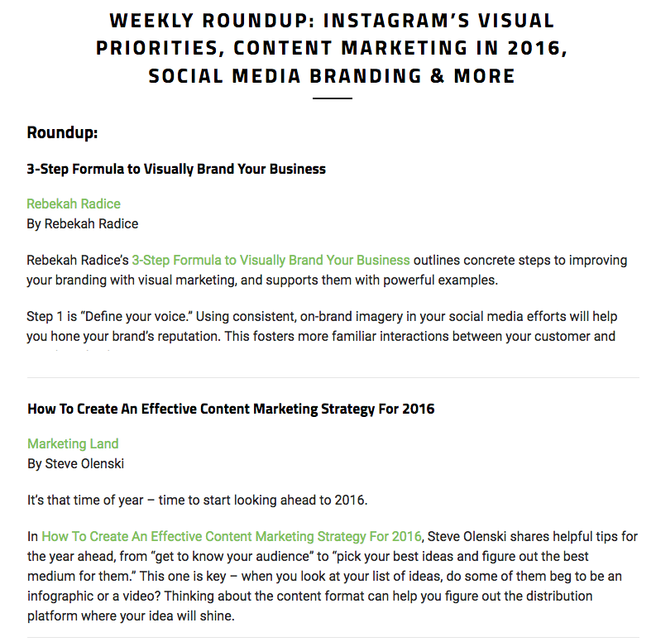
A collection of top finds, picks or tips.
Examples:
5 of the best featured stories this week
Our top 10 posts from this summer
Our 5 favorite tools/looks/recipes/photo filters this month
Best articles we found this week about ______
The only guide for _______ that you’ll ever need
1x a week or month
Image Source: Screenshot – librisblog.photoshelter.com

Slide 7
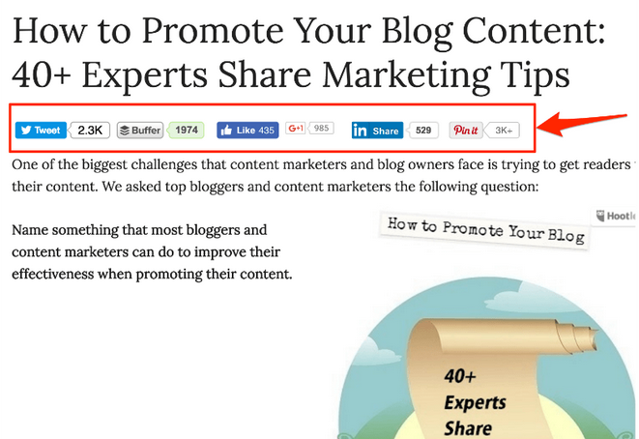
An expert roundup is a collection of interviews by industry experts.
How does this work?
Choose a popular topic
Ask experts in your niche a question related to it
Once you get enough answers, include them in a post and promote
Ask the experts who contributed to share your post also
Great for traffic!!
Do these 1-2x a year
Image Source: Screenshot – SmallBusinessIdeasBlog.com via mhThemes.com

Slide 8
?
Videos

Slide 9
Blog posts
Videos

Slide 10
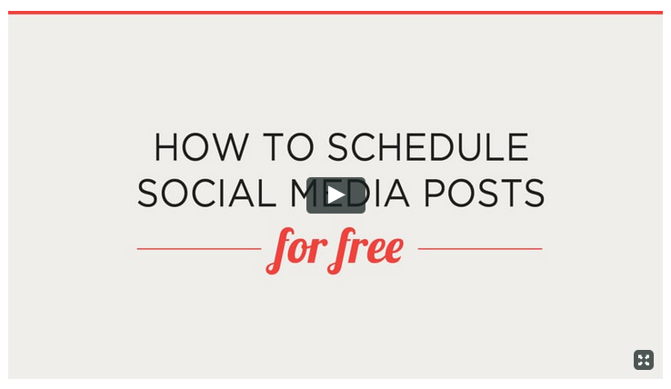
How do you turn your blog posts into a video?
Take the highlights of your post and record yourself speaking to the camera
Or, create slides and record a screencast.
Share the video on Facebook, YouTube, and Instagram with a link to the post
Include the video in your blog post.
Great way to reach a broader audience!

Slide 11
Promotions
Affiliate/Referral Products
Bundles, Specials
Products
Services
Sales

Slide 12
Promotions
20-30% of your posts
Affiliate/Referral Products
Bundles, Specials
Products
Services
Sales

Slide 13
Free
offers
Free mini-course
Webinars,Workshops
Challenges
Resource
Consult
Welcome Pack
Content Upgrades
Ebooks, Worksheets
Newsletter
Free trial

Slide 14
Quotes
Quotes
Throwback Thursday
Monday Motivation
Encourage- ment
Engaging Questions
Statistics + Facts
Favorite Hacks or tools
Holiday Wishes

Slide 15
Events
Local Events
Online Events
Contests, Giveaways
Product Launches
Announce- ments

Slide 16
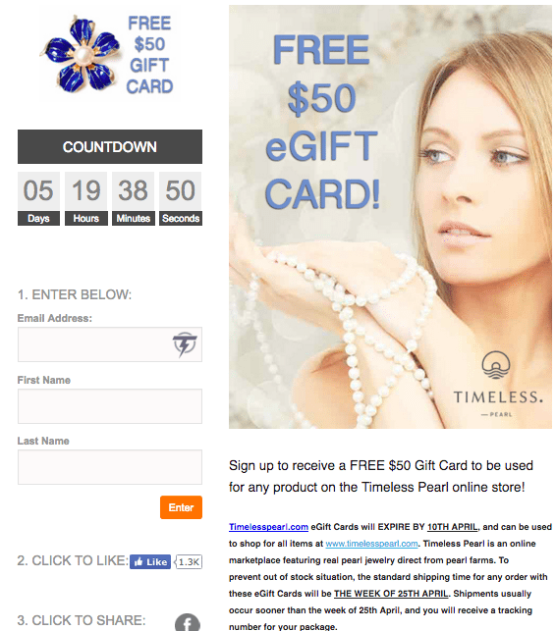
Contests and giveaways are a powerful way to build your email list.
Create your contest using KingSumo or Rafflecopter.
Make sure your prize is related to your industry.
Promote your contest to your followers, email subscribers and to contest directory sites.
Image Source: Screenshot – jeffbullas.com

Slide 17
Curated content
Articles
Quotes
Tutorials
Tips

Slide 18
What do you share first?

Slide 19
Share from two buckets first…

Slide 20
Share from two buckets first…
Blog posts
Promotions

Slide 21
Share from two buckets first…
Curated content
Quotes

Slide 22
Then share from another bucket.
Curated content
Quotes
Blog posts

Slide 23
Content Buckets
Blog posts
Promotions
Free offers
Curated content
Events
Quotes

Slide 24
When to Share?
When to share

Slide 25
How often should you post?
1-3x a day
1-2x a day
1x a day
15-30x a day
15-30x a day

Slide 26
Share from two buckets first…
Curated content
Quotes

Slide 27
Best times to share…
1-3pm
2-5pm, 2am
7-10am
10am-6pm
5pm-12am

Slide 28
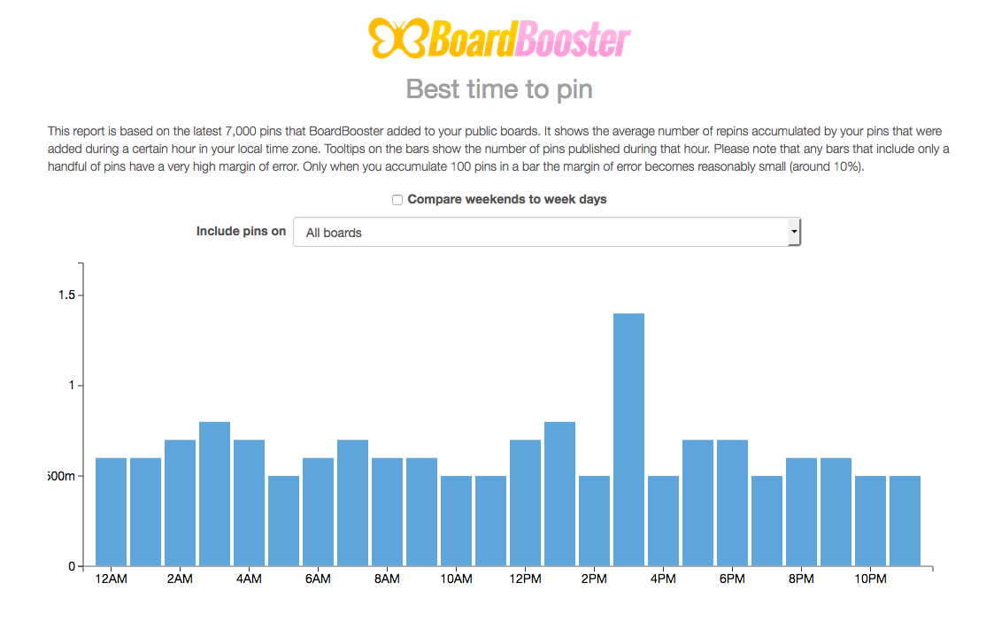
Check each site’s analytics to find the time that your audience is active.
2:30-3:30pm

