Slide 1
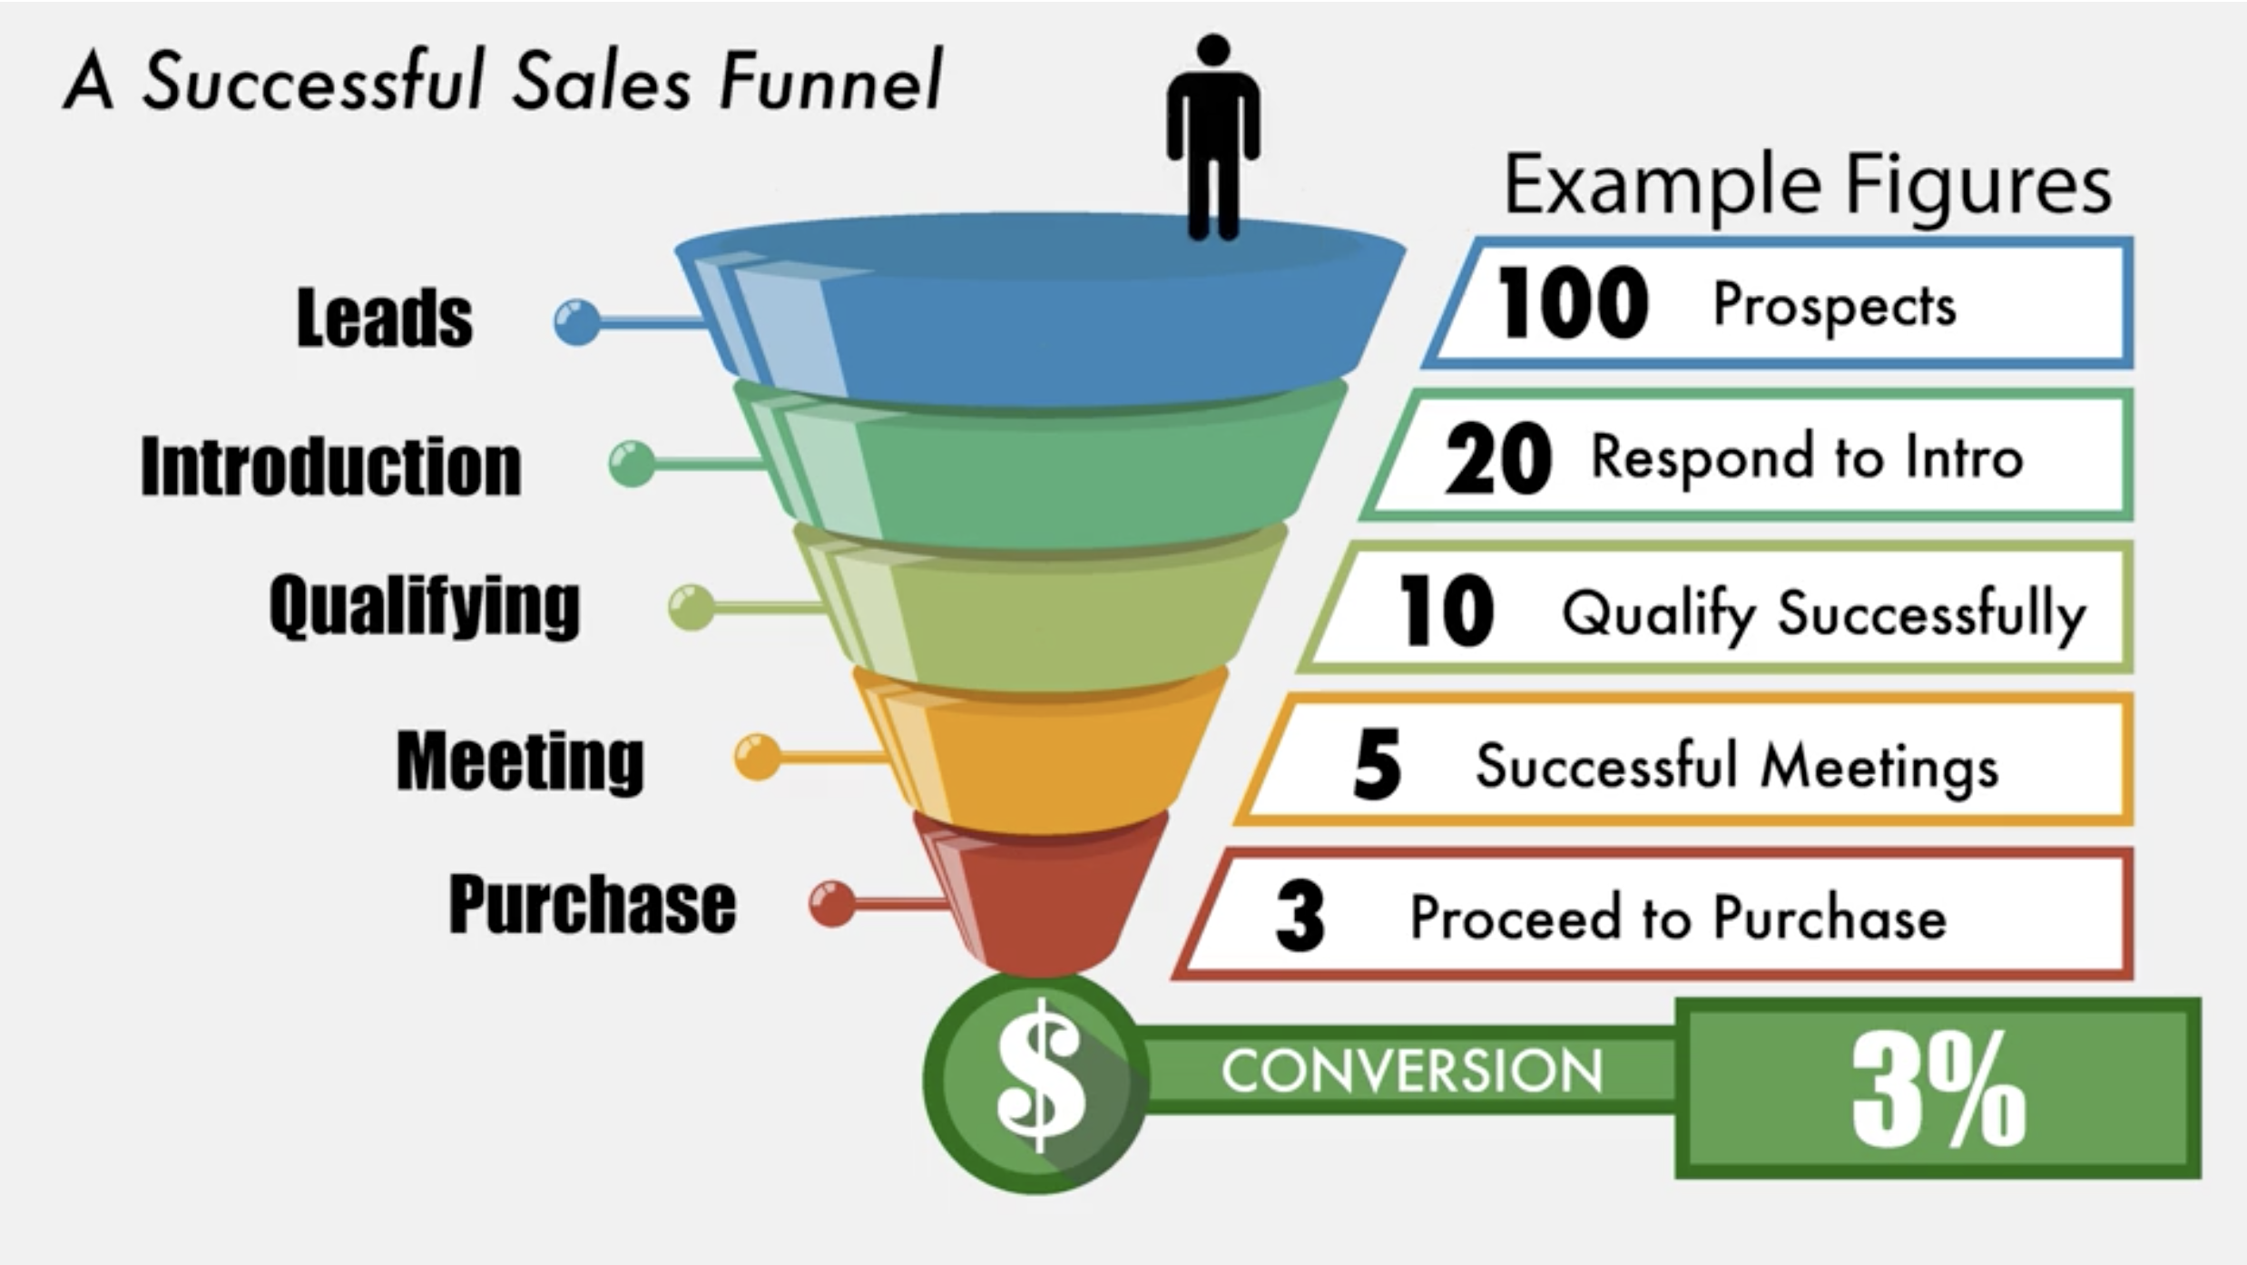
FINDING
LEADS

Slide 2
FINDING
LEADS
3 STRATEGIES FOR FINDING QUALITY LEADS

Slide 3
FINDING
LEADS
1
INTELLIGENT
CALLS & EMAILS

Slide 4
FINDING
LEADS
1
Research your prospects carefully
INTELLIGENT
CALLS & EMAILS

Slide 5
FINDING
LEADS
1
Research your prospects carefully
Gather information to make a personalized approach
INTELLIGENT
CALLS & EMAILS

Slide 6
FINDING
LEADS
1
Research your prospects carefully
Gather information to make a personalized approach
INTELLIGENT
CALLS & EMAILS
With limited resources, we must be extremely selective

Slide 7
FINDING
LEADS
1
MAKE SURE THAT WHAT YOU HAVE TO OFFER IS
GENUINELY GOOD FOR THE PROSPECT
INTELLIGENT
CALLS & EMAILS

Slide 8
FINDING
LEADS
1
“OUR GOAL IS TO INSPIRE THE PROSPECT TO FORM THE INTENT TO SOLVE HIS PROBLEM; IT IS NOT TO INSPIRE HIM TO HIRE US”
INTELLIGENT
CALLS & EMAILS

Slide 9
FINDING
LEADS
2
FIND LEADS ON
INSTAGRAM

Slide 10
FINDING
LEADS
2
Over 500 million daily users
FIND LEADS ON
INSTAGRAM

Slide 11
FINDING
LEADS
2
Over 500 million daily users
The highest engagement
of an social platform
FIND LEADS ON
INSTAGRAM

Slide 12
FINDING
LEADS
2
Over 500 million daily users
The highest engagement
of an social platform
FIND LEADS ON
INSTAGRAM
Powerful tool for anyone using video

Slide 13
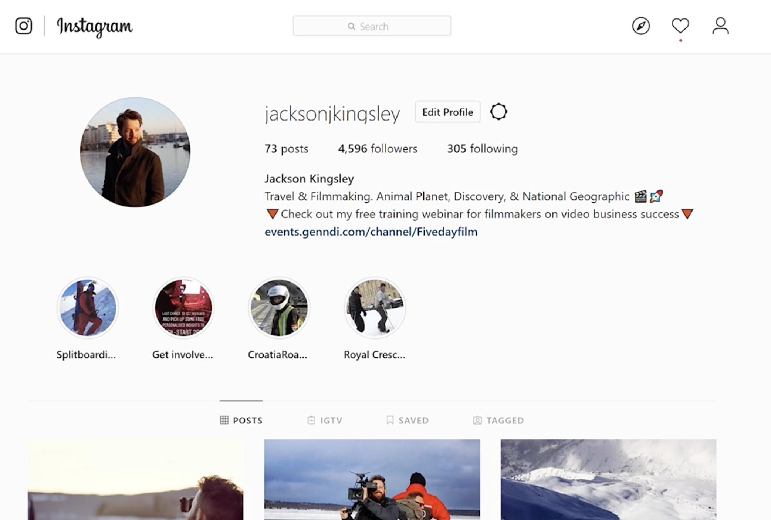
FINDING
LEADS
2
FIND LEADS ON
INSTAGRAM
Easy access to portfolio

Slide 14
FINDING
LEADS
2
DIRECT MESSAGES
FIND LEADS ON
INSTAGRAM

Slide 15
FINDING
LEADS
2
DIRECT MESSAGES
FILTER YOUR LEADS TO TARGET A SPECIFIC AUDIENCE
FIND LEADS ON
INSTAGRAM

Slide 16
FINDING
LEADS
2
DIRECT MESSAGES
FILTER YOUR LEADS TO TARGET A SPECIFIC AUDIENCE
FIND LEADS ON
INSTAGRAM
#HASHTAGS
USE HASHTAG FINDING TOOLS TO SEE WHAT IS RELEVANT IN YOUR SECTOR

Slide 17
FINDING
LEADS
2
DIRECT MESSAGES
100 DMs
IS A GOOD PLACE TO
START
FIND LEADS ON
INSTAGRAM

Slide 18
FINDING
LEADS
2
DIRECT MESSAGES
100 DMs
IS A GOOD PLACE TO
START
FIND LEADS ON
INSTAGRAM
71% OF INSTAGRAM USERS ARE UNDER 30

Slide 19
FINDING
LEADS
3
LEAD GENERATION ON
LINKED IN

Slide 20
FINDING
LEADS
3
Majority of users are over 30
LEAD GENERATION ON
LINKED IN

Slide 21
FINDING
LEADS
3
Majority of users are over 30
LEAD GENERATION ON
LINKED IN
75% of users make more than
75K per year

Slide 22
FINDING
LEADS
3
Majority of users are over 30
LEAD GENERATION ON
LINKED IN
75% of users make more than
75K per year
11 million millennials in decision making positions

Slide 23
FINDING
LEADS
3
1. Make sure your profile is up to date
LEAD GENERATION ON
LINKED IN

Slide 24
FINDING
LEADS
3
1. Make sure your profile is up to date
LEAD GENERATION ON
LINKED IN
2. Learn how to use the advance search functions

Slide 25
FINDING
LEADS
3
1. Make sure your profile is up to date
LEAD GENERATION ON
LINKED IN
2. Learn how to use the advance search functions
3. Use a multi-touch approach

Slide 26
FINDING
LEADS
3
1. Make sure your profile is up to date
LEAD GENERATION ON
LINKED IN
2. Learn how to use the advance search functions
3. Use a multi-touch approach
Do not hit the sales pitch straight away. Linkedin encourages a more personal approach

Slide 27
FINDING
LEADS
3
Touch One: Connect Request (Day 1)
LEAD GENERATION ON
LINKED IN

Slide 28
FINDING
LEADS
3
Touch One: Connect Request (Day 1)
LEAD GENERATION ON
LINKED IN
Touch Two: Conversion Starter (Day 2)

Slide 29
FINDING
LEADS
3
Touch One: Connect Request (Day 1)
LEAD GENERATION ON
LINKED IN
Touch Two: Conversion Starter (Day 2)
Touch Three: Core Message (Day 4)

Slide 30
FINDING
LEADS
3
Touch One: Connect Request (Day 1)
LEAD GENERATION ON
LINKED IN
Touch Two: Conversion Starter (Day 2)
Touch Three: Core Message (Day 4)
Touch Four : First Follow Up (Day 9)

Slide 31
FINDING
LEADS
3
STRATEGIES FOR FINDING QUALITY LEADS

Slide 32
FINDING
LEADS
3
STRATEGIES FOR FINDING QUALITY LEADS
1 INTELLIGENT CALLS & EMAILS

Slide 33
FINDING
LEADS
3
STRATEGIES FOR FINDING QUALITY LEADS
1 INTELLIGENT CALLS & EMAILS
2 INSTAGRAM

Slide 34
FINDING
LEADS
3
STRATEGIES FOR FINDING QUALITY LEADS
1 INTELLIGENT CALLS & EMAILS
2 INSTAGRAM
3 LINKEDIN

Slide 35
FINDING
LEADS
3
STRATEGIES FOR FINDING QUALITY LEADS
BEST TO PICK ONE TO BEGIN WITH

Slide 36
FINDING
LEADS
3
STRATEGIES FOR FINDING QUALITY LEADS
BEST TO PICK ONE TO BEGIN WITH
START WITH JUST 20 MESSAGES A DAY

