Slide 1
MAKE IT. MSP.
OVERVIEW
#makeitmsp

Slide 2
What is Make It. MSP.?

Slide 3
Make It. MSP. is a strategic initiative of the GREATER MSP Partnership
#makeitmsp

Slide 4
GOAL
Make MSP one of the nation’s Top 10 performers at attracting and retaining people

Slide 5
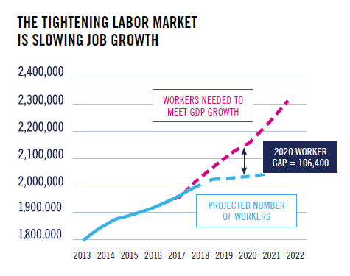
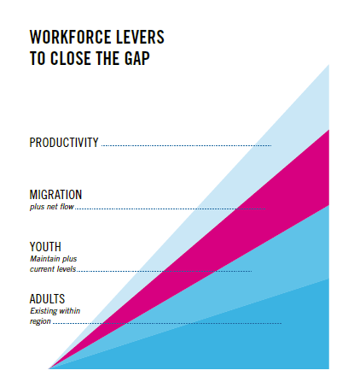
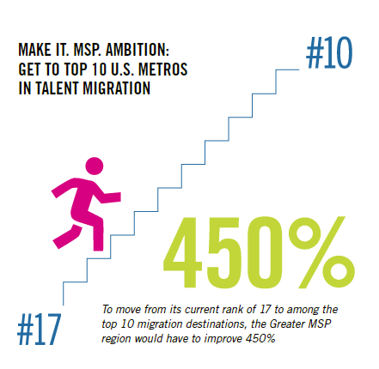
MAKE IT. MSP. ORIGIN

Slide 7
THE WORK OF MAKE IT. MSP.
DEVELOP data-driven focus with partners
COLLECT and share targeted insight
PRIORITIZE, take action, and measure results
#makeitmsp

Slide 8
How do I explain Make It. MSP. to others?

Slide 9
For people concerned with attracting and retaining people:
Make It. MSP. is an initiative full of resources to help you attract and retain talent to MSP – including research, tools, and a network of peers
#makeitmsp

Slide 10
For people living and working in MSP:
Make It. MSP. is an initiative with a network that’s here to help you make meaningful connections to professional and social opportunities in Minneapolis-Saint Paul
#makeitmsp

Slide 11
For people living and working outside MSP:
Make It. MSP. is an initiative to introduce you to Minneapolis-Saint Paul and help you discover why it’s the best place for you to make an impact
#makeitmsp

Slide 12
What are the key project teams of Make It. MSP.?

Slide 13
MSP HELLO
is a project to welcome newcomers to MSP and help them make meaningful connections
MSP HELLO

Slide 14
BE MSP
is a project to better connect people of color in MSP
BE MSP

Slide 15
MSP Tech
is a project to expand the number of tech workers in MSP
MSP TECH

Slide 16
MSP Campus
is a project to attract college interns and graduates to MSP
MSP CAMPUS

Slide 17
Where can I find out more?

Slide 18
MAKEITMSP.ORG
The Make It. MSP. website includes guides, event calendars, tools to help attract & retain people, a job portal and a blog with all the latest from the initiative
#makeitmsp

Slide 19
MAKE IT. MSP. INSIGHTS
These reports examine migration trends, people’s perceptions of MSP, and team projects. You can download them for free at makeitmsp.org.
#makeitmsp

Slide 20
QUARTERLY WORKSHOPS
These free, interactive workshops connect hundreds of current and prospective partners working to attract and retain people in MSP
#makeitmsp

Slide 21
NEWSLETTERS
These e-mails are designed for different audiences and partners, including talent leaders, newcomers, people of color, and more. Find them all at makeitmsp.org.
#makeitmsp

Slide 22
Where can I find out more?

Slide 23
FOLLOW & SUBSCRIBE
Visit makeitmsp.org to subscribe to
e-updates or follow @makeitmsp on social
#makeitmsp

Slide 24
USE TOOLS & INSIGHTS
Find our Toolkit at makeitmsp.org and give us your feedback
#makeitmsp

Slide 25
CONTRIBUTE TO A PROJECT
Contact us at info@makeitmsp.org to learn more about active projects & teams
#makeitmsp

Slide 26
INVEST IN THE MISSION
Consider sponsoring an event or program and help us achieve our ambition
#makeitmsp

Slide 27
TITLE

Slide 28
TITLE

Slide 29
TITLE

Slide 30
TITLE
#makeitmsp

