Slide 1
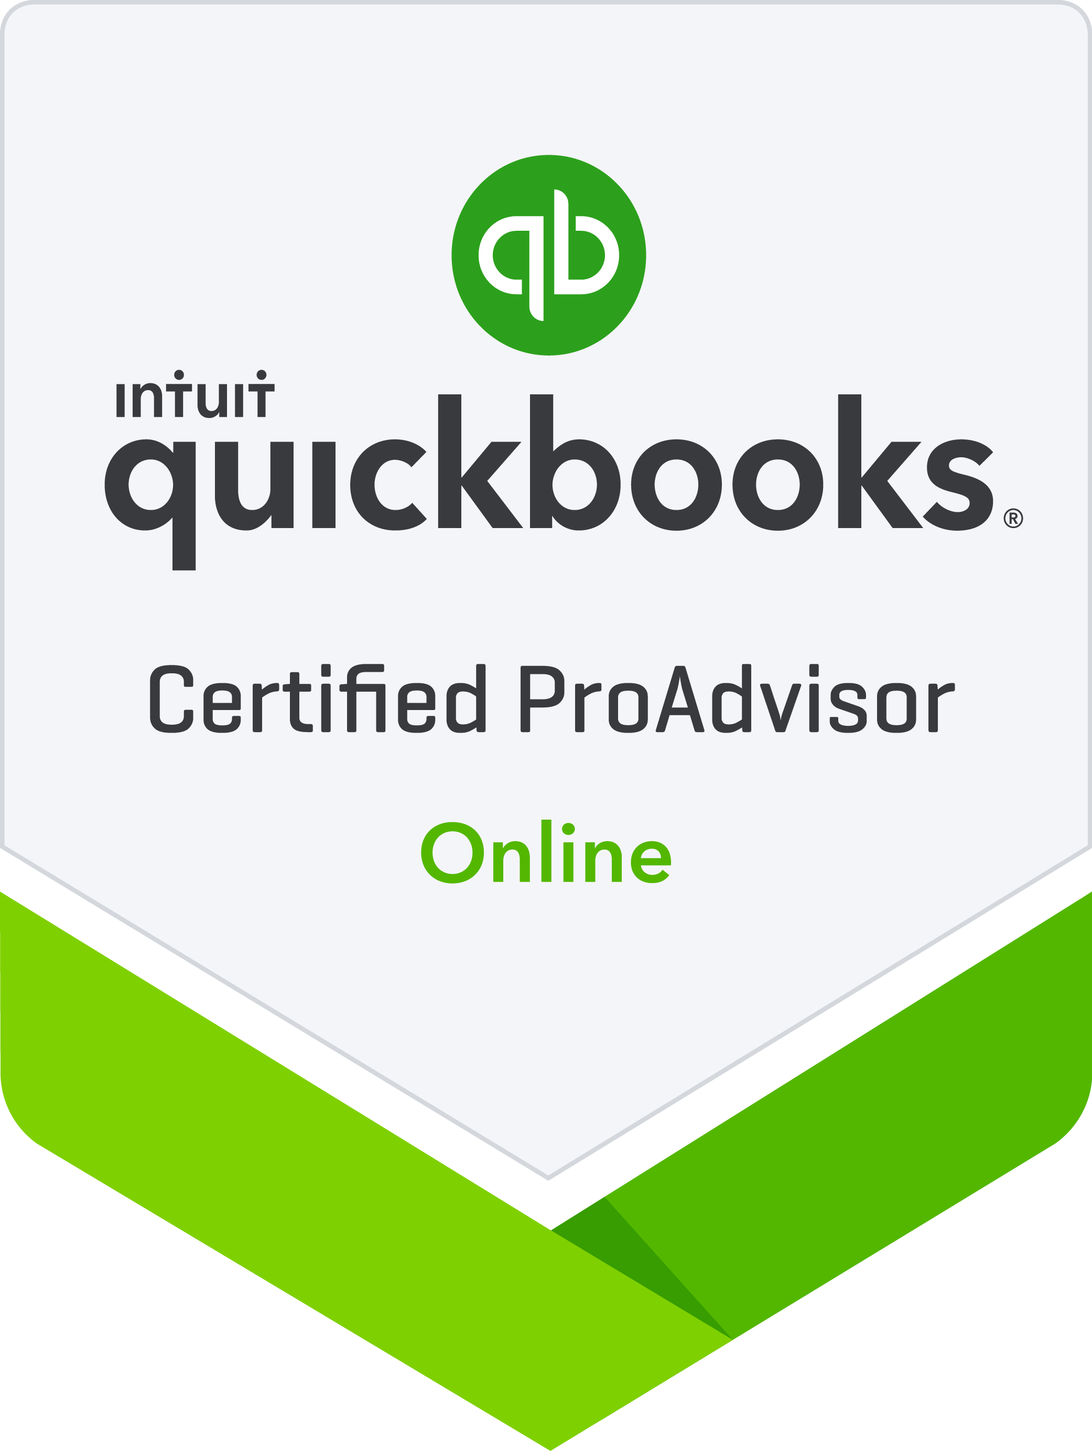
Part 3: Managing Your Books with QBO and Apps
  QuickBooks Online Fundamentals Series

Slide 2
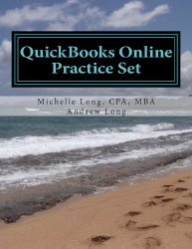

Michelle L. Long CPA, MBA
International speaker – Intuit Trainer/Writer Network US, Canada, Australia and UK
Author – 5 books (available on Amazon), co-author of Advanced Certifications for QB and other courses
Most Powerful Women 2016, CPA Practice Advisor
Co-Host – http://QBPowerHour.com
              Linkedin Group – http://tinyurl.com/qbgroup
              Facebook Group -- http://facebookgroups.com/qbpowerhour
Long for Success, LLC
www.LongforSuccess.com

Slide 3
QuickBooks Online Fundamentals Series
Part 1: Introducing QuickBooks Online Accountant
The first of a 3-part webinar series for accounting professionals who are brand new to QuickBooks Online and QuickBooks Online Accountant.
Part 2: Setting up your Firm’s Books
The second of a 3-part webinar series covers how easy it is for accounting professionals to set up the free subscription to QuickBooks Online Plus that comes with QuickBooks Online Accountant.
Part 3: Managing your Firm’s Books with QuickBooks Online and Apps
The last of the 3-part webinar series show accounting professionals how easy it is to use QuickBooks Online and apps to manage their firm’s books.

Slide 4
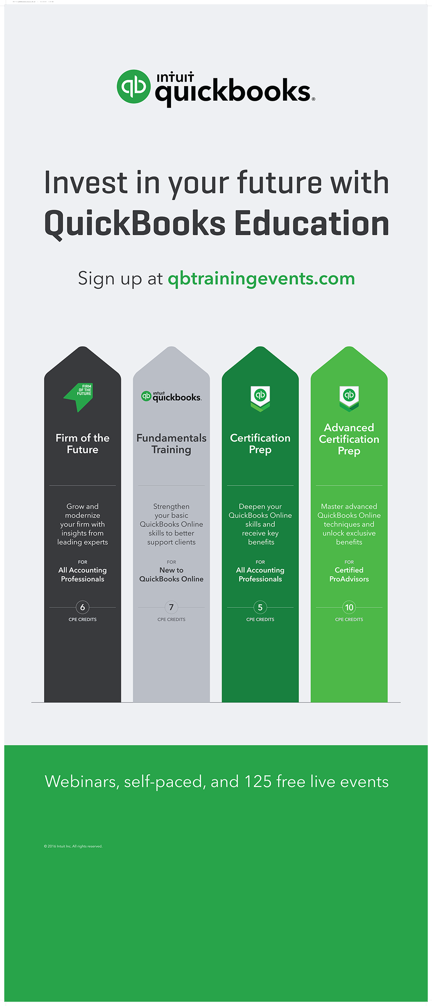
Notes:
Be sure to mention the 4 different unique trainings:
Firm of the Future (today)
QuickBooks Online Fundamentals (for those with no experience with QBO)
QuickBooks Online Certification
QuickBooks Online Advanced Certification
Set expectations….cert training - this is review to make sure you know what you need to know for the exam; fast paced….

Slide 5

CPE
Process
In order to receive CPE credit.
You must attend and answer the polling and/or CPE keywords
This webinar is eligible for up to 1.5 hours of CPE
CPE certificates are emailed directly to you within 3 weeks of the training date to the email address you used to register
Notes:
***Need to insert a CPE keyword slide in this deck***
[Read the bullets, then add these tips]
CPE certificates are e-mailed directly to you within 3 weeks to the same email address used to register.
TIP: Add accountant_training@intuit.com to your approved email sender list. Or, check your SPAM folder.
You must keep a copy for your records.

Slide 6
Learning Objectives
After completing this webinar, you should be able to:
  Describe the QuickBooks Online purchasing workflow
  Describe the QuickBooks Online sales workflow
  Run basic payroll in QuickBooks Online
  Perform routine month-end procedures in QuickBooks Online
  Determine the next steps to learn more about QuickBooks Online
  Determine the next steps for finding and supporting QuickBooks Online clients

Slide 7
Agenda
Demonstration: How to use QuickBooks Online
Mobile and Desktop apps
Next steps
Q&A

Slide 8

Use QuickBooks Online Demonstration
All elements of this demo can be found in the supplemental guide found at http://bitly.com/setup_manage_qboa
Notes:
Describe the QuickBooks Online purchasing workflow
Describe the QuickBooks Online sales workflow
Run basic payroll in QuickBooks Online
Bank recs in QuickBooks Online
Monthly reporting - P&L/Balance Sheet (management reports)
Demo Mobile app
Determine the next steps for finding and support QuickBooks Online clients
Determine the next steps to learn more about QuickBooks Online

Slide 9
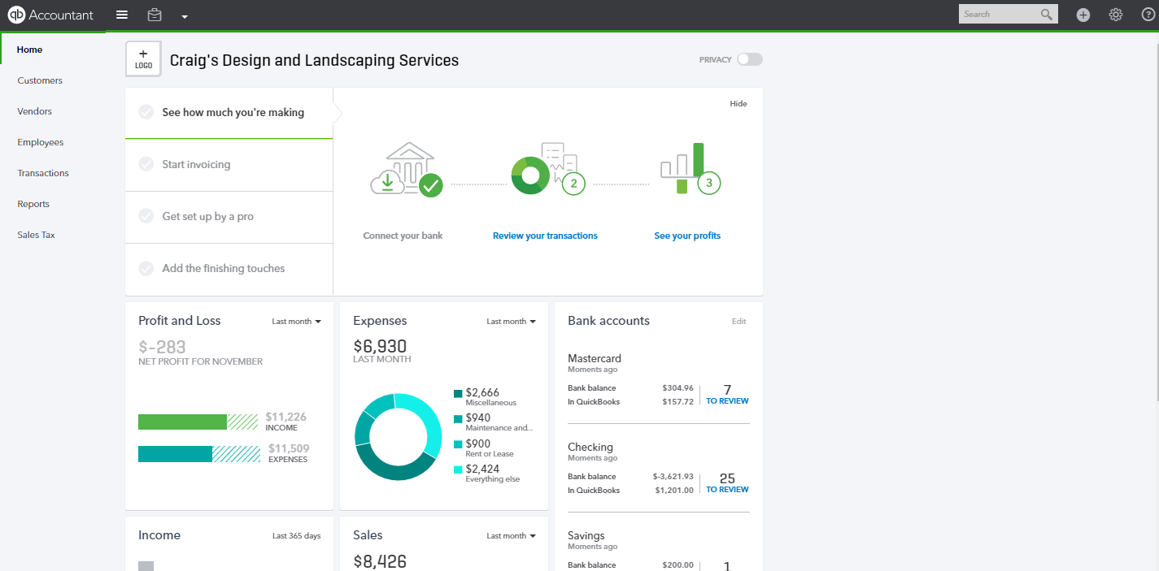
QuickBooks Online Home Page
Notes:
QuickBooks Online Home Page
Once you have opened Your Books (or any of your clients’ companies) in QBOA, click on Home in the left-hand navigation bar. Let’s pretend that this company is Your Books for the purposes of demonstration.
The Home Page for Your Books displays a summary of key information, just as it does for client companies. (Brand new companies will still have a home page but will have $0 balances.)

Slide 10
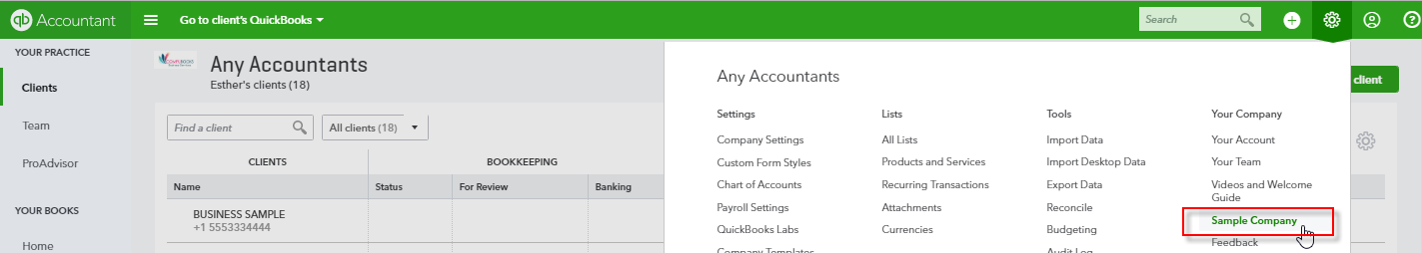
General QBO Navigation: QBOA Sample Company
Notes:
General QBO Navigation: QBOA Sample Company
When you are working in Your Books in QBOA, the interface is very much like what your clients see when they are working in their own QBO books. You have access to some extra Accountant Only functions, and we’ll touch on those later.
QuickBooks Online has been designed to be intuitive, fast and simple to use. The user interface is simple and unified, which results in fewer clicks to find the desired information or functions.
In order to demonstrate QBOA, let’s use the same “sandbox” that you have available in order to try out the features: the QBOA Sample Company. To access this company, open QBOA with your credentials. When in the Your Practice area or in Your Books, click on the Gear icon. Under Your Company, click on Sample Company.
One nifty thing about the Sample Company is that you can do whatever you want in it; as soon as you close the browser, your edits are “forgotten” and the next time you open the Sample Company, you’ll be starting again with a fresh set of unaltered sample data.
If you see a confirmation screen asking if you want to sign out of your current firm in order to open the sample company, click on Continue. You will then be signed into Craig’s Design and Landscaping Services as an Accountant user with access to the extra features of QBOA.

Slide 11
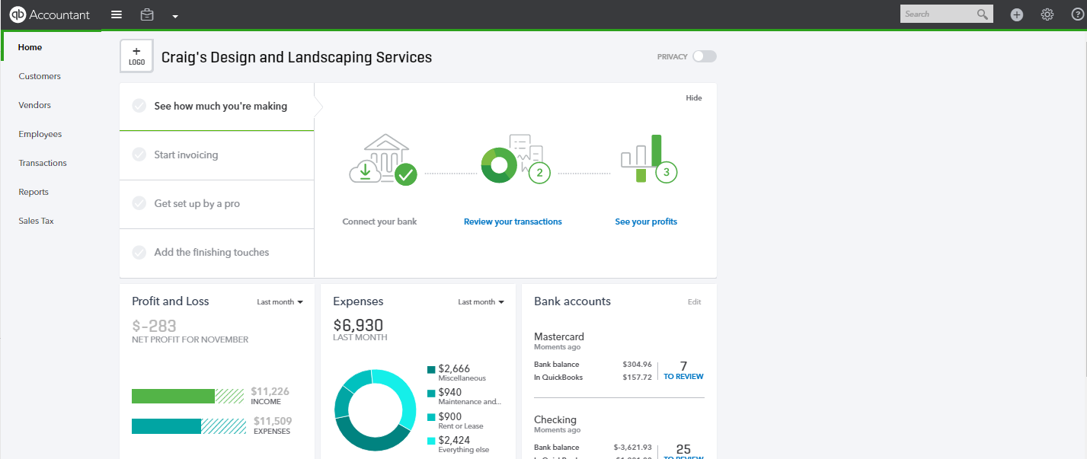
Navigating the QuickBooks Online Home Page
Notes:
Navigating the QuickBooks Online Home Page
Once you have opened the sample QBOA company (or Your Books or any of your clients’ companies in QBOA), click on Home in the left-hand navigation bar. Let’s pretend that this QBOA sample company is Your Books for the purposes of demonstration.
The Home Page displays a summary of key information, just as it does for client companies. (Brand new companies will still have a home page but will have $0 balances.)

Slide 12
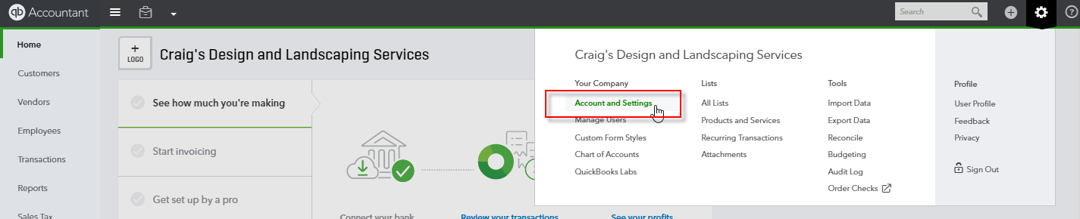
Don’t Forget the Account and Settings
Notes:
Don’t Forget the Account and Settings
As described earlier, the Account and Settings are located in the top right corner of your QuickBooks Online screen, and are accessed by clicking on the Gear icon and looking under Your Company.

Slide 13
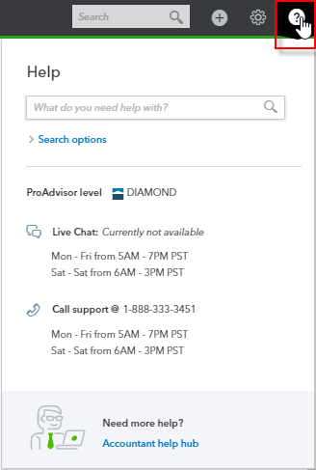
Help
Notes:
Help
To access the Help function, click on Question Mark in the top right corner.

Slide 14
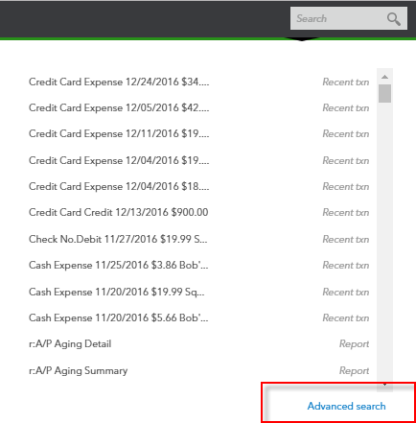

Search
Notes:
Search
The Search field in the top right of the screen allows you to find QuickBooks Online names, accounts, transactions and reports quickly by text string, transaction number, date, or dollar amount. The Advanced Search feature, available once you access Search (clicking on the magnifying glass will do that), provides additional filter options.

Slide 15
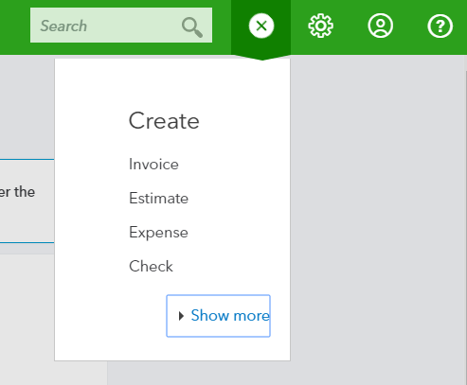
Quick Create
Notes:
Quick Create
The Quick Create button in the top right section of the screen allows you to access four key transaction types quickly. It is a + button that turns into an x once it is pressed.
If the Quick Create produces a very short list of functions, clicking on Show more button expands the list to include all the available transactions.

Slide 16
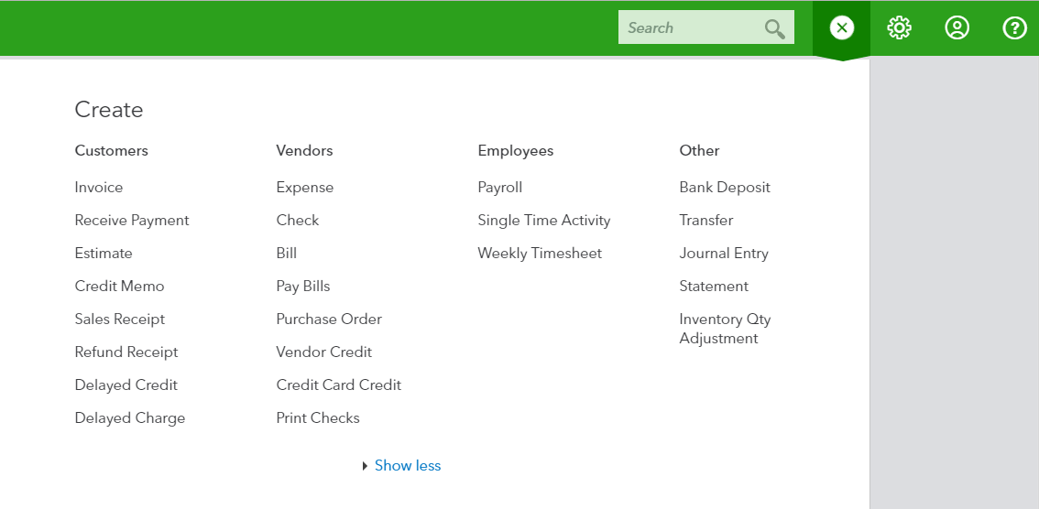
Quick Create: Choose Your Transaction
Notes:
Quick Create: Choose Your Transaction
When all the transactions appear as a result of clicking Show more, QuickBooks remembers this choice for next time.
Choose the transaction you want to launch.
Clicking on the x will close the Quick Create window.

Slide 17
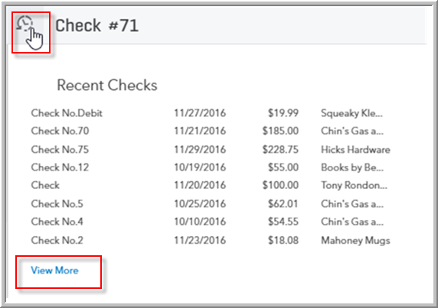
Recent Transactions
Notes:
Recent Transactions
Once a transaction type is open, you will see a button in the top left corner of the transaction. It looks like a clock with a counter-clockwise arrow.
Clicking on this counter-clockwise arrow produces a Recent Transactions menu. Use this feature to display a list of recently recorded transactions of this same type. Each of these listed transactions can be opened by clicking on the selection. Click on View More to expand the list or create a more advanced search form.

Slide 18
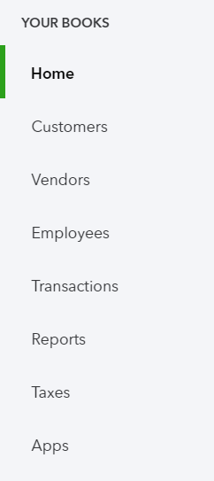
Left-Hand Navigation Bar
Notes:
Left-Hand Navigation Bar
The left-hand navigation bar provides access to:
Home – to return to the Home Page
Customers – Create, import, edit and delete customers. The Customer Money Bar shows the flow of money into the business.
Vendors – Create, import, edit and delete Vendors; the Vendor Money Bar shows the flow of money out of the business
Employees – Manage Employees and run payroll
Transactions – This is a shortcut to Banking (including Bank Feeds), Sales, Expenses and the Chart of Accounts
Reports – Access to Reports
Taxes – A business registered for sales tax and payroll tax can file each of them here
Apps – Access featured applications and add-ons to QuickBooks Online from this page. (This tab is not available in the Sample Company, and so you may want to open up a real company such as Your Books in order to explore this feature.)

Slide 19
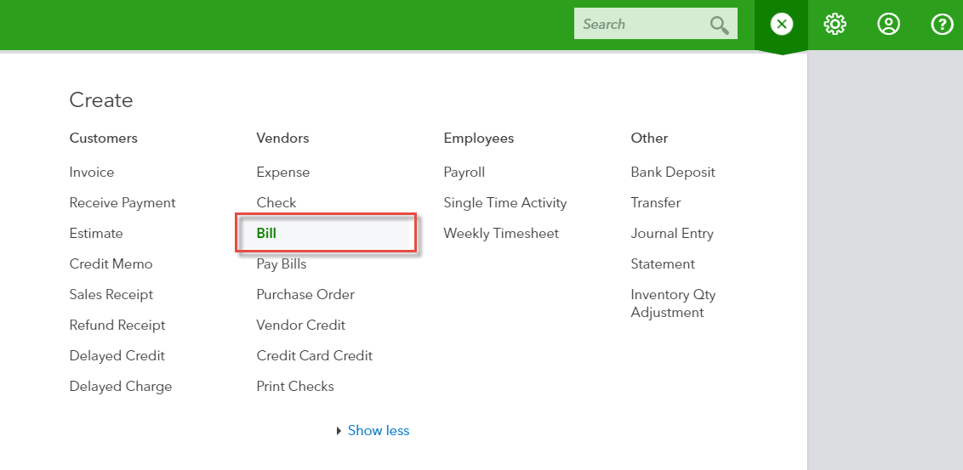
Purchase and Expense Workflows: Bills, etc.
Notes:
Purchase and Expense Workflows: Bills, etc.
Bills, available in QuickBooks Online Essentials and Plus, allow you to track Accounts payable. Select Quick Create (the plus sign); under Vendors, select Bill.

Slide 20
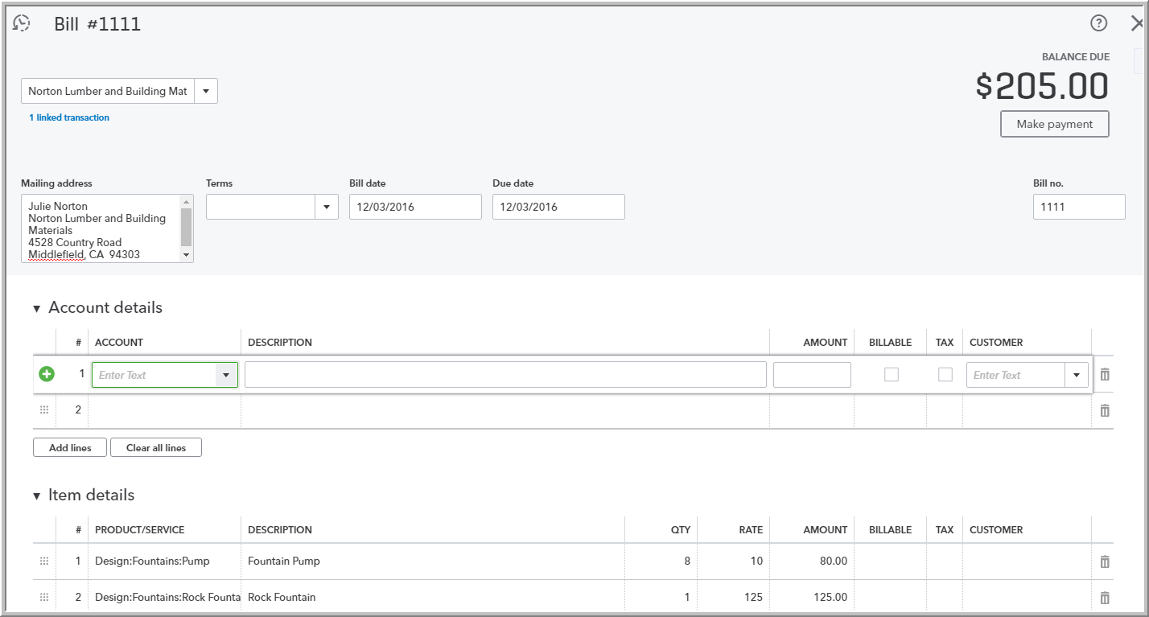
Purchase and Expense Workflows: Bills, etc.
Notes:
Complete the detail of the bill transaction including the vendor, the reference (bill) number, and the terms / due date.
Define the detail(s) of the bill by allocating it/them to the relevant account(s) (if using general ledger accounts) and/or item details (if using products and services, which are, in turn, linked to general ledger accounts). Specify the amount for each expense or item, and if applicable, if it’s billable to a customer, taxable (if it is to be billed), and to be tracked against a customer.
Any additional fields, such as a Memo, can be completed.
If necessary, attach a document or any file by clicking on Attachments in the bottom left corner of the form. This can be used to store related documents for future reference. Attachment file sizes can be a maximum of 25MB each.
Click Save and Close or Save and New.
Other Types of Supplier Related Transactions
Vendor Credit, Credit Card Credit, and Purchase Orders can be also accessed in the Vendors section of the Quick Create menu. (Expense, Check, Pay Bills transactions and Print Checks will be covered shortly in this session.)

Slide 21
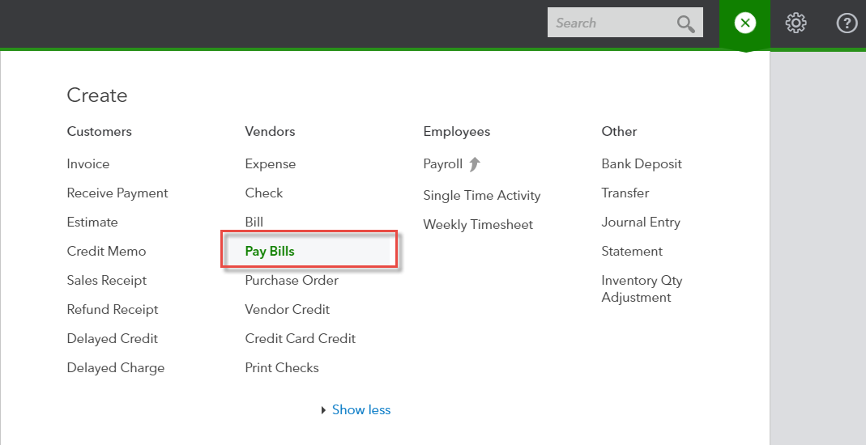
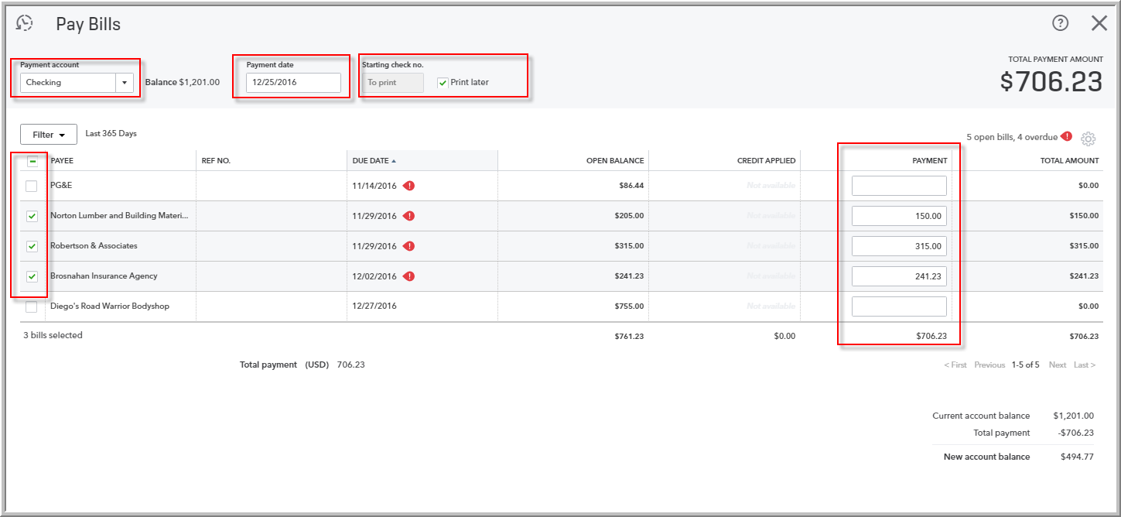
Purchase and Expense Workflows: Pay Bills
Notes:
Purchase and Expense Workflows: Pay Bills
The easiest way to find and pay unpaid bills is to select Quick Create. Under Vendors, click on Pay Bills.
When you select bills to pay, you can specify if they’re being paid by check, cash or credit card. You will also specify the payment date. If these bills are being paid by manual check, you can enter the starting manual check number. If they’re being paid by printed check, you can set up those checks to print later, and then send the checks through the printer (we’ll cover printing checks in just a bit). If the bills are being paid in part, you can specify the payment amount in the Payment column. If there are vendor credits to be applied to reduce the amount to pay, you’ll see the credit total appear in the Credits Applied column, ready to use to lower your payment. When you’re done specifying the bills to pay, select Save, Save and Print, or Save and Close.

Slide 22
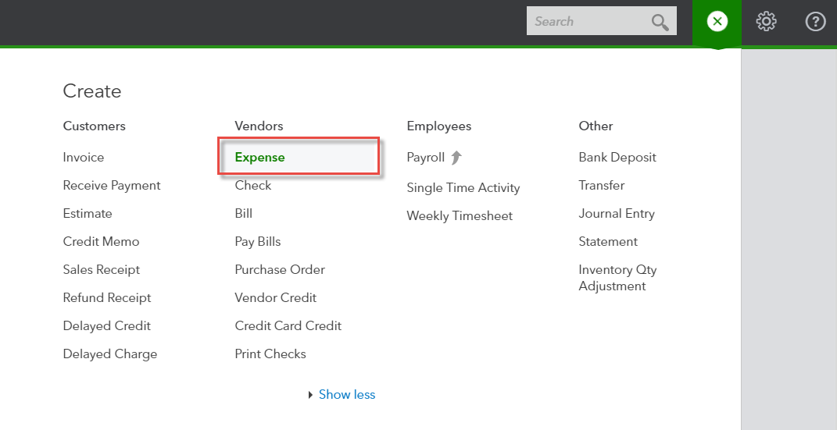
Purchase and Expense Workflows: Expense Transactions
Notes:
Purchase and Expense Workflows: Expense Transactions
To enter an expense transaction, select Select Quick Create (the plus sign). Then under Vendors, select Expense.

Slide 23
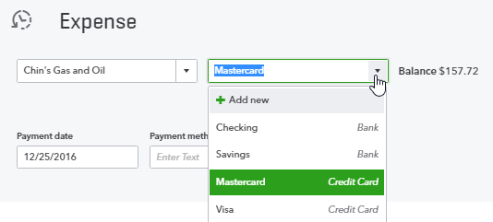
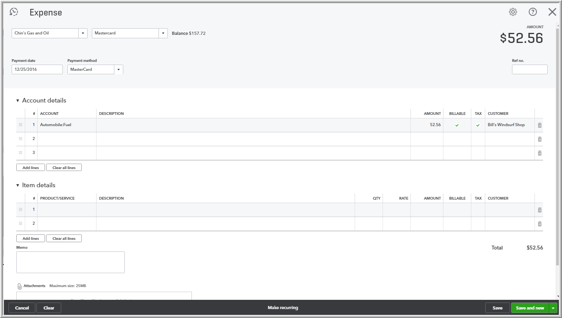
Purchase and Expense Workflows: Filling out Expense Transactions
Notes:
Purchase and Expense Workflows: Filling out Expense Transactions
In the Expense window itself, select the account from which the expense was paid, such as petty cash, a bank account or credit card account.
Complete the detail of the expense transaction including the payee, the reference number, and the payment date. The detail area looks very much like that of a bill.
Define the expense(s) by allocating it/them to the relevant account(s) (if using general ledger accounts) and/or item details (if using products and services, which are, in turn, linked to general ledger accounts). Specify the amount for each expense or item, and if applicable, if it’s billable to a customer, taxable (if it is to be billed), and to be tracked against a customer.
Any additional fields such as a Memo can be completed.
If necessary, attach a document or any file by clicking on Attachments in the bottom left corner of the form. This can be used to store related documents for future reference. Attachment file sizes can be a maximum of 25MB each.
Click Save and Close or Save and New.

Slide 24
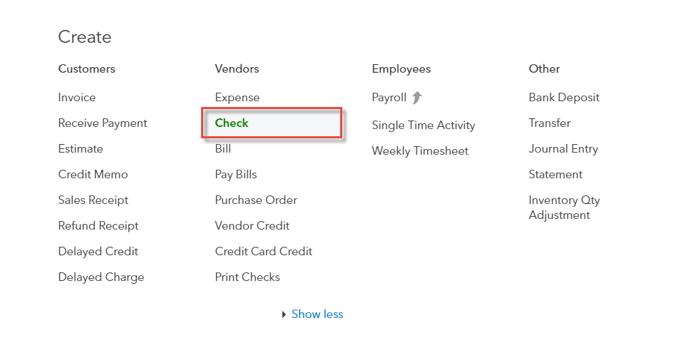
Purchase and Expense Workflows: Checks
Notes:
Purchase and Expense Workflows: Checks
You can record checks by using the Expense transaction, and this is especially useful if you’re going through a shoebox of a mixture of check, petty cash, and credit card transactions from all kinds of accounts, as they can all be entered in this way in one window.
However, many times, if you are not using a bill payment check (such as in the case of QuickBooks Online Simple Start, which doesn’t track bills), and especially if you are going to want to set up checks to print, you’ll want to use the Check transaction, accessed by selecting Quick Create (the plus sign). Then under Vendors, select Check.
Very much like what you encountered in the Expense transaction screen, a check can be filled out with payee, source account, account and/or item details, amounts and billable/taxable/customer information, memo, and attachment.

Slide 25
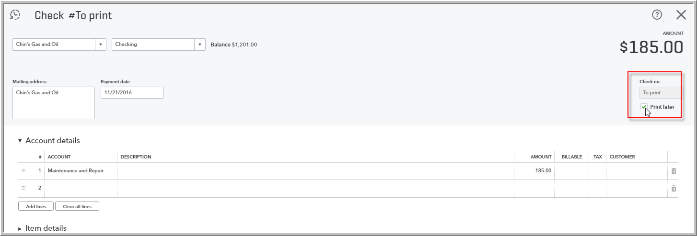
Purchase and Expense Workflows: Filling out Checks
Notes:
Purchase and Expense Workflows: Filling out Checks
The Check form has a place for a manual check number to be assigned, or (and this is different from the Expense transaction), you can check the box next to Print later to put this check along with other checks or bill payment checks into the print queue.
When you’re finished filling out this Check screen, click Save and Close or Save and New.

Slide 26
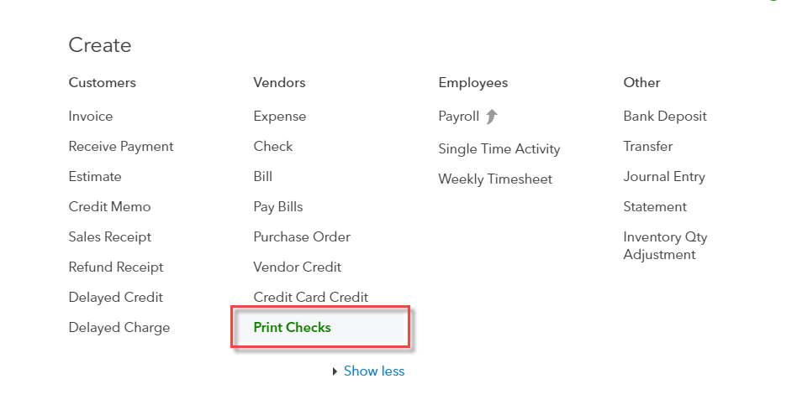
Purchase and Expense Workflows: Printing Checks
Notes:
Purchase and Expense Workflows: Printing Checks
After you’ve created regular or bill payment checks that are tagged to print later, you will want to print them on check stock that is loaded into your printer.
Select Quick Create (the plus sign). Then under Vendors, select Print Checks.

Slide 27
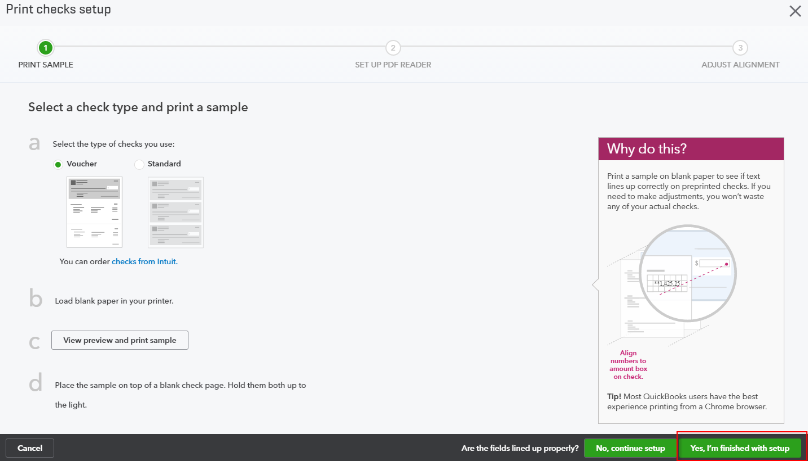
Purchase and Expense Workflows: Printing Checks - Setup
Notes:
Purchase and Expense Workflows: Printing Checks - Setup
(You may encounter, especially the first time you print checks, a Print checks setup screen to ensure that you are choosing the correct check type (voucher or standard), set up your PDF reader (since checks are previewed as PDF’s before they are printed) and to align the checks with the printer you’re using. When you’re finished with this step, select Yes, I’m finished with setup.)

Slide 28
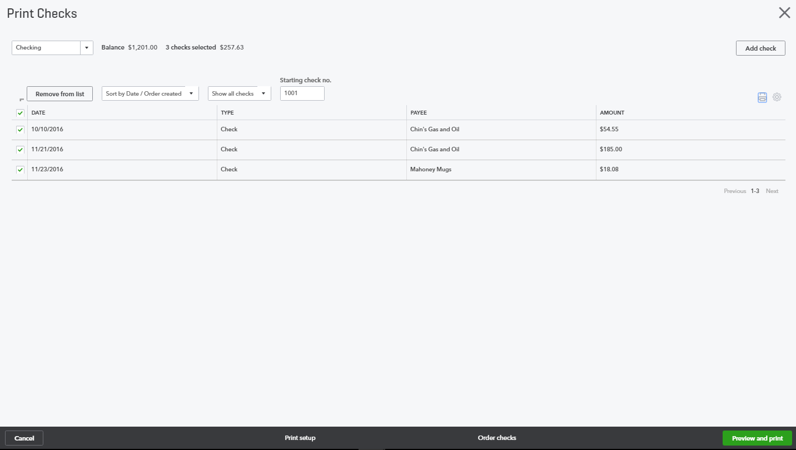
Purchase and Expense Workflows: Selecting Checks to Print
Notes:
Purchase and Expense Workflows: Selecting Checks to Print
In the Print Checks window, specify the bank account for this print queue and place a checkmark next to the checks and/or bill payment checks to be printed. You may sort the list by payee, order created, date/payee, or date/order created. You can choose to show all checks available to print, or just all regular checks or just all bill payment checks. Enter the Starting check number of the pile of check stock that you are loading into your printer.
When you’re ready, select Preview and print. You will see a print preview in PDF format of all the checks about to print. If you’re satisfied with how they look, click on Print.

Slide 29
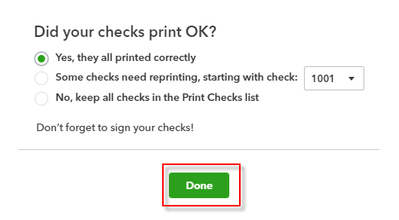
Purchase and Expense Workflows: Selecting Checks to Print
Notes:
Purchase and Expense Workflows: Selecting Checks to Print
When you’re finished printing, you’ll see a Did your checks print OK? Screen, which you’ll address according to whether all your checks printed properly or not. When you are finished with this screen, click Done.

Slide 30
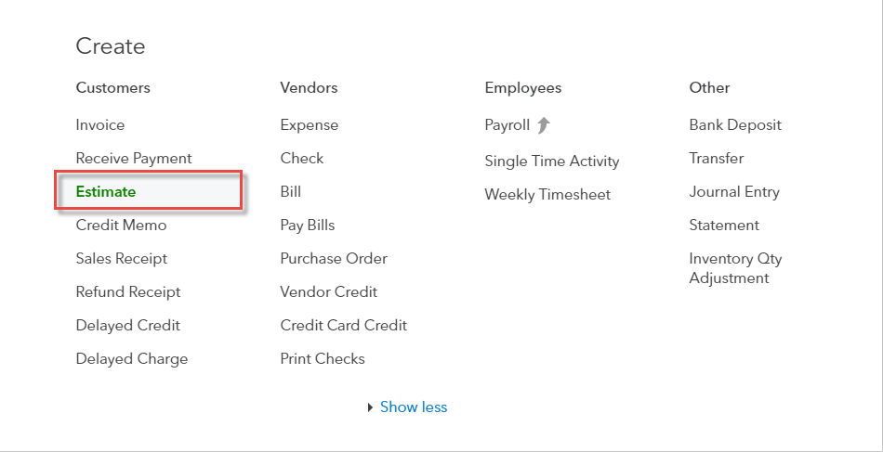
Sales Workflows: Creating Estimates
Notes:
Sales Workflows: Creating Estimates
Estimates can be easily accessed from the Quick Create menu. To create an estimate:
Go to the Quick Create (the plus sign). Under Customers, select Estimate.

Slide 31
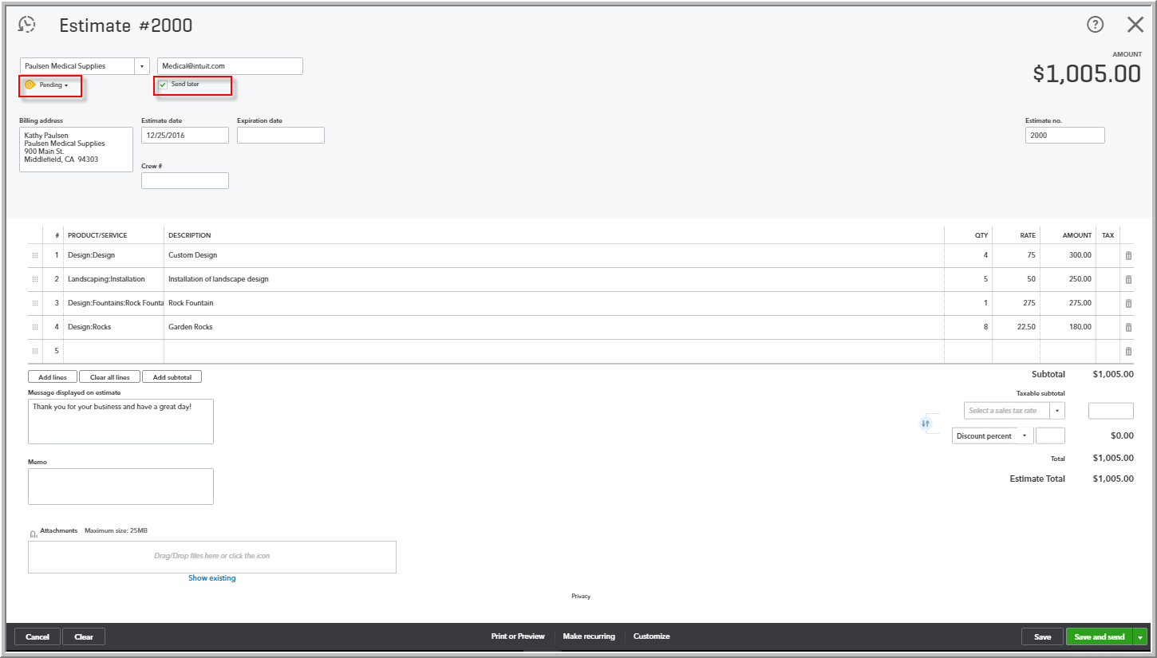
Sales Workflows: Filling out Estimates
Notes:
Sales Workflows: Filling out Estimates
Estimates can be easily accessed from the Quick Create menu. To create an estimate:
Go to the Quick Create (the plus sign) at the top of the QuickBooks Online screen. Under Customers, select Estimate.
Complete the on-screen estimate, including selecting a customer, date, estimate number (if custom transaction numbers were chosen in the Account and Settings), products/services of your choosing, description, the quantity and selling price for each. Specify whether each product/service is taxable, line by line. Add more lines, if needed. In the footer, select the tax rate, if applicable.
Complete any other desired fields, such as the Discount or add a message to be displayed on the estimate.
If necessary, attach a document or any file by clicking on Attachments in the bottom left corner of the form. This can be used to store related documents for future references. Attachment file sizes can go up to 25MB each.
Bear in mind that each estimate can have a status of Pending, Accepted, Closed, or Rejected. Also, you can check the box next to Send Later in order to put this estimate in an email queue.
Select Save and Send to email your customer the estimate. Click Save and Close to save the estimate and return to the homepage, or select Save and New to save the estimate and start to create a new one.

Slide 32
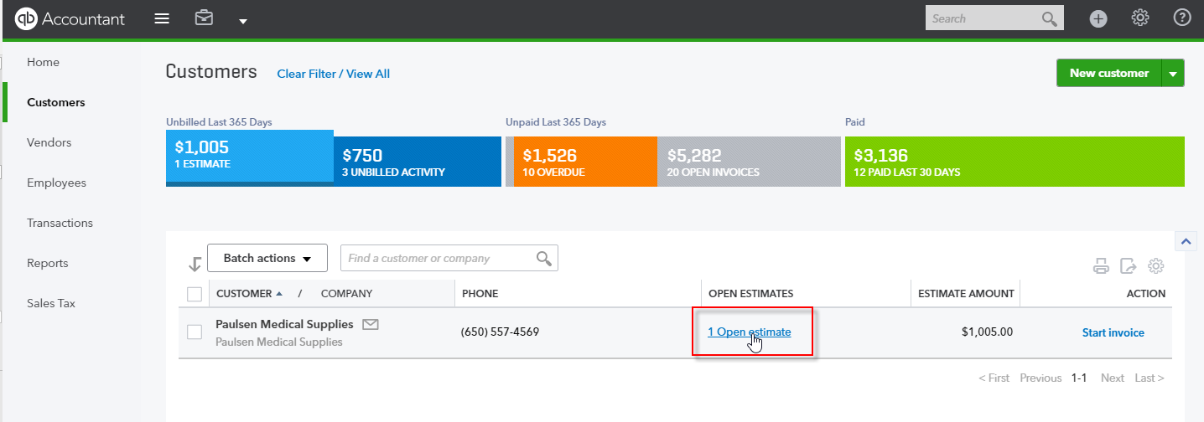
Sales Workflows: Turning Estimates into Invoices
Notes:
Sales Workflows: Turning Estimates into Invoices
Once the customer agrees to an estimate, it can be copied to an invoice.
The easiest way of finding Estimates is by selecting Customers from the left-hand navigation bar.
In the Customer Center, click on the Estimates box in the Money Bar. Locate the customer for whom you wish to update the estimate. Select the Open estimates link for that customer.

Slide 33
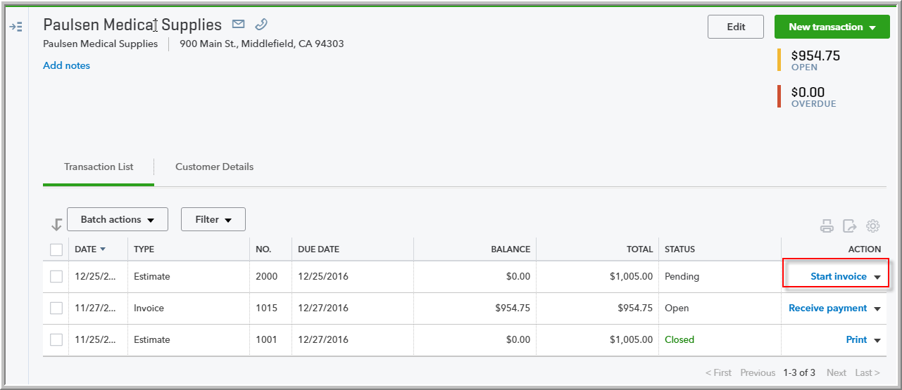
Sales Workflows: The Resulting Invoice from an Estimate
Notes:
Sales Workflows: The Resulting Invoice from an Estimate
To create a new invoice from the pending estimate in question, click on Start Invoice under the Action column for that estimate.
(NOTE: In the drop-down next to Start Invoice in the Action column, you can also edit the estimate and update its Status (such as from Pending to Accepted), and then convert it to an invoice.

Slide 34
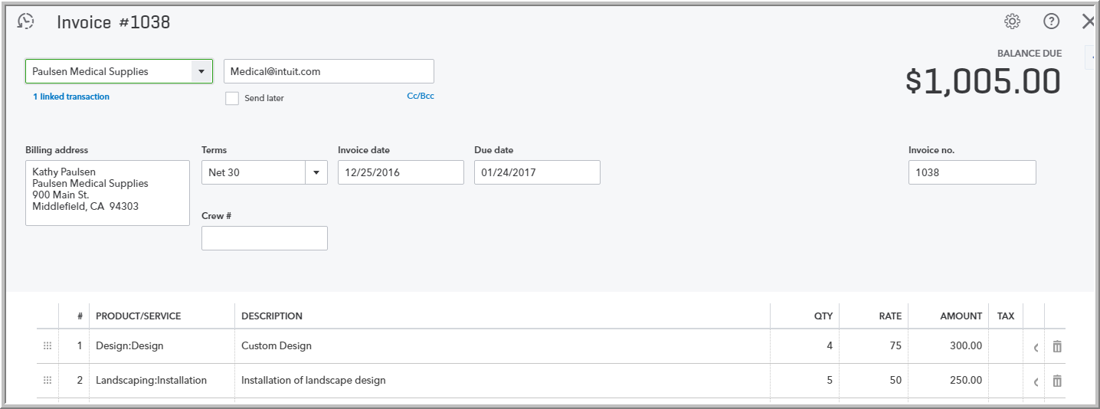
Sales Workflows: The Resulting Invoice from an Estimate
Notes:
Sales Workflows: The Resulting Invoice from an Estimate
A new invoice populated with the details from the estimate is created for you. Make any changes such as adding a message or discount or to attach a document. Select Save and Send, Save and New, or Save and Close.

Slide 35
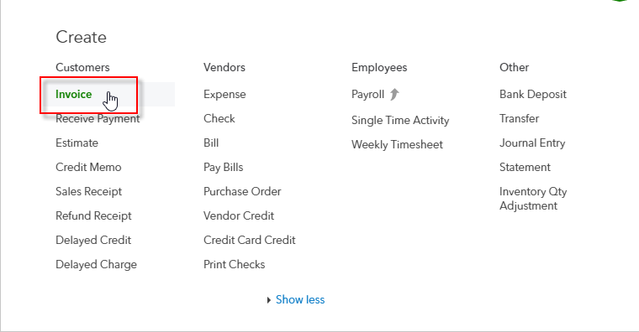
Sales Workflows: Creating Invoices (Not from an Estimate)
Notes:
Sales Workflows: Creating Invoices (Not from Estimates)
Although we just covered turning estimates into invoices, many times invoices are created without first creating an estimate. Creating invoices can be easily accessed from the Quick Create menu.
To create an invoice without creating an estimate first:
Go to the Quick Create (the plus sign) at the top of the QuickBooks Online screen.
Under Customers, select Invoice.

Slide 36
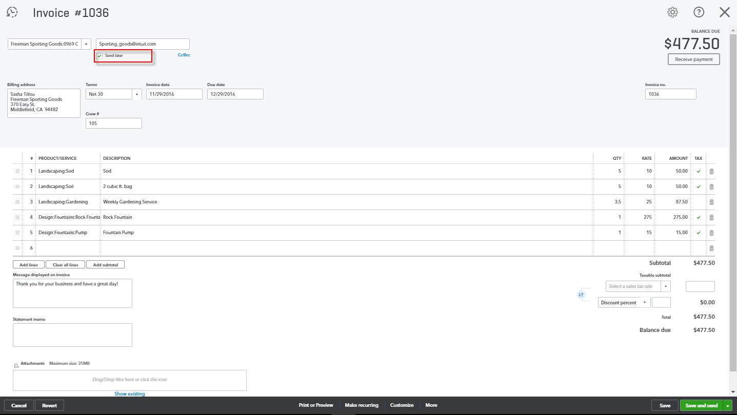
Sales Workflows: Filling out the Invoice (Not from an Estimate)
Notes:
Sales Workflows: Filling out the Invoice (Not from an Estimate)
Complete the on-screen invoice, including selecting a customer, date, invoice number (if custom transaction numbers were chosen in the Account and Settings), products/services of your choosing, description, the quantity and selling price for each. Specify whether each product/service is taxable, line by line. Add more lines, if needed. In the footer, select the tax rate, if applicable.
Complete any other desired fields, such as the Discount or add a message to be displayed on the invoice.
If necessary, attach a document or any file by clicking on Attachments in the bottom left corner of the form. This can be used to store related documents for future references. Attachment file sizes can go up to 25MB each.
Select Save and Send to email your customer their invoice, click Save and Close to save the invoice and return to the homepage, or select Save and New to save the invoice and start creating a new one.

Slide 37
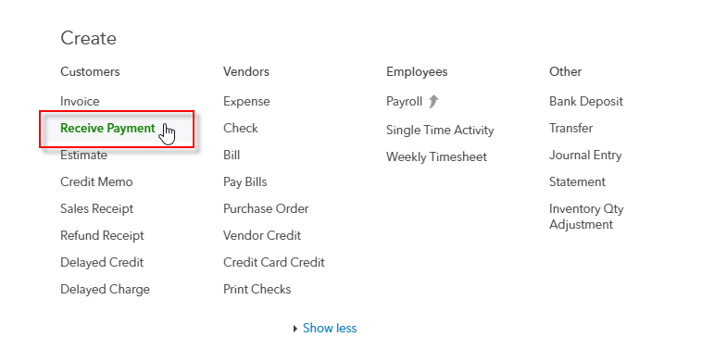
Sales Workflows: Receiving Payment on Invoices
Notes:
Sales Workflows: Receiving Payment on Invoices
As with many functions in QuickBooks Online, customer payments against invoices can be processed several ways, and so we’re going to cover just one method here.
Go to the Quick Create (the plus sign) at the top of the QuickBooks Online screen.
Under Customers, select Receive Payment.
Enter or choose the Customer name. The Receive Payment window will populate with any invoices outstanding for this customer. (If you’re not 100% sure of the Customer name, but you know the invoice number that is being paid, you can click on Find by invoice no. to bring up the correct Customer and invoice.)

Slide 38
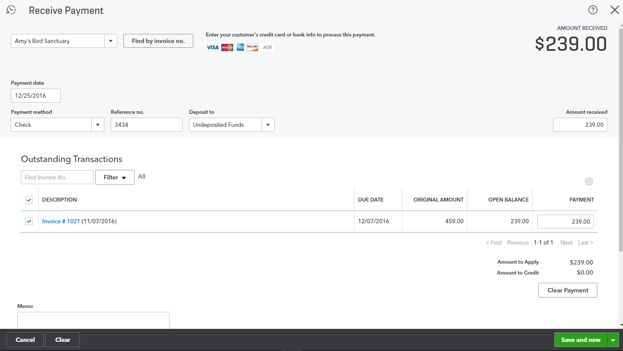
Sales Workflows: Filling out the Receive Payment on Invoices
Notes:
Sales Workflows: Filling out the Receive Payment on Invoices
Enter the payment date, payment method, reference number (e.g., check number), and the account to which this payment will be deposited. If this payment will ultimately be deposited into the bank, together with other payments in one batch, select Undeposited Funds as the Deposit to account. (If this payment is going into the bank by itself, as in the case of a wire transfer, you may choose the actual bank account and bypass Undeposited Funds.) Place a checkmark next to each invoice that is being paid; if any less than the outstanding amount of each checked invoice is being paid, overwrite the Payment amount for that invoice. If any credit memos are being applied by this customer to reduce this payment, you will be able to check the credit memo(s) being used at the bottom of the screen. Add a memo and attachments as necessary. Select Save and New or Save and Close as required.
After all received payments are recorded in this fashion, it’s time to deposit them into the bank in batches (if they were deposited into Undeposited Funds). Go to the Quick Create at the top of the QuickBooks Online screen.

Slide 39
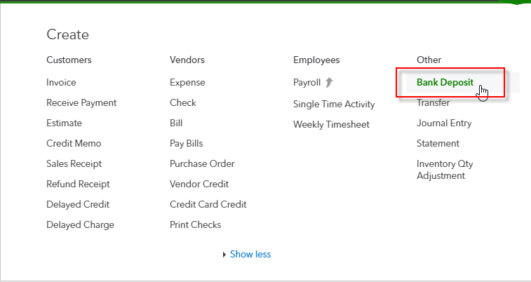
Sales Workflows: Depositing the Money You Received
Notes:
Sales Workflows: Depositing the Money Your Received
After all received payments are recorded in this fashion, it’s time to deposit them into the bank in batches (if they were deposited into Undeposited Funds). Go to the Quick Create at the top of the QuickBooks Online screen.
Under Other, select Bank Deposit.

Slide 40
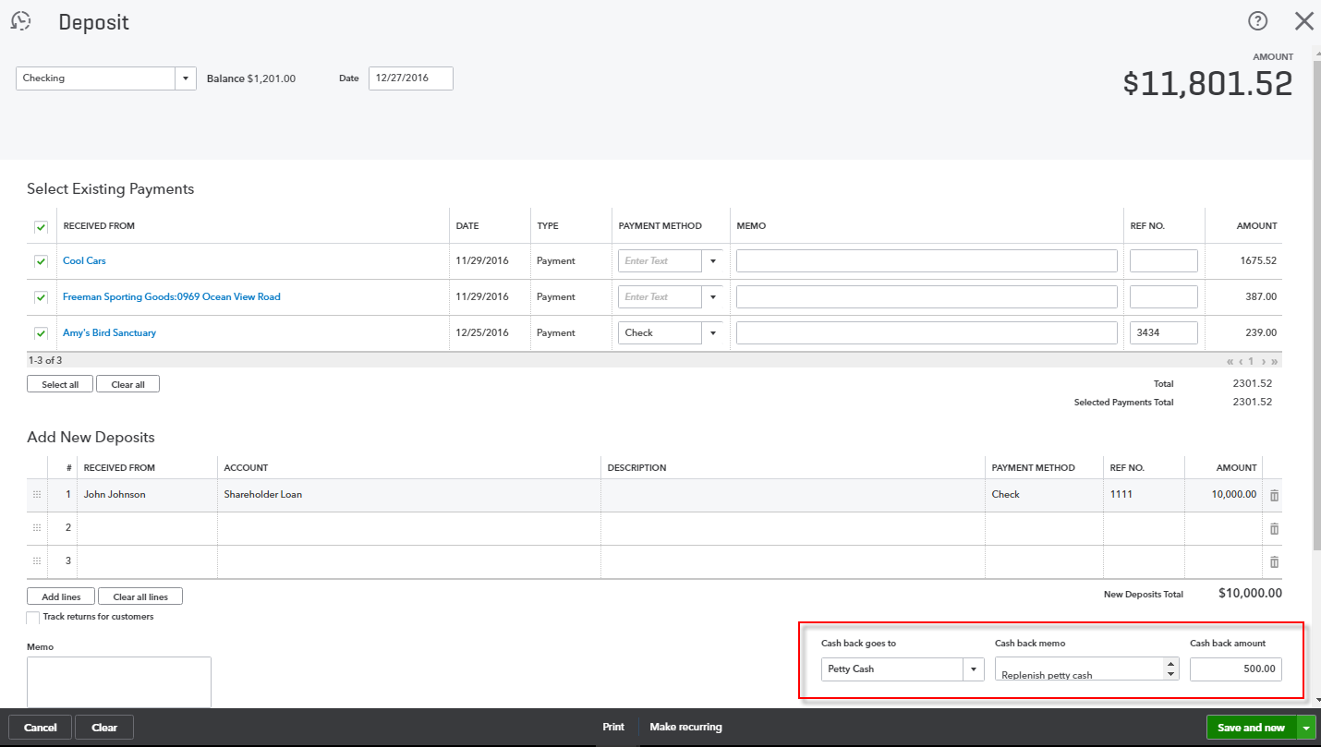
Sales Workflows: Filling out the Bank Deposit
Notes:
Sales Workflows: Filling out the Bank Deposit
Any funds sitting in Undeposited Funds will appear in the Deposit window under Select Existing Payments at the top of the screen. Select the bank account and the date of the deposit. Place a checkmark next to each payment being deposited in the Select Existing Payments section. Then, under Add New Deposits, enter any non-sales-related funds going into the bank in this same deposit, such as shareholder loans or insurance premium refunds. If there is any cash back reducing the total of this deposit, specify the amount and where it’s going (such as Petty Cash). Confirm the total, add a memo and attach a document if desired. Select Save and New or Save and Close.

Slide 41
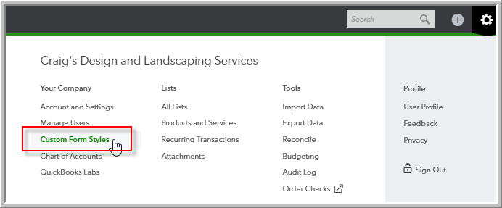
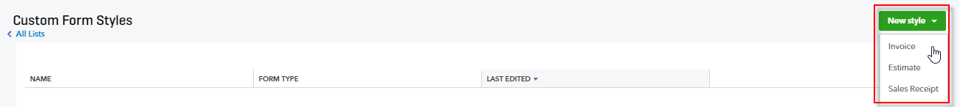
Customizing Invoices: Accessing
Notes:
Customizing Invoices: Accessing
Customize the look of the invoice template by including a logo, editing the font and more.
To customize invoices in a QBO company, click on the Gear icon. Then, under Settings, select Custom Form Styles.
In the top right corner of the Custom Form Styles window, select New Style, and then specify whether this is a new style of Invoice, Estimate, or Sales Receipt. In this example, I’m selecting a new Invoice template.

Slide 42
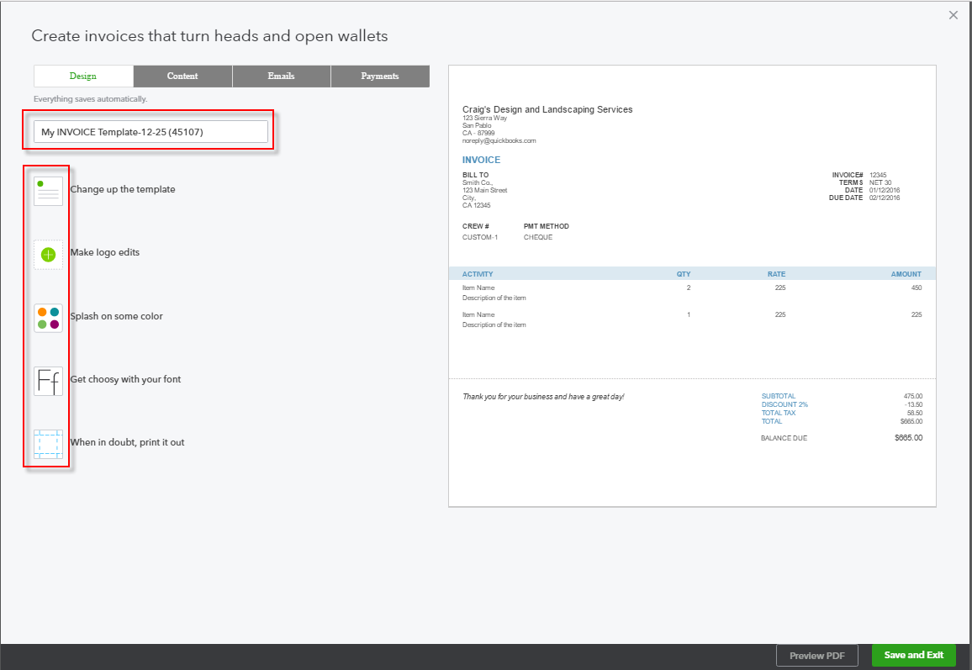
Customizing Invoices: Creating a New Template
Notes:
Customizing Invoices: Creating a New Template
Assign a name to your new template. In the Design tab, choose a template and accent colour, upload your logo, and try out some fonts. You can also print out your in-progress template from the Design tab if you’re in doubt as to how this would appear on paper. In the Content tab, specify columns, header, footer and more. You can also specify how Standard and Reminder emails will behave in the Emails tab, and you can let customers pay online in the Payments tab. Select Preview PDF to check out your design progress, and when you’re done, select Save and Exit.

Slide 43
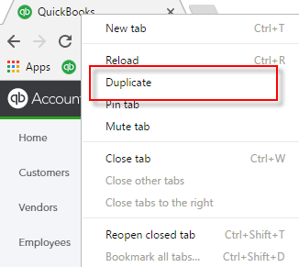
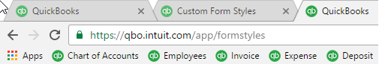
Efficient Browser Use: Opening Two or More Companies, Duplicating Tabs
Notes:
Efficient Browser Use: Opening Two or More Companies
You can open more than one company in QBO and QBOA using one of two methods:
Open up QBO or QBOA using a different browser for each company you wish to open (for example, Chrome, Firefox, and Safari to open three different companies), or…
Use the Chrome sign in feature and sign in as different Google account users in different Chrome instances/windows or open an incognito window.
Efficient Browser Use: Duplicating Tabs
In Chrome, you can right-click on the browser tab and choose Duplicate one or more times.
This creates as many identical copies of the tab that you’ve duplicated as you want. Then, you can open up any of the “copies” and navigate to another function in QBO.
Then, you can merely click on another tab to move to another area of the company’s books without losing what you were doing in the original tab.

Slide 44
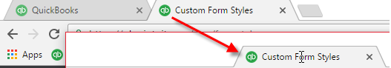
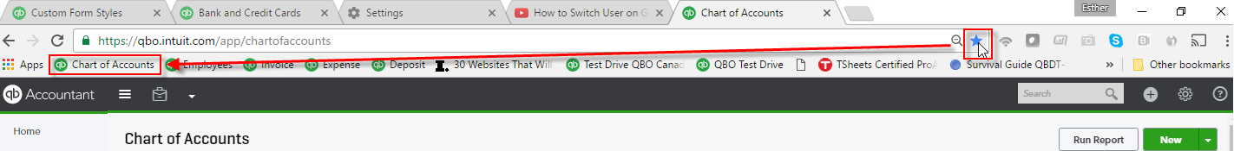
Efficient Browser Use: Pulling Away Tabs, Using Bookmarks
Notes:
Efficient Browser Use: Pulling Away Tabs
In Chrome, you can also drag a browser tab away from its neighbors and create a separate window of Chrome, perhaps to view in a separate monitor (if you have more than one) or another part of the same monitor (if you have a large one). This is great for viewing reports and related transactions.
Efficient Browser Use: Bookmarks
If you see a function, report or screen in QBO or QBOA that you would like to access in the future with just one click, regardless of the QBO company that is open, all you have to do is bookmark the screen in your browser.
In this example, we’ve opened the Chart of Accounts and we want to access it with just one click, in any company that we’ve opened in QBO or QBOA.
Bookmark this page; whenever you are in this browser (in Chrome, logged in as the same user), you will see this bookmark as well as any other bookmarks. Clicking on this bookmark will take you to the Chart of Accounts of whatever QBO company is currently open.

Slide 45
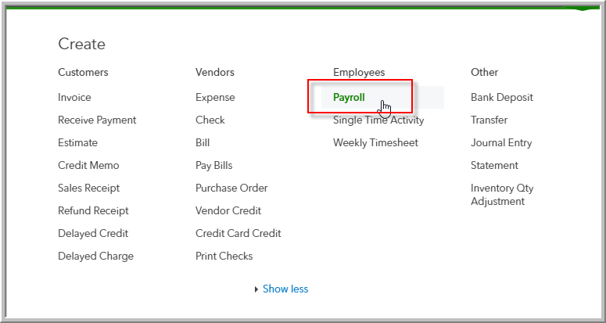
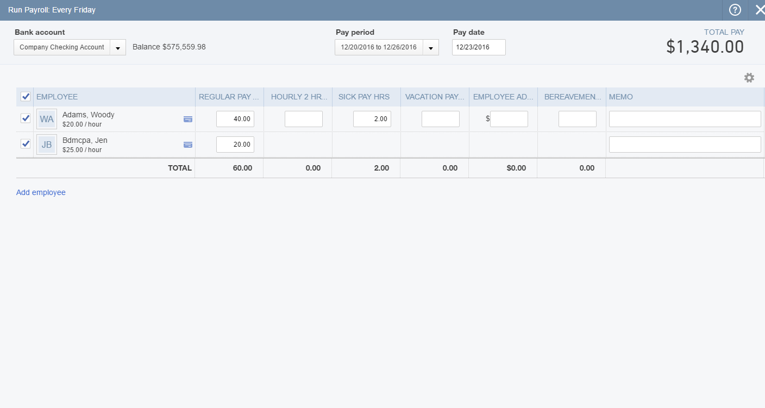
Payroll: Running Payroll
Notes:
Payroll: Running Payroll
Go to the Quick Create at the top of the QuickBooks Online screen.
Under Employees, click on Payroll. (You may be asked to confirm the payroll frequency)
Choose the bank account, pay period, and pay date. Ensure there is a checkmark next to each employee to be paid. Enter hours, overtime hours, sick pay hours, vacation pay, and a memo where required.
Click on Preview payroll (or Save for later).

Slide 46
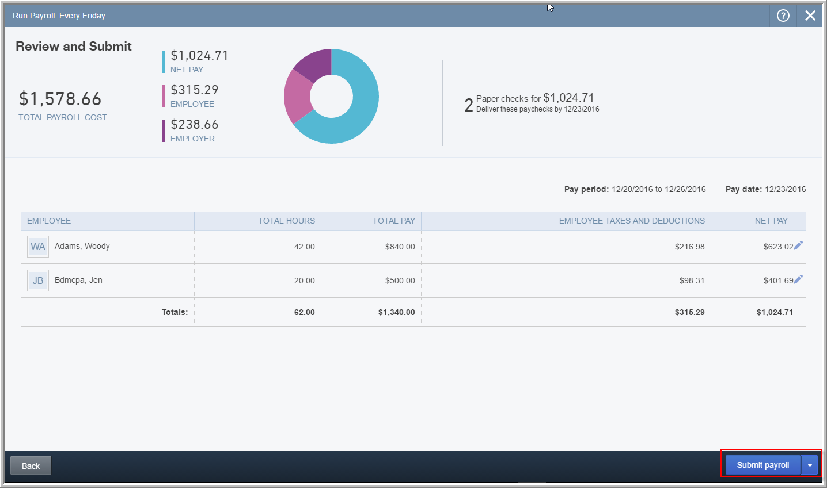
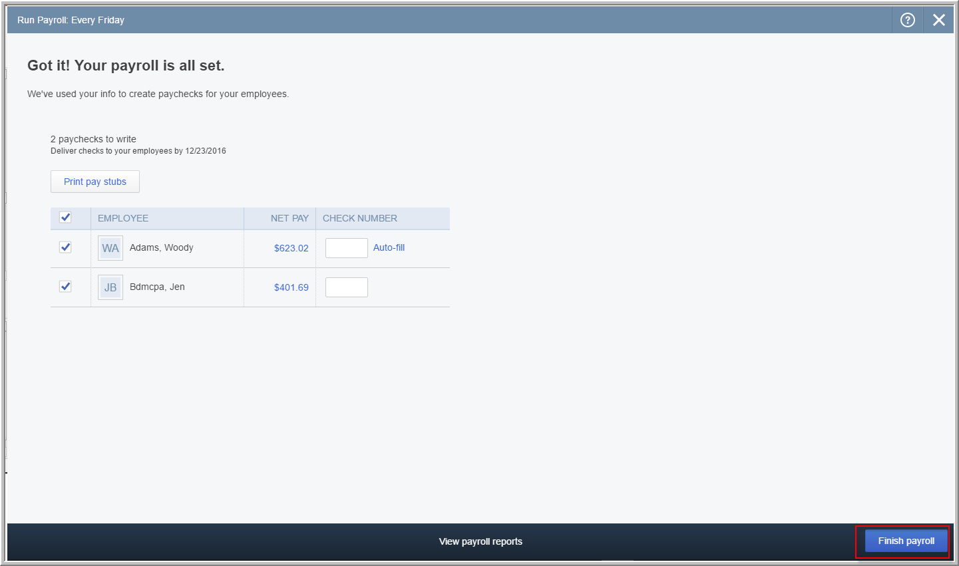
Payroll: Reviewing and Submitting
Notes:
Payroll: Reviewing and Submitting
Review the pending payroll and make any edits as required by clicking on the individual pencil icons. You’ll see a summary of the paper checks and the direct deposit payroll. When you’re ready, click on Submit payroll (or Save for later).
You’ll see Got it! Your payroll is all set in the next window. There, you’ll have the opportunity to print the paychecks or assign a check number (for those that are paper checks).

Slide 47
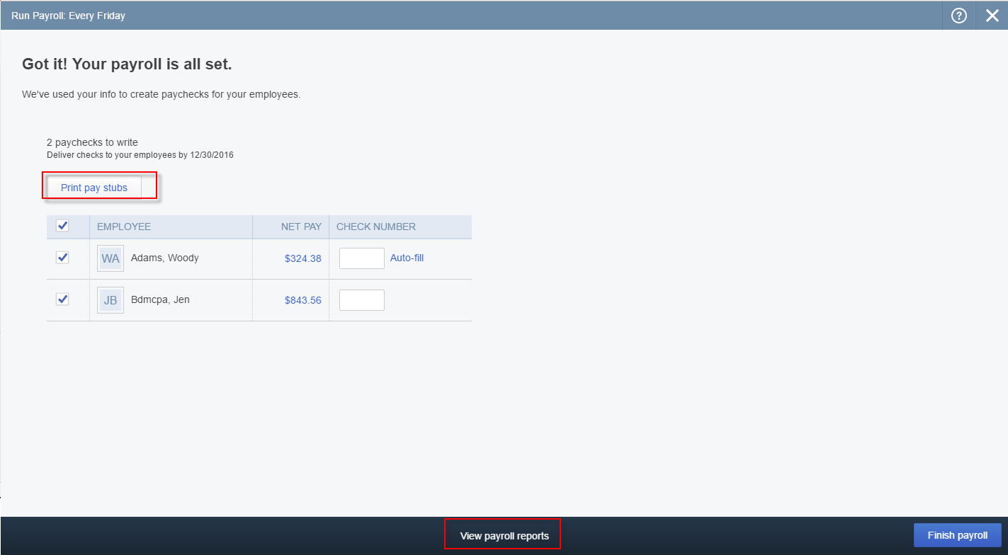
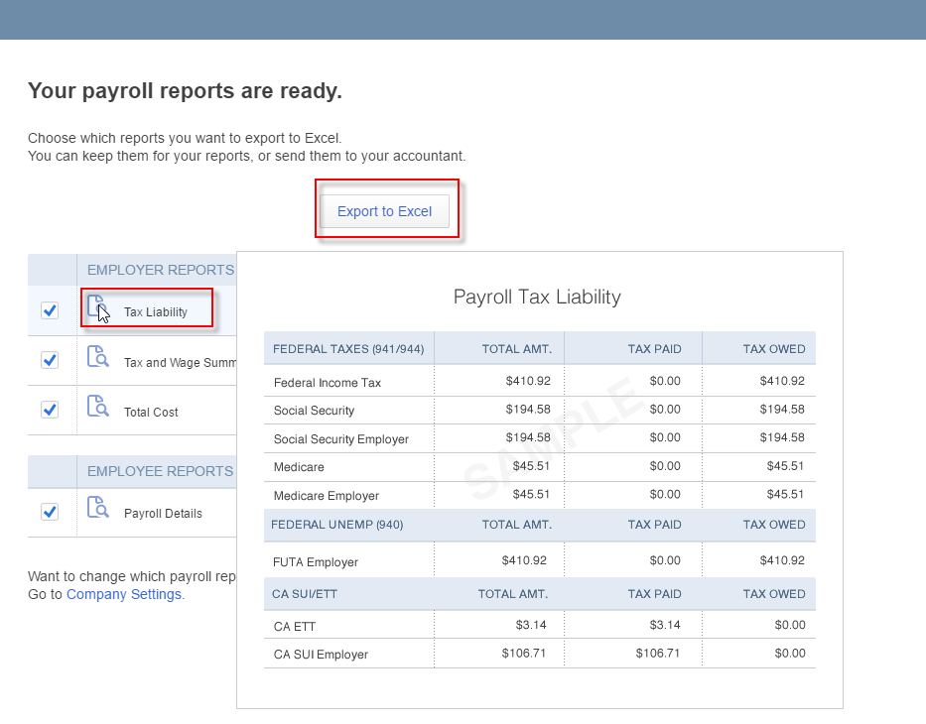
Payroll: Viewing Payroll Reports and Finishing Payroll
Notes:
Payroll: Viewing Payroll Reports and Finishing Payroll
From this Got it! Your payroll is all set screen, you can also print pay stubs for those paychecks that are direct deposit.
You can also click on View payroll reports at the bottom of the screen for more information. Those reports can be exported to Excel in the Your payroll reports are ready screen that appears. Also, if you hover your mouse pointer over the name of a payroll report, it will appear as a pop-up for your to review. Click OK to return to the Got it! Your payroll is all set window.
When you’re ready, click on Finish payroll.
You may see a Tax payments due screen for payroll taxes. At the appropriate time, Review and pay.

Slide 48



Routine Monthly Reconciliations: Start Reconciling
Notes:
Routine Monthly Reconciliations: Start Reconciling
Click on the Gear icon.
Under Tools, click on Reconcile.
In the Reconcile window that appears, choose the account you wish to reconcile in the Account drop-down. If this account has been reconciled in previous periods, you will see them summarized in the Reconciliation History & Reports section. Click on Reconcile Now. We’re choosing a checking account here.
In the Start Reconciling window, enter the Statement End Date and the Ending Balance per the bank statement on that date. Click OK.

Slide 49

Routine Monthly Reconciliations: Finish Reconciling
Notes:
Routine Monthly Reconciliations: Finish Reconciling
Ensure that there is a checkmark next to Hide transactions after the statement’s end date in the top right corner of the next screen. Then review the statement and place a checkmark next to each check/payment in the left section and each deposit/credit in the right section, if they cleared the bank.
If there are any service charges or interest earned on the statement that you haven’t entered until this point, click on Edit information from Statement and enter those transactions in the window that appears. (You can also use this option to correct the statement date and balance if you made an error earlier.) Then click OK to return to the Reconcile window.
When you are finished, if you have captured everything correctly, the Difference at the bottom of the window (between the Statement Ending Balance you entered and the Cleared Balance that is calculated from what you checked off) will be 0.00. When this difference is zero and only when this difference is zero at the end of your reconciling efforts, click on Finish Now. (If you haven’t finished and you have to leave in the middle of reconciling to pick this up again at another time, click on Finish Later. QBO will remember all the work you’ve done and bring you back to the point where you had to leave.)

Slide 50


Routine Monthly Reconciliations: Reconciliation History & Reports
Notes:
Routine Monthly Reconciliations: Reconciliation History & Reports
The Reconciliation History & Reports for this account will now include this reconciliation in its listed history.
Each of these is a hyperlink upon which you can click to produce the Reconciliation Report.

Slide 51

Key Monthly Reports: Profit and Loss and Balance Sheet
Notes:
Key Monthly Reports: Profit and Loss and Balance Sheet
Although you can run reports from QBO and QBOA at any time, it’s recommended that reports are run at the very least on a monthly basis, often after the reconciling is done.
From the left-hand navigation bar, select Reports.
You’ll see several report categories. From the Recommended Reports category, select, one at a time, Profit and Loss and Balance Sheet.

Slide 52


Key Monthly Reports: Customizing
Notes:
Key Monthly Reports: Customizing
For each report, choose the date or date range, and then click on Customize at the top.
Review the various sections of customization: General, Number format, Rows/Columns, Filter, and Header/Footer. Make the changes you want, and when you’re finished, you can click on Run Report to display it on the screen with the customizations you’ve chosen.

Slide 53

Key Monthly Reports: Printing, Emailing, Exporting & Saving Customizations
Notes:
Key Monthly Reports: Printing, Emailing, Exporting & Saving Customizations
You can then review the customized report on the screen.
You can click on the Gear icon at the top of the report to change the display density from Compact to Regular, or back again.
If it is to your liking, next to the Gear icon, you can click on the appropriate icons to Print, Email, or Export the report to Excel. You can also select to Save Customizations if this report is going to be run a lot in the future with refreshed data. Reports whose customizations have been saved will appear in the Reports section My Custom Reports so they can be accessed easily to be run in the future.

Slide 54
Desktop Apps for QBO and QBOA
  Free QBO and QBOA Desktop Apps
  Windows or Mac
  Start workday faster
  Work within multiple windows
  Automatic refresh
  Maximize productivity
  Start where you left off
Notes:
Consult your Supplemental Guide for the URL’s to download the QBO and QBOA Desktop Apps for free.
[http://quickbooks.intuit.com/accountants/resources/features-quickbooks-app/ for QBOA
https://quickbooks.intuit.com/apps/ for QBO]

Slide 55

Desktop Apps for QBO and QBOA
Notes:
Desktop Apps for QBO and QBOA
Consult your Supplemental Guide for the URL’s to download the QBO and QBOA Desktop Apps for free.
[http://quickbooks.intuit.com/accountants/resources/features-quickbooks-app/ for QBOA
https://quickbooks.intuit.com/apps/ for QBO]

Slide 56

QBO Apps: Introduction
Notes:
QBO Apps: Introduction
Apps are basically little, self-contained programs. They are used to enhance the existing functionality of software. Apps that work with QBO are part of that QBO Ecosystem, and they work seamlessly with QBO.
Let’s go and check it out right now. From within QBO or QBOA, click on the Apps tab in the left-hand navigation bar. If you’re not in QBO or QBOA, go to Apps.com.

Slide 57


QBO Apps: Accessing via the App Center
Notes:
QBO Apps: Accessing via the App Center
The App Center is accessed via the left-hand Navigation bar, but it is not available from a Sample Company. Therefore, you must have a real QBO or QBOA company (such as Your Books) open to see it. (If you are not signed in to QBO or QBOA, you can also go to apps.com to see the apps available.)
Once you are in the App Center (in QBO or QBOA), you’ll see two tabs: All Apps and My Apps. In All Apps, search for apps.

Slide 58

QBO Apps: Searching for Apps in the App Center
Notes:
QBO Apps: Searching for Apps in the App Center
When you click on an app, you’ll be able to see overviews, reviews, pricing, and support, as well as more information. You can see ratings awarded by other users for this app and you can click on Get App Now. Many are available for trial use, and ProAdvisors can often benefit from reduced or waived subscription fees from developers.

Slide 59

QBO Apps: My Apps
Notes:
QBO Apps: My Apps
My Apps are those apps to which you’ve already connected for this open company, including payroll.

Slide 60

QBO Apps: Searching for Apps on Apps.com
Notes:
QBO Apps: Searching for Apps on Apps.com
If you’re not signed in to QBO or QBOA, you can still search for apps by going to apps.com. Remember to choose your country’s flag and start searching in the search bar next to it. You can view all apps and browse by category as well.
just as if you had clicked on the Apps tab inside of QBO or QBOA, you will be able to see overviews, reviews, pricing, and support, as well as more information. You can see ratings awarded by other users for this app and you can click on Get App Now. Many are available for trial use, and ProAdvisors can often benefit from reduced or waived subscription fees from developers.

Slide 61


Mobile Ready
QuickBooks Online
is Now Available
on All Your Devices
Access it on Your
iPad, iPhone and
Android Phone or Tablet
View and edit
customer information
Add photos and notes
So you don’t forget anything
Create and send
Invoices and estimates
Record payments and
check your latest figures
Notes:
QuickBooks Online is now available on all your devices
Access it on your iPad, iPhone and Android Phone or Tablet

Slide 62

Support, Help and Resources
Customer Care Team
  Any QuickBooks Online Problems Call
  1 888 333 3451 or live chat from within
  QuickBooks Online Accountant
Sales
  1 888 666 7917
In-product Help
  QBO Blog
  https://quickbooks.intuit.com/blog
  Accountant University and
  Accountant Resources
  http://quickbooks.intuit.com/accountants/resources/

Slide 63
The Next Steps
Sign up for QBOA
  quickbooks.intuit.com/accountants/quickbooks-accountant
  Or call (888) 666-7917
Complete QBO Fundamentals Training
  Attend Part 2 of the free online training sessions to be able to use and recommend QuickBooks Online to your clients
  Optional training: Self-study modules and exam in QBOA > ProAdvisor > Certification
  Live certification prep training (webinars & in person) http://bitly.com/accountant_university
Get QBO Certified
Get your first clients
  Identify your first 3 clients for QuickBooks Online

Slide 64


FREE live events to prepare you for the QuickBooks Online Certification
Your Way!
www.quickbookstrainingevents.com
Notes:
*** How many credits for each of the Training Tour and the Live webinars? I took out reference to the weekly webinars and the months in which they take place. I also took out reference to the number of CPE credits that can be earned. They can find out all this on the site.***

Slide 65
Q&A

Slide 66
Summary
After attending this webinar, you should now be able to:
  Describe the QuickBooks Online purchasing workflow
  Describe the QuickBooks Online sales workflow
  Run basic payroll in QuickBooks Online
  Perform routine month-end procedures in QuickBooks Online
  Determine the next steps for finding and supporting QuickBooks Online clients
  Determine the next steps to learn more about QuickBooks Online

Slide 67
CPE
Reminder
CPE certificates are emailed directly to you within 3 weeks of the training date to the email address you used to register
You must keep this copy for your records
Notes:
***Need to insert a CPE keyword slide in this deck***
[Read the bullets, then add these tips]
CPE certificates are e-mailed directly to you within 3 weeks to the same email address used to register.
TIP: Add accountant_training@intuit.com to your approved email sender list. Or, check your SPAM folder.
You must keep a copy for your records.

Slide 68
Thank you
Sign up for free at:
http://quickbooks.intuit.com/accountants/quickbooks-accountant/
Or call (888) 666-7917
Notes:
Call 888-666-7917 to sign up for QuickBooks Online Accountant for free or to ask any questions.

