Slide 1
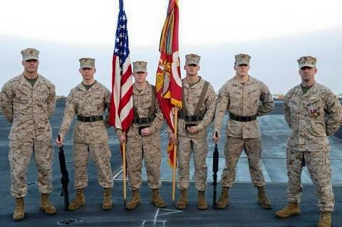
Military 101

Slide 2
Overview:
Who are Veterans?
Oath of Enlistment
Differences in service branches
Reserve and Guard brethren
Military Ranks
Military Occupations
Military Terminology

Slide 3
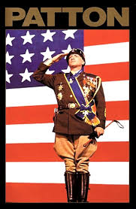
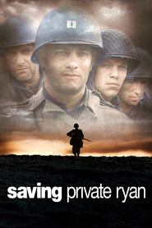
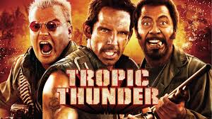
Military Culture Expert.

Slide 4
Who are Veterans?
FOR THE VA: Title 38 USC 501(a) refers:
“Veteran” means a person who served in the active military, naval, or air service and who was discharged or released under conditions other than dishonorable”
OH Rev Code § 5901.01:
Served on Active Duty, and received an honorable separation
Died while on active duty
MIA for more than 90 days
Certain Merchant Marines
OR, TO RECEIVE FINANCIAL ASSISTANCE
Served on active duty other than for training or became disabled as a result of said training

Slide 5
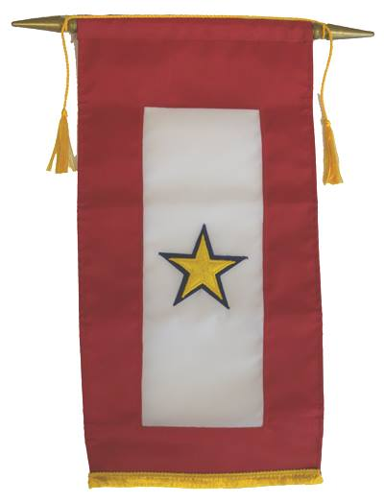
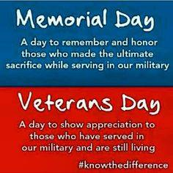

Slide 6
While Each Branch of Our Military Has Distinct Histories, Customs and Courtesies
We All Share One Common Oath of Office or Enlistment With Only Minor Variations

Slide 7
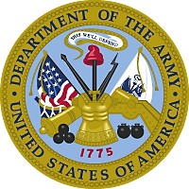
The Order of Precedence of the United States Armed Forces
Army Est. 14 June 1775
“The U.S. Army defends the land mass of the United States, its territories, commonwealths, and possessions; it operates in more than 50 countries.”

Slide 8
The Order of Precedence of the United States Armed Forces
Marines Est. 10 November 1775
“The U.S. Marine Corps maintains ready expeditionary forces, sea-based and integrated air-ground units for contingency and combat operations, and the means to stabilize or contain international disturbance.”

Slide 9
The Order of Precedence of the United States Armed Forces
Navy* Est. 13 October 1775
“The U.S. Navy maintains, trains, and equips combat-ready maritime forces capable of winning wars, deterring aggression, and maintaining freedom of the seas.”

Slide 10
The Order of Precedence of the United States Armed Forces
Air Force Est. 18 September 1947
“The U.S. Air Force provides a rapid, flexible, and when necessary, a lethal air and space capability that can deliver forces anywhere in the world in less than forty-eight hours.”

Slide 11
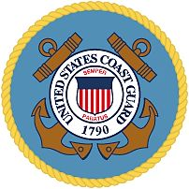
Coast Guard Est. 4 August 1790
“The U.S. Coast Guard provides law and maritime safety enforcement, marine and environmental protection, and military naval support.”

Slide 12
Military Core Values
Honor, Courage, Commitment
Marines/Navy
Integrity, Service, Excellence
Air Force
Honor, Respect, Devotion to Duty
Coast Guard
Loyalty, Duty, Respect,
Selfless Service, Honor,
Integrity, Personal Courage
Army

Slide 13
Reserve and Guard Members

Slide 14
OUR RESERVE COMPONENT
When we think about veterans who are in need of employment assistance, those in the National Guard and Reserve are often overlooked.
Did you know?
40% of forces that served in Iraq and Afghanistan were Guard or Reserve units.*
Have the same training, skills, and requirements as the “Active” military.
Enlisted force is well educated.
Many Guard and Reserve members have held a civilian job, and understand the business culture.
*hiddensurge.nationalsecurityzone.org

Slide 15
TOP TEN REASONS TO HIRE MEMBERS OF THE GUARD AND RESERVE
10. GLOBAL PERSPECTIVE
Military employees have experiences that directly relate to current world events.
9. ON-TIME, ALL THE TIME
Military employees know that every second counts.
8. FIRST CLASS IMAGE
Military employees understand a professional appearance is a must.
7. CALM UNDER PRESSURE
Military employees are resilient and know how to handle stress, both on and off
the job.
6. “CAN DO ATTITUDE”
Military employees possess critical skills and understand that nothing is impossible.

Slide 16
TOP TEN REASONS TO HIRE MEMBERS OF THE GUARD AND RESERVE
5. PHYSICAL CONDITIONING
Military employees are in top physical condition, resilient, and drug-free.
4. UNDERSTAND DIVERSITY
Military employees have succeeded in a very diverse workplace.
3. RESPONSIBILITY
Military employees know how to make decisions and take responsibility for meeting objectives.
2. PROFESSIONALISM
Military employees have a high degree of integrity, an air of self-respect, and a sense of honor.
1. LEADERSHIP
Military employees are excellent leaders and outstanding followers: loyal, dedicated, and highly
motivated.

Slide 17
How do Military Ranks Translate?
E1 – E3 (Junior Enlisted) = Assembler, Specialist, Team Member, or Technician
E4 – E5 (E6) (NCO) = Manager, Foreman, Technical Supervisor
E6 (E7) – E9 (Senior NCO) = Technical Advisor, Division Supervisor
W1 – CW5 Warrant Officers = Range from Technical Advisors to Director
01 – 03 (Company Grade) = Program Administrator, Supervisor
04 (Field Grade) = Deputy Dir., Assist Director, Operations Manager
05-06 (Sen. Field Grade) = Chief Officers/ Director
07-010 (General Officer) = CEO / President

Slide 18
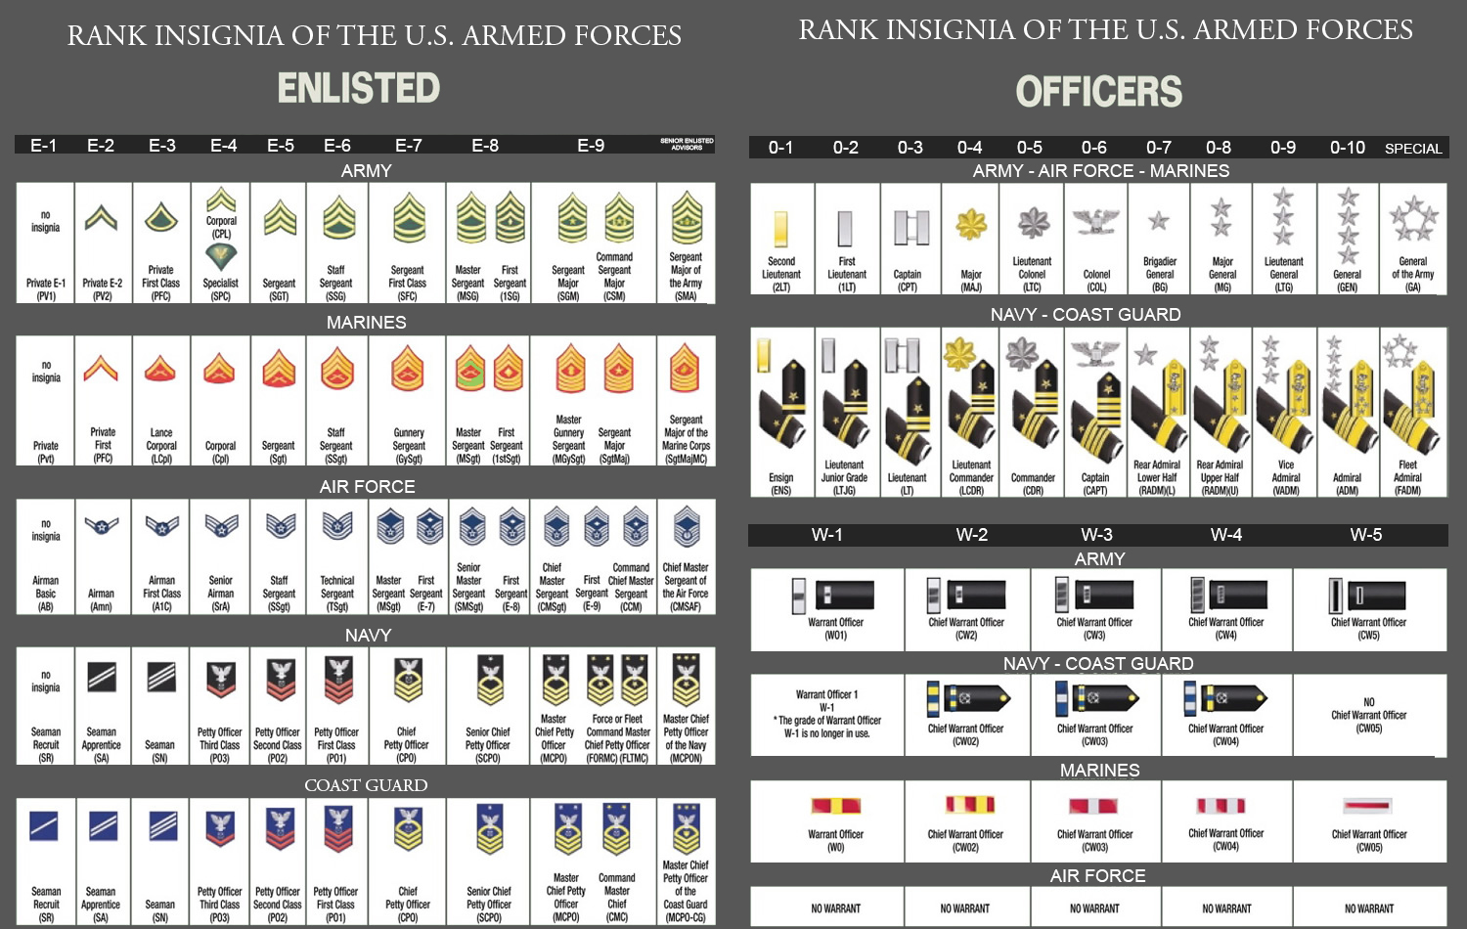

Slide 19
Pay Grade vs Rank
Never call someone by their pay grade – this is considered disrespectful, when in doubt use their entire rank. (i.e. Private First Class, Sergeant, Staff Sergeant, etc)
Not all service branch's have same ranks. (i.e. E7 = Army - Sergeant First Class, Navy – Chief Petty Officer, Marine Corps – Gunnery Sergeant, and Air Force – Master Sergeant)

Slide 20
Military Occupations and Education
There are hundreds of occupations in each of the military branches
Known as MOS, AFSC, or a Rating
Most require the completion of formal occupational schools while some Military Occupational Specialties are attained upon completion of an On the Job Training (OJT) program.
¹ “95% percent of our employees have high school diplomas versus 27% percent of the national work force; 5.6% of our troops have masters degrees versus 4.9% of the national work force² .”
Sources as of 21 September 2014:
¹http://www.defense.gov/about/dod101.aspx
²http://www.census.gov/population/socdemo/education/cps2004/tab01-01.pdf

Slide 21
Military Occupations
Number of Occupations Available
Army | More than 150 different career paths
Marine Corps | Nearly 340 primary occupations in 80 fields
Navy | More than 160 career paths
Air Force | More than 130 careers
Coast Guard | More than 30 career paths

Slide 22
Military Terminology (Slang)
ASAP – As Soon As Possible
G2G – Good to Go
Rack time – sleep
DD Form ID10T – non-existent form…spells IDIOT
Chem Light Batteries – non-existent; snipe hunt for new guy
BCG’s (Birth-control glasses) – ugly glasses issued in basic that will never land you a date
Embrace the suck – encouragement to accept an un-fun task
Voluntold – being offered up as “volunteers”
Zero Dark Thirty – it is going to be a VERY early day

Slide 23
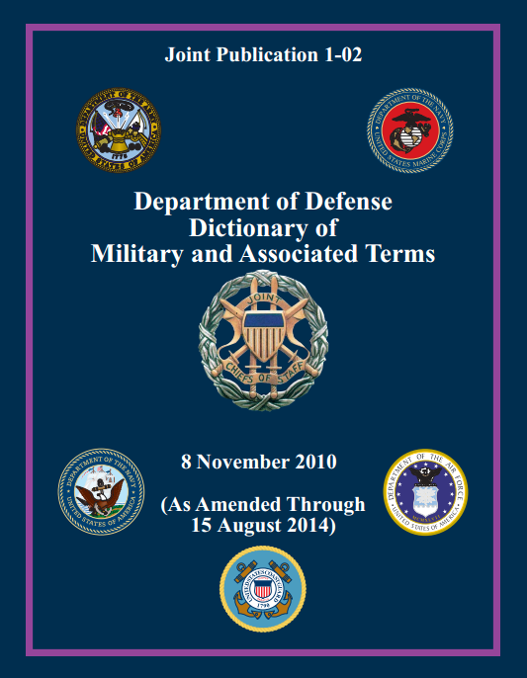
Military Terminology (Official)
Military Terms or Slang | Definitions
Pay Grade | Military Pay Scales
PCSOs | Permanent Change of Station Orders
Terminal Leave | Authorized Absence pending end of contract
HHG | Household Goods
DITY Move | Do It Yourself Move
TAP Class | Transition Assistance Program
PermTAD | Permissive Temporary Additional Duty
471 Pages
DoD Dictionary of Military and Associated Terms

