Slide 1
HOW WE GOT TO WHO WE ARE

Slide 2
Acts 18:24-26
2 Timothy 2:14-16
2 Timothy 3:16-17
HOW WE GOT TO WHO WE ARE

Slide 3
What do you know about Alexander Campbell?
HOW WE GOT TO WHO WE ARE

Slide 4
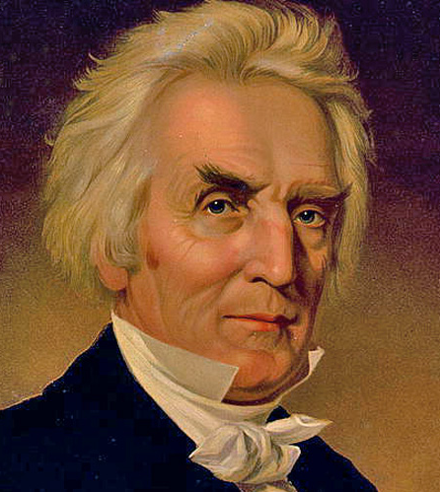
Alexander Campbell
HOW WE GOT TO WHO WE ARE
1788-1866

Slide 5
Family
HOW WE GOT TO WHO WE ARE

Slide 6
Preacher
HOW WE GOT TO WHO WE ARE
Sermon on the Law
September 1, 1816

Slide 7
Debater
HOW WE GOT TO WHO WE ARE
John Walker
1820
W. L. Macalla
1823
Robert Owen
1829

Slide 8
Author
HOW WE GOT TO WHO WE ARE
“Christian Baptist”
1823 -1830
“Millennial Harbinger”
1830 – 1864
“Living Oracles”
1826

Slide 9
Unifier
HOW WE GOT TO WHO WE ARE

Slide 10
Evaluated Progress in the 1840’s
HOW WE GOT TO WHO WE ARE
200,000 members
1848
“our denomination”
Missionary Society
1849

Slide 11
Influence
HOW WE GOT TO WHO WE ARE

