Slide 1
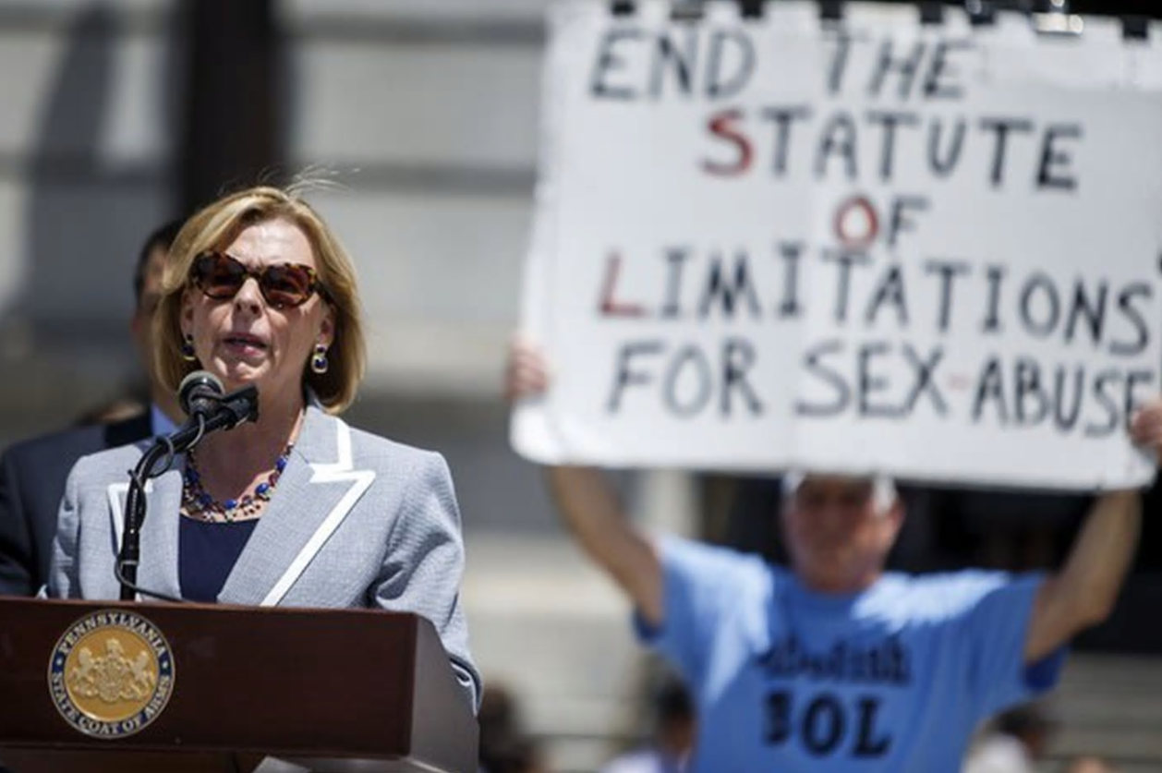
Clergy Sex Abuse and the First Amendment
PROF. MARCI A. HAMILTON
Founder, CEO, CHILD USA
CLE on Child Sex Abuse, Religious Institutions, and the First Amendment
November 17, 2020
CHILD USA Copyright © 2020
childusa.org

Slide 2
CHILD USA Copyright © 2020
childusa.org

Slide 3
Theories of Child Sex Abuse Liability
Intentional child sexual abuse causes of action (via an age cap, discovery rule, revival laws, continuing violations tolling doctrine, duress tolling doctrine)
Negligence/Recklessness (negligence, gross negligence, negligent hiring/administrative negligence, negligent supervision, or negligent retention of an employee, negligent supervision of a child, failure to report, failure to protect/warn)
Fraudulent Concealment
Equitable Estoppel
Breach of Fiduciary Duty
Civil Conspiracy
Respondeat superior
CHILD USA Copyright © 2020
childusa.org

Slide 4
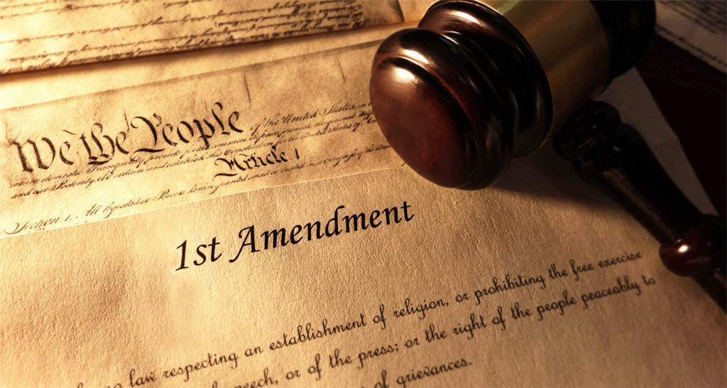
CHILD USA Copyright © 2020
childusa.org

Slide 5
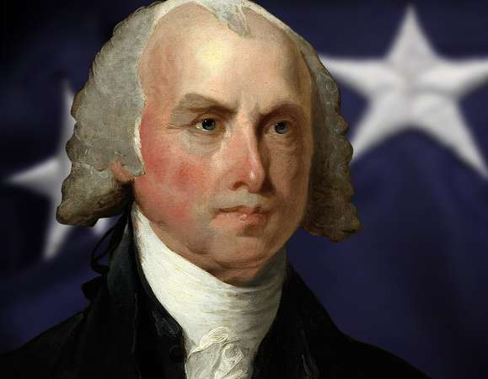
James Madison, Memorial and Remonstrance
“Because experience witnesseth that ecclesiastical establishments, instead of maintaining the purity and efficacy of Religion, have had a contrary operation. During almost fifteen centuries has the legal establishment of Christianity been on trial. What have been its fruits? More or less in all places, pride and indolence in the Clergy, ignorance and servility in the laity, in both, superstition, bigotry and persecution.”
CHILD USA Copyright © 2020
childusa.org
Notes:
https://billofrightsinstitute.org/founding-documents/primary-source-documents/memorial-and-remonstrance/

Slide 6
Neutral Generally Applicable Laws Apply to Religious Actors
CHILD USA Copyright © 2020
childusa.org
Notes:
https://billofrightsinstitute.org/founding-documents/primary-source-documents/memorial-and-remonstrance/

Slide 7
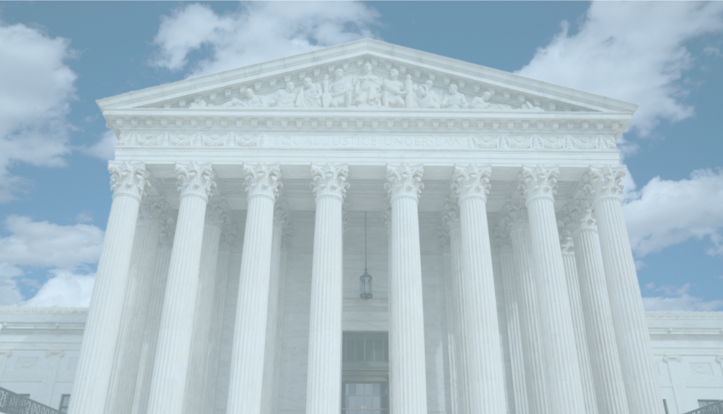
The Foundational Case:
Employment Division v. Smith
Emp't Div., Dep't of Human Res. v. Smith, 494 U.S. 872 (1990).
CHILD USA Copyright © 2020
childusa.org
Notes:
https://billofrightsinstitute.org/founding-documents/primary-source-documents/memorial-and-remonstrance/

Slide 8
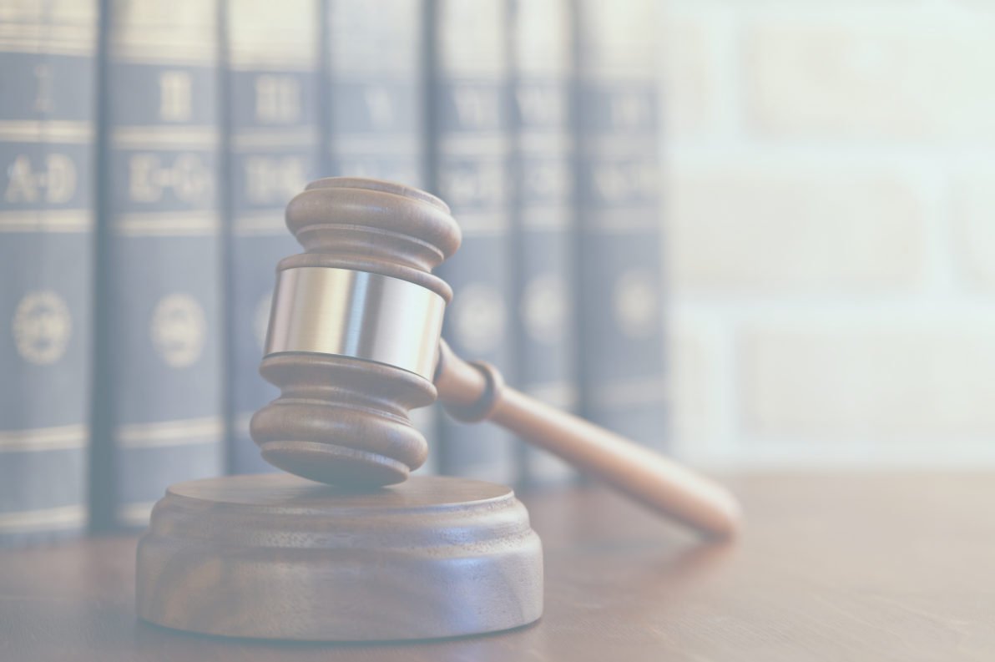
Torts Apply to Religious Entities
CHILD USA Copyright © 2020
childusa.org
Notes:
https://billofrightsinstitute.org/founding-documents/primary-source-documents/memorial-and-remonstrance/

Slide 9
Malicki v. Doe
Malicki v. Doe, 814 So. 2d 327 (Fla. 2002).
CHILD USA Copyright © 2020
childusa.org
Notes:
https://billofrightsinstitute.org/founding-documents/primary-source-documents/memorial-and-remonstrance/

Slide 10
Norman Redwing v. Catholic Bishop For The Diocese Of Memphis
Redwing v. Catholic Bishop for Diocese of Memphis, 363 S.W.3d 436 (Tenn. 2012).
CHILD USA Copyright © 2020
childusa.org
Notes:
https://billofrightsinstitute.org/founding-documents/primary-source-documents/memorial-and-remonstrance/

Slide 11
Gibson v. Brewer
Gibson v. Brewer, 952 S.W.2d 239 (Mo. 1997).
CHILD USA Copyright © 2020
childusa.org
Notes:
https://billofrightsinstitute.org/founding-documents/primary-source-documents/memorial-and-remonstrance/

Slide 12
Laws that Target Religion Are Subject to Strict Scrutiny
CHILD USA Copyright © 2020
childusa.org
Notes:
https://billofrightsinstitute.org/founding-documents/primary-source-documents/memorial-and-remonstrance/

Slide 13
Church of the Lukumi Babalu Aye v. Hialeah
Church of the Lukumi Babalu Aye, Inc. v. Hialeah, 508 U.S. 520 (1993).
CHILD USA Copyright © 2020
childusa.org
Notes:
https://billofrightsinstitute.org/founding-documents/primary-source-documents/memorial-and-remonstrance/

Slide 14
A Window does not target the Roman Catholic Church:
Melanie H. v. Doe
Melanie H. v. Doe, Civil No. 04-1596-WQH-(WMc) (S.D.Cal. Dec. 5, 2005).
CHILD USA Copyright © 2020
childusa.org
Notes:
https://billofrightsinstitute.org/founding-documents/primary-source-documents/memorial-and-remonstrance/

Slide 15
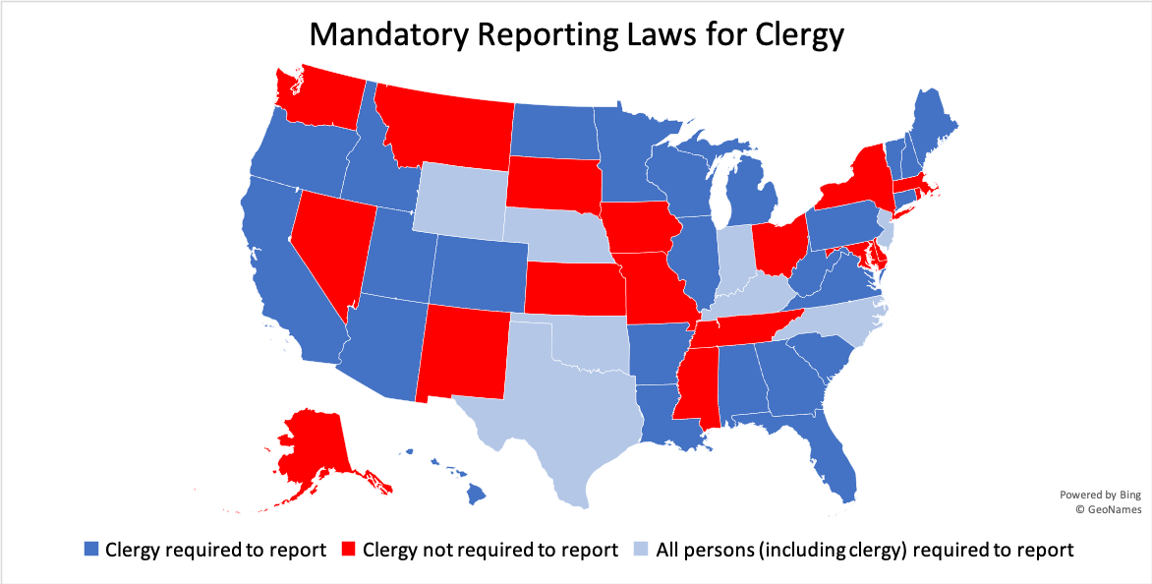
CHILD USA Copyright © 2020
childusa.org

Slide 16
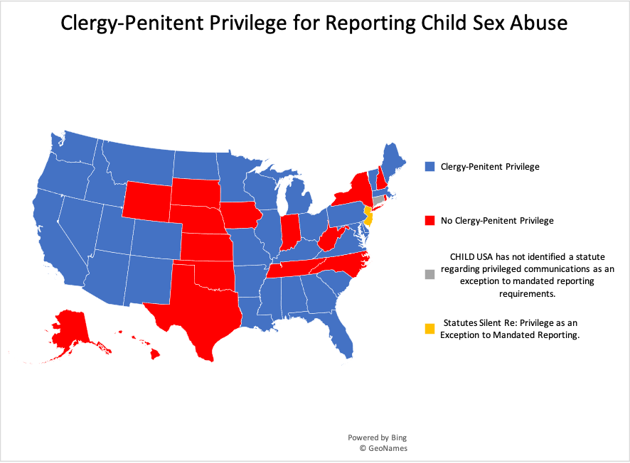
CHILD USA Copyright © 2020
childusa.org

Slide 17
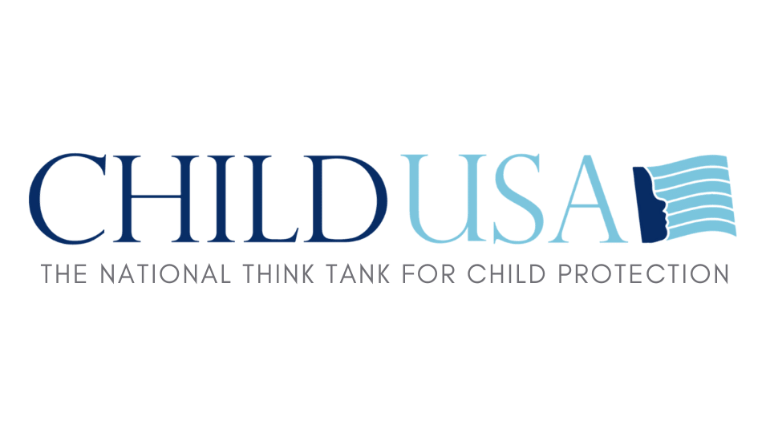
Visit our website for the most up-to-date information on SOL reform and CSA legal changes.
www.childusa.org
CHILD USA Copyright © 2020

