Slide 1
Why Become a Certified Military Talent Employer (CMTETM)?

Slide 2
HR Holds the Key
You can see both sides of the employment equation
Knowledge, resources, managing expectations
Make your employer exemplary

Slide 3
Certified Military Talent Employer
Credibility
Competitive edge
AAP and VEVRAA
Reduce time to hire and turnover

Slide 4
The Veterans
“Real world experience”
High-value technical and soft skills
Difficulty selling themselves and translating

Slide 5
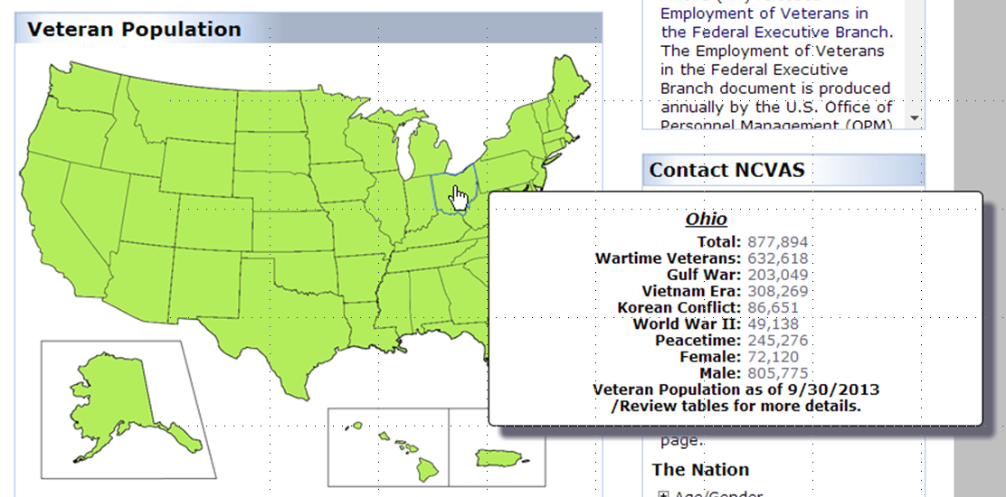
Ohio Veteran Population
http://www.va.gov/vetdata/Veteran_Population.asp
21 September 2014

Slide 6
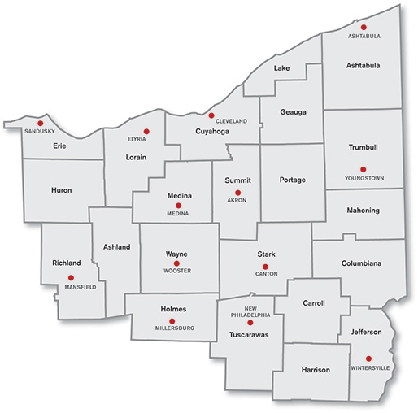
Ohio Veteran Population
According to VA Vet Data, there are approximately 150,000 working-aged veterans among the 22 counties making up NEO
150,000
There are roughly 43,000 Guard and Reserve Personnel in the State of Ohio

Slide 7
CMTETM Criteria
Share aggregate information
Make and accept veteran referrals
Train leadership on USERRA
Train HR staff on unique aspects of military recruitment and retention
Formalized outreach and targeted recruitment
Display NEOVETS logo

Slide 8
CMTETM Criteria
Integrate best practices
Employee Veterans Resource Group
Military Leave Policy
Educate employees on National Guard training
Onboarding process
Feedback to NEOVETS

