Slide 1
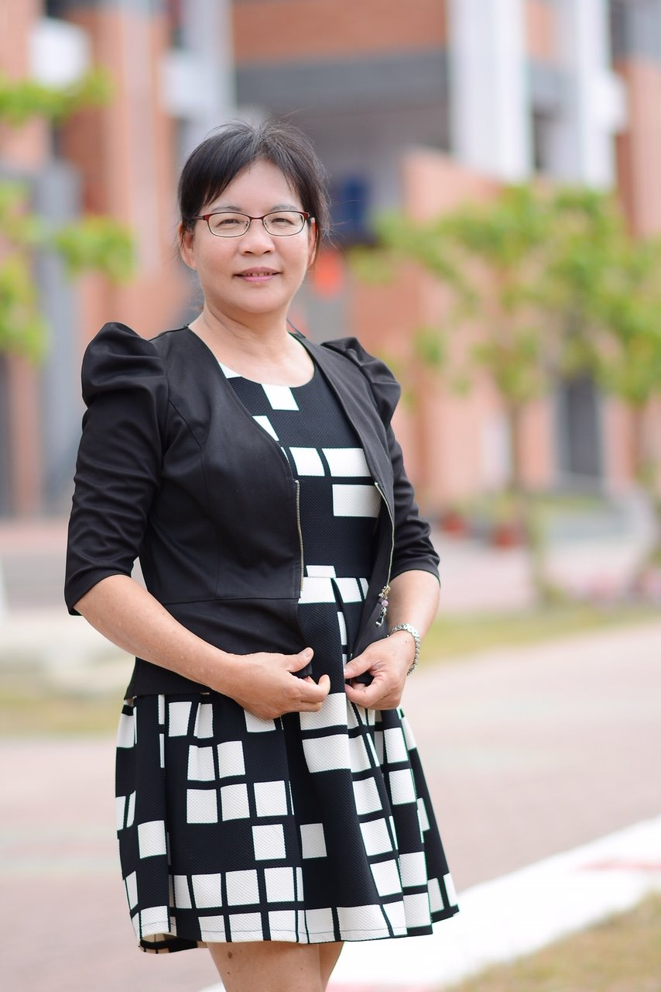
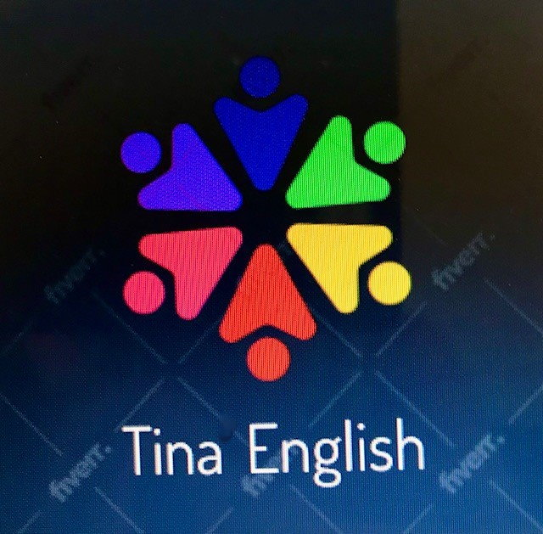
Make Learning English
Fun and Effective

Slide 2
一般動詞過去式 Verb Past Tense Sentence Patterns Training
郭淑媛(Tina)老師
2021/9/05

Slide 3
一般動詞過去式
文法解析:我們在使用中文,句子沒有現在式或過去式的區別，但是使用英文來描述過去的人事物的時候，要使用過去式的動詞時態(Past Tense)。英文過去式句子主要表現在句子的動詞，一般動詞的過去式，是從原式變化而來，分為規則變化和不規則變化，規則變化大部分是在原式後面加ed，少數的例外如下:

Slide 4
一般動詞過去式的ed字尾發音
一般動詞過去式加ed的字尾發音，主要依循三種規則1.[有聲加有聲]，2.[無聲加無聲] ，3.字尾發[t]或[d]，加ed要發[id]的音:
動詞字尾發[t]或[d]，加ed要發[id]的音。

Slide 5
Pattern Training
Part A.
He is watching TV now.(現在進行式)
He watches TV every day.(現在簡單式)
He watched TV yesterday.(過去式)

Slide 6
She is chatting with her friends now.
She chats with her friends every day.
She chatted with her friends today.

Slide 7
We are jogging now.
We jog every morning.
We jogged yesterday morning.

Slide 8
My father is cooking now.
He cooks every weekend.
He cooked this weekend.

Slide 9
Linda is studying English now.
She studies English every day.
She studied English yesterday.

Slide 10
They are playing basketball now.
They play basketball every weekend. They played basketball last weekend.

Slide 11
Who typed the letter? I didn’t type the letter!
Who signed the letter? I didn’t sign the letter!
Who mailed the letter? I didn’t mail the letter!

Slide 12
Who called me?
I didn’t call you!
Who farted?(誰放屁)
I didn’t fart!(我沒放屁)

Slide 13
I mailed the letter.
When did you mail the letter?
I called you.
When did you call me?

Slide 14
She typed the letter.
When did she type the letter?
He washed the car.
When did he wash the car?

Slide 15
When did she type the letter?
She typed the letter this morning.
When did he wash the car?
He washed the car this morning.

Slide 16
When did you call me?
I called you this morning.
When did you mail the letter?
I mailed the letter this morning.

Slide 17
Good job, guys!
Keep practicing everyday.
You’ll be perfect and successful.

Slide 18
Thank you for practicing with me.
See you in the next video.

