Slide 1
Protocol Independent Multicast

Slide 2
PIM
Protocol Independent Multicast is a routing protocols for multicast
Cisco fully supports PIM
Multicast routing is a networking method for efficient distribution of one-to-many traffic. A multicast source, such as a live video conference, sends traffic in one stream to a multicast group. The multicast group contains receivers such as computers, devices, and IP phones.
Unfortunately, multicast on the Internet has never really been implemented. ... The only place where you might see multicast on the Internet is your local ISP.

Slide 3
PIM
PIM Distribution Trees
Define the path that IP multicast traffic follows through the network to reach receivers.
Source Trees/Shortest Path Trees
Shared Trees
SPT is know as: (S,G) SOURCE/GROUP
Because every SPT is rooted at the source (S), every source sending to a multicast group requires an SPT.

Slide 4
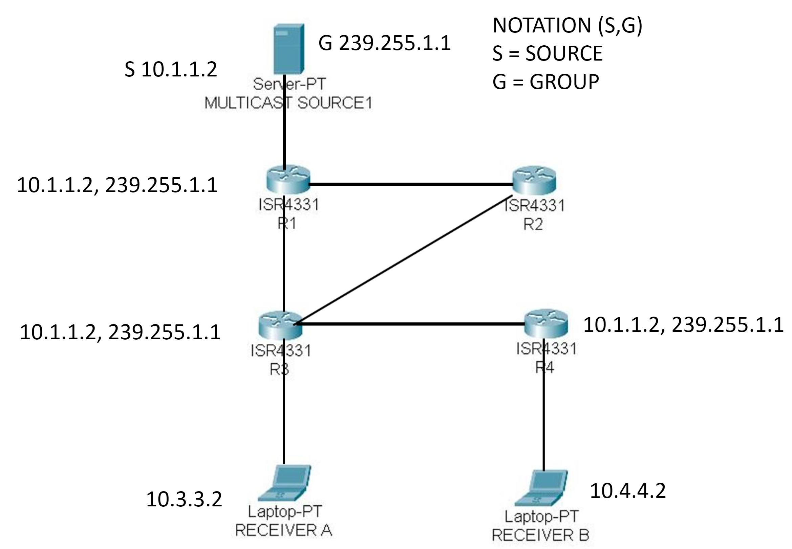
PIM Source Tree Example

Slide 5
PIM
Shared Trees
Multicast distribution tree where the root of the shared tree is not the source, but a router designated as the rendezvous point (RP).
Shared Trees also called, RP Trees or RPT.
Multicast traffic is forwarded down the shared tree according to the group address (G) that the packets are addressed to.
Multicast traffic is forwarded down the RPT, regardless of the source address.
Notated as (*,6)
. all sources

