Slide 1
Copula & Time Series Modeling for Risk Analysis Application
Yas Suttakulpiboon

Slide 2
My Approach to Time Series Modeling
Time Series Modeling
Mean (Expected Value)
Variance (Heteroskedasticity Effect)
GARCH
ARIMA
Fully-parameterized Approach
Dependence
Correlation (Normal Dist) or Copula
Semi- or Non-parametric Approach
Empirical Distribution
ML or AI
Bootstrap

Slide 3
Mean Equation
The mean equation of an univariate time series xt can be described by the process
xt = E(xt |Ft−1) + εt
where E(· | ·) denotes the conditional expectation operator, Ft−1 the information set at time t − 1, and εt the innovations of the time series.

Slide 4
ARMA mean equation
The ARMA(m,n) process of autoregressive order m and moving average order n can be described as
with mean µ, autoregressive coefficients ai and moving average coefficients bi .

Slide 5
ARIMA mean equation

Slide 6
ARIMA mean equation

Slide 9
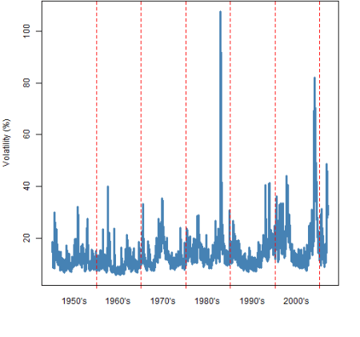
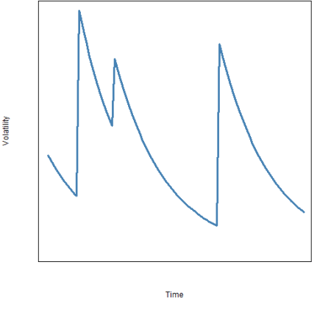
Variance Equation: GARCH
Volatility
Noise + MA Component

Slide 10
Variance Equation: GARCH
The mean equation does not take into account heteroskedastic effects typically observed in financial time series. Engle [1982] introduced the Autoregressive Conditional Heteroskedastic model, named ARCH, later generalised by Bollerslev [1986], named GARCH.

Slide 11
Variance Equation: GARCH
Ding [1993] introduced the APARCH(p,q) variance that can be expressed as
where δ > 0 and −1 < γi < 1. This model adds the flexibility of a varying exponent with an asymmetry coefficient γi to take the leverage effect into account and the varying power δ to consider the Taylor effect.

Slide 13
Multivariate GARCH: DCC-GARCH

